Slide 1

FOOD PARADISE
- INAMHUSAIN

Slide 2
INTRODUCTION
Name Of Project :-
FOOD PARADISE.
Definition :-
- Online Food Delivery System.
- Order your Food at home.

Slide 3
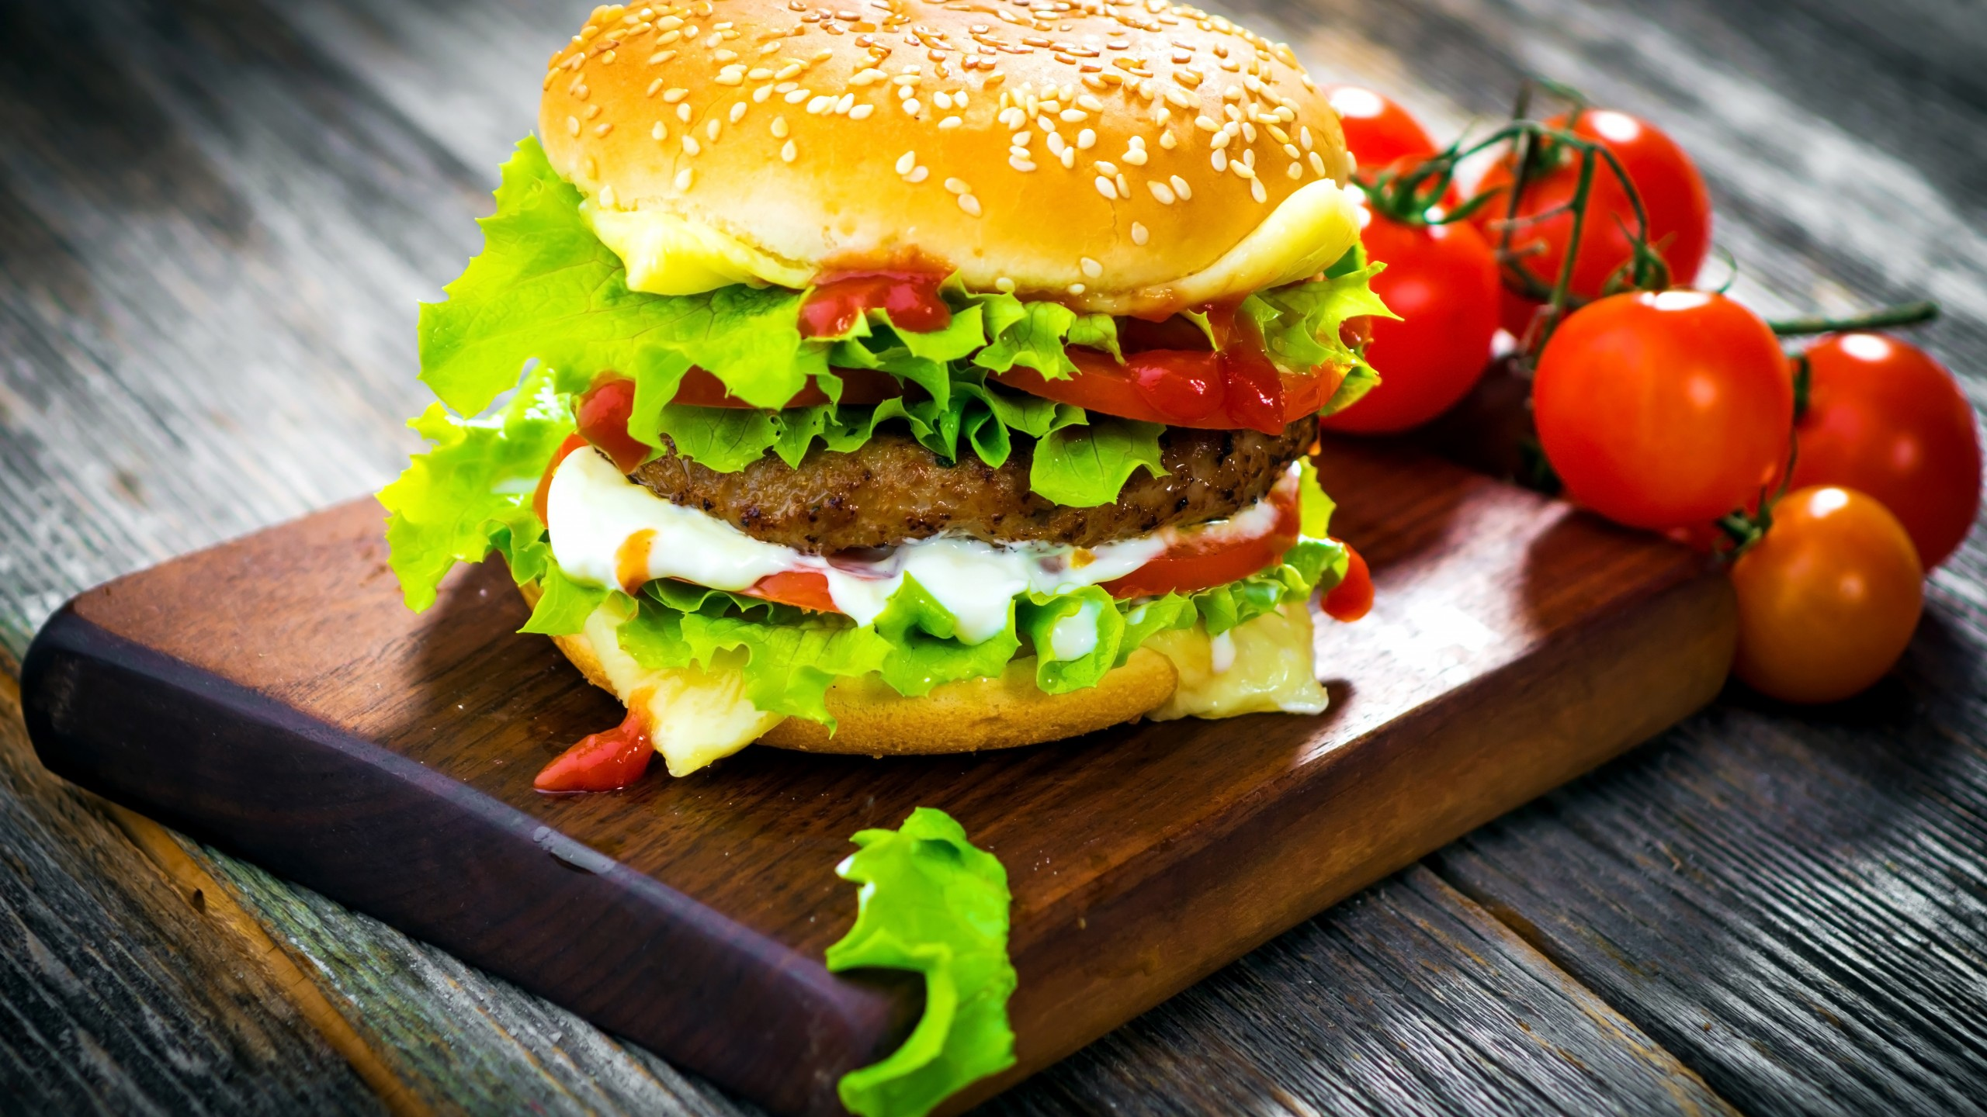
TOPICS
Need for System Development
FOOD PARADISE
System Investigation
Types Of User

Slide 4
Types of user
ADMIN
USER
GUEST

