Slide 1
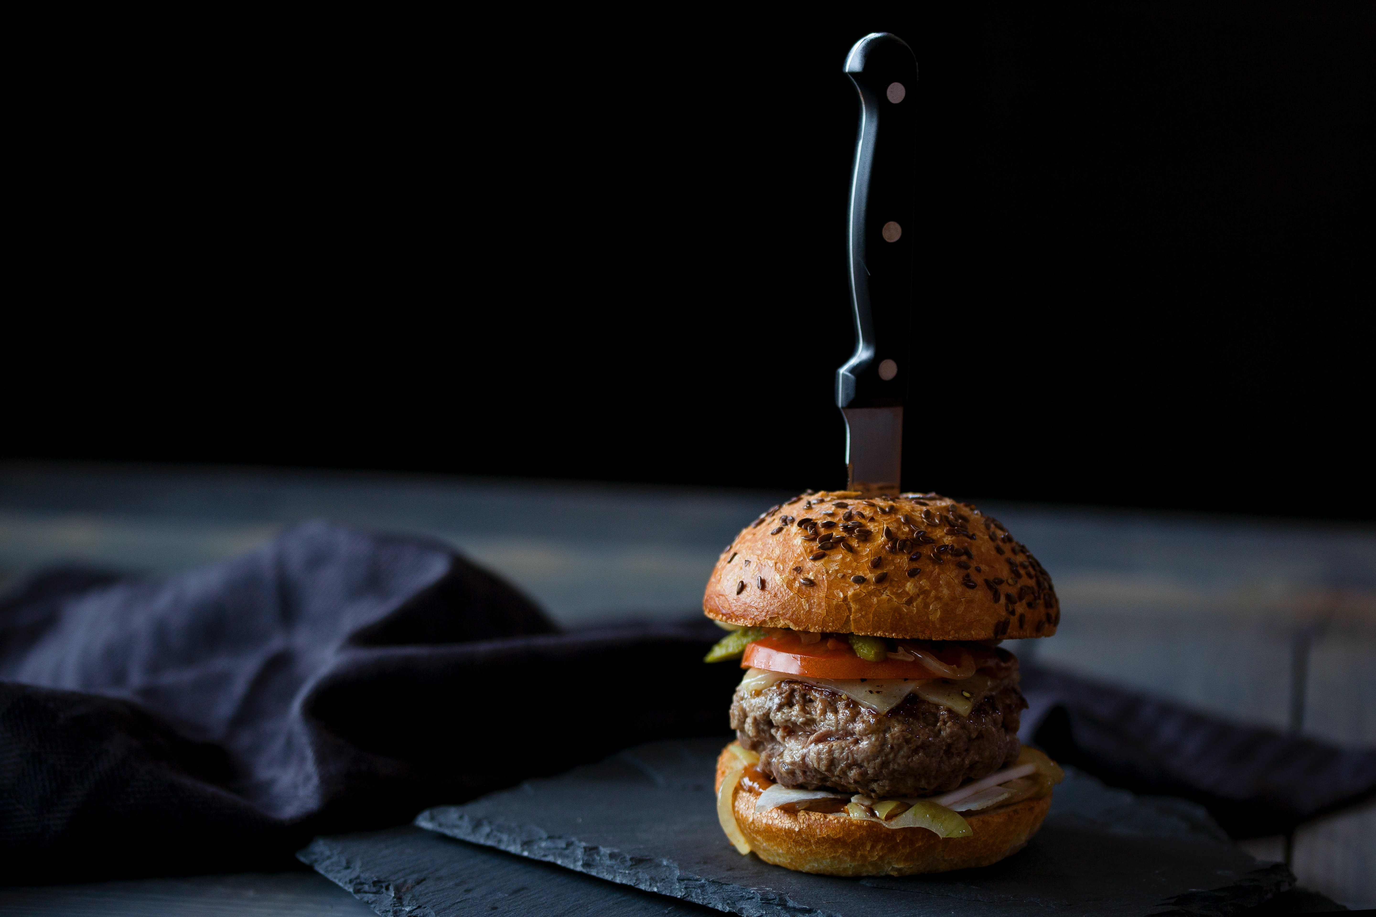
FOOD PARADISE
Inamhusain.M.Masi

Slide 2
INTRODUCTION
Name Of Project :-
FOOD PARADISE.
Definition :-
- Online Food Delivery System.
Order your Food at home.

Slide 3
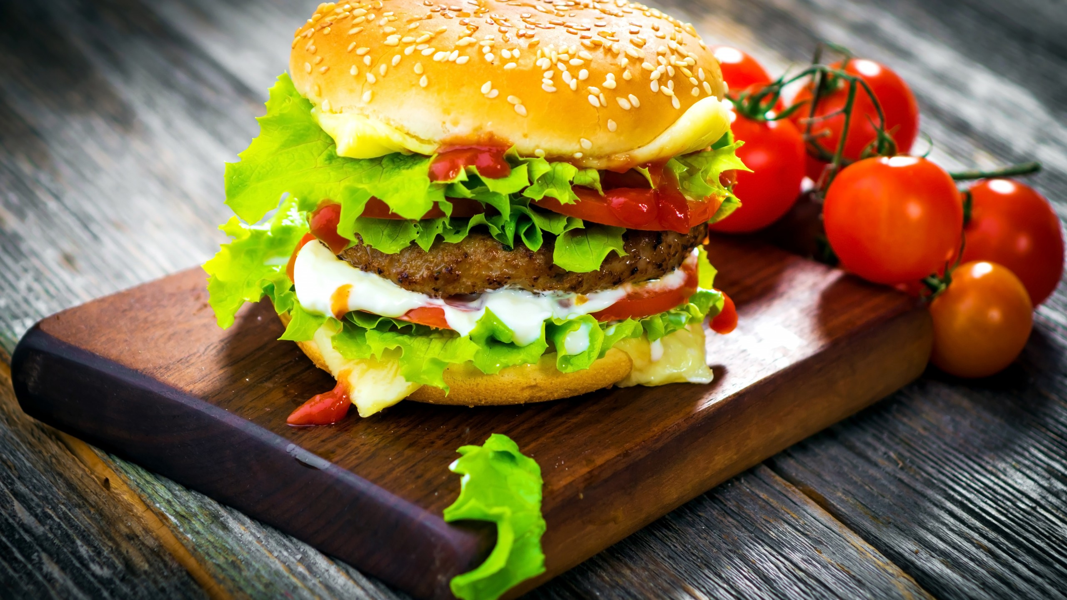
TOPICS
Need for System Development
FOOD PARADISE
System Investigation
Types Of User

Slide 4
NEED FOR SYSTEM DEVELOPMENT
Old system base of on paper work , To make paperless system
Old system is manual, make system automatic
To make business online
To increase customer
Old system is difficult and very time consuming

Slide 5
SYSTEM INVESTIGATION
This system allow a user to buy single and multiple items over the internet
Covers large number of customer
User Friendly interface and easy navigation
Add multiple Item in cart and remove item
Order multiple items.
Admin can handle all orders and products
Generate Reports

Slide 6
Types of user
ADMIN
End USER

Slide 7
ADMIN MODULE SPECIFICATION
  Login
  Add Items
  Edit Items
  Delete Items
  Manage Orders
  Logout

Slide 8
END USER MODULE SPECIFICATION
  Registration
  Login
  View Product & Product Description
  Add to Cart & Remove from Cart
  Change Shipping Address
  Confirm Order
  Logout

Slide 9
  Thank You

