Slide 1
PCEP Extensions for Establishing Relationships Between Sets of LSPs
PCE WG, IETF93, Prague, Czech
draft-minei-pce-association-group-02.txt
Ina Minei (inaminei@google.com)
Edward Crabbe(edward.crabbe@gmail.com)
Siva Sivabalan(msiva@cisco.com)
Hariharan Ananthakrishnan(hari@packetdesign.com)
Xian Zhang(zhang.xian@huawei.com)
Yosuke Tanaka(yosuke.tanaka@ntt.com)
Dhruv Dhody(dhruv.ietf@gmail.com)

Slide 2
Changes(v02) from Version 00
Updated object encoding of the newly defined PCEP ASSOCIATION object;
  Adding association source;
Added RBNF encoding of this newly defined object in PCEP messages;
Refined text around the above two points:
  Allowing both PCC and PCE to create association group;
Updated Author/contributor affiliation/list;

Slide 3
Draft Goal and Non-Goal Recap
Defining a generic mechanism to associate a set of LSPs or between a set of LSPs and a set of attributes
DO NOT define any specific TLVs for applications such as (not limited to)
  protection/restoration
  Attributes association

Slide 4
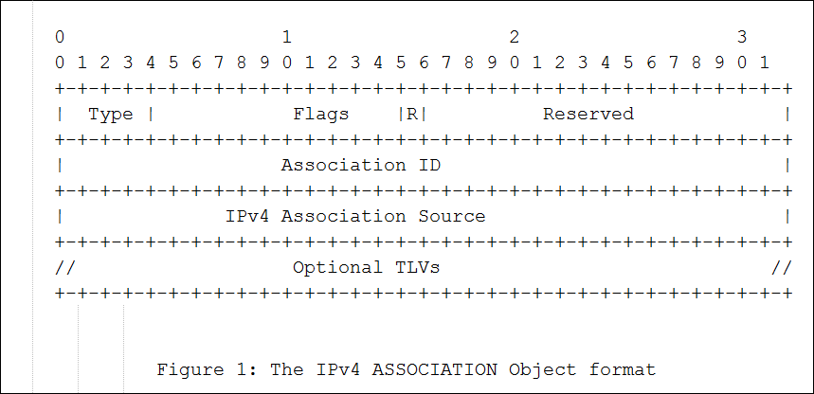
PCEP ASSOCIATION Object Format
Type: 4 bits - the association type (for example protection). The association type will be defined in separate documents.
Flags: 12 bits – only one defined: R (Removal - 1 bit): when set, the requesting PCE peer requires the removal of an LSP from the association group
Association ID: 32 bits - the identifier of the association group.,
Optional TLVs: Variable - no TLVs are defined in this document.

Slide 5
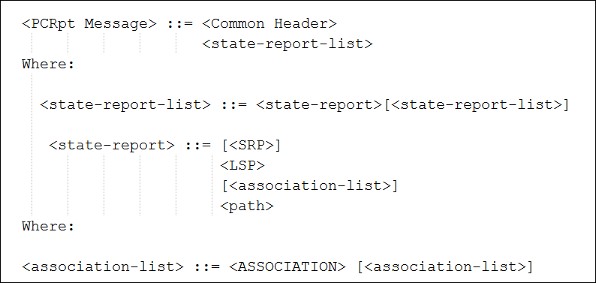
Message Encoding
Key takeaway: a LSP can belong to one or multiple association group.
Usage:
  PCRpt: PCC report/delete association group information;
  PCUpd/PCInitiate: PCE create/update association group information;
  PCReq: PCC indicates association group information.

Slide 6
Next Step
This draft received wide interest: WG adoption?

