Slide 1


Restaurant Order, Kitchen & Billing System
PSPJ PROJECT
Shaan Inampudi
G. Bhaargav
2620030286
2620030287
Course: 26SC1101E PSPJ | Section: 13 | Faculty: CHAITANYA KUMAR
1

Slide 2

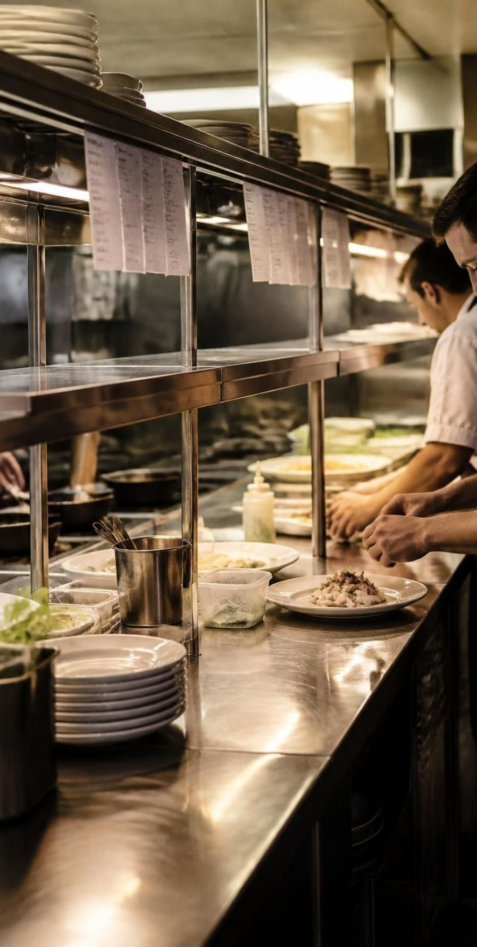
ABSTRACT
A beginner-level Java console application designed to view the restaurant menu, place food orders, forward confirmed orders to the kitchen, and generate the final bill with automated calculations.
Data Storage: Parallel arrays manage menu item names, unit prices, and ordered quantities cleanly.
Modular Methods: Distinct functional methods split the application into reusable, maintainable sections.
Control Flow: Interactive menu selection, order loop, and rigorous input validation for choices and quantities.
Core Java Concepts: Demonstrates variables, constants, arithmetic operators, Scanner input, formatted output, conditionals, loops, methods, arrays, linear searching, summation, and counting.
2

Slide 3
UNDERSTANDING PROBLEM STATEMENT
Module Segregation:
01
02
03
04
05
06
Menu Management
Order Management
Kitchen Management
Billing Management
Input Validation
Method-Based Design
Handles invalid choices and quantities.
Food names and unit prices stored in parallel arrays.
Captures item numbers and quantities; updates ordered counts.
Shows ordered items and quantities for preparation.
Calculates subtotal, discount, 5% tax, and final payable.
Separates program logic into reusable methods.
Key Advantages: Beginner-friendly console; modular methods and arrays reduce repetition; automatic calculations reduce billing errors; validation; expandable with customer details, tables, payment modes, and a database.
3

Slide 4
CO 1 TOPIC
Variables, Constants, and Operators in Action:
Constants (final)
Defined fixed values such as final double TAX_RATE = 0.05; representing the standard 5% restaurant tax rate.
Variables & Arrays
Declared variables for user choice, subtotal, discount, tax, and final amount; parallel arrays foodItems, prices, and quantities hold operational state.
Arithmetic Operators
Used multiplication (prices[i] * quantities[i]) for line totals and summation for subtotal calculation.
Discount Calculations
Tiered discount logic calculates savings using percentage multipliers (10% discount for orders ≥ Rs. 1000, 5% for orders ≥ Rs. 500).
Tax Computation & Net Payable
Applied formula tax = (subtotal - discount) * TAX_RATE; and finalAmount = subtotal - discount + tax; to derive final billing figures.
4

Slide 5

CO 2 TOPIC
Scanner Input, Output Formatting & Conditionals:
Scanner input: Scanner sc = new Scanner(System.in); captures menu choices, item selections, and quantities.
Formatted output: System.out.println() displays the menu.
switch on menu choice 1–5: the default case prints “Invalid choice.”
if / else-if discount slabs: 10% at subtotal ≥ Rs.1000; 5% at ≥ Rs.500; otherwise zero.
5

Slide 6
CO 3 TOPIC
Repetition Structures & Loop Control:
01
02
do-while Loop:
Drives the primary application menu; ensures the console interface renders at least once and continues looping until the user selects choice 5 (Exit).
while(true) Order Loop:
Allows continuous, multiple-item selection in a single session; uses sentinel value 0 with a break; statement to return to the main dashboard.
03
04
Standard for Loops:
Iterates systematically across parallel arrays to display the full menu, print pending kitchen order lines, and compute the subtotal summation.
Loop Jump Statements:
break terminates order entry or exits loops; continue safely skips invalid input passes during item validation without crashing the console session.
05
Enhanced Highlight:
The extended version incorporates robust input retry loops catching InputMismatchException to re-prompt smoothly upon non-integer keystrokes.
6

Slide 7
CO 4 TOPIC
Modular Architecture with Methods, Parameters & Return Values:
displayMenu()
placeOrder(Scanner sc)
displayKitchenOrder()
Void method that iterates and prints the restaurant item list, item numbers, and unit prices.
Parameterized method receiving the active Scanner reference to orchestrate interactive item selection and update order counts.
Inspects ordered quantities and outputs active preparation tickets for the kitchen team.
calculateSubtotal()
calculateDiscount(double subtotal)
generateBill()
Returns double; computes and aggregates total gross cost across all ordered items.
Takes subtotal as argument and returns computed discount double based on tier thresholds.
Coordinates subtotal, discount, and tax routines to print the complete itemized receipt.
Enhanced Highlight: The enhanced version leverages OOP methods with an interface Printable, inheritance (MenuItem / OrderItem), and modular file I/O writing to latest_receipt.txt.
7

Slide 8
CO 5 TOPIC
Array Structures and In-Memory Data Management:
Structure / Principle | Declaration & Syntax | Role in System
Item Names Array | String[] foodItems = {"Burger", "Pizza", "Pasta", "French Fries", "Soft Drink"}; | Menu titles
Price Mapping Array | double[] prices = {120, 250, 180, 100, 60}; | Unit prices in INR
Quantities Array | int[] quantities = new int[foodItems.length]; | Cumulative counts, sized to the menu
Zero-Based Indexing | quantities[item - 1] += quantity; | Convert item number to array index
Data Consistency | Shared index i aligns the three arrays | Accurate line items across operations
Enhanced Highlight: The enhanced version uses MenuItem objects and Arrays.sort() with Comparable to sort by price.
8

Slide 9
CO 6 TOPIC
Searching, Summation & Counting Logic:
Searching / Validation
Validates that each requested item number lies within the range 1 to foodItems.length; the enhanced version also uses a custom InvalidOrderException for invalid orders.
Boolean Found Flag
Kitchen display and bill generation use a boolean found indicator to determine whether any menu item has a positive ordered quantity.
Summation
Subtotal loop aggregates prices[i] * quantities[i] for every menu position.
Counting / Filtering
Only entries with quantities[i] > 0 are printed as kitchen lines and bill line items, avoiding empty rows.
Receipt Output: The extended version preserves Subtotal, Discount, Tax (5%), and Final Amount in the saved receipt file.
9

Slide 10
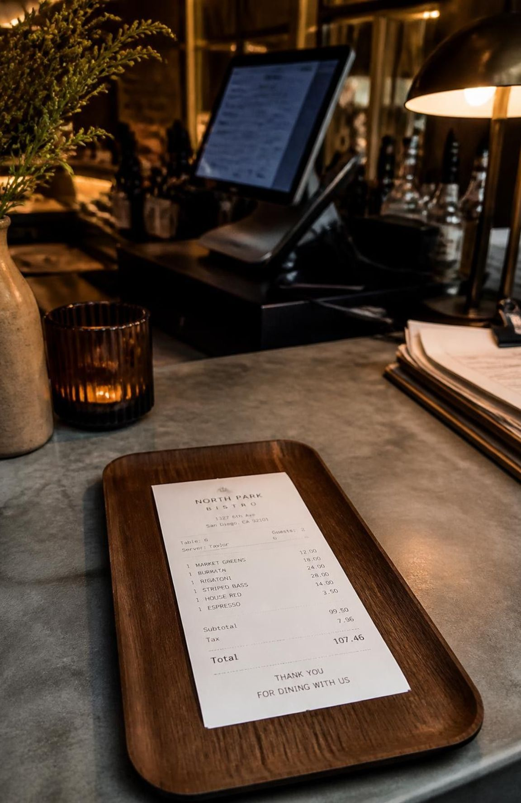
CONCLUSION
The Restaurant Order, Kitchen & Billing System is a modular, beginner-friendly console system covering menu viewing, ordering, kitchen tracking, and billing, with input validation and automatic calculations. It can be extended with customer details, tables, payment modes, and a database.
Enhanced version: sorts the menu by price with Arrays.sort/Comparable; uses MenuItem and OrderItem classes, the Printable interface, and inheritance; handles InvalidOrderException and InputMismatchException; and saves the bill to latest_receipt.txt via file I/O.
10

Slide 11
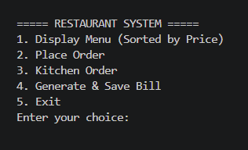
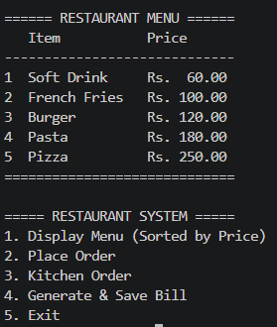
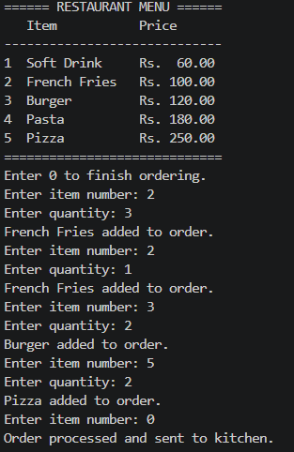
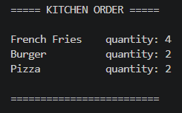
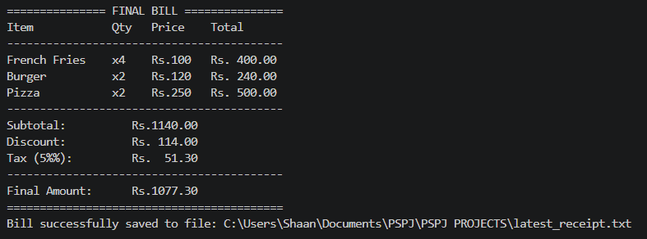
Screen Shots
1. Restaurant System
2. Display Menu
3. Placing Order
4. Kitchen Order
5. Billing
2

