Slide 1
Swift
Anna Bottu, Hui Wang, Carrie Adkins, Landon Everhart, Tyler Barrett, Inan Ismailov, Andrew Perera

Slide 2
Swift Introduction Anna B
A programming language that is multi-paradigm, general-purpose, and compiled.
Specifically developed for macOS, iOS, tvOS, Linux, watchOS.
Created by Apple and is designed with the aim of working with Cocoa Touch, Cocoa frameworks and an extensive set of Objective-C codes that have been written for the products of Apple Incorporation.
The language ideas for Swift were taken from Rust, Objective-C, Ruby, Haskell, C#, CLU, Python, and a range of other programming languages.

Slide 3
Swift History Carrie
Development began July 2010 by Chris Lattner. Left Apple for Tesla in 2017 and Swift project lead went to Ted Kremenek.
Introduced at Apple’s 2014 Worldwide Developers Conference(WWDC). With the first App released in Swift being the Apple WWDC application June 2, 2014.
Version 1.0 September 9, 2014. This coincide with Xcode 6.0
Proprietary language until version 2.2, when it was made open source under the Apache License 2.0, with a Runtime Library Exception. (License not required in compiled distribution)

Slide 4
History continued Carrie
GitHub repository established that allows developers to create pull requests and contribute to the project. December 2015 IBM announced Swift Sandbox which allows developers to write Swift in one pane and display in another.
Swift Playgrounds announced at WWDC 2016. This is a game platform designed to teach children to code.
Swift has been available for Linux since version Swift 2.2 and can be used to create Linux servers.
Swift is currently at version 5.1, the stable version brought the SwiftUI, this provides a framework for declarative UI structure design on all Apple platforms.

Slide 5
Pros Landon
Standard library makes the most obvious solution perform the best
Includes low-level primitives such as types, flow control, and operators
Includes object-oriented features such as classes, protocols, and generics
Easy to pick up
Takes less time to build iOS apps

Slide 6
Pros Anna B
Designed to be Safe
Syntax encourages clean and efficient coding
Fast. It is over twice as fast as Objective-C and over 8 times faster than python
Named parameters are expressed in a clean syntax that makes APIs even easier to read
No headers or semicolons (unless doing more than one command per line)
Memory is automatically managed which means no garbage collection

Slide 7
Cons Andrew
The language is still quite young
There is a limited talent pool for it
Poor interoperability with third-party IDEs
Lack of support for earlier iOS versions
You have to use Xcode

Slide 8
Syntax: Variables Tyler
Dynamically typed
Able to determine type based on right side of equals
var word = “Hi” var String word = “Hi”
Var/Let
Var used when variable will be changed (var word = “Hi”)
Let used when variable is constant (let word = “Hi”)
State variables: A new addition to SwiftUI
Special variables that change state of the entire view
@state editable = false
Equivalent statements

Slide 9
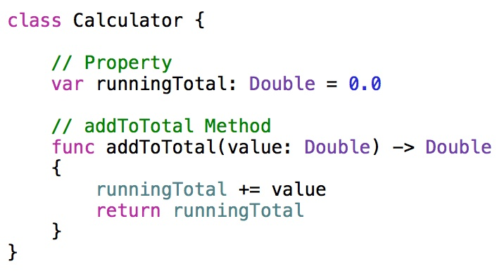
Syntax: Functions and classes Anna W
Functions - Every function in Swift has a type, consisting of the function’s parameter types and return type.
Classes - You introduce classes with the class keyword and place the entire definition within a pair of braces:

Slide 10
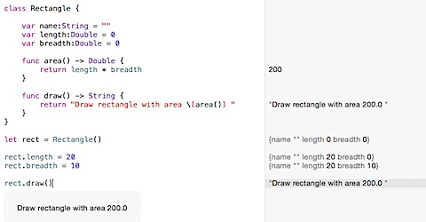
Classes continued Anna W
Class Instances - The simplest form of initializer syntax uses the type name of the class followed by empty parentheses.
Addition info: Unlike other programming languages, Swift doesn’t require you to create separate interface and implementation files for custom classes. You define a class in a single file, and the external interface to that class is automatically made available for other code to use.

Slide 11
Applications Landon
Many great iOS apps have been built using Swift such as
Lyft
LinkedIn
Kickstarter
Apple released an iPad application called Swift Playgrounds that makes learning Swift interactive and fun
Playgrounds requires no coding knowledge
Uses puzzles to teach Swift basics
Universities and academic institutions are now adding Swift to their curriculum to teach in computer programming courses

Slide 12
Applications Inan
Earlier this year, Apple released SwiftUI, which allows developers to build user interfaces for iOS, macOS, watchOS and tvOS.
Because this toolkit is native to all of these platforms, you can release your code to any of them interchangeably.
What makes this toolkit special is it’s declarative. What this means is instead of letting the application know of any state changes in response to user interaction and changing the UI manually, we can declare all possible states at once, and let swift handle layout changes based on the developer’s declarations.

Slide 13
Sources
https://en.wikipedia.org/wiki/Swift_(programming_language)#Version_history
https://swift.org
https://docs.swift.org/swift-book/LanguageGuide/Functions.html
https://docs.swift.org/swift-book/LanguageGuide/ClassesAndStructures.html

