Slide 1


Isolation Forest
B04505011
工海三
顧家琛

Slide 2
Outline
Algorithm Introduction
．iTree
．iForest
Code Review
．Parameters
． n_estimators
． max_samples
Live Demo(Using InAnalysis)
Conclusion
Reference

Slide 3
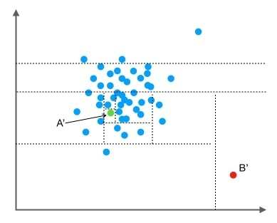
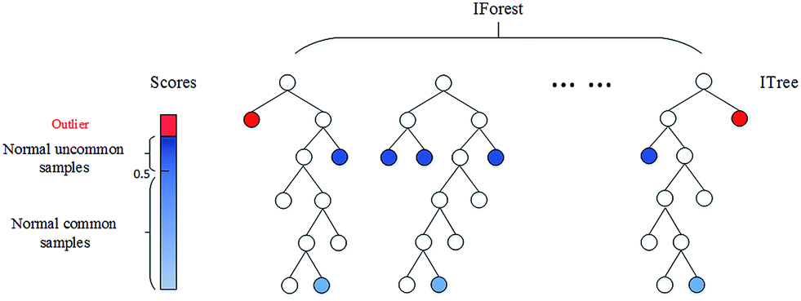
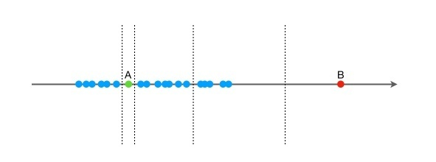
Algorithm Introduction
iTree
．randomly selecting a feature
．randomly selecting a split value

Slide 4
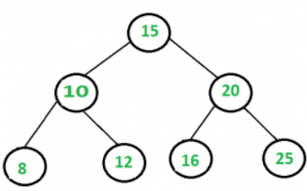
Algorithm Introduction
iTree
Who’s abnormal?

Slide 5
Algorithm Introduction
iForest
．measure of normality
．高度☹log₂(n))

Slide 6
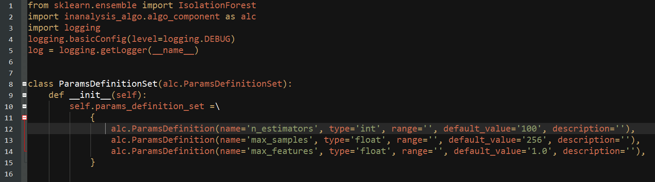
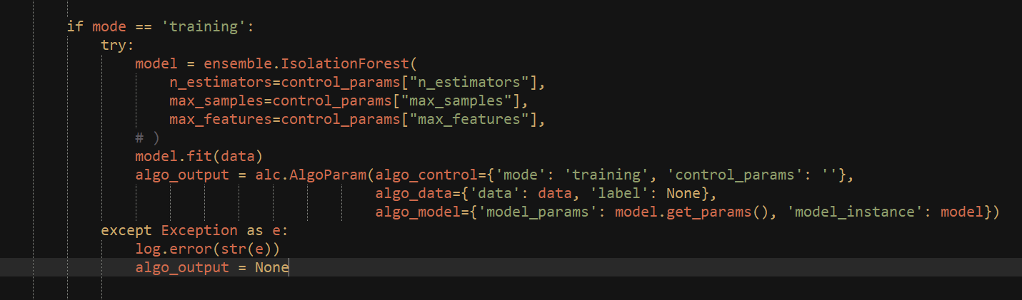
Code Review

Slide 7
Code Review
WHY?
n_estimators , max_samples :
Default: n_estimators = 100 , max_samples = 256

Slide 8
Code Review
WHY?
n_estimators , max_samples :
Default: n_estimators = 100 , max_samples = 256

Slide 9
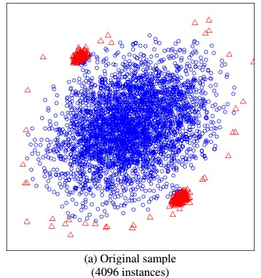
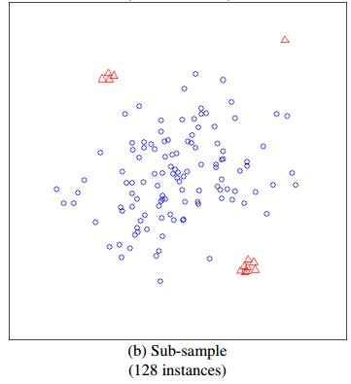
Code Review
n_estimators , max_samples :
Default: n_estimators = 100 , max_samples = 256

Slide 10

Code Review
n_estimators , max_samples :
Default: n_estimators = 100 , max_samples = 256

Slide 11

Live demo

Slide 12
Conclusion

Slide 13
Reference
https://read01.com/xD8AEnO.html
http://scikit-learn.org/stable/modules/outlier_detection.html#isolation-forest
http://scikit-learn.org/stable/modules/generated/sklearn.ensemble.IsolationForest.html#sklearn.ensemble.IsolationForest
https://read01.com/xD8AEnO.html#.WlSHaKjXZEY
https://zh.wikipedia.org/wiki/AdaBoost

