Slide 1
Data Mining(資料礦掘) Final Report
所 級：土木所博二
學 號：d05521016
姓 名：鄭閔中
授課教授：張瑞益 2018.01.10

Slide 2
oUTLINE
Algorithm Introduction
Code Review
Live Demo
Conclusion
Reference

Slide 3
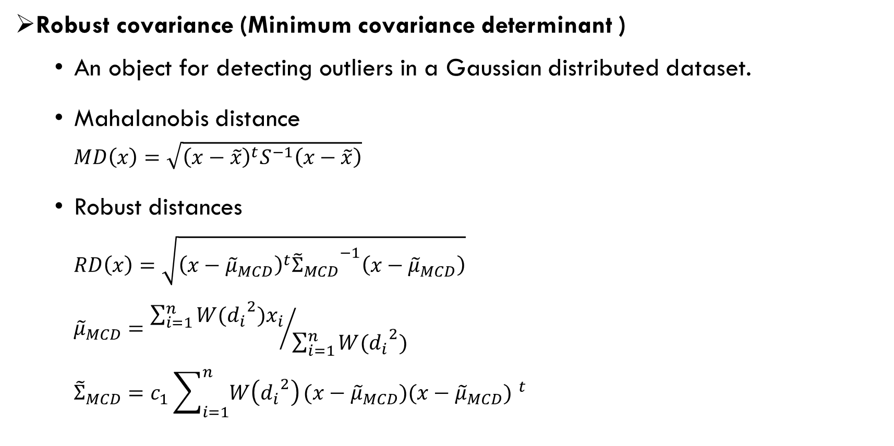
Algorithm Introduction
Robust covariance (Minimum covariance determinant )
An object for detecting outliers in a Gaussian distributed dataset.
Mahalanobis distance
$$MD\left(x\right)=\sqrt{{\left(x−\tilde{x}\right)}^{t}S^{−1}\left(x−\tilde{x}\right)}$$
Robust distances
$$RD\left(x\right)=\sqrt{{\left(x−{\tilde{μ}}_{MCD}\right)}^{t}{{\tilde{Σ}}_{MCD}}^{−1}\left(x−{\tilde{μ}}_{MCD}\right)}$$
$${\tilde{μ}}_{MCD}={\sum_{i=1}^{n}{W({d_{i}}^{2})x_{i}}}/{\sum_{i=1}^{n}{W({d_{i}}^{2}) }}$$
$${\tilde{Σ}}_{MCD}=c_{1}\sum_{i=1}^{n}{W\left({d_{i}}^{2}\right)}(x−{\tilde{μ}}_{MCD}){(x−{\tilde{μ}}_{MCD}) }^{t}$$
appropriate weight function

Slide 4
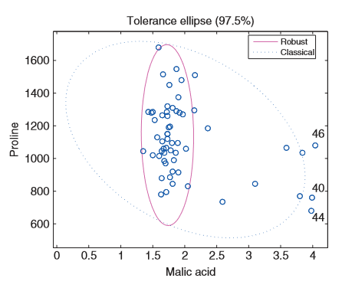
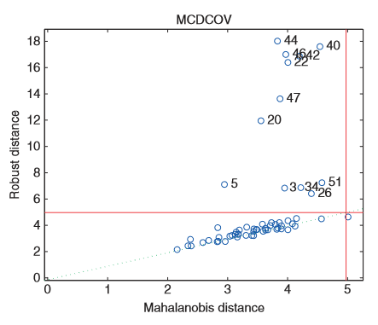
Algorithm Introduction
Robust covariance (Minimum covariance determinant )
Fig.1Bivariate wine data with classical and
robusttolerance ellipse.
Fig.2 Distance-distance plot of the full wine
data.

Slide 5
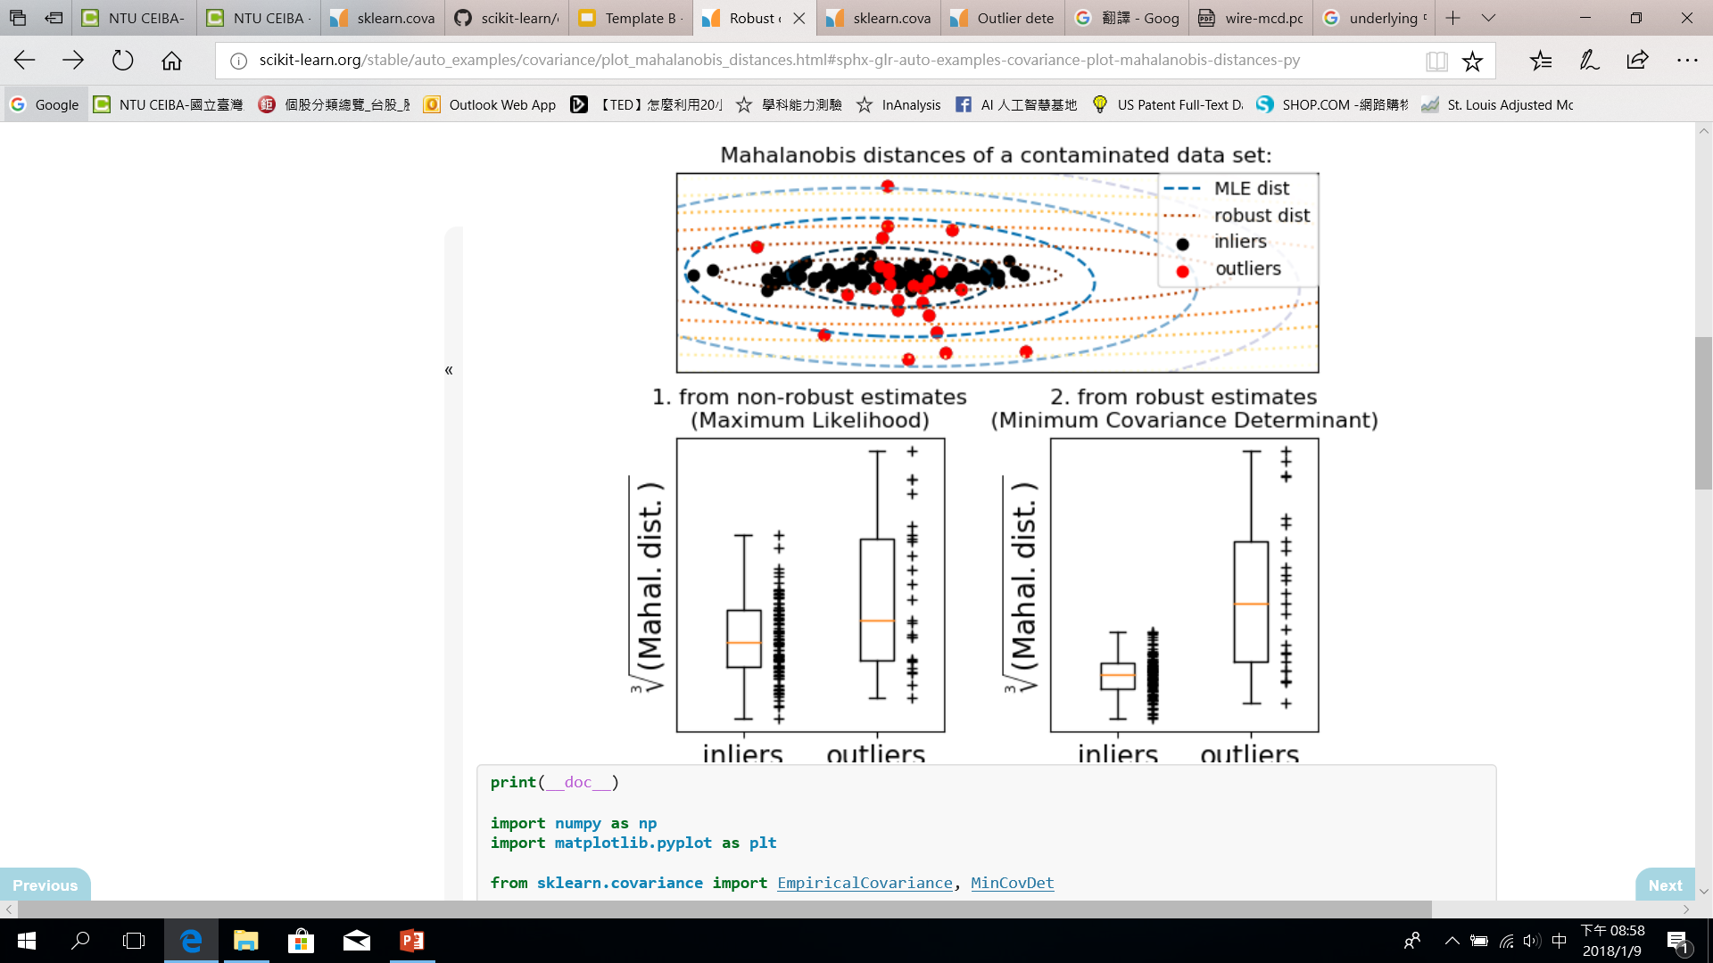
Algorithm Introduction
Robust covariance (Minimum covariance determinant )
inliers
outliers
inliers
outliers
Fig.3 Non-robust estimates.
Fig.4 Robust estimates.

Slide 6
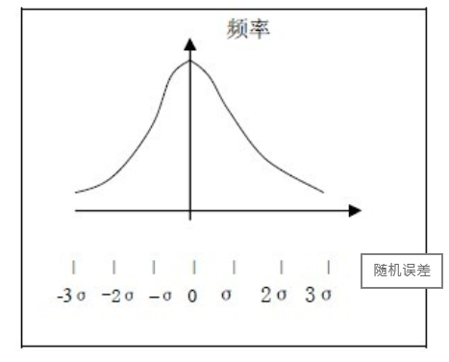
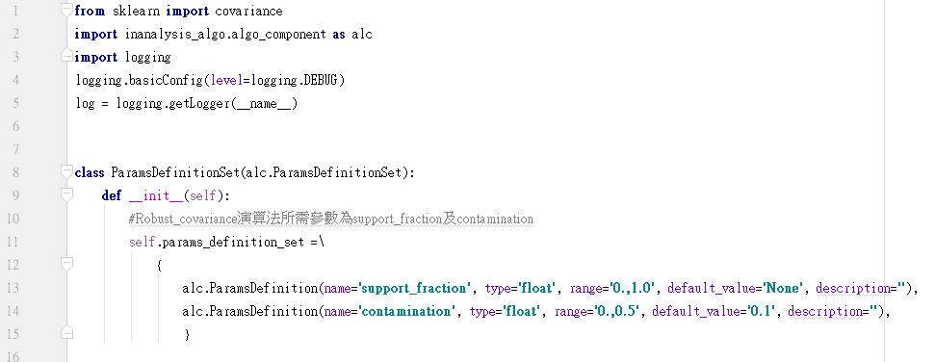
Code Review
Robust_covariance_d05521016.py
support_fraction：決定分析資料數
Contamination：決定圈選範圍

Slide 7
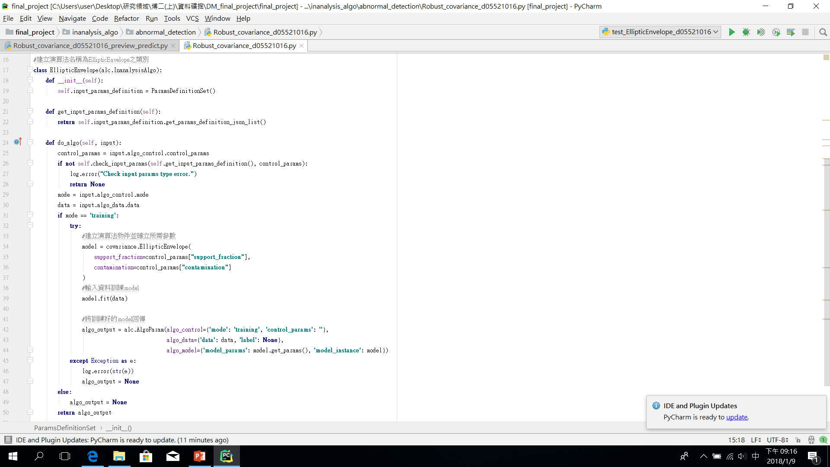
Code Review
Robust_covariance_d05521016.py

Slide 8
Code Review
Robust_covariance_d05521016.py

Slide 9
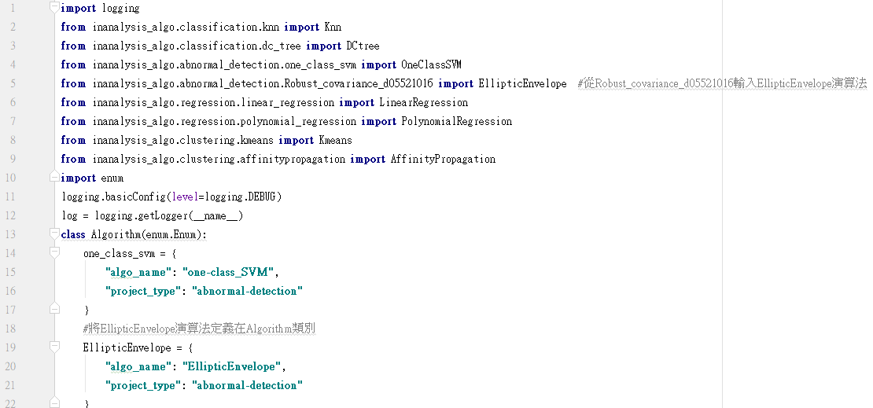
Code Review
Utils.py

Slide 10
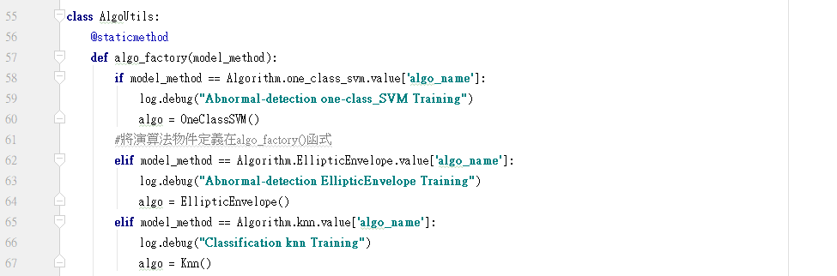
Code Review
Utils.py

Slide 11
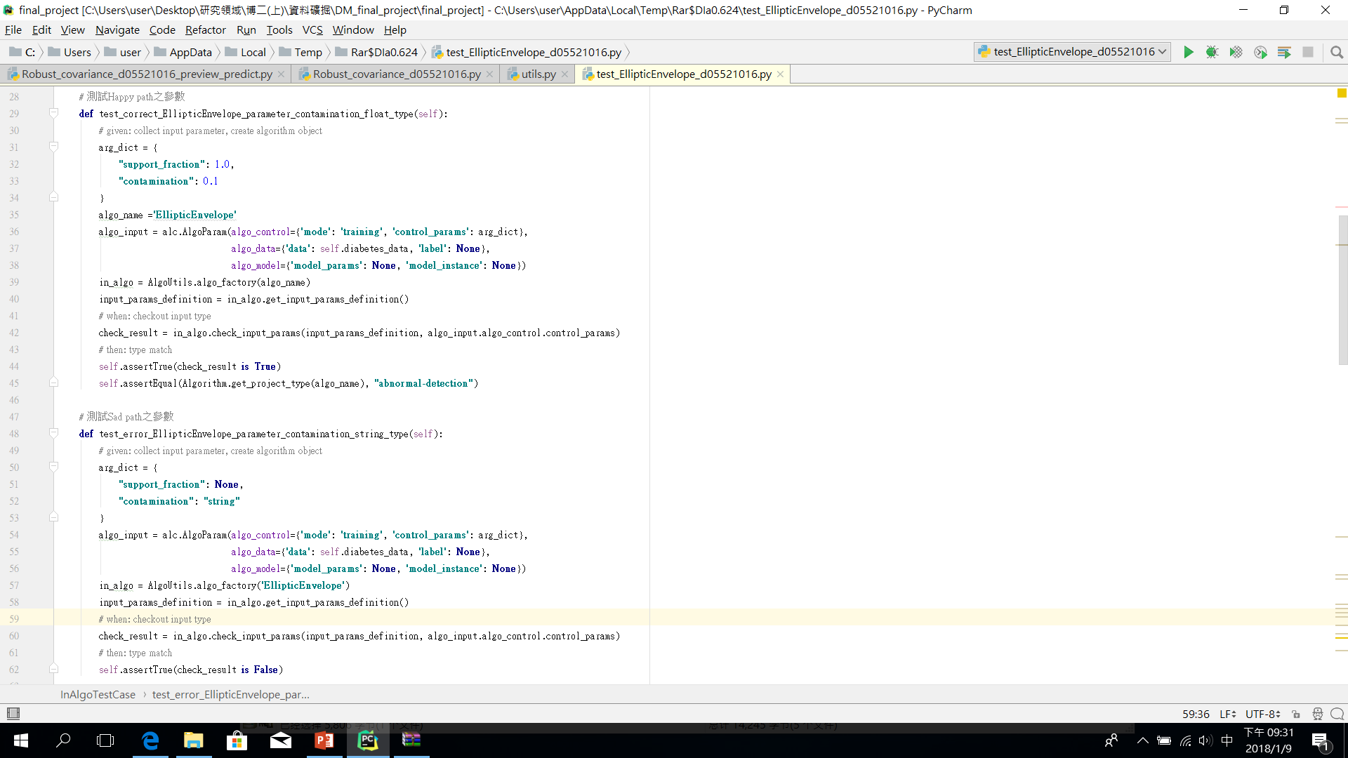
Code Review
Test_EllipticEnvelope_d05521016.py

Slide 12
Code Review
Test_EllipticEnvelope_d05521016.py

Slide 13
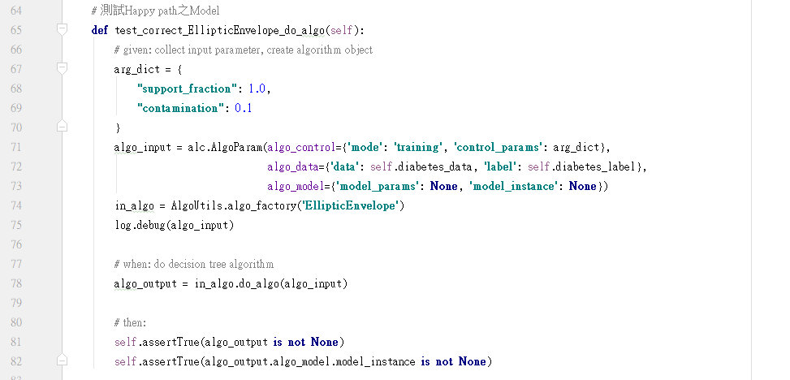
Code Review
Test_EllipticEnvelope_d05521016.py

Slide 14
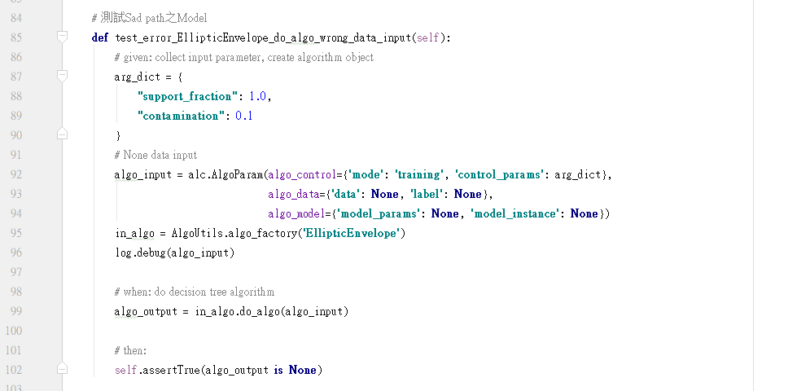
Code Review
Test_EllipticEnvelope_d05521016.py

Slide 15
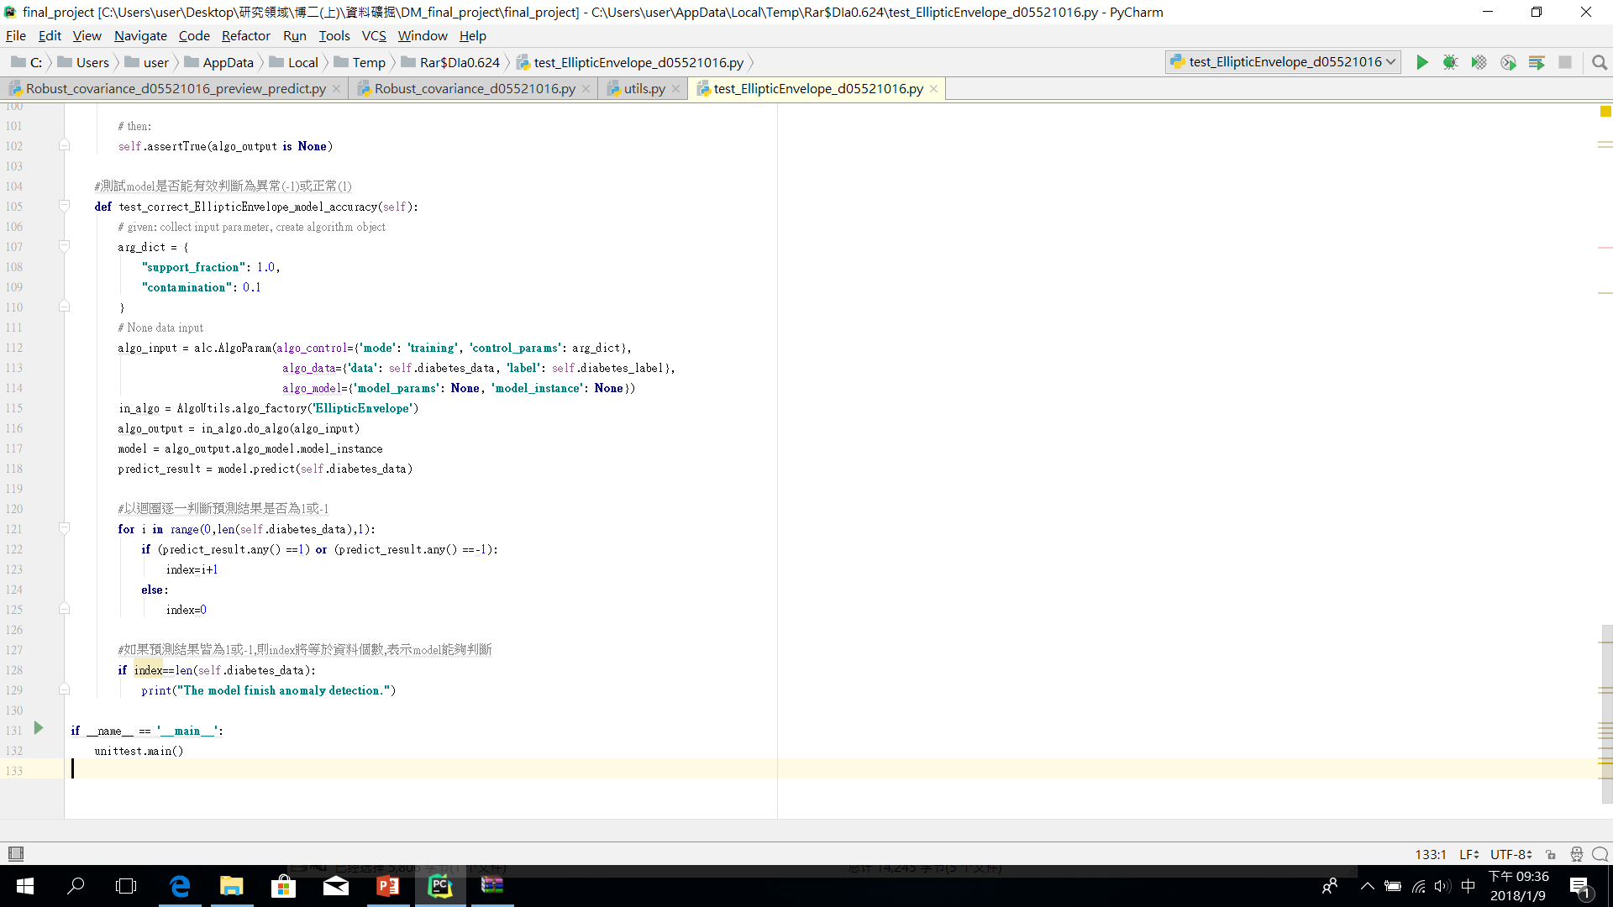
Code Review
Test_EllipticEnvelope_d05521016.py

Slide 16
Code Review
Test_EllipticEnvelope_d05521016.py

Slide 17
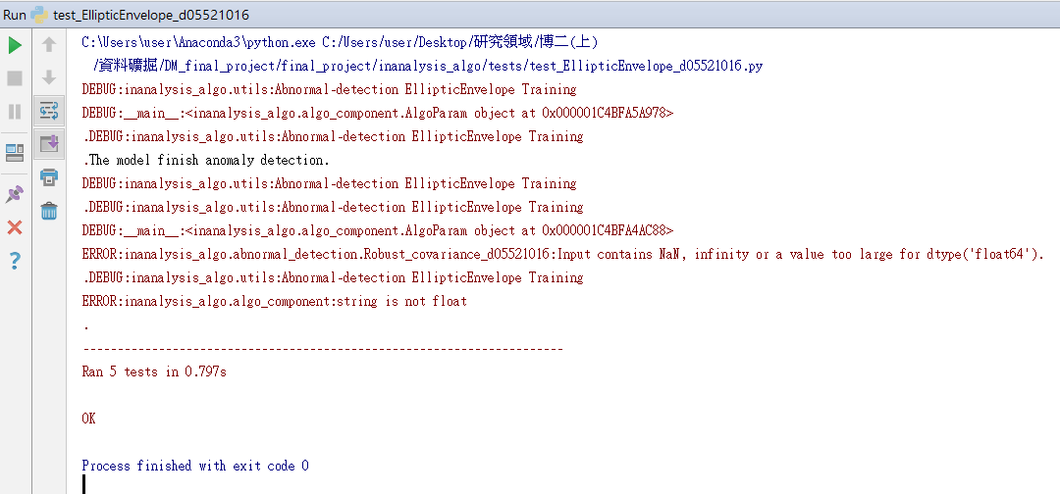
Code Review
Test_EllipticEnvelope_d05521016.py

Slide 18
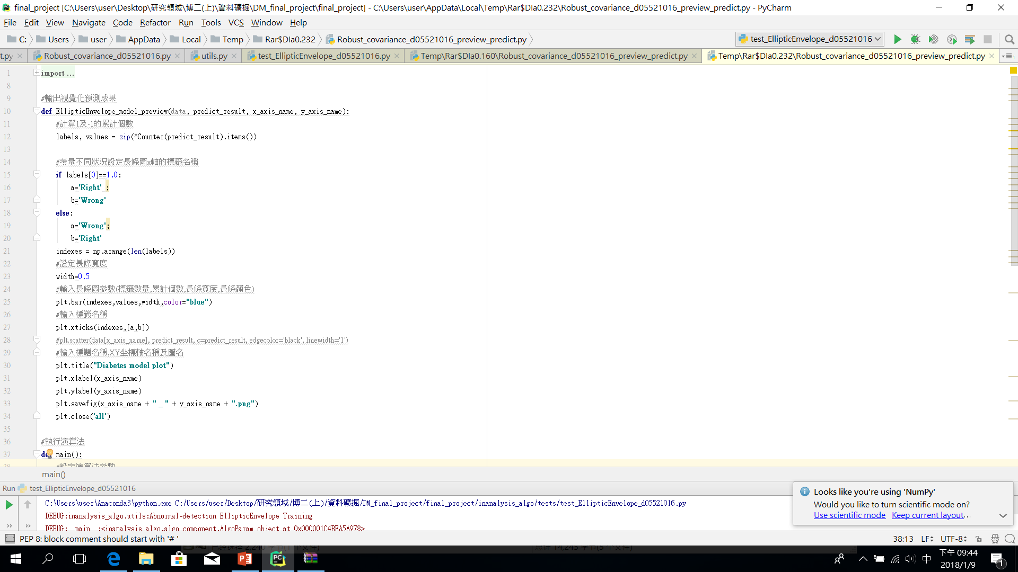
Code Review
Robust_covariance_d05521016_preview_predict.py

Slide 19
Code Review
Robust_covariance_d05521016_preview_predict.py

Slide 20
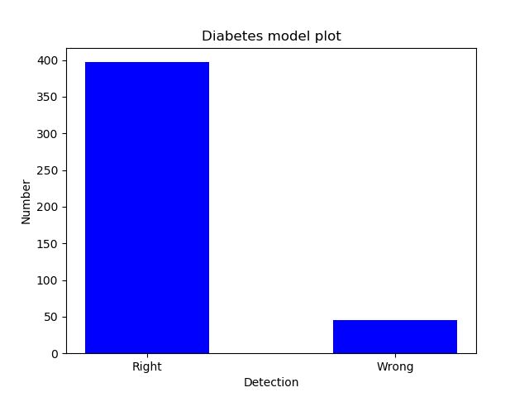
Code Review
Robust_covariance_d05521016_preview_predict.py
Fig.5 Model Preview of prediction.

Slide 21
Live Demo
http://ntuesoe.com:8008/

Slide 22
Conclusion
依授課內容於InAnalysis作業平台完成機器學習實作案例
資料數量、分佈方式及優劣將影響機器學習成果，並影響適用之演算法
在機器學習領域，目的、動機及效益之重要性遠大於演算法技術的發展

Slide 23
Reference
Mia Hubert and Michiel Debruyne, Minimum covariance determinant,WIREs Computational Statistics 2010,Volume 2:37-43.
http://scikit-learn.org/stable/modules/generated/sklearn.covariance.EllipticEnvelope.html
http://scikit-learn.org/stable/auto_examples/covariance/plot_mahalanobis_distances.html#sphx-glr-auto-examples-covariance-plot-mahalanobis-distances-py

