Slide 1
AdaBoost Classifier
學號：r02543045
姓名：辛丞鈞
Notes:
Let’s talk about cities and transportation first
Transportation
How to move people and goods is always an urban issue
Before we start to talk about the MoD system, let’s talk about city first, because I am an architect and an urban designer by training. Everything goes back to my roots.

Slide 2
Outline
Notes:
Let’s talk about cities and transportation first
Transportation
How to move people and goods is always an urban issue
Before we start to talk about the MoD system, let’s talk about city first, because I am an architect and an urban designer by training. Everything goes back to my roots.

Slide 3
- Algorithm Introduction
- Code Review
- Model Preview
- Live Demo(Using InAnalysis)
- Conclusion
- Reference

Slide 4
Algorithm Introduction
Notes:
Let’s talk about cities and transportation first
Transportation
How to move people and goods is always an urban issue
Before we start to talk about the MoD system, let’s talk about city first, because I am an architect and an urban designer by training. Everything goes back to my roots.

Slide 5
AdaBoost 屬於 Ensemble methods
Boosting: improving weak classifiers
An AdaBoost classifier is a meta-estimator that begins by fitting a classifier on the original dataset and then fits additional copies of the classifier on the same dataset but where the weights of incorrectly classified instances are adjusted such that subsequent classifiers focus more on difficult cases.

Slide 6
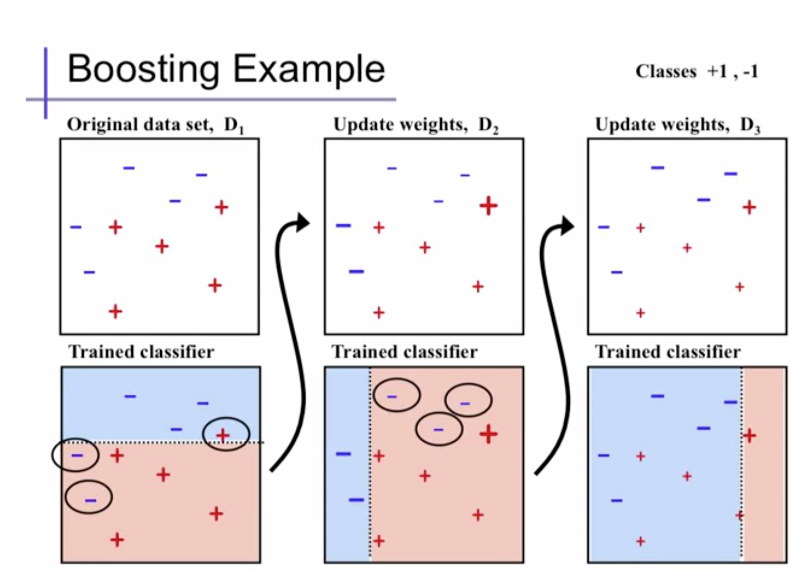

Slide 7
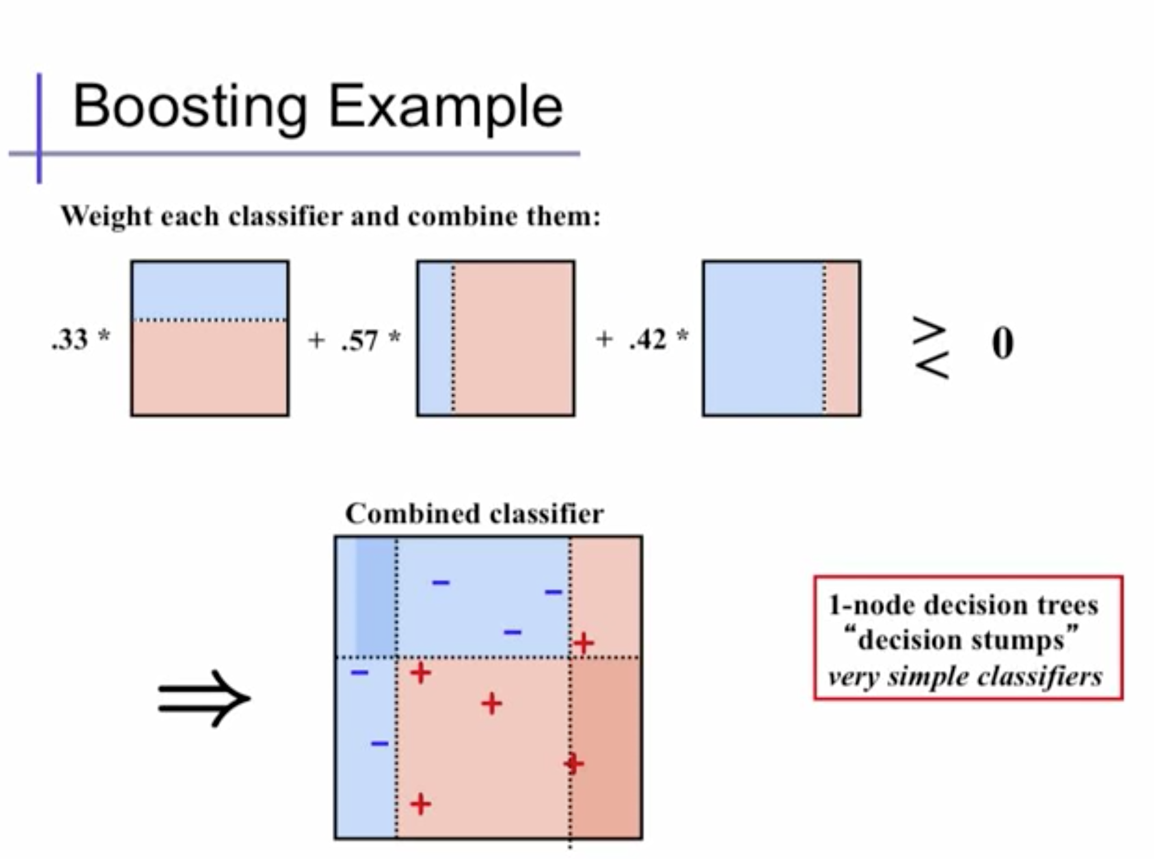

Slide 8
Code Review
Notes:
Let’s talk about cities and transportation first
Transportation
How to move people and goods is always an urban issue
Before we start to talk about the MoD system, let’s talk about city first, because I am an architect and an urban designer by training. Everything goes back to my roots.

Slide 9
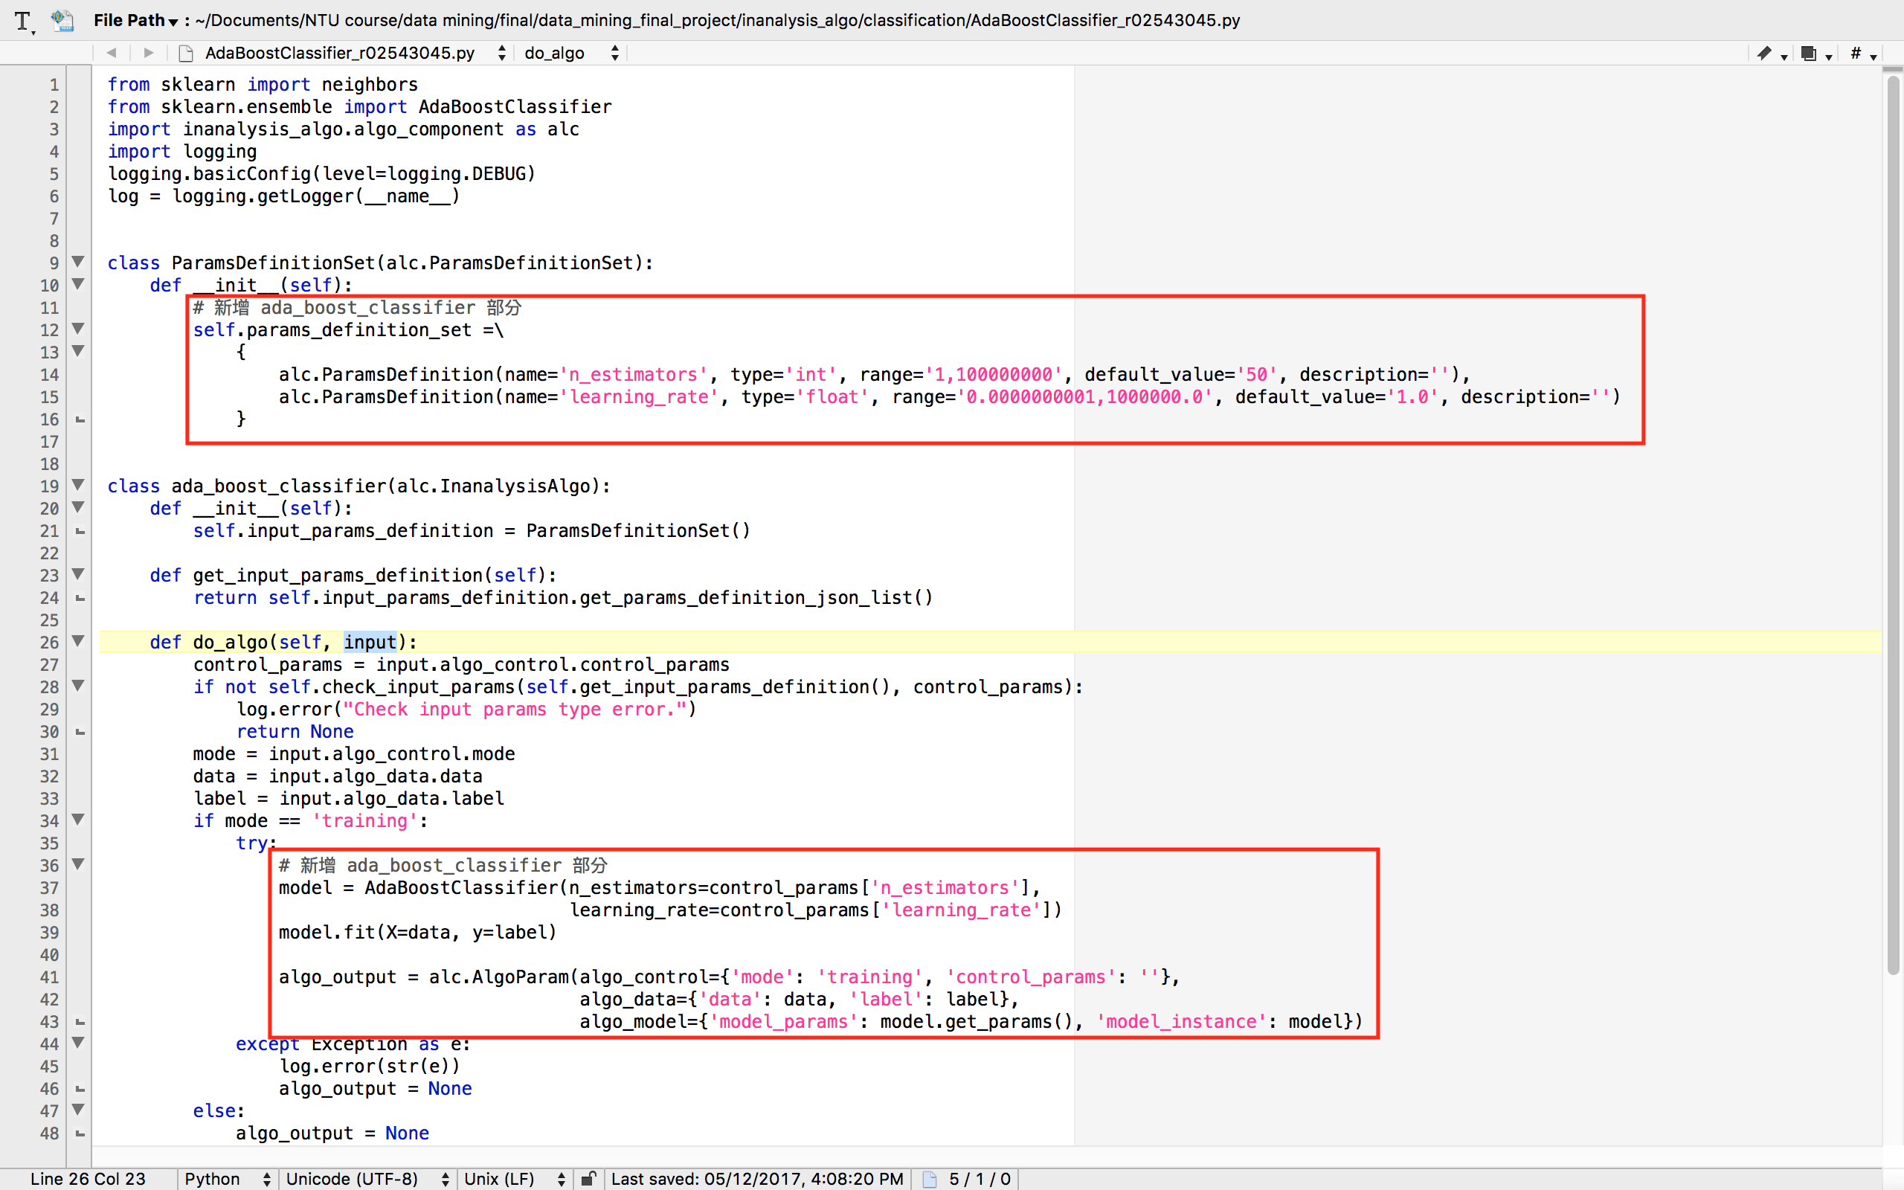

Slide 10
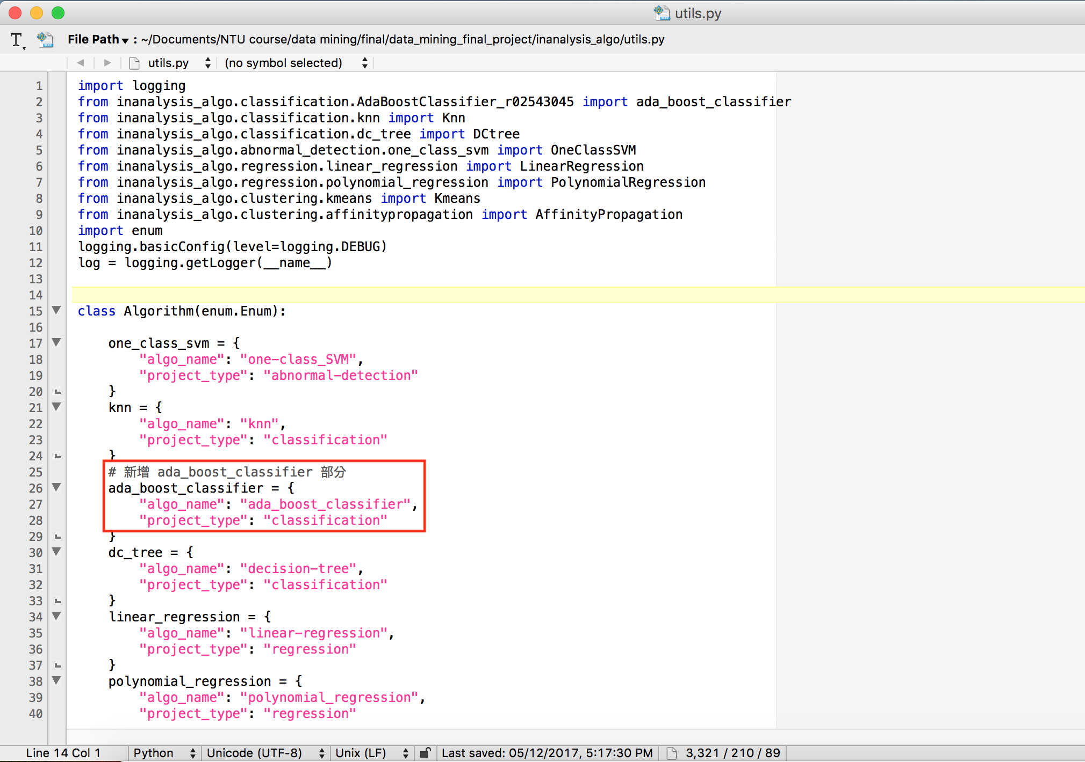

Slide 11
Model Preview
Notes:
Let’s talk about cities and transportation first
Transportation
How to move people and goods is always an urban issue
Before we start to talk about the MoD system, let’s talk about city first, because I am an architect and an urban designer by training. Everything goes back to my roots.

Slide 12
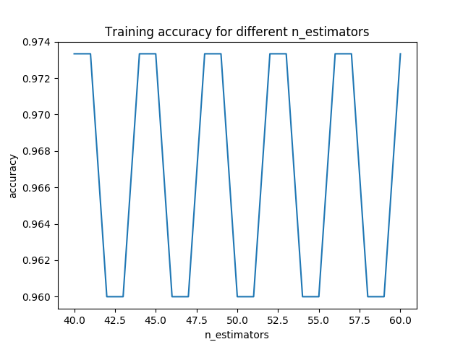

Slide 13
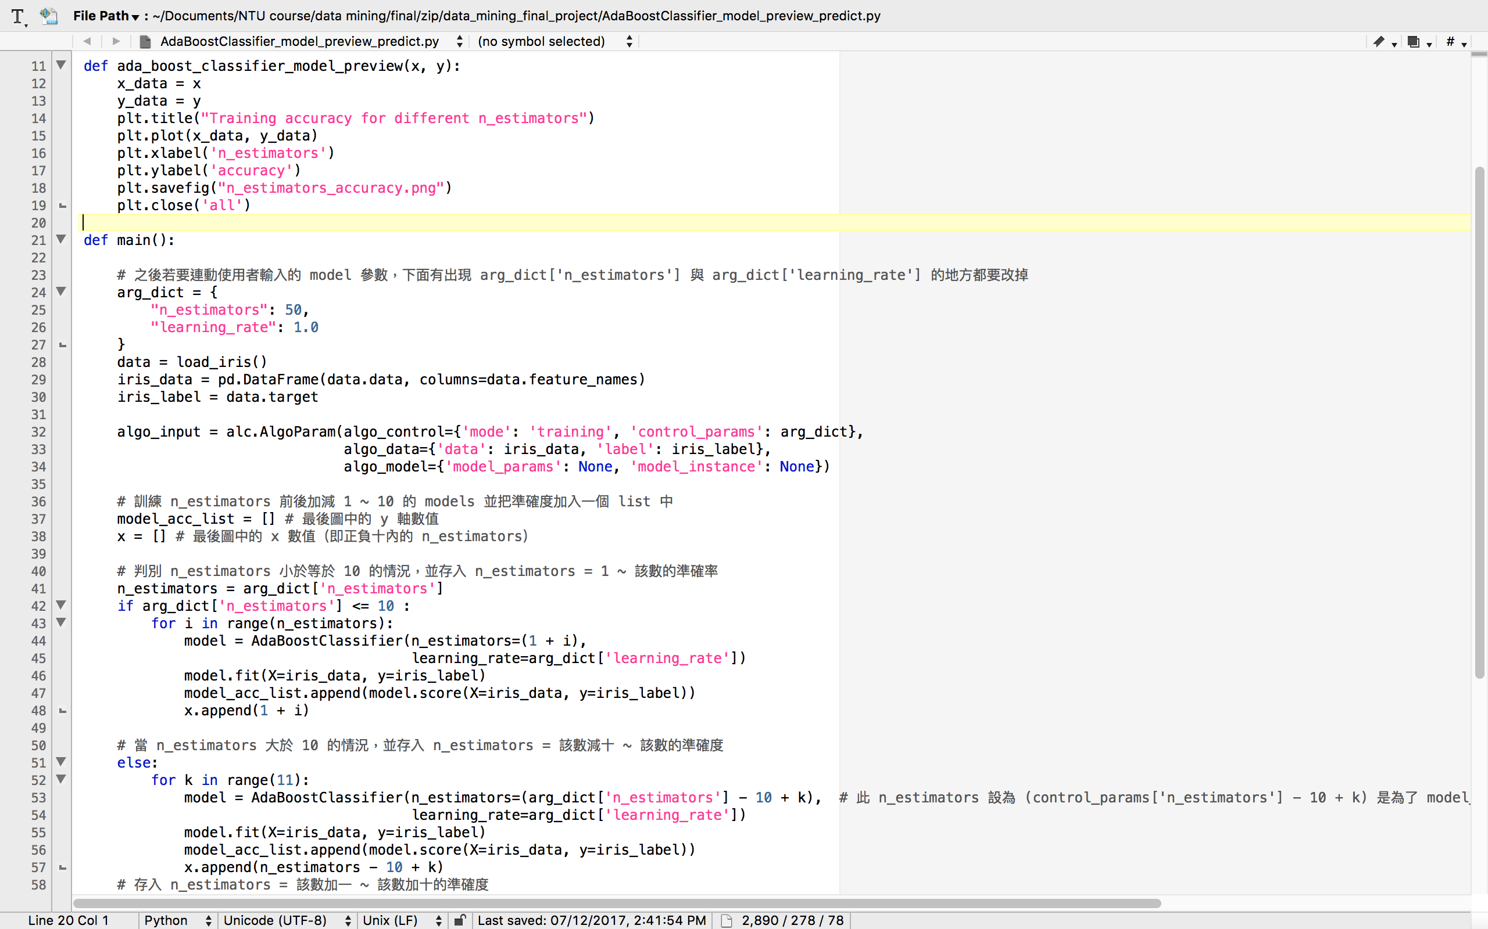

Slide 14
Live Demo
InAnalysis live demo: http://ntuesoe.com:8008/
Notes:
Let’s talk about cities and transportation first
Transportation
How to move people and goods is always an urban issue
Before we start to talk about the MoD system, let’s talk about city first, because I am an architect and an urban designer by training. Everything goes back to my roots.

Slide 15
Conclusion
Notes:
Let’s talk about cities and transportation first
Transportation
How to move people and goods is always an urban issue
Before we start to talk about the MoD system, let’s talk about city first, because I am an architect and an urban designer by training. Everything goes back to my roots.

Slide 16
瞭解 AI, Data Mining 的歷史、發展與相關演算法和應用
學會基本的 unit testing
瞭解並實作 AdaBoost Classifier
學會看其他人的程式，與如何將自己的程式加入並可相容
Python 物件導向的概念與實作

Slide 17
Reference
Notes:
Let’s talk about cities and transportation first
Transportation
How to move people and goods is always an urban issue
Before we start to talk about the MoD system, let’s talk about city first, because I am an architect and an urban designer by training. Everything goes back to my roots.

Slide 18
- UC Irvine: https://www.youtube.com/watch?v=ix6IvwbVpw0
- sklearn: http://scikit-learn.org/stable/modules/generated/sklearn.ensemble.AdaBoostClassifier.html

Slide 19
Thank You

