Slide 1
期末報告-- DBSCAN
學號：R05631018
姓名：曾秋旺

Slide 2
Outline
Algorithm Introduction
Code Review
Model Preview
Live Demo
Conclusion
Reference

Slide 3
Outline
Algorithm Introduction
Code Review
Model Preview
Live Demo
Conclusion
Reference

Slide 4
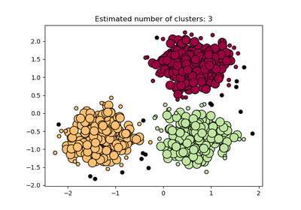
Algorithm Introduction
DBSCAN: Clustering Density-Based Spatial Clustering of Application with Noise
Distance (radius ε)
Nearest Neighbors → min_samples
Source: http://scikit-learn.org/stable/modules/generated/sklearn.cluster.DBSCAN.html

Slide 5
Algorithm Introduction
Limitation: Data which not contain clusters of similar density
Source: http://scikit-learn.org/stable/modules/generated/sklearn.cluster.DBSCAN.html

Slide 6
Outline
Algorithm Introduction
Code Review
Model Preview
Live Demo
Conclusion
Reference

Slide 7
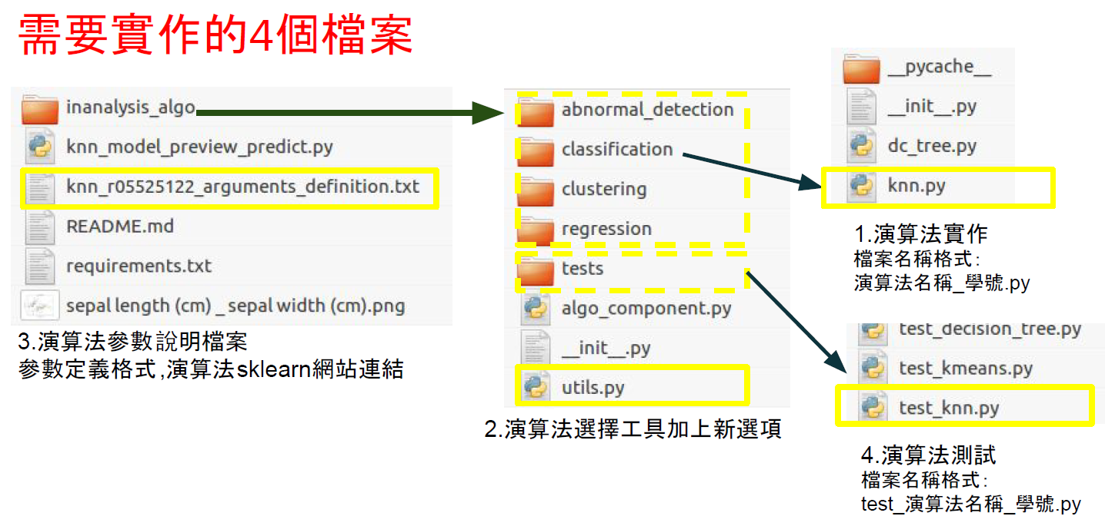

Code Review
Source: TAs

Slide 8
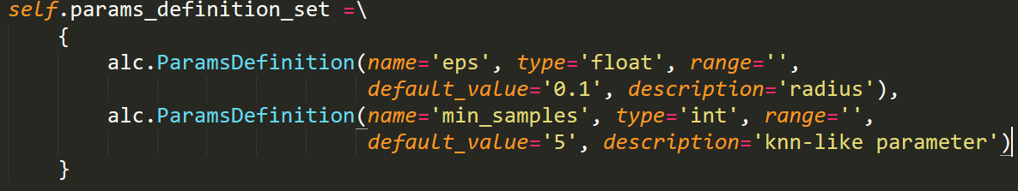
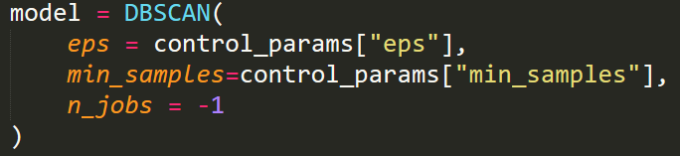
Code Review

Slide 9
Code Review
Source: TAs

Slide 10
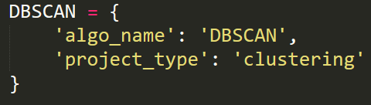

Code Review

Slide 11
Code Review
Source: TAs

Slide 12
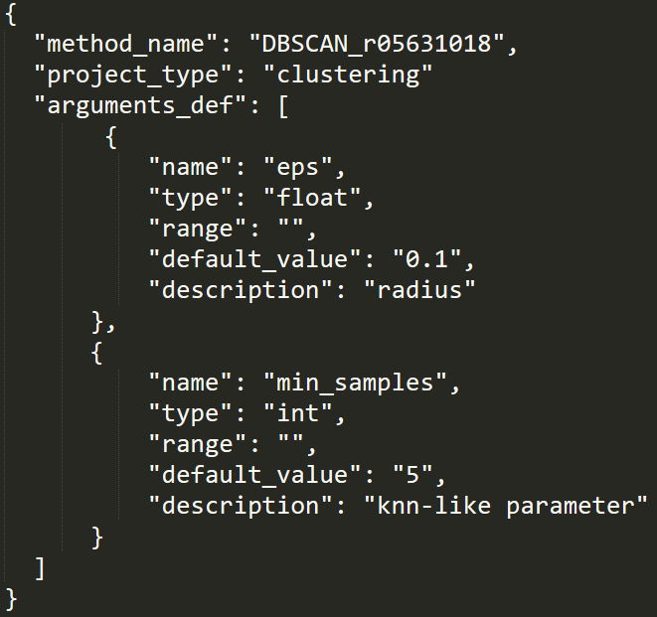
Code Review

Slide 13
Code Review
Source: TAs

Slide 14
Code Review

Slide 15
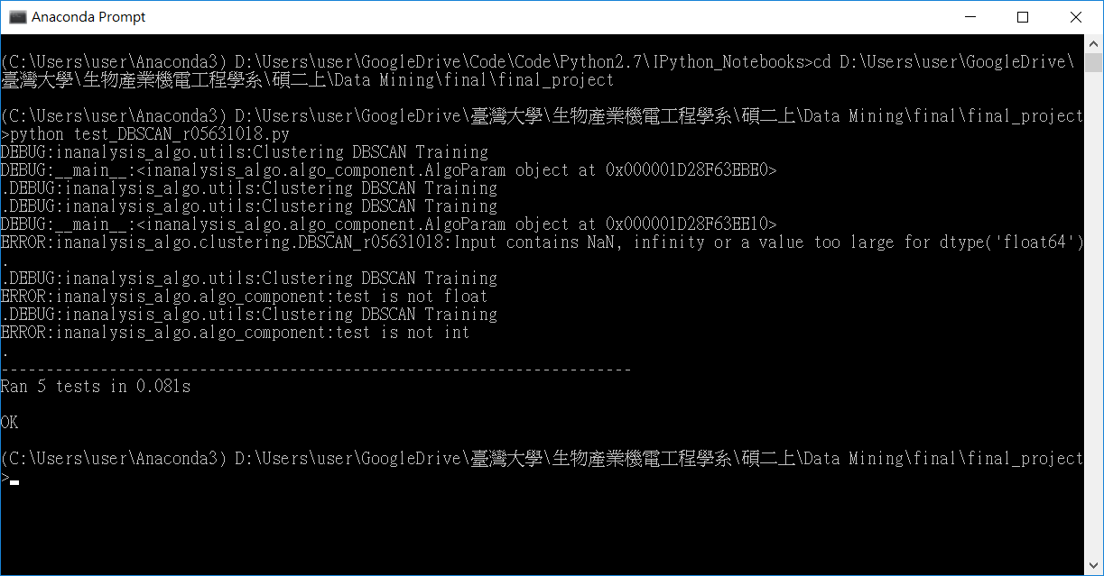
Code Review

Slide 16
Outline
Algorithm Introduction
Code Review
Model Preview
Live Demo
Conclusion
Reference

Slide 17
Model Preview
Procedure:
Data pre-processing
Clusters counting
Scatter

Slide 18
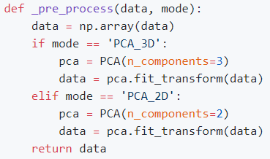
Model Preview
1. Data pre-processing

Slide 19
Model Preview
2. Clusters counting
Source: http://scikit-learn.org/stable/modules/generated/sklearn.cluster.DBSCAN.html

Slide 20
Model Preview
3. Scatter
import matplotlib.pyplot as plt
from mpl_toolkits.mplot3d import Axes3D

Slide 21
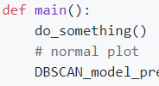
Model Preview
Github: https://github.com/WarrenTseng/DM2017_final_model_preview
免責聲明

Slide 22
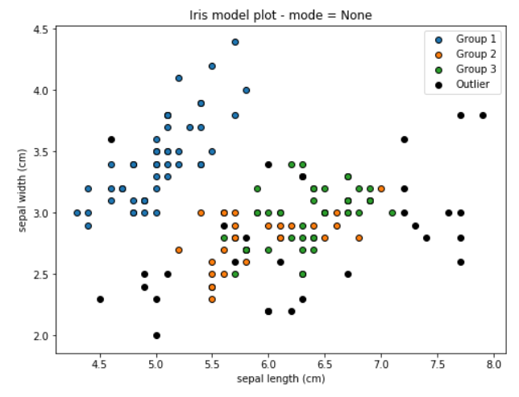
Model Preview

Slide 23
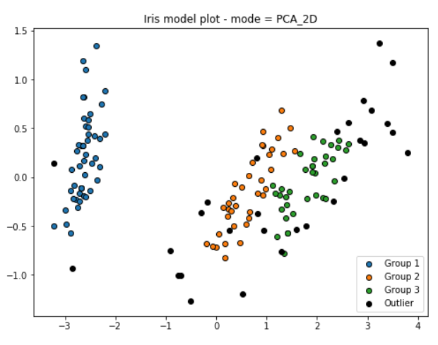
Model Preview

Slide 24
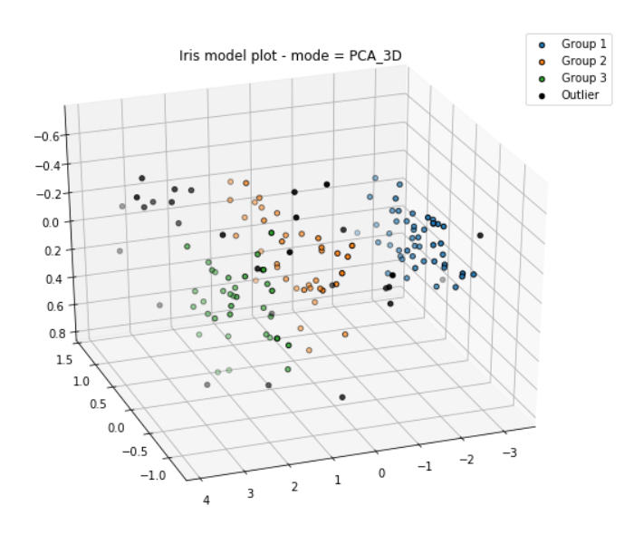
Model Preview

Slide 25
Outline
Algorithm Introduction
Code Review
Model Preview
Live Demo
Conclusion
Reference

Slide 26
Live Demo
InAnalysis: http://ntuesoe.com:8008/

Slide 27
Outline
Algorithm Introduction
Code Review
Model Preview
Live Demo
Conclusion
Reference

Slide 28
Conclusion
The procedure of data mining
System design

Slide 29
Outline
Algorithm Introduction
Code Review
Model Preview
Live Demo
Conclusion
Reference

Slide 30
Reference
Scikit-Learn: http://scikit-learn.org/stable/modules/generated/sklearn.cluster.DBSCAN.html
Wikipedia: https://zh.wikipedia.org/wiki/DBSCAN

Slide 31
Thanks for your attention

