Slide 1
Clustering Agglomerative Clustering (Hierarchical clustering)
生醫電資所 R05945054 楊牧

Slide 2
Algorithm Introduction **Bonus: Model Preview Code Review Live Demo(Using InAnalysis) Conclusion Reference

Slide 3
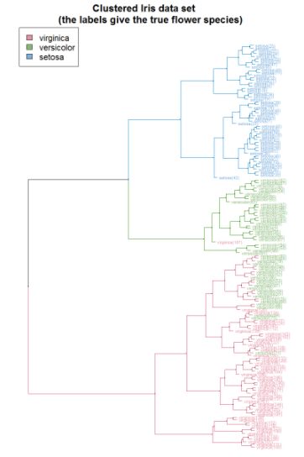
Algorithm Introduction
Hierarchical clustering
Build nested clusters by merging(agglomerative) or splitting(divisive) them successively.
Tree (dendrogram) - Hierarchy of clusters.
Root: all the samples. Leaves: one sample.
https://upload.wikimedia.org/wikipedia/commons/1/12/Iris_dendrogram.png

Slide 4
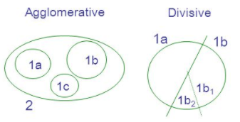
Algorithm Introduction
Agglomerative Clustering
Bottom up
each observation starts in its own cluster, and clusters are successively merged together.
Distance Metric
Linkage Method
http://slideplayer.com/slide/3387893/12/images/14/2+Non+overlapping+Overlapping+Single+Linkage:+Minimum+distance+*.jpg

Slide 5
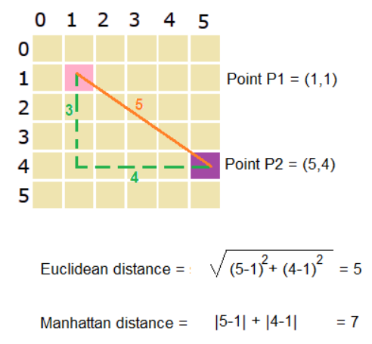
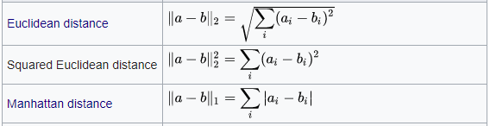
Algorithm Introduction
Distance Metric
https://prismoskills.appspot.com/lessons/2D_and_3D_Puzzles/Chapter_05_-_Distance_between_points.jsp
https://en.wikipedia.org/wiki/Hierarchical_clustering

Slide 6
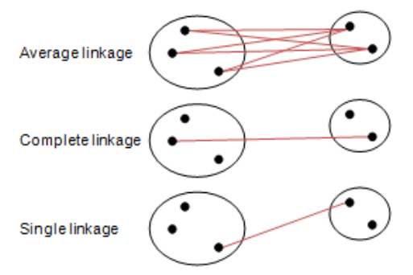
Algorithm Introduction
Linkage method
Ward minimizes the sum of squared differences within all clusters.
Minimization of within-cluster variance.
https://www.multid.se/genex/onlinehelp/hs515.htm

Slide 7
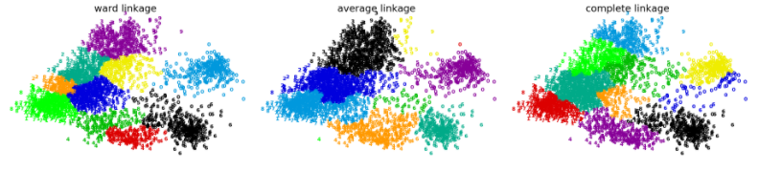
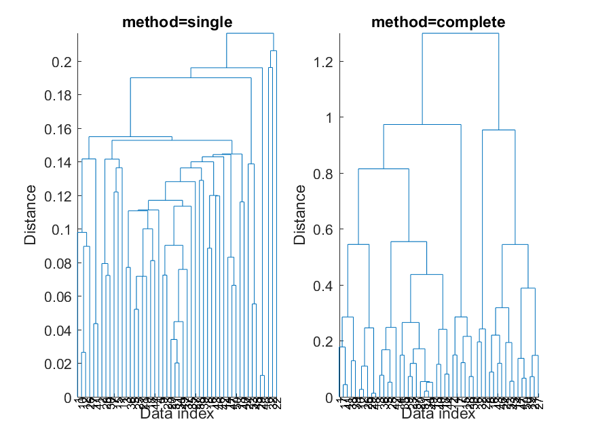
Algorithm Introduction
Linkage method
http://mirlab.org/jang/books/dcpr/dcHierClustering.asp?title=3-2%20Hierarchical%20Clustering%20(%B6%A5%BCh%A6%A1%A4%C0%B8s%AAk)&language=chinese
http://scikit-learn.org/stable/modules/clustering.html#hierarchical-clustering

Slide 8
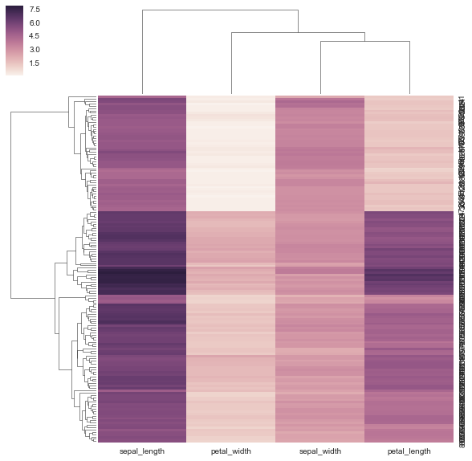
**Bonus: Model Preview
seaborn
- clustermap
Linkage method='average' Distance metric='euclidean'
heatmap

Slide 9
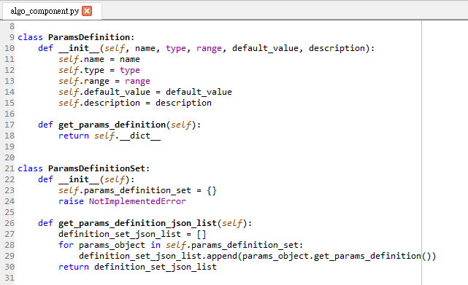
Code Review
Notes:
->在各演算法子類別中實作
ParamsDefinition類別包含單項參數相關資料
○ Attribute：參數名稱(name)、參數型態(type)、參數範圍
(range)、參數初始值(default_value)、參數描述
(description)
○ Method：get_params_definition()會以字典型態
(key-value pair)回傳所有Attribute的資料
● ParamsDefinitionSet由ParamsDefinition組成
○ Attribute：參數定義組(params_definition_set)將所有
參數相關資料包成List型態
○ Method：get_params_definition_set()會回傳List型態
包含所有參數相關資料

Slide 10
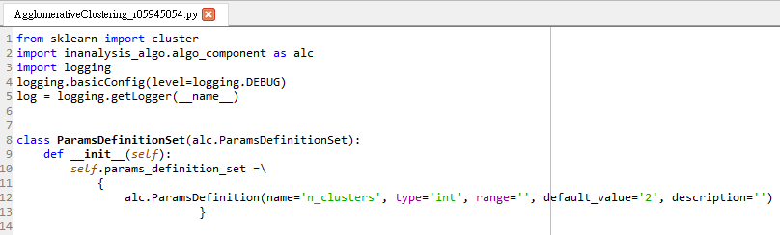
Code Review
affinity=’Euclidean’
linkage=’ward’
Notes:
繼承 algo_component 中的 ParamsDefinitionSet 類別
If linkage is “ward”, only “euclidean” is accepted.

Slide 11
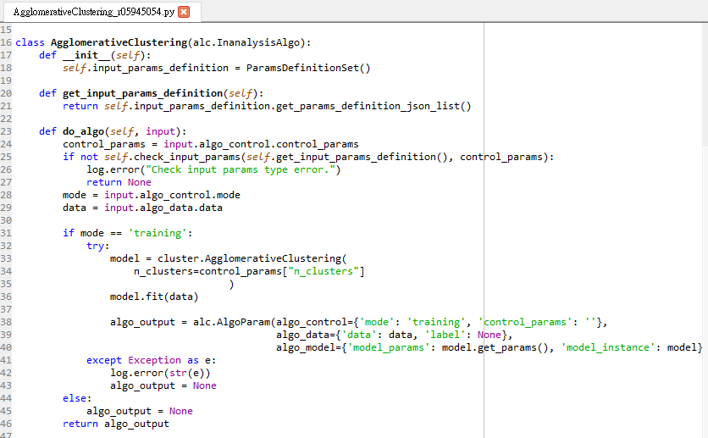
Code Review
Notes:
依照參數建立sklearn演算法物件
放入資料訓練model
將訓練好的模型打包回傳

Slide 12
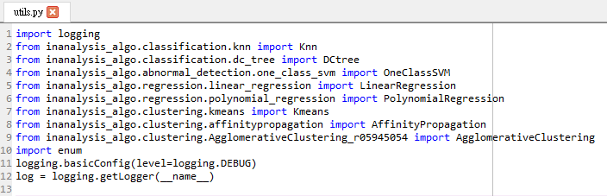
Code Review

Slide 13
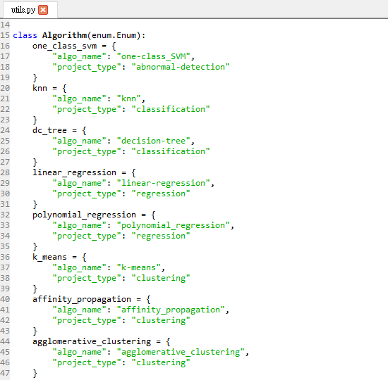
Code Review
Notes:
將演算法名稱和類別定義在Algorithm這enum類別
並藉由algo_factory()這個函式來取得演算法物件

Slide 14
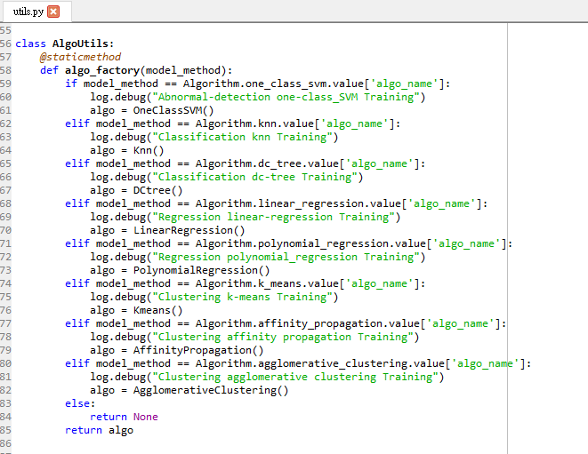
Code Review

Slide 15
Live Demo(Using InAnalysis)
Wholesale customers Data Set
Wholesale_customers_nolabel_data.csv
Attributes: 1) Fresh 2) Milk 3) Grocery 4) Frozen 5) Detergents_paper 6) Delicatessen 7) Channel: Horeca Or Retail
Notes:
1) FRESH: annual spending (m.u.) on fresh products (Continuous); 2) MILK: annual spending (m.u.) on milk products (Continuous); 3) GROCERY: annual spending (m.u.)on grocery products (Continuous); 4) FROZEN: annual spending (m.u.)on frozen products (Continuous) 5) DETERGENTS_PAPER: annual spending (m.u.) on detergents and paper products (Continuous) 6) DELICATESSEN: annual spending (m.u.)on and delicatessen products (Continuous); 7) CHANNEL: customersâ€™ Channel - Horeca (Hotel/Restaurant/CafÃ©) or Retail channel (Nominal)

Slide 16
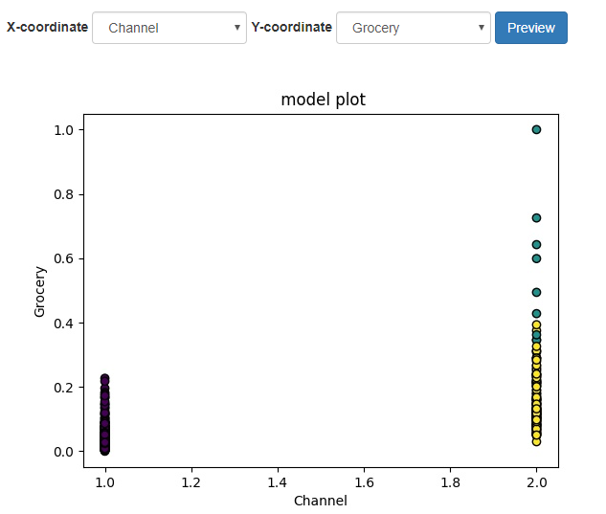
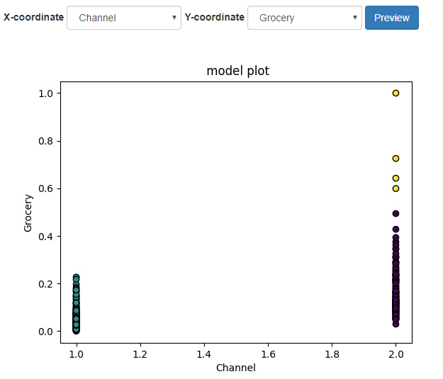
K-means vs. Agglomerative Clustering
5 Features: Milk, Grocery, Detergents Paper, Delicassen, Channel
n_clusters = 3

Slide 17
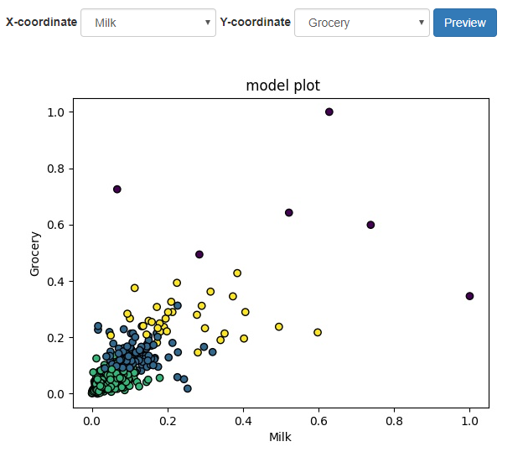
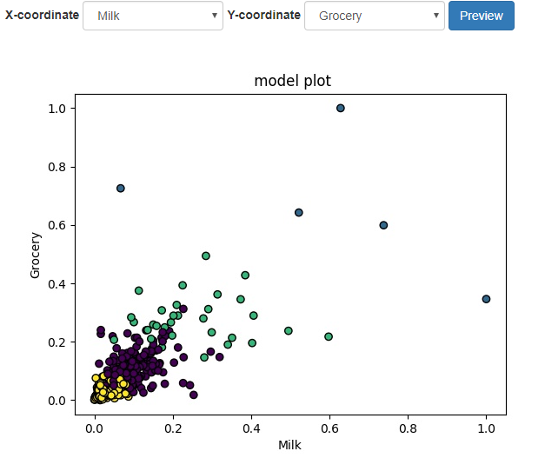
K-means vs. Agglomerative Clustering
3 Features: Milk, Grocery, Detergents Paper
n_clusters = 4

Slide 18
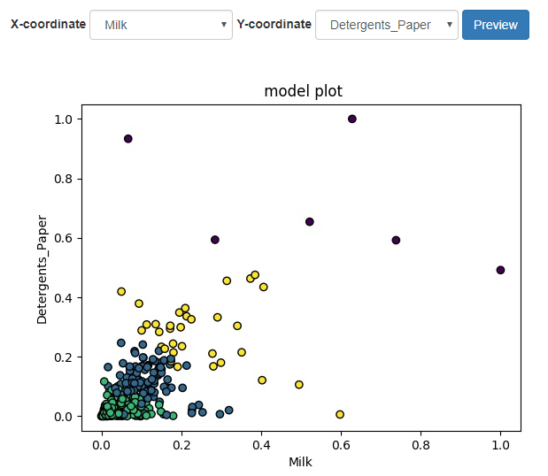
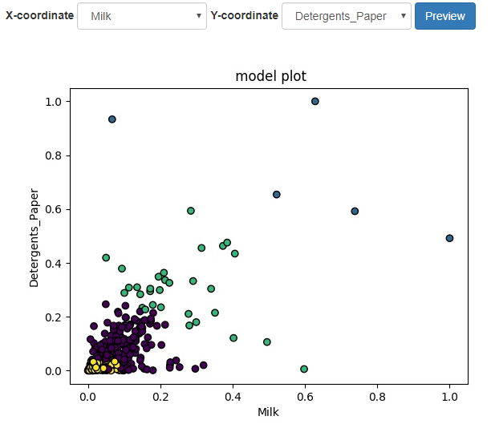
K-means vs. Agglomerative Clustering
3 Features: Milk, Grocery, Detergents Paper
n_clusters = 4

Slide 19
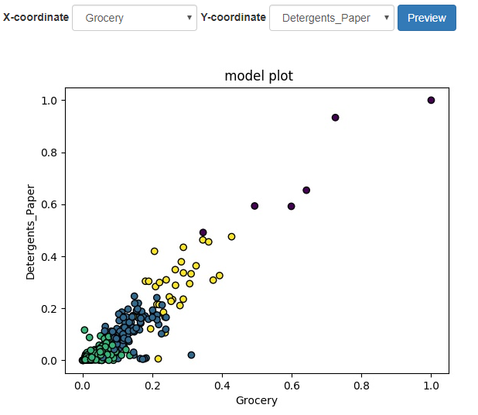
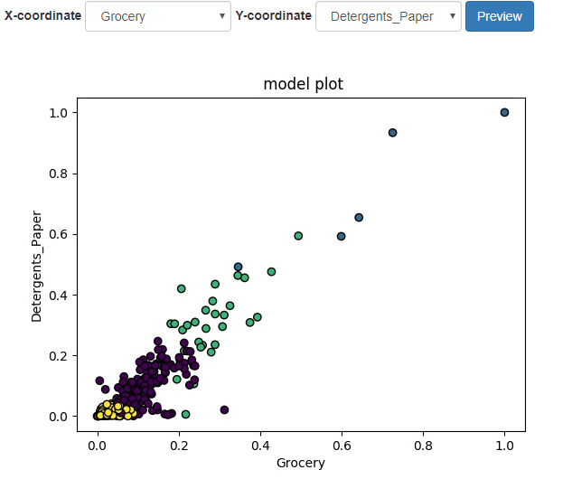
K-means vs. Agglomerative Clustering
3 Features: Milk, Grocery, Detergents Paper
n_clusters = 4

Slide 20
Conclusion
Scikit-learn
Unit test
Visualization
Object-oriented programming
Real data set

Slide 21
Reference
http://seaborn.pydata.org/generated/seaborn.clustermap.html
http://archive.ics.uci.edu/ml/datasets/Wholesale+customers
https://arxiv.org/pdf/1211.0437.pdf
http://scikit-learn.org/stable/modules/clustering.html#hierarchical-clustering
http://scikit-learn.org/stable/modules/generated/sklearn.cluster.AgglomerativeClustering.html#sklearn.cluster.AgglomerativeClustering
https://www.multid.se/genex/onlinehelp/hs515.htm
https://en.wikipedia.org/wiki/Hierarchical_clustering

Slide 22
Thank you

