Slide 1
LARAVEL BASICS Part(1)
Inanc Alp Gunalp

Slide 2
Considering you have been able to start a basic project in Laravel, I will be going over the setup briefly.
I will cover fundamental relationships between Models and how to use them with Tinker.
- Tinker is a powerful debugging tool which is useful to test some of the implementation cases.
While progressing through the end goal, will try to mention some other functionalities.
I will be using VS Code for the project environment.

Slide 3
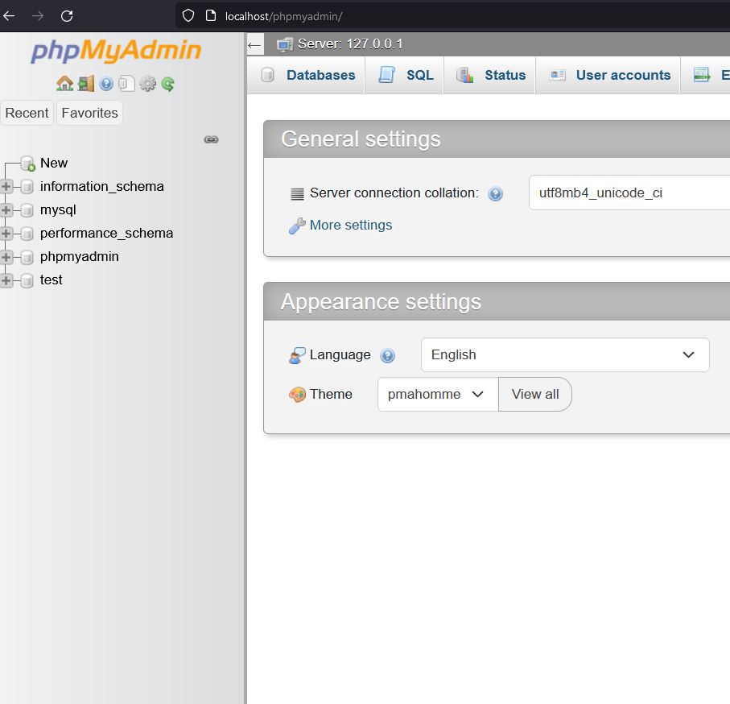
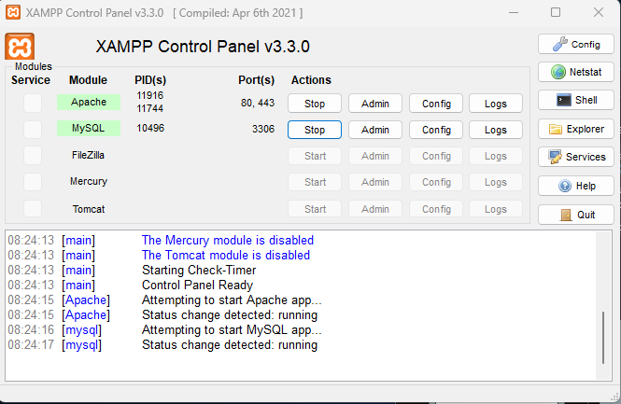
First off, turn on Xampp Apache and MySQL

Slide 4
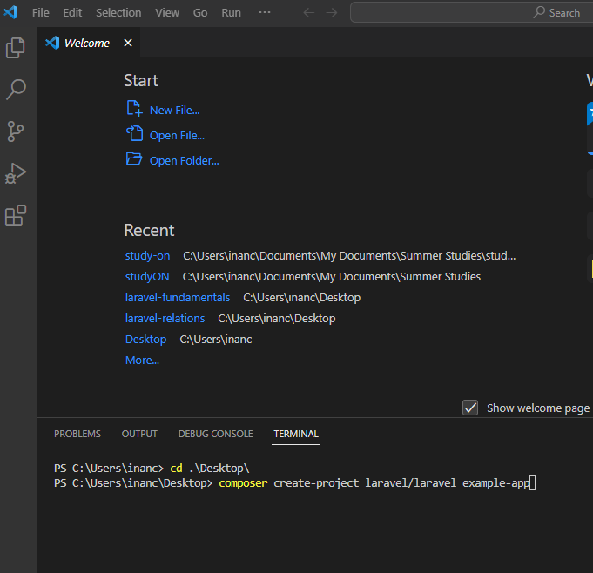
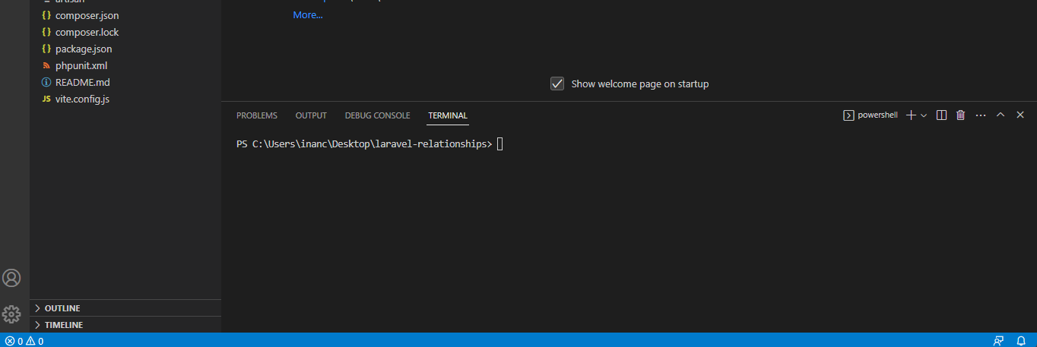
Create a new Laravel Project and set your environment ready. (I have used “laravel-relationships” instead of name “example-app” later on.)

Slide 5
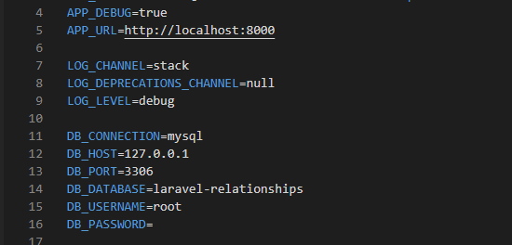
Use of “.env” file.
Setting-up DB Connection
- DB_DATABASE=<db-name>
Assigning URL that will be used
- APP_URL=<url-name>
- If want to use another port number rather than 8000:
- “php artisan serve –port=<num>”

Slide 6
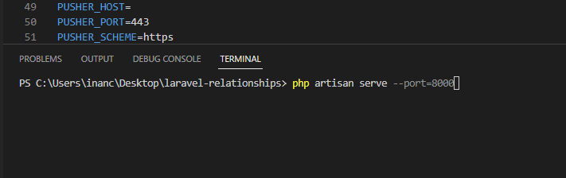
Start the project.

Slide 7
SCENERIO
We will cover a Student Model which will be interacting with Question Model.
Idea is that students can write questions for others ++ students will be answering the questions. In that case whoever solved the question will be recorded and then, related data can be retrieved.
(!) Student can write questions.
- Student HAS MANY questions.
(!) Question can be written by ONE Student.
- Question BELONGS TO a single Student.
(!) Student can solve questions AND Question can be solved by MANY students.
- MANY TO MANY RELATIONSHIP
(?) ONE TO ONE relationship will not be covered within the scenario since, it has the same implementations as HAS MANY && BELONGS TO.
- (EX) If Student has a Profile, then Student HAS ONE profile and Profile BELONGS TO a single Student.

Slide 8
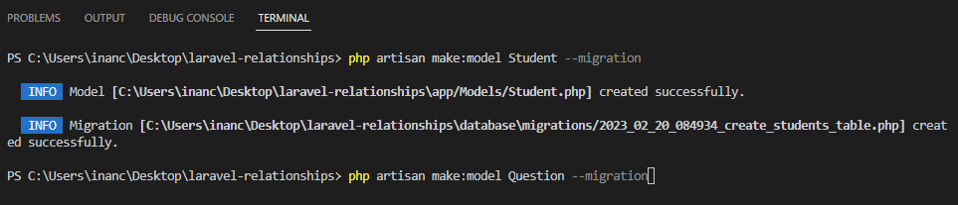
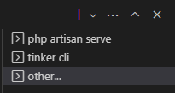
Create template Model and Migration files for our implementations.
- App\Models directory for Model files that been created.
- and Database\Migrations for Migration files.
(!) Open up an extra terminal for the commands since our project should continue to work at background.

Slide 9
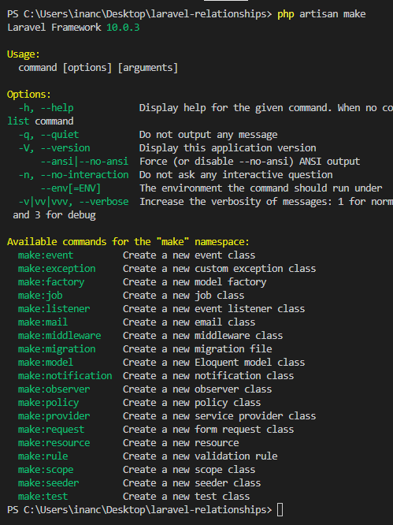
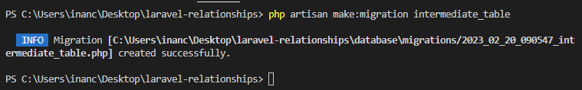
Since we will use an intermediate table for ManyToMany relationship, we need an extra migration to do.
(!) All other “php artisan” commands can be found as seen at right side.

Slide 10
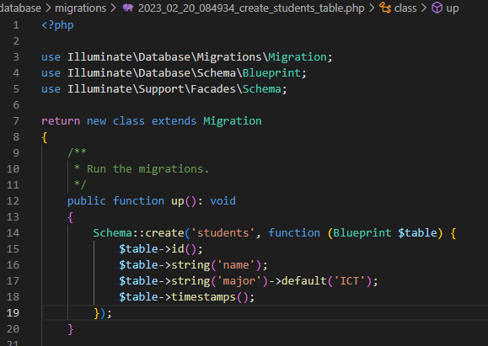
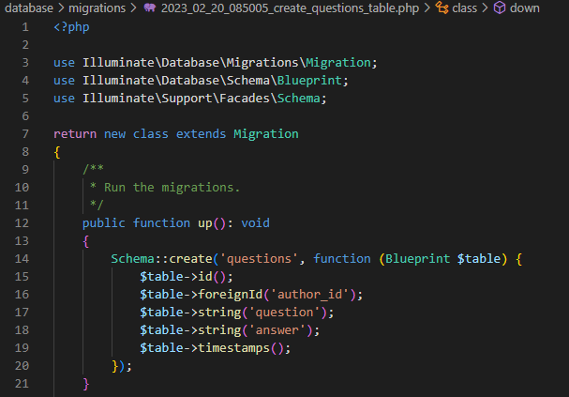
Fill in the necessary attributes for Database tables.
As seen, with “major”, default(‘ict’) “modifier” in use.
More options like this can be found in documentation/database:migration.

Slide 11
Student, simply, has a name and major.
Question, simply, has the question and the answer ++ author_id since it will be written by a Student(author).

Slide 12
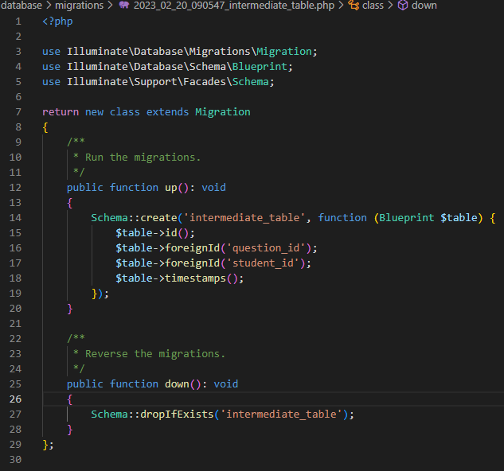
Intermediate Table Implementation for ManyToMany Relationship

Slide 13
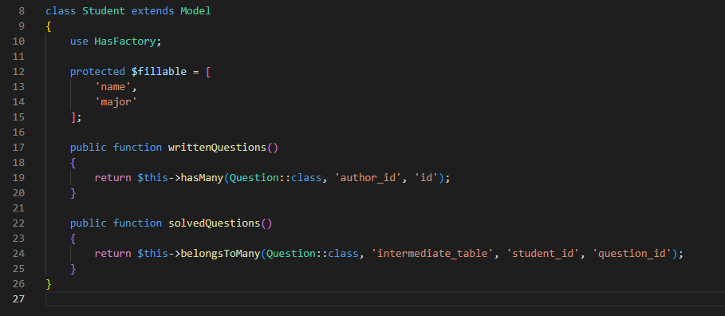
Student Model
$fillable: simply, the attributes that can be manipulated by the user.

Slide 14
Student Model
writtenQuestions(): User has many writtenQuestions.
author_id refers to the attribute within the Question Model, while “id” refers the attribute within the Student Model. So when retrieving writtenQuestion, these two attributes will be compared from both tables for the relationship.

Slide 15
Student Model
solvedQuestions():
When creating manyToMany relationships in Laravel, “belongsToMany” method will be used.
intermediate_table: name of the extra table to look up for in ManyToMany relationship.
student_id: PK of the Student Model in intermediate table
question_id: PK of the Question Model in intermediate table

Slide 16
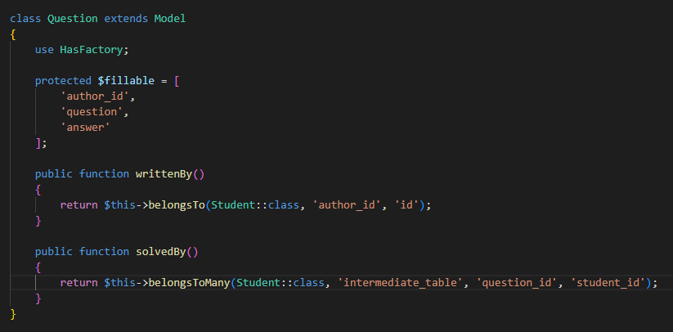
Question Model
Usually assigning an id as fillable not a good idea but this time, for the sake of simplicity, why not ?

Slide 17
Question Model
writtenBy():
Question belongsTo a Student.
author_id: id of the Student within the questions table.
id: id of the Student within the students table.

Slide 18
Question Model
solvedBy():
manyToMany as you predicted.
attributes are as explained before.

Slide 19

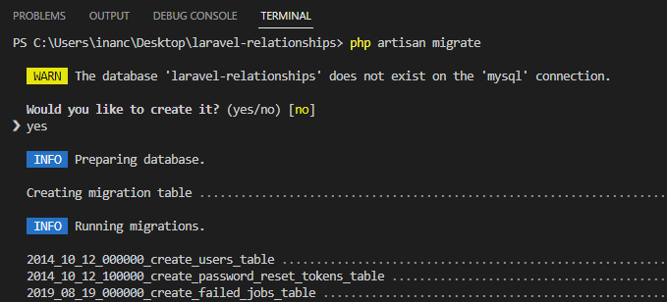
Since all necessary informations are filled, Models and Migration files are ready, lets migrate our Tables.

Slide 20
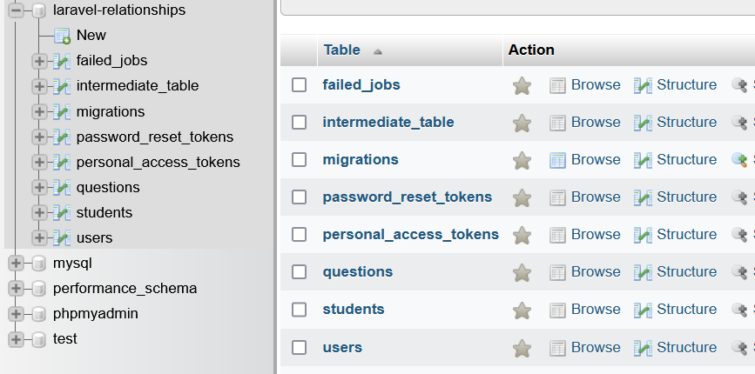
Since all necessary informations are filled, Models and Migration files are ready, lets migrate our Tables.

Slide 21
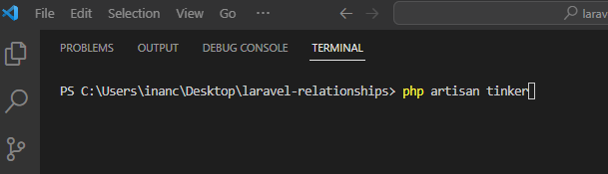
Since Our Implementations are complete, lets see if they work as intended!
With using Tinker we can create object and push them into database, use the methods we have created for the relationships and see if everything is working as planned.

Slide 22
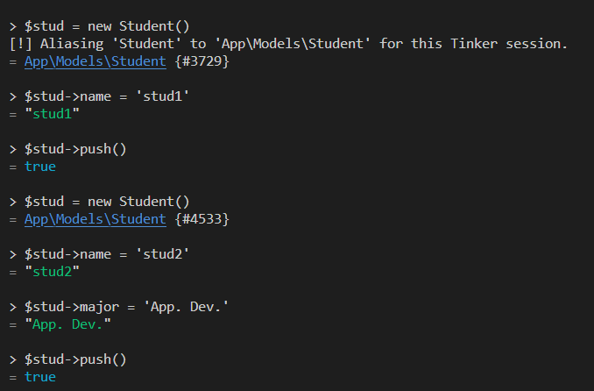
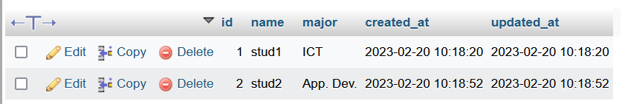
An easy way to interact with models.

Slide 23
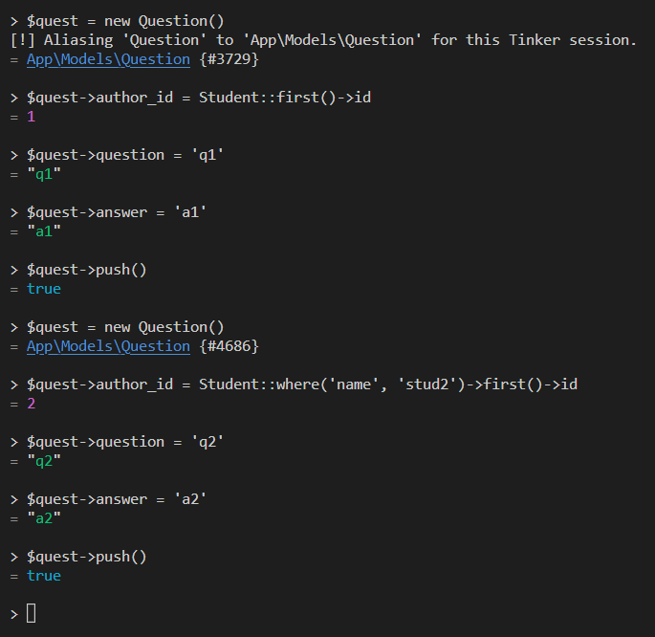
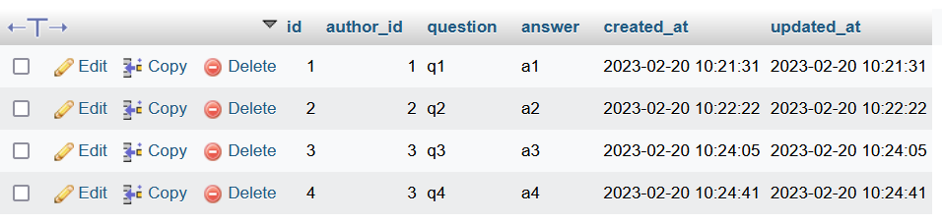

Slide 24
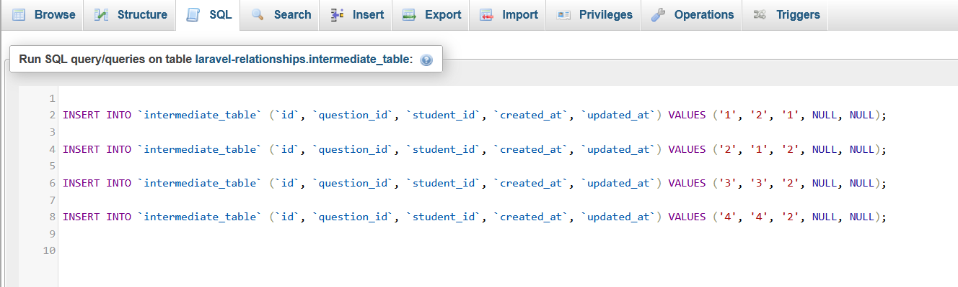
Suppose that:
- stud1 solved question2.
- stud2 solved question1, 3 and 4.

Slide 25
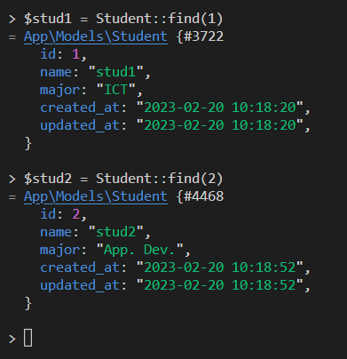
find(PK):
- Will find the object with the given id.

Slide 26
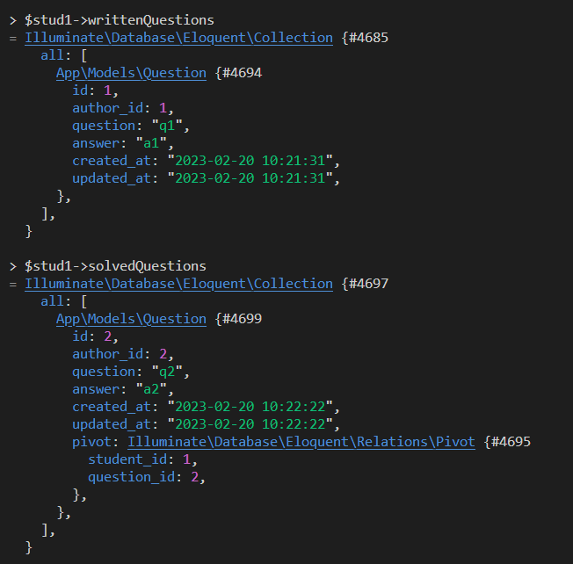
Stud1 can retrieve the correct information!
Laravel Collections are arrays with built-in methods which make things way too easy. More info @documentation.

Slide 27
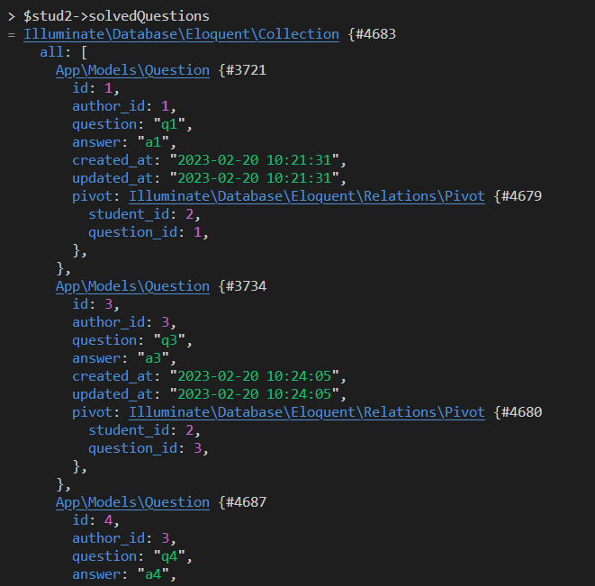
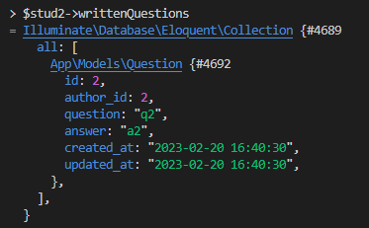
Stud2 can retrieve the correct information!

Slide 28
Stud2 can retrieve the correct information!

Slide 29
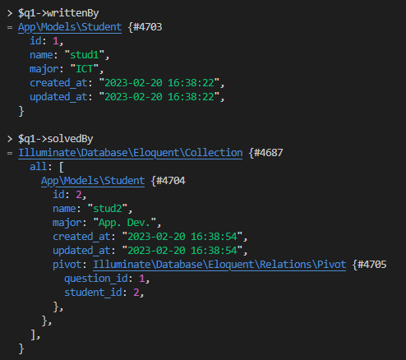
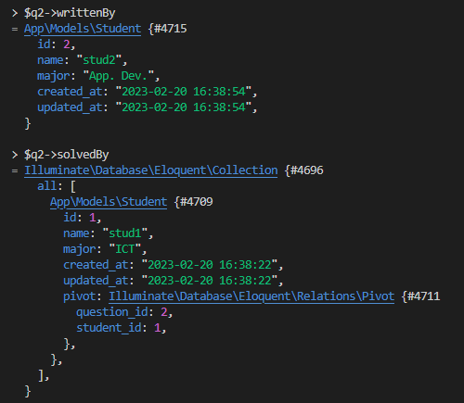

Slide 30
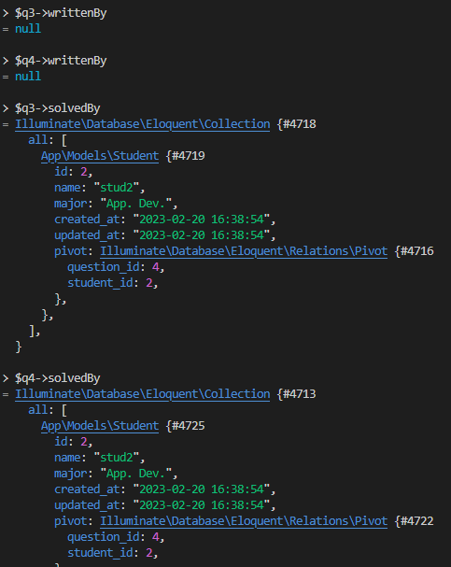
I have assigned q3 & q4 author_id’s with using integer value “3”. Since there is no student with the releated id number, they return “null”.

Slide 31
Since we have been able to make it sure that relationships are working as we intended, rest will be much easier!
Next Step:
- Route implementations.
- Controller implementations with Validations.
- Structuring view files with HTML && Tailwind CSS.

Slide 32
And we are done.

