Slide 2
LARAVEL BASICS Part-2 (DB SEEDING)
Inanc Alp Gunalp

Slide 3
With this presentation you will see:
- Laravel Breeze User Authentication
- Will provide you a User Model and migrations ++ authentication system.
- When done correctly, “Login and Register” options will be seen at the top right corner of the “welcome” page.
- Then you are able to create user accounts for your application!
- Laravel Database:Seeding
- Laravel Eloquent:Factories

Slide 4
Set Laravel Breeze with following the documentation.
https://laravel.com/docs/10.x/starter-kits
If already have migrations in the project:
- php artisan migrate:fresh
- php artisan migrate:refresh
- (what is the difference?)

Slide 5
I have changed the Student model as, only including attribute: “major”.
- Since User Model include all other necessary user information ++ for the sake of continuity of this series, student model and relationships with Question Model will be the same.

Slide 6
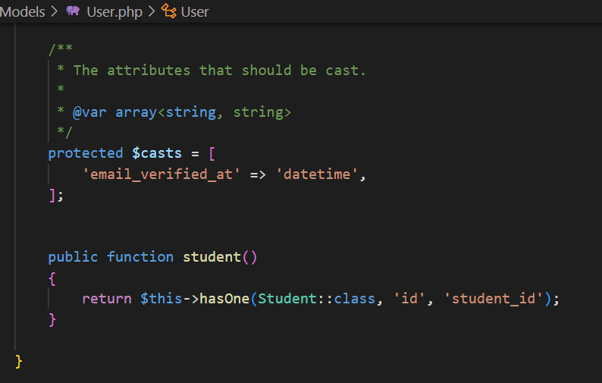
One to One relationship between User Model and Student Model.
- I have fetched the relationship only from the User Model since User is the essential Model to reach for the Student Model.
- If you want, you can fetch it from the Student Model too.
https://laravel.com/docs/10.x/eloquent-relationships

Slide 7
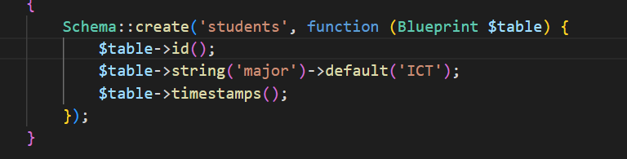
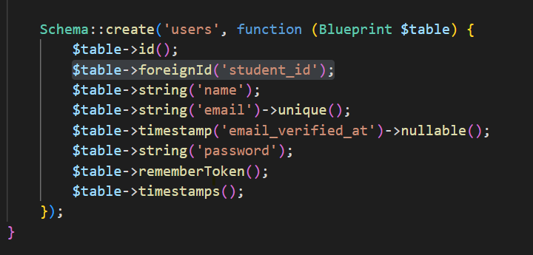
(!) Finish it up with a fresh migration for sure.
https://laravel.com/docs/10.x/eloquent-relationships

Slide 8
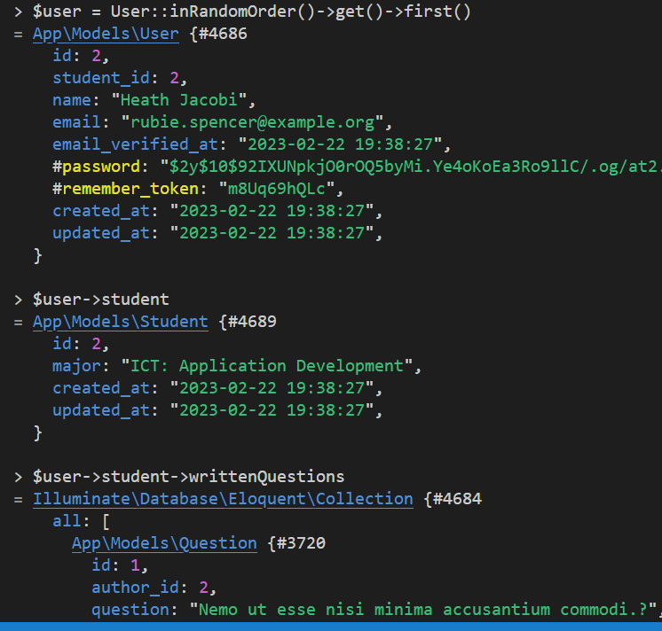
@ the end, expected end result will be as seen in examples:
(Tinker in use)

Slide 9
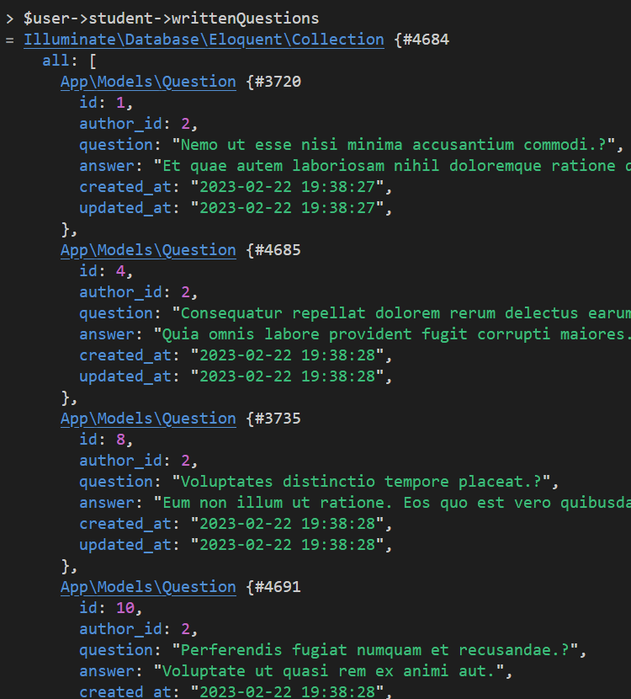
@ the end, expected end result will be as seen in examples:

Slide 10
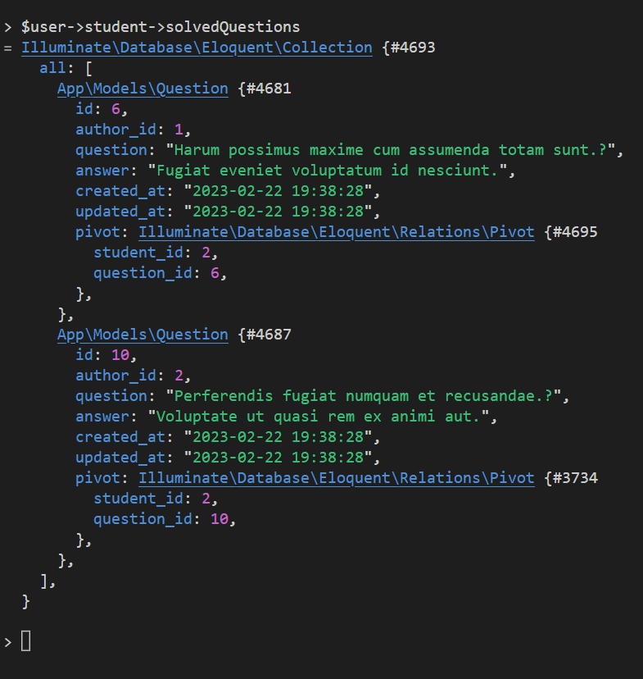
@ the end, expected end result will be as seen in examples:

Slide 11
Seeding?? Factories??
- We will also use PHP Faker(fake()) with Factory Class to define our logic.
https://fakerphp.github.io/formatters/
- Then will call our factory methods within our defined Seeder method, with the necessary orders.
- There should be a default App\Databe\Seeders\DatabaseSeeder.php file already.
- As well as App\Databe\Seeders\UserFactory.php
What is going on?? Stick around for a bit…
https://laravel.com/docs/10.x/eloquent-factories
https://laravel.com/docs/10.x/seeding

Slide 12
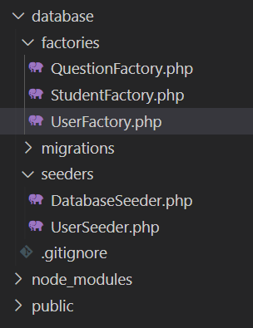
DataBaseSeeder.php will be enough for our example.
- if not-exist : php artisan make:seeder DatabaseSeeder
++ We need Question and Student Factories ready too.
php artisan make:factory QuestionFactory
php artisan make:factory StudentFactory

Slide 13
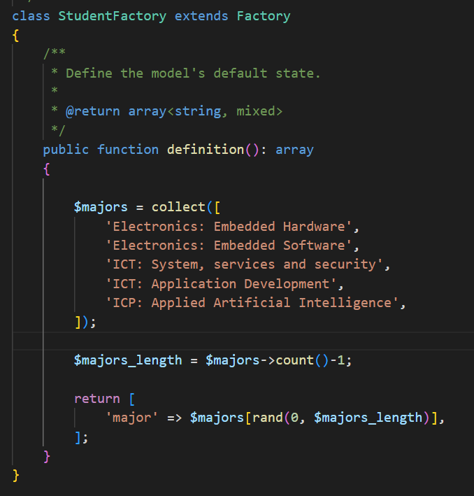
StudentFactory.php
What it Does??
- Simply, creates a student Entity with major randomly selected from the defined collection.
Okaay.. But where is the initial Model defined for Student Model, which is the “User” ??

Slide 14
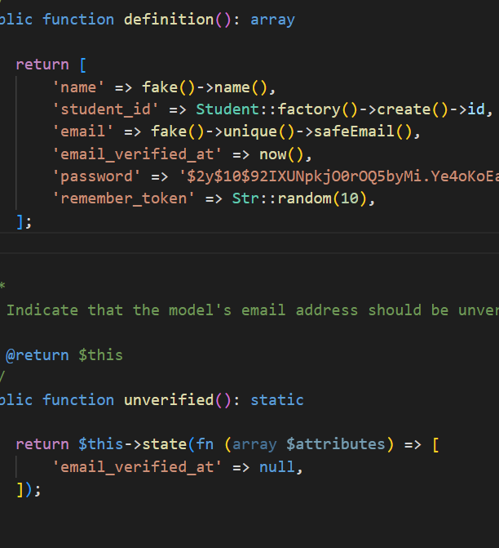
UserFactory.php
(!) All implementation is pre-defined within Laravel at this stage.
Except ‘student_id’ => Student::fac…
- Calls StudentFactory class to create an object. Then grabs the id of that object as “student_id”.
(!) at that stage Student object been recorded to DB. Means that, order of steps taken (such like..most programing languages?) are important which we will see soon.

Slide 15
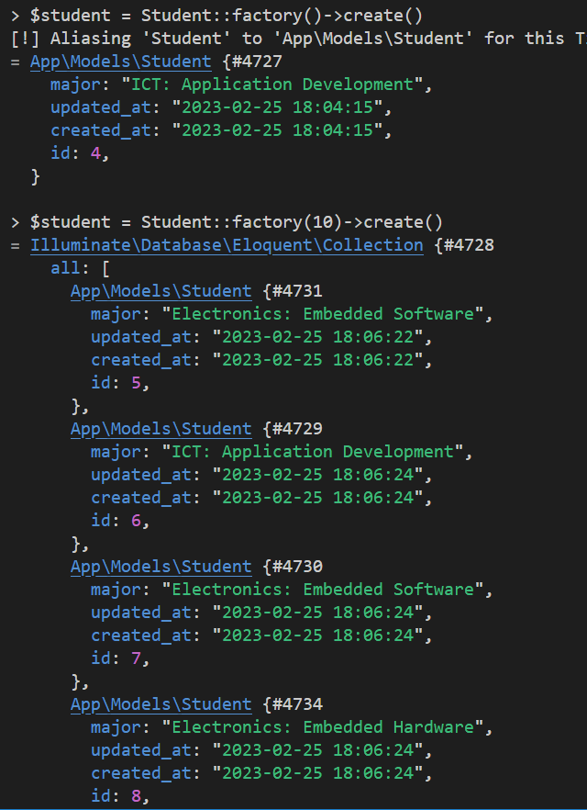
Reminder
You can always test your logic within Tinker.

Slide 16
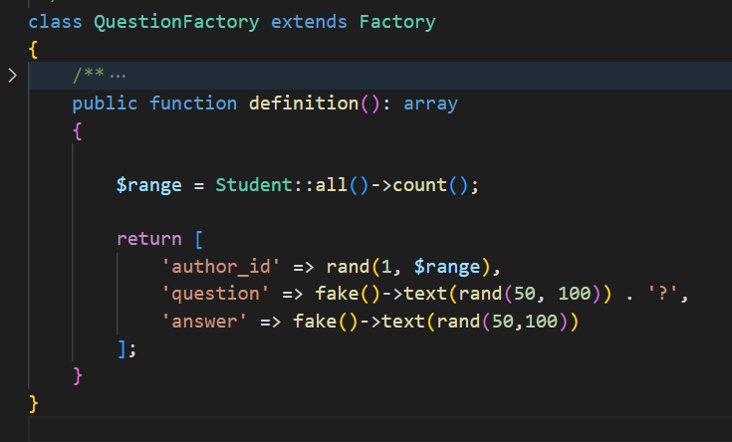
QuestionFactory.php
Randomly assigning question to a student.

Slide 17
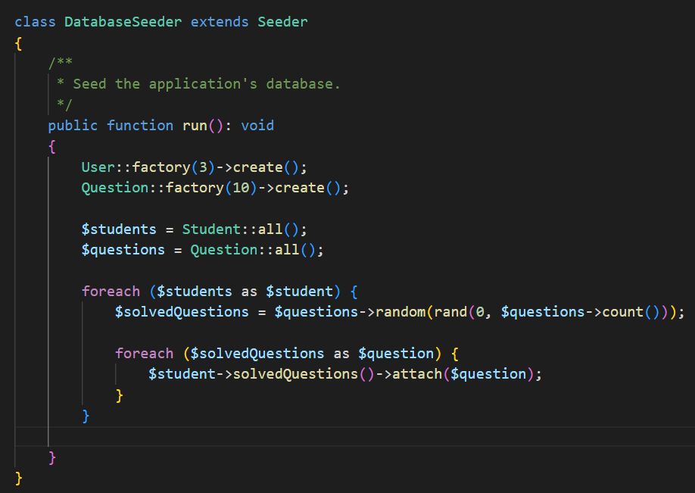
Getting it all together with:
DatabaseSeeder.php

Slide 18
Getting it all together with:
DatabaseSeeder.php
Simply, creating 3 User and 10 Questions.
Reminder: StudentFactory is implemented already within UserFactory.

Slide 19
Getting it all together with:
DatabaseSeeder.php
Retrieving all the students and questions that we have just created into variables as collections.
Then attaching some random amount of randomly selected questions into each students.
(!) Do notice when using “attach()”, state will be recorded into the “intermediate_table” we have created for the ManyToMany relationship. (if confusing: refer to the first presentation.)

Slide 20
Finally:
php artisan migrate:fresh –seed
Check your db.
And we are done.

