Slide 1


Energy Consumption Analysis of AI Algorithms for Predicting RUL(Remaining Useful Life)
Using LSTM, Random Forest, and XGBoost
Serhat Ege İnanç
22/05/2024

Slide 2
Introduction
Goal: Predict the Remaining Useful Life (RUL) of fuel cells.
Algorithms Used: LSTM, Random Forest, XGBoost.
Focus: Analyze and compare the energy consumption of these algorithms using the Perun library.
Data Source: Dataset "IEEE PHM 2014 Data Challenge.".
Execution Method: Parallelism with CPU cores. Utilizes Python's ‘concurrent.futures’ module to achieve parallelism.

Slide 3
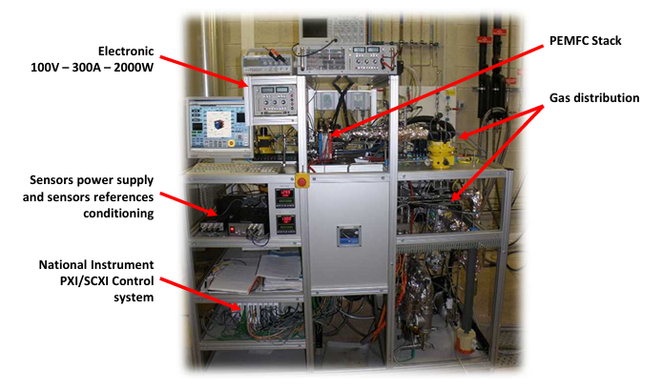
Data Source
Fuel Cell Machine
IEEE PHM 2014 Data Challenge.
1020 hours of measurement of Voltage, Temperature, Current(I), Resistance(𝞨) ect. With Fuel Cell machine.
IEEE 2014 Data Challenge https://repository.lboro.ac.uk/articles/dataset/IEEE_2014_Data_Challenge_Data/3518141

Slide 4
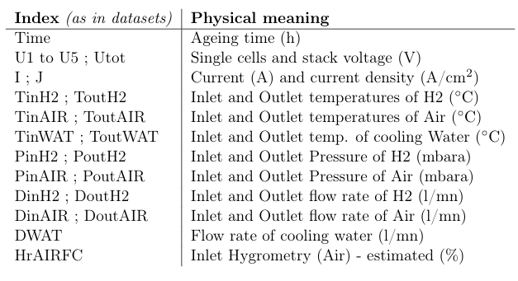
Data Source(Every Feature)

Slide 5
Why Predict RUL?
Importance: Ensures reliability and efficiency of energy systems.
Applications: Prevents unexpected failures, reduces maintenance costs, improves safety.
L. Ren, L. Zhao, S. Hong, S. Zhao, H. Wang and L. Zhang, "Remaining Useful Life Prediction for Lithium-Ion Battery: A Deep Learning Approach," in IEEE Access, vol. 6, pp. 50587-50598, 2018, doi: 10.1109/ACCESS.2018.2858856.

Slide 6
Algorithms Overview
LSTM: Suitable for time series prediction, captures long-term dependencies.
Random Forest: Ensemble method, robust to overfitting.
XGBoost: Efficient, high performance, handles sparse data well.
Hochreiter, Sepp & Schmidhuber, Jürgen. (1997). Long Short-term Memory. Neural computation. 9. 1735-80. 10.1162/neco.1997.9.8.1735.
Tin Kam Ho, "Random decision forests," Proceedings of 3rd International Conference on Document Analysis and Recognition, Montreal, QC, Canada, 1995, pp. 278-282 vol.1, doi: 10.1109/ICDAR.1995.598994.
Tianqi Chen and Carlos Guestrin. XGBoost: A Scalable Tree Boosting System. In 22nd SIGKDD Conference on Knowledge Discovery and Data Mining, 2016

Slide 7
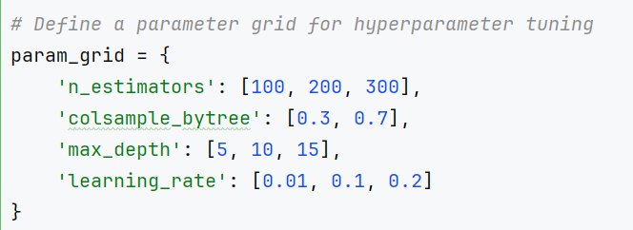
Algorithms Configurations
LSTM:
Epochs: 100
Learning Rate: 0.03
Batch size: 32
XGBoost:
Learning rate: 0.1
N estimator: 100
Max depth: 10
Random Forest:
N estimator: 50
Random state: 42
Shuffle: False
Maximizing accuracy is top priority !
Using Grid Search library greatly helps to find the most efficient parameters.

Slide 8
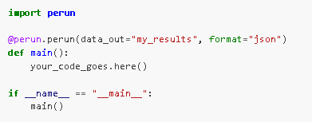
Perun* Library
Python package that calculates the energy consumption of Python scripts.
Calculates from Intel RAPL, Nvidia-NVML, and psutil.
Gathers data from hundreds of nodes, and accumulate it efficiently.
*:Gutiérrez Hermosillo Muriedas, J.P., Flügel, K., Debus, C., Obermaier, H., Streit, A., Götz, M.: perun: Benchmarking Energy Consumption of High-Performance Computing Applications. In: Cano, J., Dikaiakos, M.D., Papadopoulos, G.A., Pericàs, M., and Sakellariou, R. (eds.) Euro-Par 2023: Parallel Processing. pp. 17–31. Springer Nature Switzerland, Cham (2023). https://doi.org/10.1007/978-3-031-39698-4_2.

Slide 9
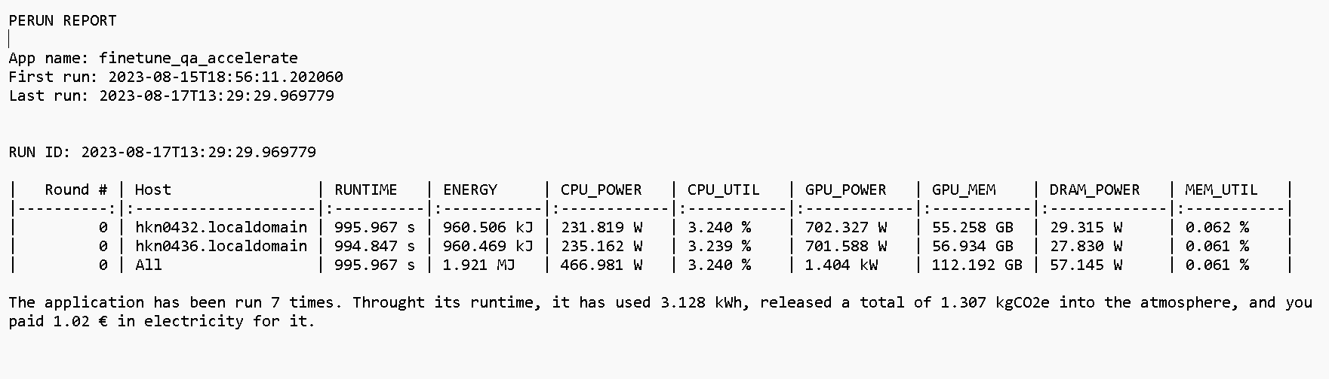
Perun Library

Slide 10
Perun Library
Advantages:
Reliable energy measurement.
Compatible with Intel and Nvidia
Easy to use, easy to read
Disadvantages:
Only compatible with Intel and Nvidia therefore basic cycle calculation may be required for some of the systems.

Slide 11
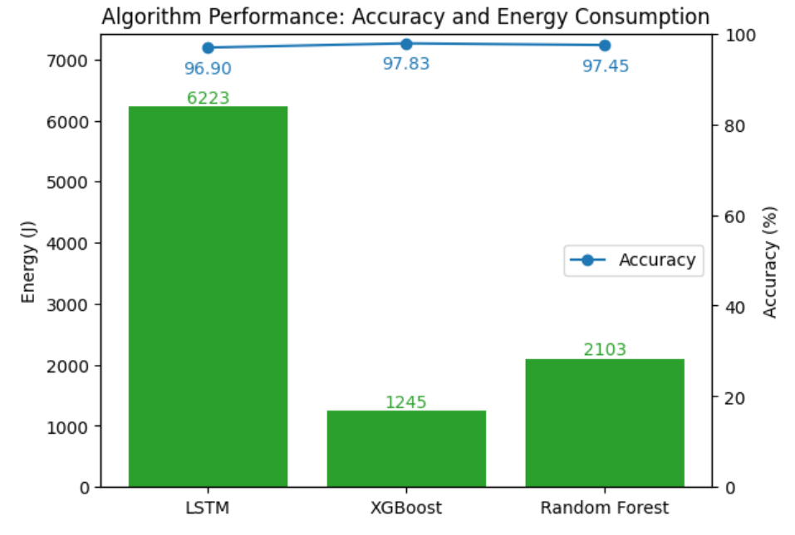
Experimental Evaluation ⅓ (1 Cores)
Observations:
LSTM: High energy consumption (~6000 J).
XGBoost: Low energy consumption (~1000 J).
Random Forest: Moderate energy consumption (~2000 J).

Slide 12
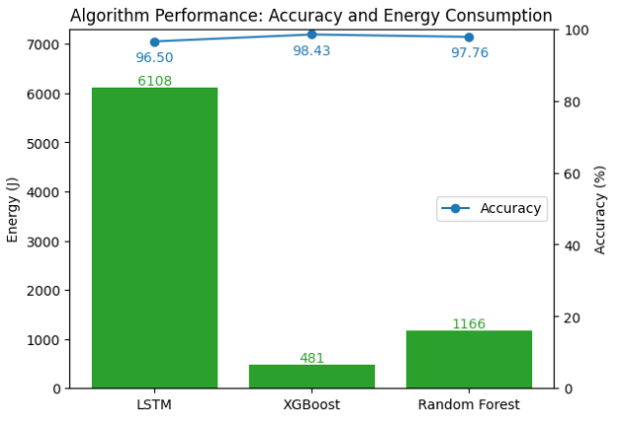
Experimental Evaluation ⅔ (2 Cores)
Observations:
LSTM: High energy consumption (~6000 J).
XGBoost: Low energy consumption (~500 J).
Random Forest: Moderate energy consumption (~1000 J).

Slide 13
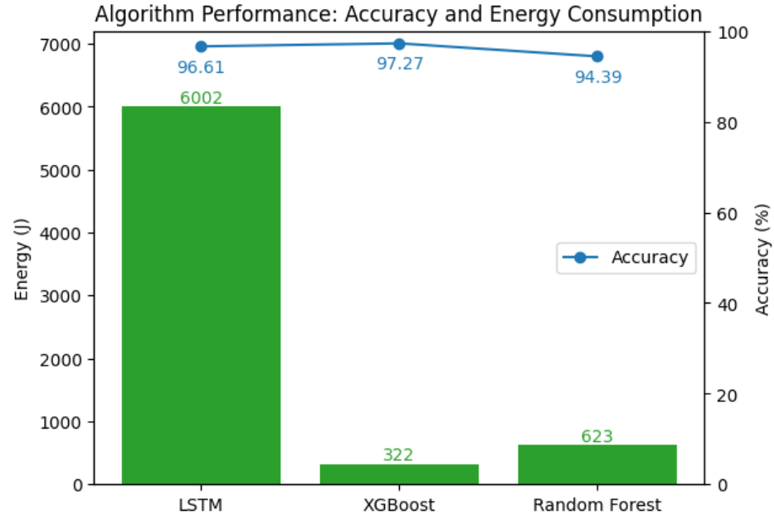
Experimental Evaluation 3/3 (4 Cores)
Observations:
LSTM: High energy consumption (~6000 J).
XGBoost: Low energy consumption (~300 J).
Random Forest: Moderate energy consumption (~600 J).

Slide 14
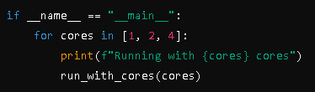
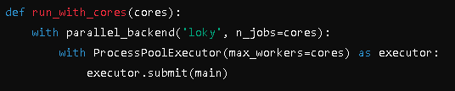
Detailed Analysis
Parallelism: Using ‘concurrent.futures’ library synchronously executes functions with 1, 2, 4 cores.
LSTM: High energy due to sequential processing nature, limited parallelization benefits.
Random Forest: Benefits from parallel processing, energy decreases with more cores.
XGBoost: Efficient parallel processing, maintains low energy consumption.

Slide 15
CPU Cycle* Numbers Calculation
LSTM - Random Forest - XGBoost
1 Core execution:
2 Core execution:
4 Core execution:
560,548,821,013 - 158,326,919,618 - 603,094,170
415,872,660,315 - 133,045,281,006 - 480,407,293
362,287,058,454 - 124,923,715,136 - 336,727,234
*: A. Wespi and E. H. Rothauser, "Utilizing idle CPU cycles in a distributed computing system," Proceedings of the IEEE 1997 National Aerospace and Electronics Conference. NAECON 1997, Dayton, OH, USA, 1997, pp. 173-180 vol.1, doi: 10.1109/NAECON.1997.617777.

Slide 16
Conclusion
LSTM: High accuracy but high energy consumption, less efficient with more cores. High CPU cycle usage due to sequential processing and complex cell operations.
Random Forest: Good balance with reduced energy using more cores. High CPU usage due to the need for building numerous decision trees with multiple splits and evaluations.
XGBoost: Most energy-efficient, maintains high accuracy. Lower CPU cycle usage due to efficient implementation, system optimizations, and parallel processing capabilities.
Future Work: Explore optimization techniques, different hardware configurations, and more energy-efficient algorithms.

Slide 17
References
IEEE 2014 Data Challenge https://repository.lboro.ac.uk/articles/dataset/IEEE_2014_Data_Challenge_Data/3518141
Hochreiter, Sepp & Schmidhuber, Jürgen. (1997). Long Short-term Memory. Neural computation. 9. 1735-80. 10.1162/neco.1997.9.8.1735.
Tin Kam Ho, "Random decision forests," Proceedings of 3rd International Conference on Document Analysis and Recognition, Montreal, QC, Canada, 1995, pp. 278-282 vol.1, doi: 10.1109/ICDAR.1995.598994.
Tianqi Chen and Carlos Guestrin. XGBoost: A Scalable Tree Boosting System. In 22nd SIGKDD Conference on Knowledge Discovery and Data Mining, 2016
Gutiérrez Hermosillo Muriedas, J.P., Flügel, K., Debus, C., Obermaier, H., Streit, A., Götz, M.: perun: Benchmarking Energy Consumption of High-Performance Computing Applications. In: Cano, J., Dikaiakos, M.D., Papadopoulos, G.A., Pericàs, M., and Sakellariou, R. (eds.) Euro-Par 2023: Parallel Processing. pp. 17–31. Springer Nature Switzerland, Cham (2023). https://doi.org/10.1007/978-3-031-39698-4_2.

