Slide 1



Improve the efficiency of your Big Data application

Slide 2
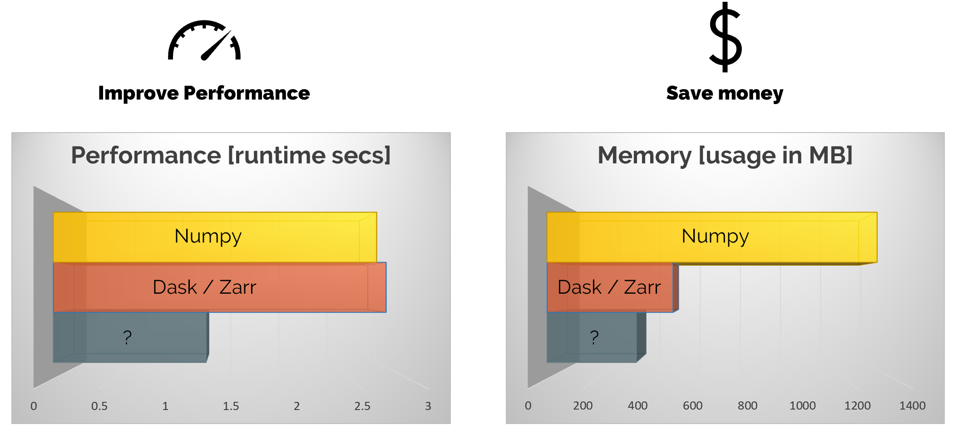
What does it mean

Slide 3
Who we are
Francesc
  Physicist by training
  Computer scientist by passion
  Open Source enthusiast by philosophy
  Founder and main developer of Blosc and PyTables
Christian
  Technologist - in love with efficiency
  Previously engaged with high-frequency trading
  Performance tuning from top (business-process) to bottom (assembly)

Slide 4
How can this be achieved
Fuse computation with compression as closely as possible
Fast compression / Save resources / do more with less
Reduce memory-copies (Zero copy)
Open Data-Format
...

Slide 5
Fast compression
Introduce Blosc

Slide 6
Multi-Dimensional Containers
Introduce Caterva

Slide 7
Adding Computational Engine
LLVM
User-defined functions
Chaining expressions (expressions)

Slide 8
ironArray
Putting it all together

Slide 9
Benchmarks
Data < Memory
  Slicing
  evaluation
Data > Memory (optional)
Add as many slides as possible

Slide 10
DEMO
Interactive
Python API / Examples

Slide 11
Questions
...

