Slide 1

Log-in

Slide 2
Employee Phase

Slide 3
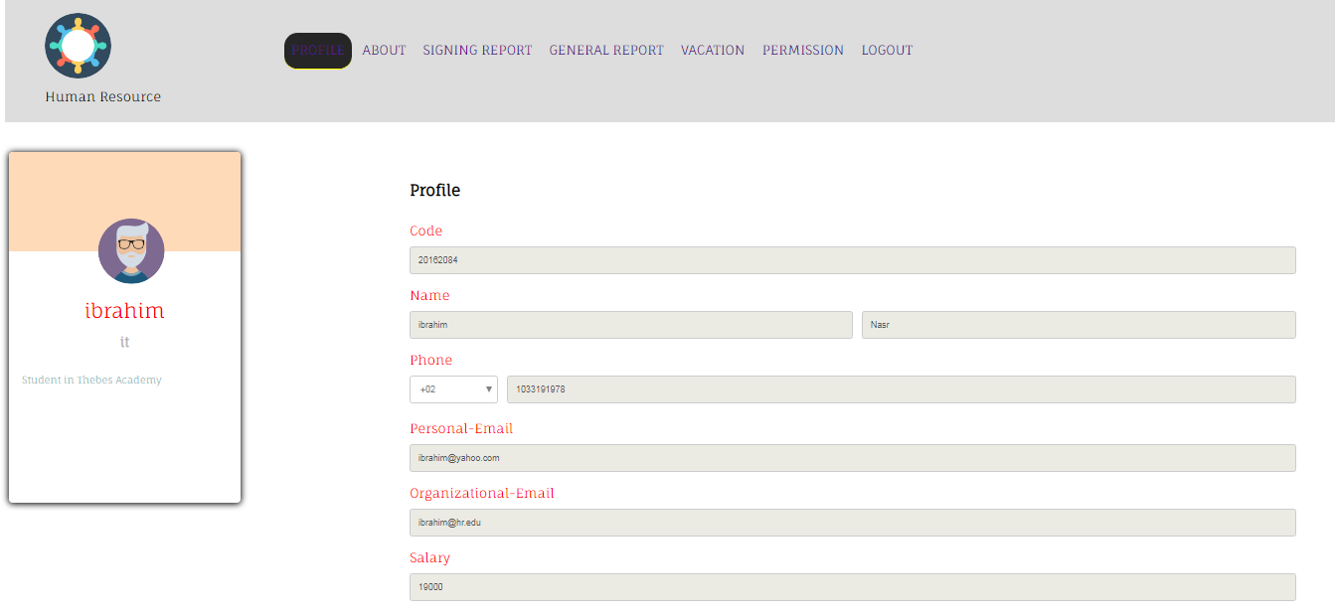
Employee-profile

Slide 4
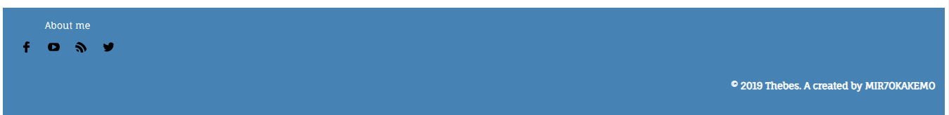
Employee-about

Slide 5
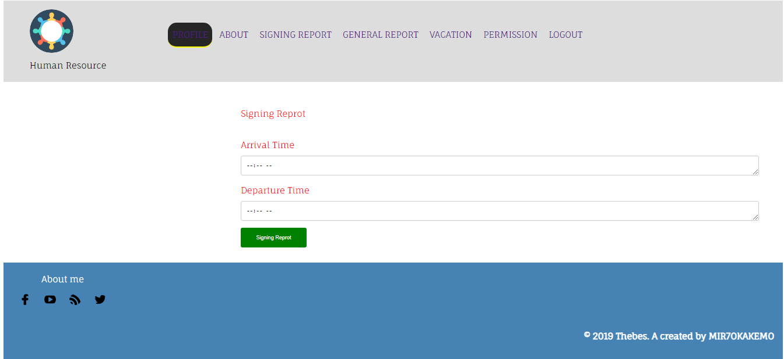
Employee-signing report

Slide 6
Employee-signing report

Slide 7
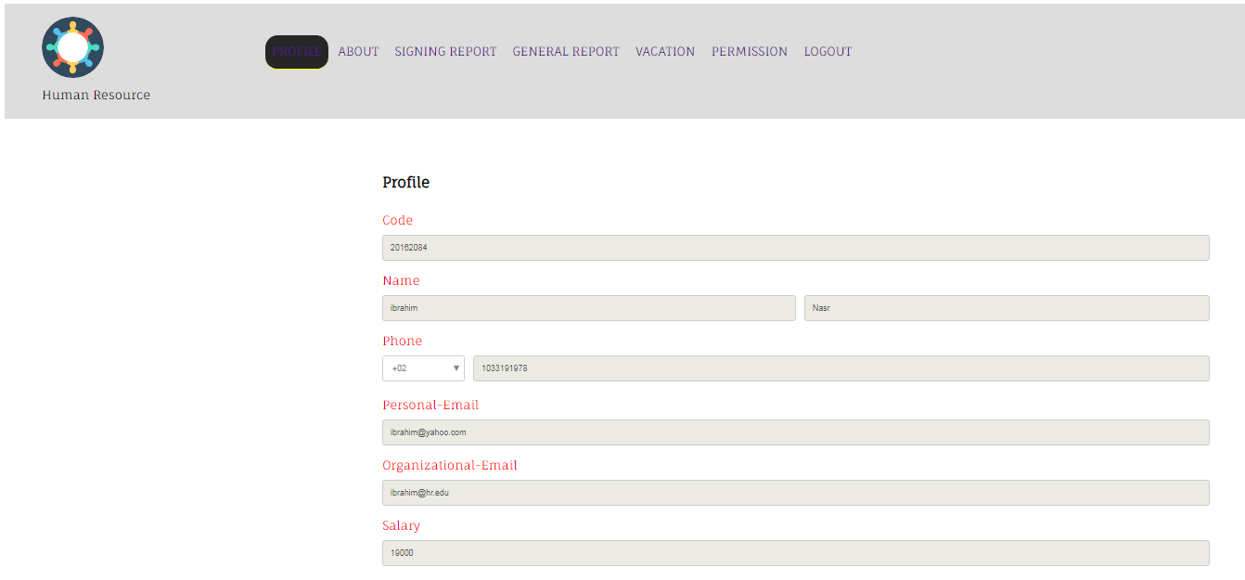
Employee-General report

Slide 8
Employee-General report

Slide 9
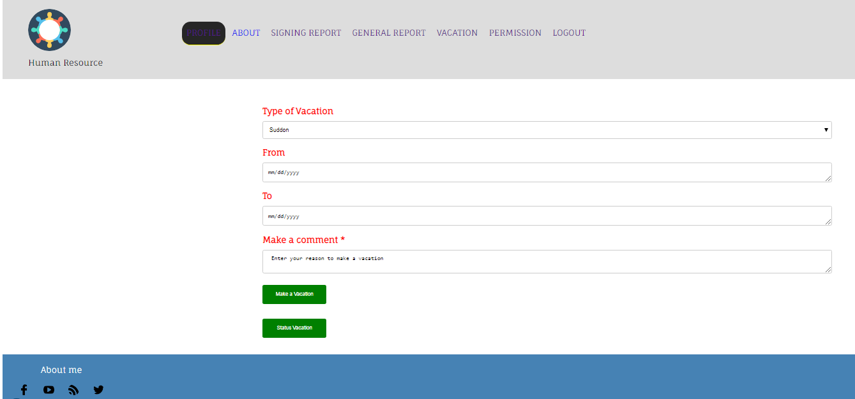
Employee-Vacation

Slide 10
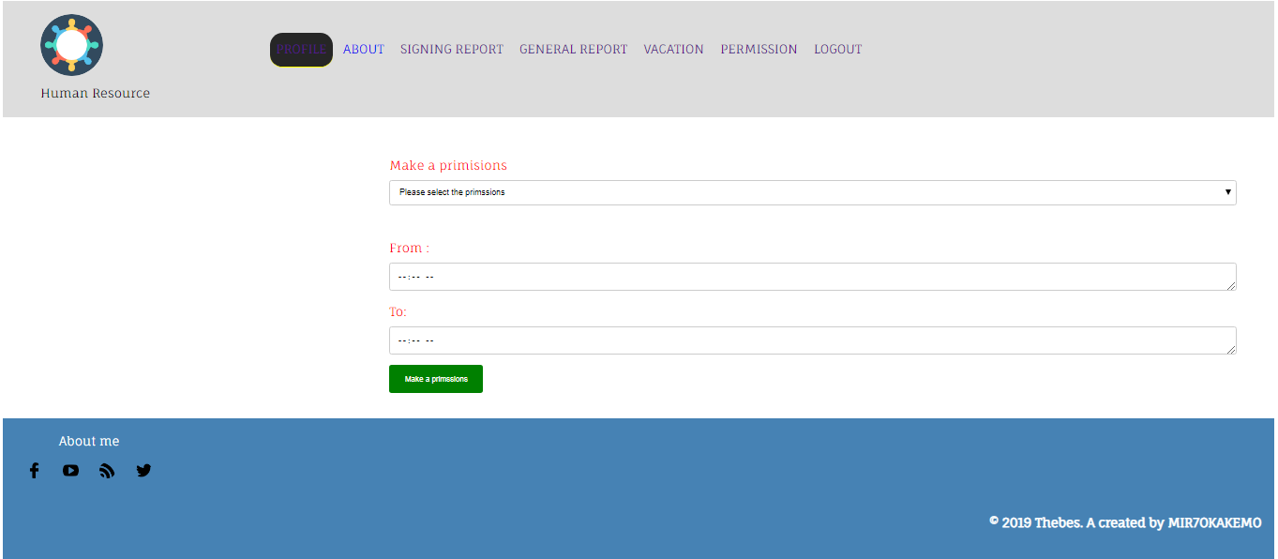
Employee-make a permission

Slide 11
Admin Phase

Slide 12
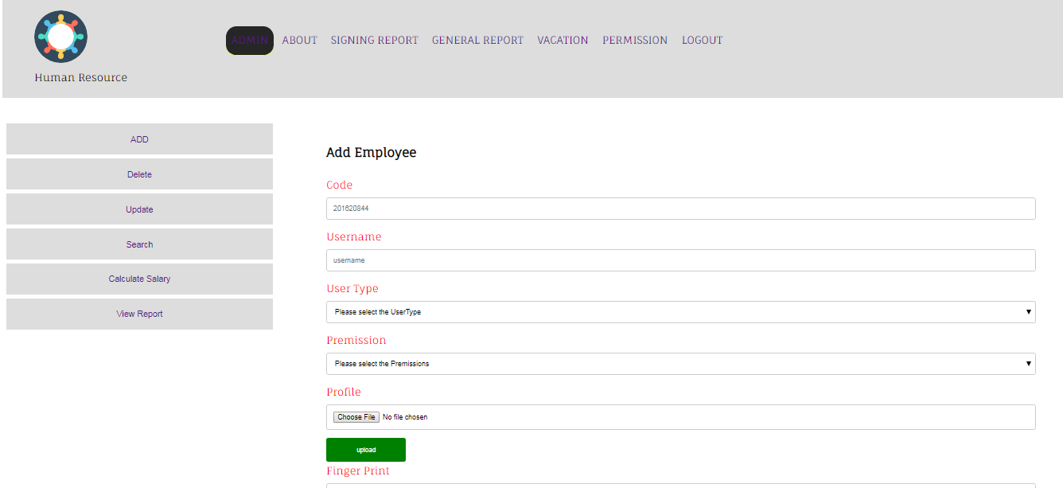
Admin-Add employee

Slide 13
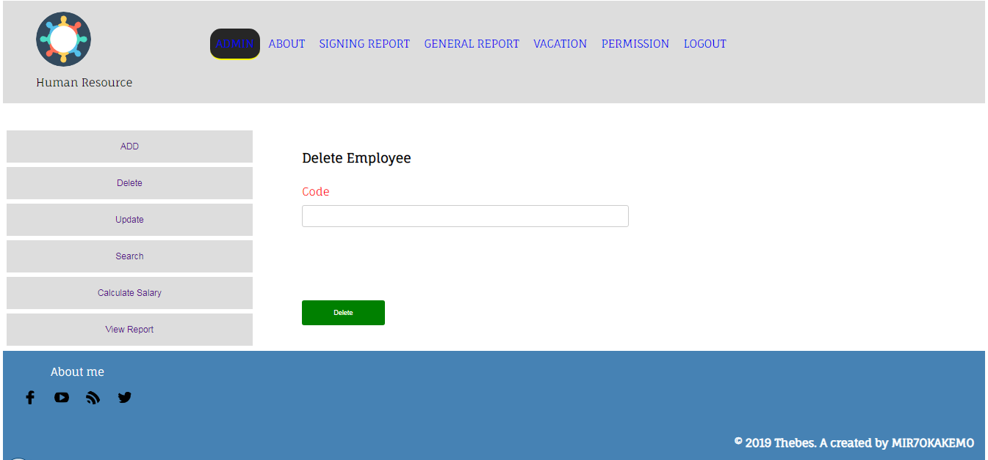
Admin-Delete employee

Slide 14
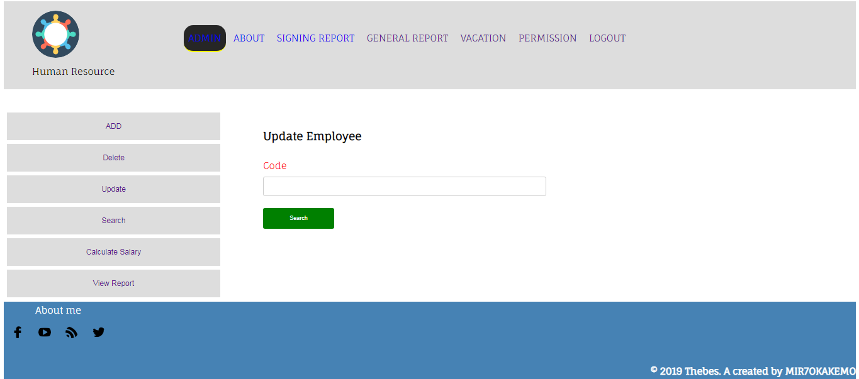
Admin-Update employee

Slide 15
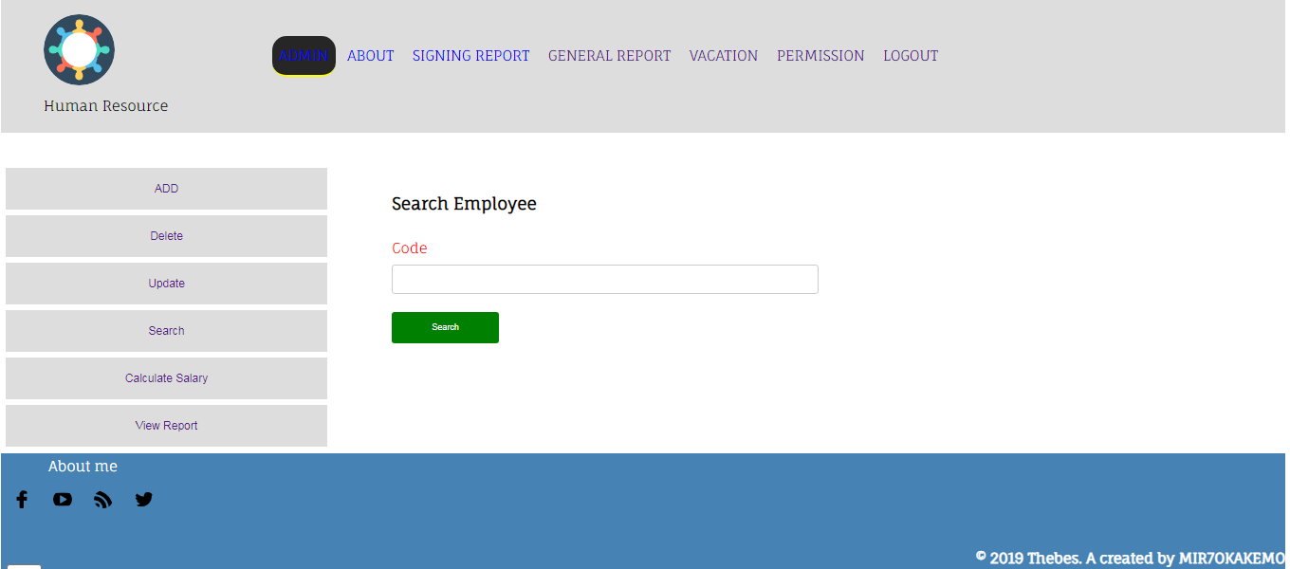
Admin-Search employee

Slide 16
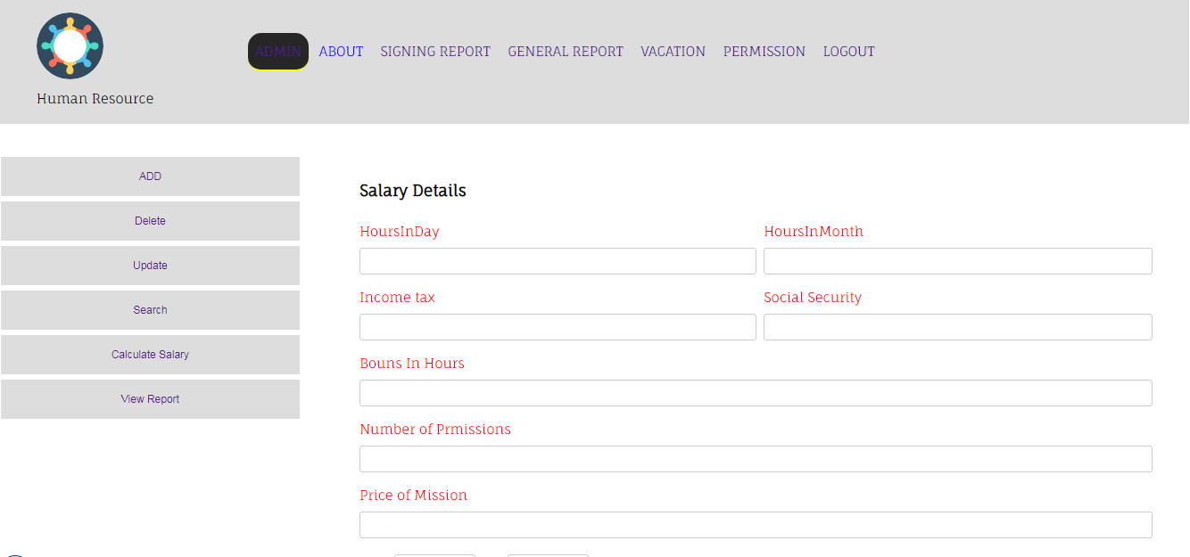
Admin- Calculate Salary employee

Slide 17
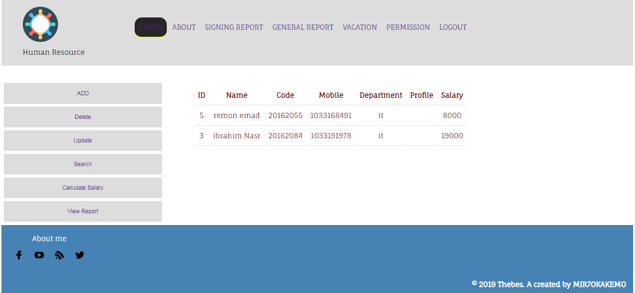
Admin- View report employee

Slide 18
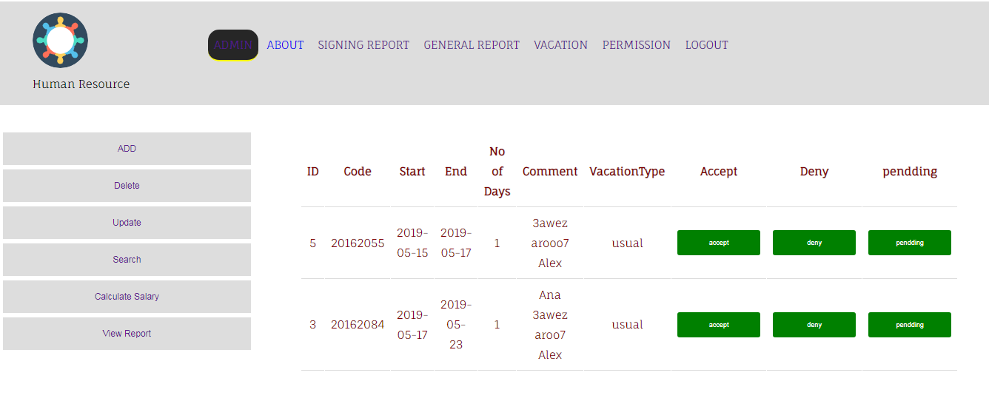
Admin- request employee

Slide 19
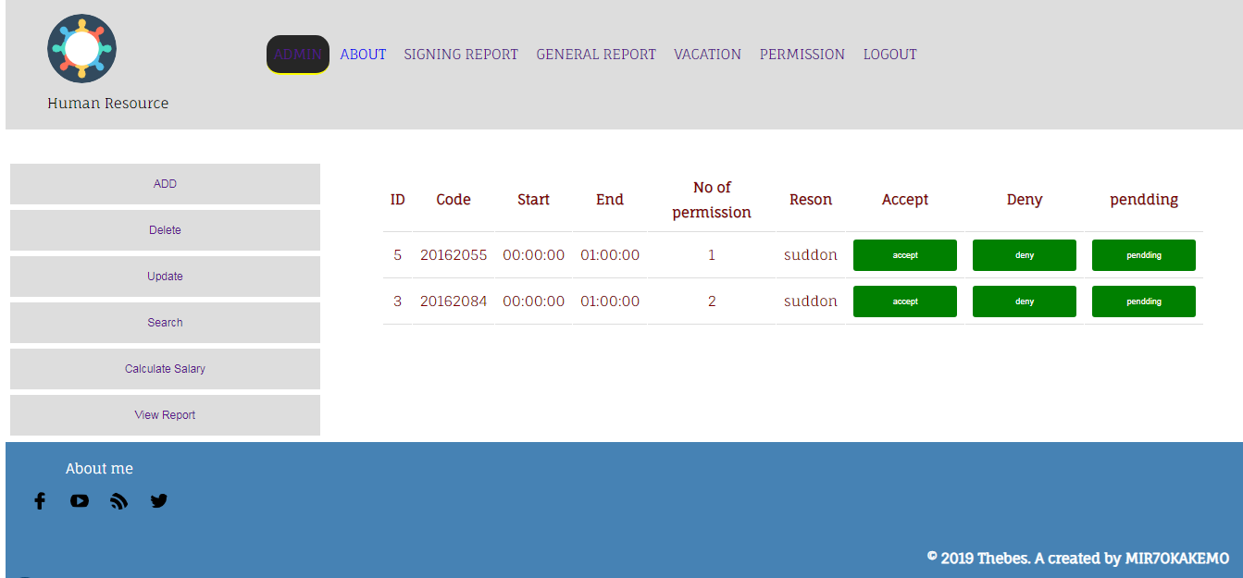
Admin- request permission employee

Slide 20
Owner Phase

Slide 21
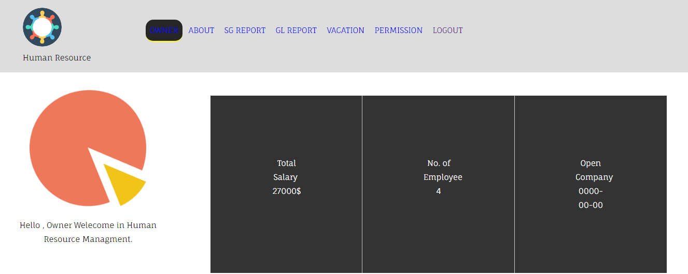
Owner Profile

Slide 22
Log out

