Slide 1
Predicting Blood Glucose
Time Series Analysis

Slide 2
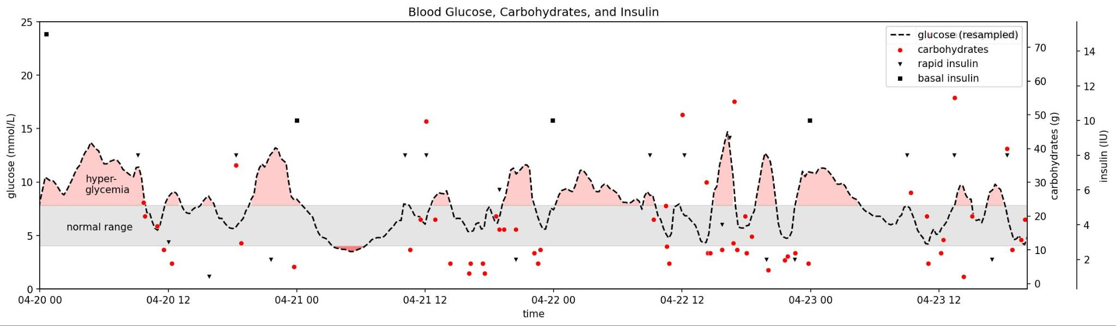
Blood glucose out of range requires frequent adjustments …
Notes:
Peaks of high blood glucose are undesirable (atherogenic).
A measure of how well glucose is under control is not just the average blood glucose value, but equally important is the ‘time in target’.

Slide 3
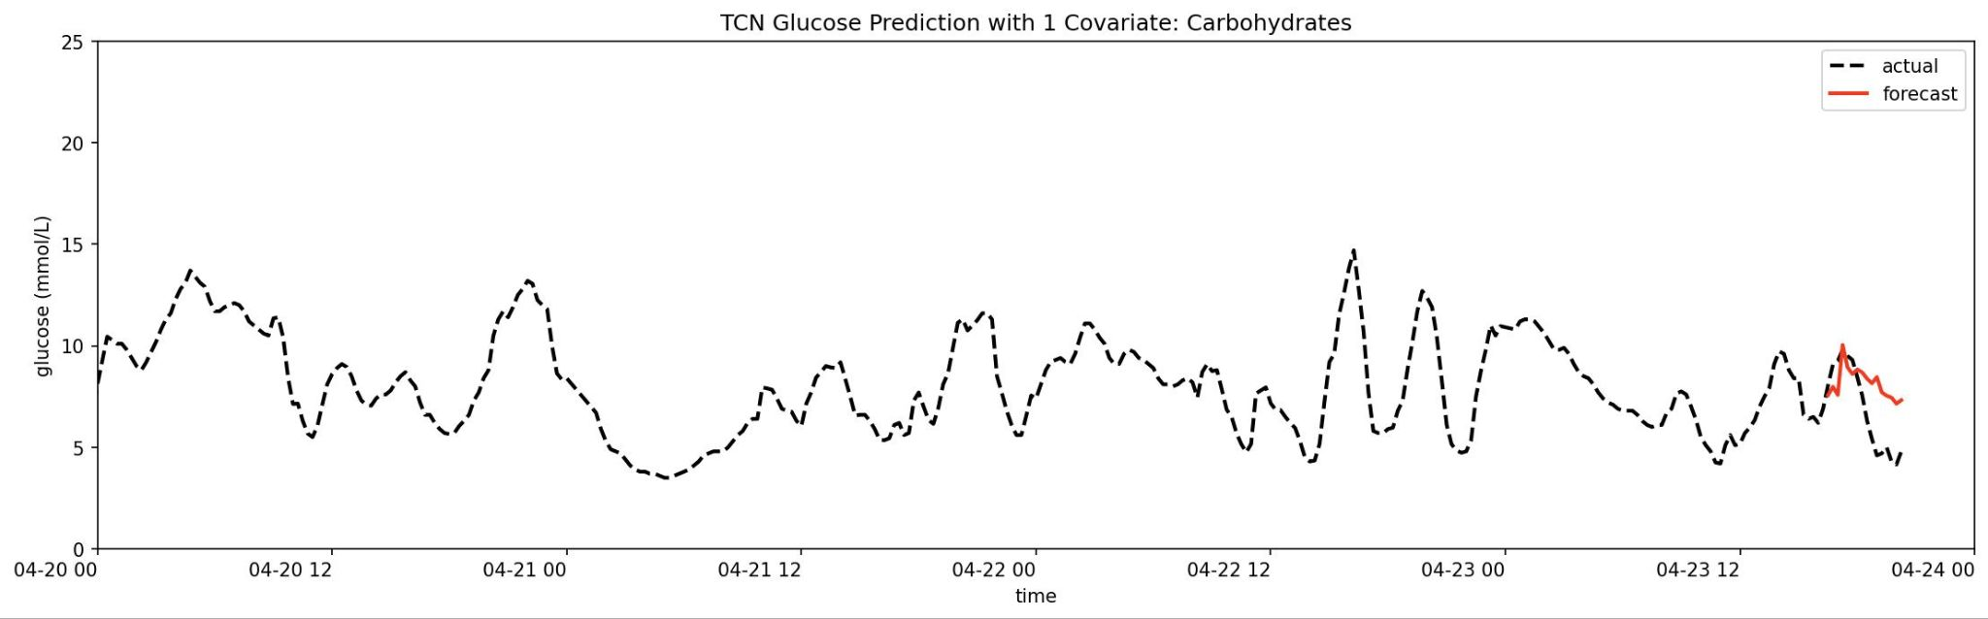
… that could be avoided with a glucose prediction.
Notes:
If a forecast for were available, a more proactive strategy (instead of reactive) could have been used to avoid the peak.

Slide 4
The best model …
Model selection based on mean absolute percentage error of predicted vs. actual blood glucose
SARIMAX: Seasonal AutoRegressive Integrated Moving Average with eXogenous variables
TCN: Temporal Convolutional Network
SARIMAX (2, 1, 1) | TCN
34% | 31%
Notes:
MAPE is a common performance measure for time series forecasting.
It is easy to translate what it means in actual units of the time series (as opposed to, e.g., MSE).

Slide 5
… is not good enough, …
A 30% error can make the difference between hyperglycemia vs. hypoglycemia
The predicted range is too large to determine the exact insulin dose

Slide 6
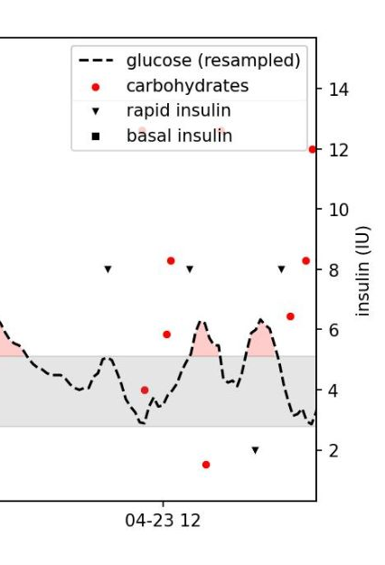
… but may still be useful for 2 hours of the forecast.
Notes:
Second last peak: three snacks while blood glucose is normal, but rising - insulin is injected after glucose has already risen above normal
With a forecast of the effects of the first snack, a pre-bolus strategy could have been employed for the remaining snacks,
potentially avoiding the peak altogether.

Slide 7
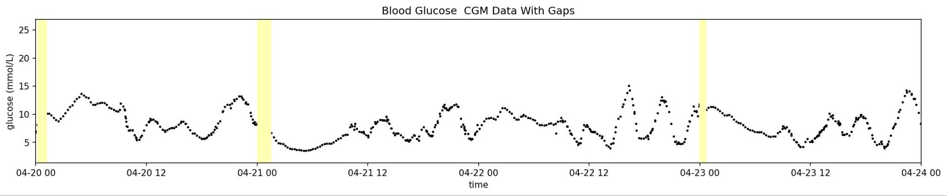
Using CGM data…
CGM: continuous glucose monitor
Notes:
Yellow bars represent gaps in CGM blood glucose data.
These occur for example when the sensor is changed (every other week),
or when the reader or phone has not read sensor data for more than the max number of hours stored.

Slide 8
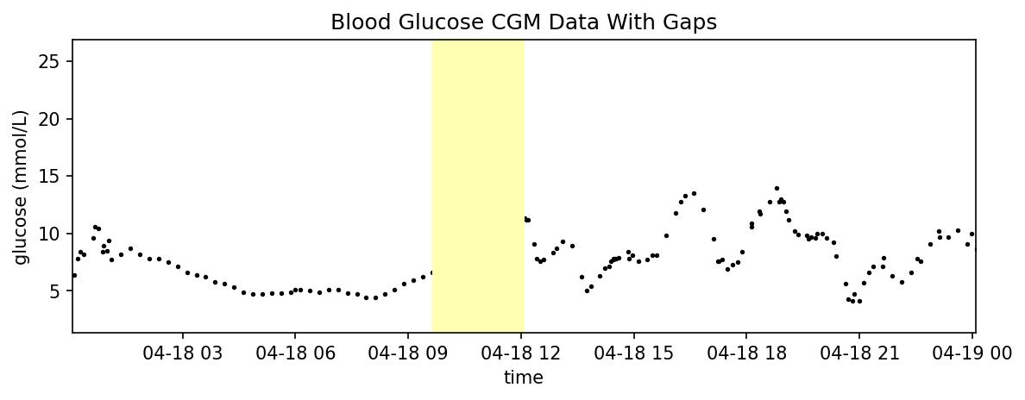
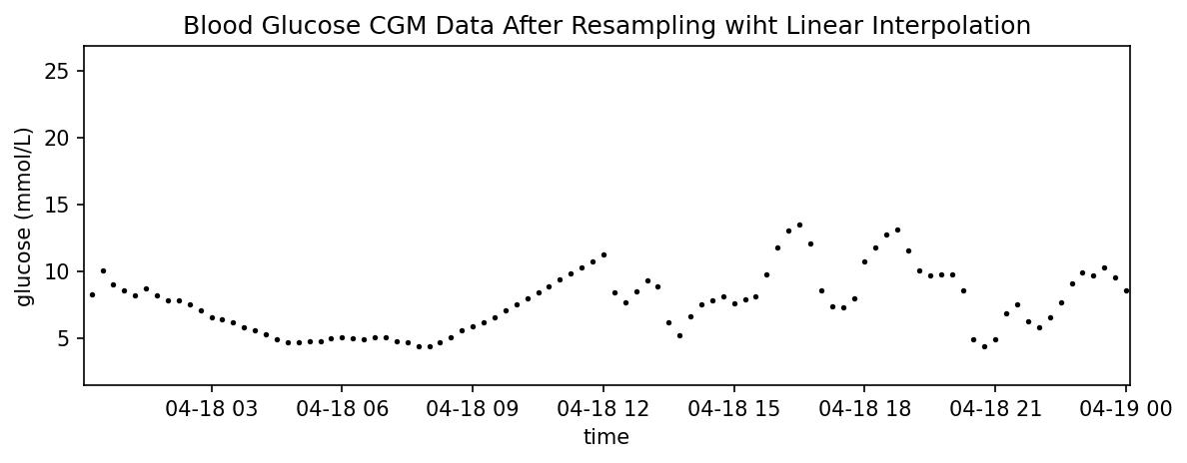
… requires connecting the dots.
Gaps up to 3 hours
Resampled at 15 minute intervals with linear interpolation
Notes:
A common time series fill strategy is, e.g, using the last known value.
Here, linear interpolation seemed to be a better fit.
Unlike stock data, there are no naturally occuring ‘jumps’ in this physiologic data.
(The question this raises is: Does this constitute data leak?
During fitting of the model output chunk may contain end of a filled gap. Also, two-sided: cross-contamination.)

Slide 9
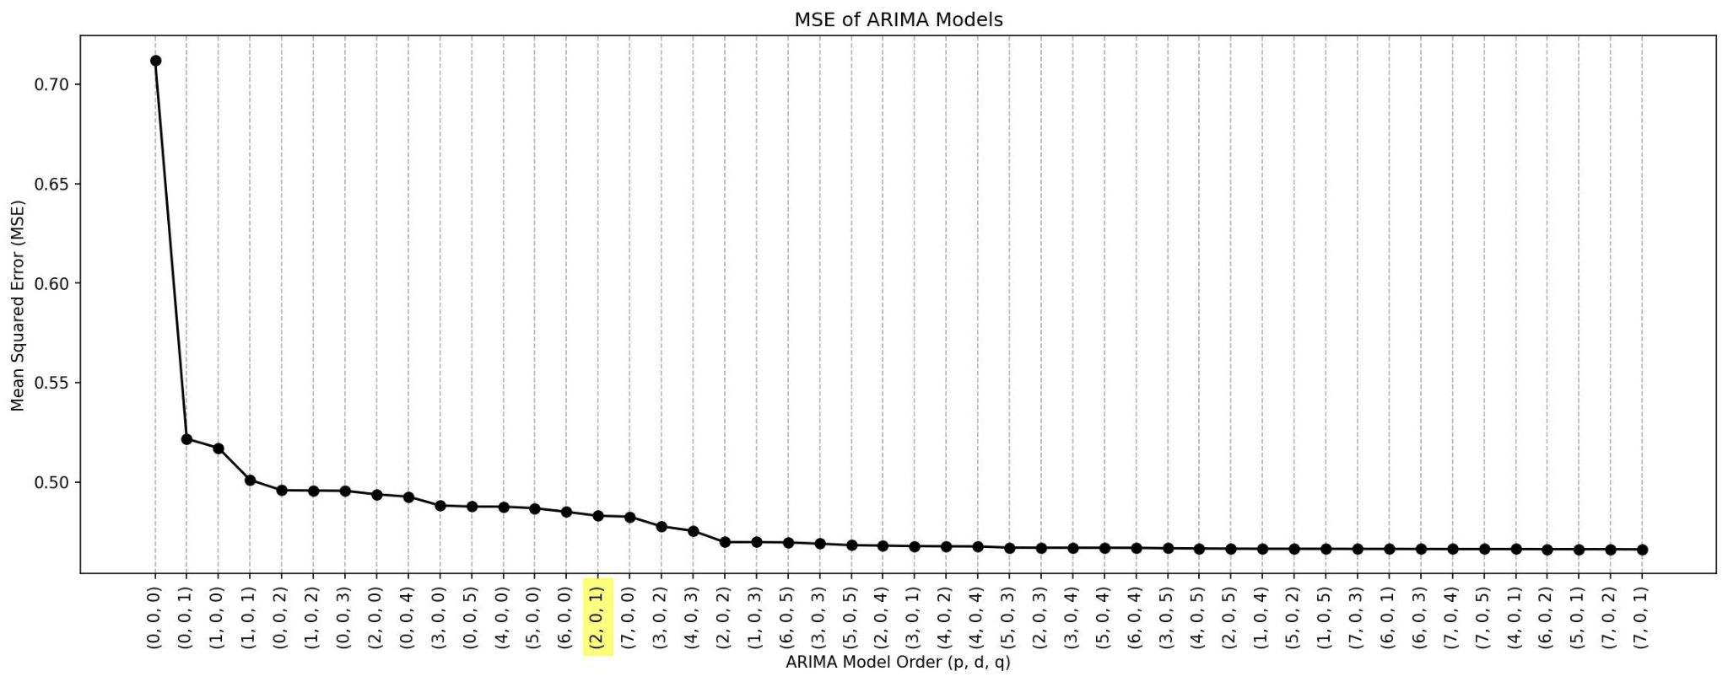
Small ARIMA model order is good enough…
Note: model order for once differenced series
Notes:
In choosing the model order, lower model complexity was given preference over marginally better performance.
Lower complexity models better generalize.

Slide 10
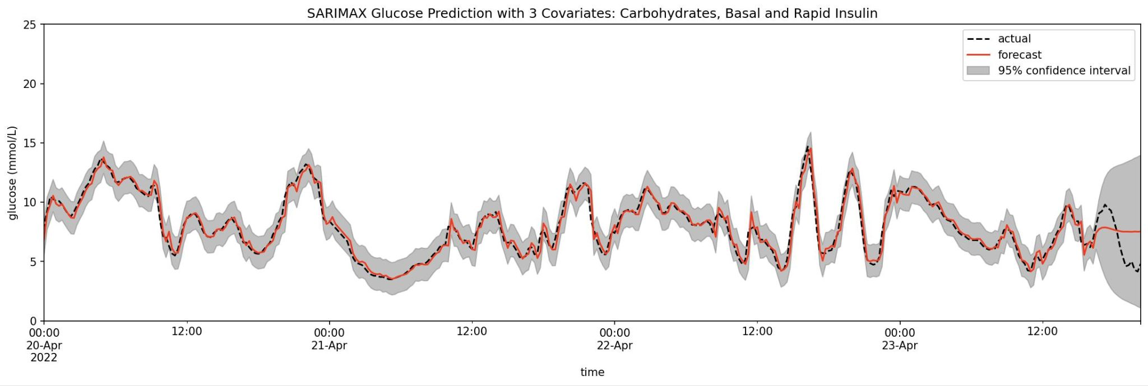
.. and used to fit a SARIMAX (2, 1, 1) model with 3 covariates.
Notes:
SARIMAX with same model order determined for ARIMA. (Is this the right approach? Try using covars when finding order.)
Last four hours are forecast using future covariates,
remainder is one-step-ahead forecast.

Slide 11
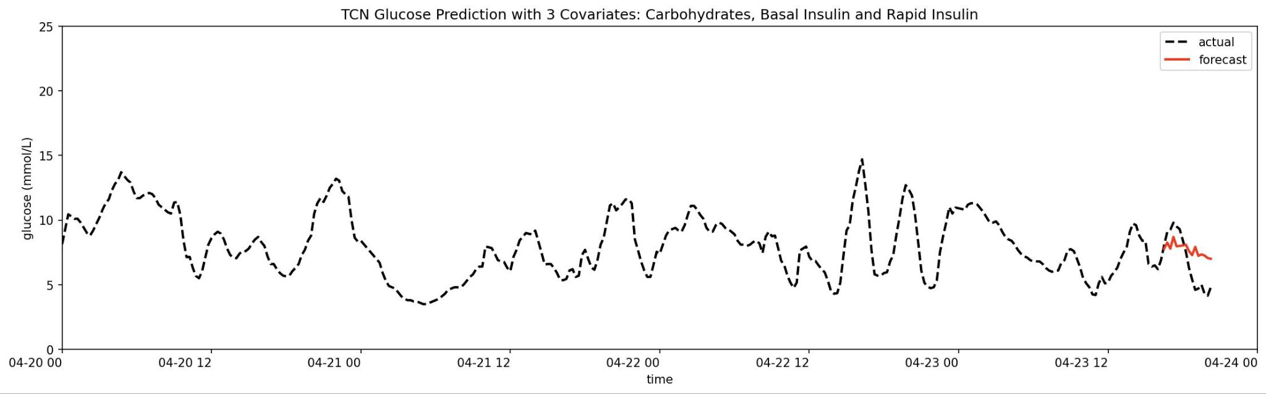
A TCN model with 3 covariates looks similar to SARIMAX….
Notes:
Looks more like SARIMA and doesn’t match actual glucose during first 2 hours as well as TCN with just carbs.

Slide 12
… after TNC with 1 covariate seemed so promising.

Slide 13
A better model is needed…
Salvage current models
Use smaller forecast horizon
Improve tuning
Try different model
Temporal Fusion Transformer (TFT)
…meanwhile, only use the first 2 hours of forecast.
Notes:
Forecast horizon: Try 30 minute intervals (requires only 8 steps)
Tune parameters: try cross validation tools
TFT borrows concepts from Transformers for learning short and long term dependencies; it supports multi-horizon forecasts, future and past covariates

