Slide 1

🌦️AutoAI-Based Weather Prediction
Powered by IBM Watsonx AutoAI
Presented by: Inayat Ahmad
Date: August 2025

Slide 2
Project Objective
Predict hourly weather conditions using historical weather data.
Use IBM Watsonx AutoAI to automate model training.
Eliminate the need for manual feature engineering or tuning.
Output: Predict categories like
🌤️ Clear
🌧️ Rain
🌫️ Fog
❄️ Snow

Slide 3
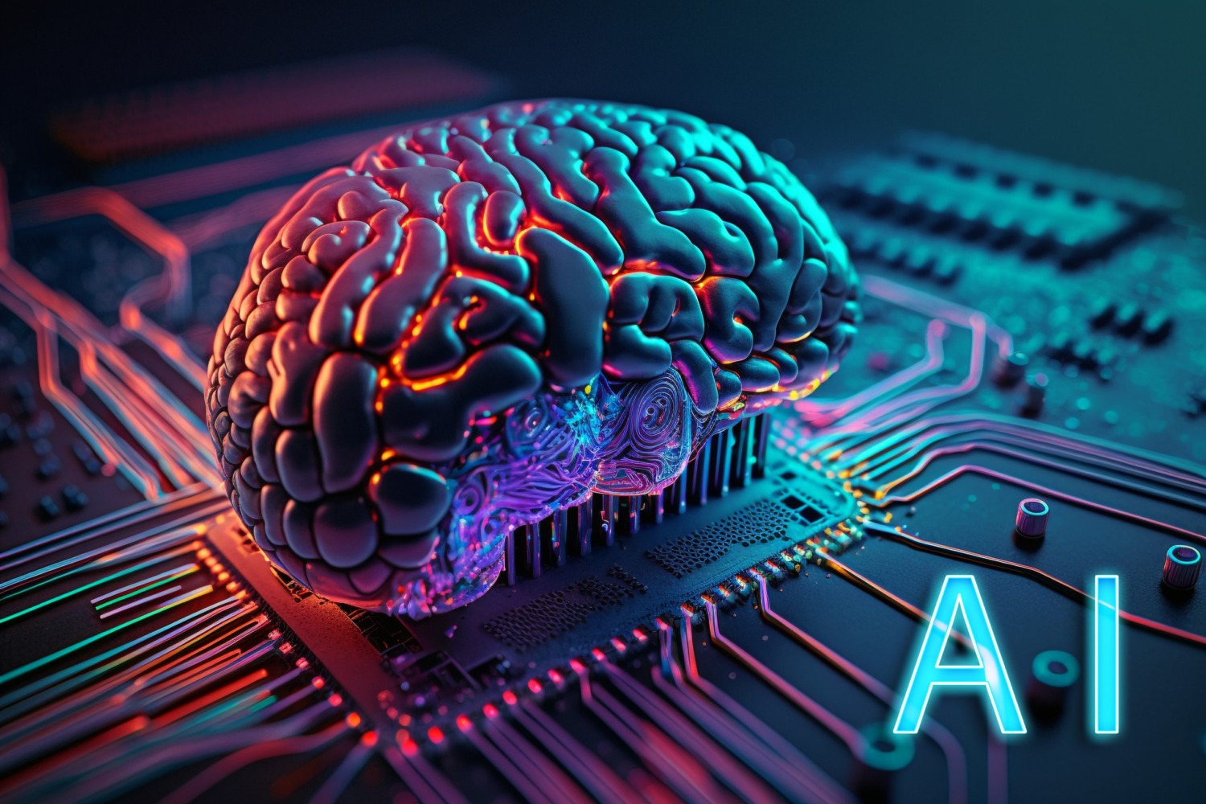
About AutoAI
(IBM Watsonx)
IBM Watsonx AutoAI is a no-code/low-code ML automation tool.
Automatically:
Cleans data
Selects features
Trains & compares multiple models
Helps in faster & smarter deployment of ML pipelines

Slide 4
01
Source: Hourly historical weather dataset
02
Columns: 12 features (e.g., temperature, humidity, wind speed)
Dataset Overview
03
Target Variable: Weather (categorical: Clear, Rain, Fog, Snow)
04
Data used for classification problem

Slide 5
04
Compare model performance
05
Use best model for prediction
01
Load weather dataset
02
Run AutoAI experiment
03
Train multiple ML models
Project Workflow

Slide 6
01
Load weather dataset
04
Compare model performance
05
Use best model for prediction
Project Workflow
02
Run AutoAI experiment
03
Train multiple ML models

Slide 7
AutoAI Experiment Setup
Platform: IBM Watson Studio + Python 3.11
Target column: Weather
Package used: ibm-watsonx-ai
Problem type: Classification

Slide 8
Target column: Weather
Package used: ibm-watsonx-ai
AutoAI Experiment Setup
Problem type: Classification
Platform: IBM Watson Studio + Python 3.11

Slide 9
Conclusion & Future Work
AutoAI makes weather prediction faster, accurate, and automated
Add more features like visibility or pressure
No need to manually write complex ML pipelines
Deploy as web app or REST API
Integrate with live weather APIs

Slide 10
AutoAI makes weather prediction faster, accurate, and automated
Integrate with live weather APIs
Conclusion & Future Work
Add more features like visibility or pressure
Deploy as web app or REST API
No need to manually write complex ML pipelines

Slide 11
THANK YOU!

Slide 12
THANK YOU!

