Slide 1
MentoBot
Model a low cost and affordable Smart Autonomous Remote Monitored Agri - Horticulture systems.
Team Name - Random Ideas
Team Members:
Inbasagar D (Final Year)
Mugundhan SM (Final Year)
Vigneshwar M (Final Year)
Hrithik R (Final Year)
Domain - Electronics Industry

Slide 2
Problem Statement
To Model a low cost and affordable Smart Autonomous Remote Monitored Agri - Horticulture systems.
Novelty:
The vision of this project is to create an open and accessible technology aiding everyone to grow food and to grow food for everyone. The mission is to grow a community that produces hardware plans, software, data, and documentation enabling everyone to build and operate a farming machine.
The entire system is numerically controlled and thus fully automated from the sowing of seeds to harvest.
The hardware is designed to be simple, scalable, and hackable.
Ability to plant polycrops in a machine efficient manner.
Ability to optimize operations such as watering, spraying, and seed spacing.
24/7 possible operation.
Scalable from a backyard system to an industrial operation.
Allows for the democratization and decentralization of food production.

Slide 3

Introduction
Most agricultural food production in the modern day is performed in small scale, monocrop farms on huge plots of land.
While it has been streamlined to produce huge amounts of food at a relatively cheap price, monocrop farming puts a significant strain on the soil and the surrounding environment by using up specific nutrients for different crops, as well as using tremendous amounts of water.
The idea with this system is to shift dependence on small scale agriculture by giving people the ability to cultivate their own plants with little to no actual physical labour on their part.
This means that, this system, a person with little to no actual gardening experience could have the home-garden of their dreams with no more effort than a few taps on the keypads.

Slide 4
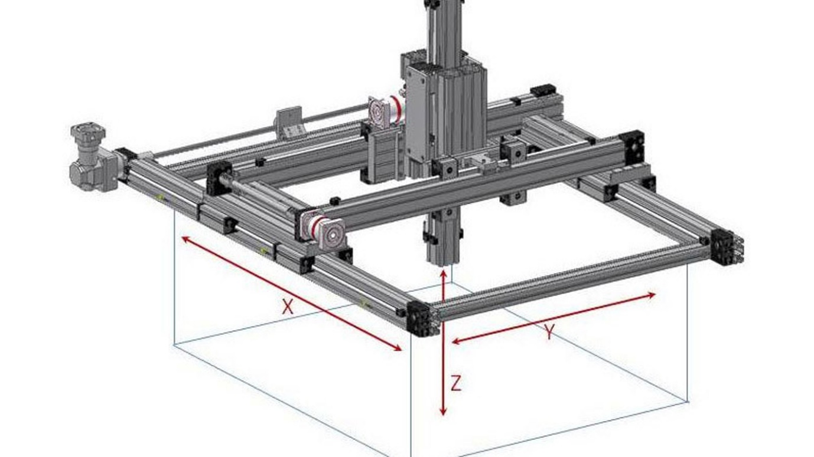
Requirements
Hardware:
Mechanics: (Estimated for a 1m sq. area and 0.25m height)
Note: Grows with the area.
Mild steel Square Pipes (50x50 mm and 3mm thick)
L Brackets
Ball Bearing Sliding Tracks
Gear rack arrangement – 2
Sprinkler
Electronics/Electricals:
Arduino Nano
Arduino keypad
Motors(12v 1kg/cm 300rps-2nos. + 5v dc motor- 1 no.)
Motor speed and direction control circuit (L298N)

Slide 5
Methodology
A Cartesian robot that is mounted over the area where gardening/farming is about to be done. The area assumed here is a 1m x 1m area with the a height of 25cms. A square/rectangular frame of Mild steel square tubes is built around the area and mounted at an elevation of 0.25m using four poles. The parts are assembled using L brackets. Two Ball Bearing Sliding Tracks are attached to the top side of two opposite tubes in the frame. One of the corners of the frame is assumed to be origin and everything else is controlled as if they lie in positive x and y axes of that origin. A Traversal square tube is mounted on these Sliding tracks so that it can move freely in the Y axis. Another Vertical Tube is attached to the Traverse tube with a sliding track, which can be moved across the bar i.e., in the x axis. The pinion is connected to a driving motor which is attached with the moving component and the rack is attached to the stationary component.

Slide 6
Algorithm
A frame is considered and assume one point as origin, then assign x axis and y axis.
Configure the keypad and motor driver in Arduino.
Listen for key inputs from keypad.
Check if the given key is “#”, if it is then switch the input flag.
Reset the box dimensions and call getDim function.
If the given key is not “#” and it is either “1” or “2” then input mode if off.
Then enable the motors
If the key is “1” enable sowing flag.
If the key is “2” enable spraying flag.
If motors are enabled and input mode is off,
Call displaceRight function until right end is reached.
If position “y” plus increment(0.2m) is within box dimension, call displaceTop function, else call restoverPosition function.
Call displaceLeft function until left end is reached.
DisplaceRight and displaceLeft functions will traverse 20cm and calls sowing or spraying function based on the flags.

Slide 7
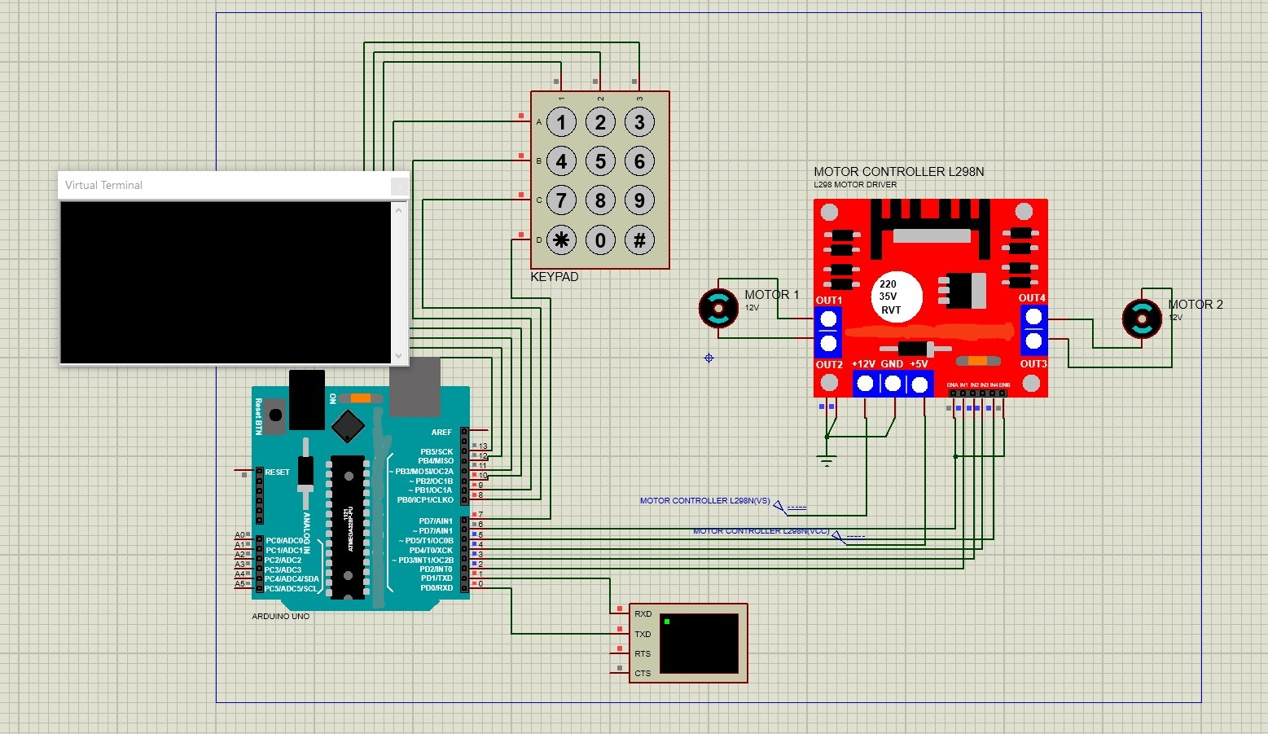
Implementation
Assume a rectangle with bottom left corner as origin
Declare variables –
Dimensions of the area, Current Position of the attachment variables, Motor speed, Control pins – motor 1, motor 2, ENA=10, ENB=10 SPEED SETTERS, Increment – 0.2m, State variables.
Setup Keypad. Listen for keypad input.
If there is an keypad input, if it starts from # then it is a box dimension. Get the value and convert it into int to update the box dimensions.
Conversion to int.
Input format for box dimensions.
Now again wait for keypad keys.

Slide 8
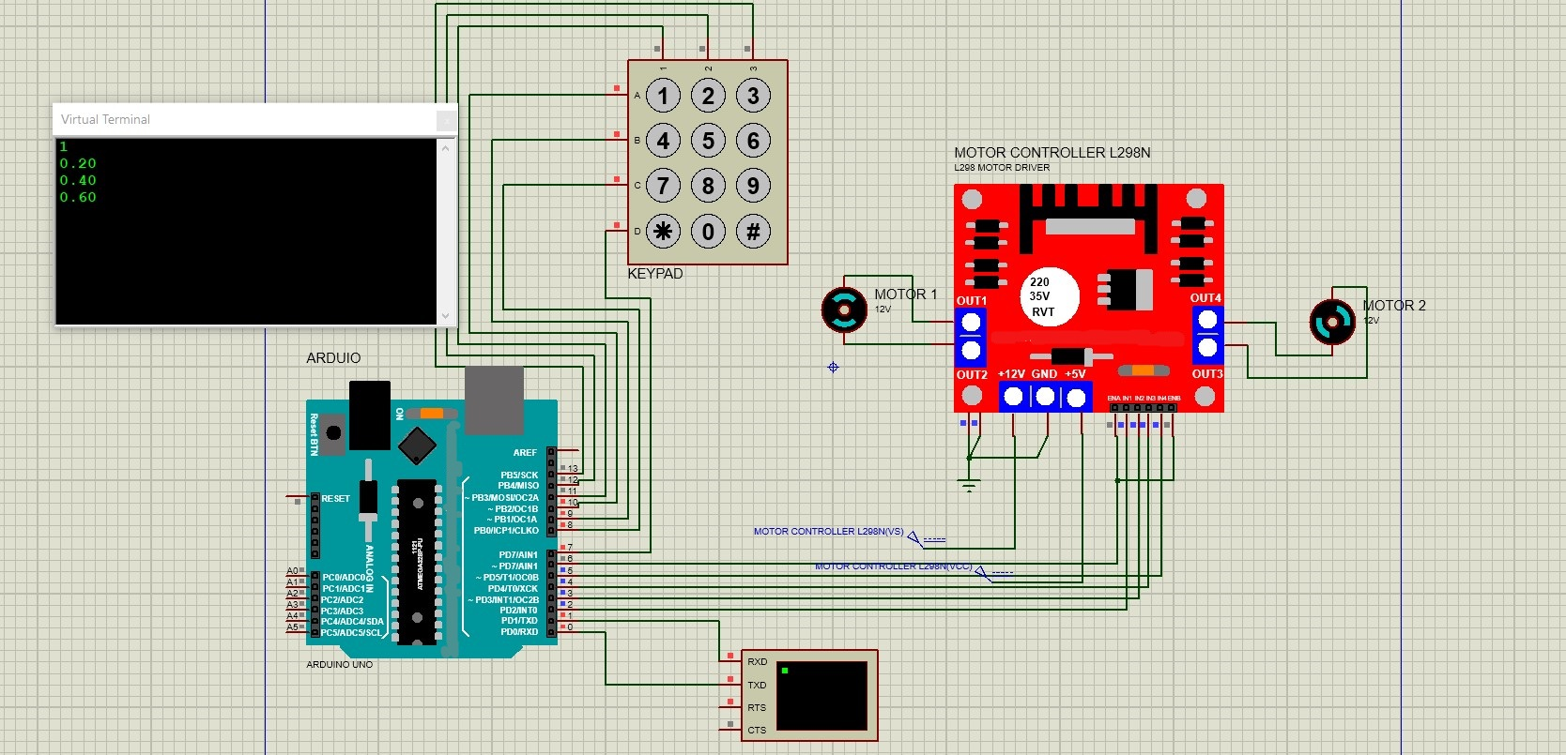
Implementation
Instructions are denoted by asterisk ‘*’ followed by number.
*1* = seeding
*2* = Watering/ insecticide spraying
*3* = Fertilizer scattering
Functions are created for each instruction and they are called.
Every operation is done in a zig zag motion starting from origin each denoted by state variables.
Set mstate to 1.
Execute Loop condition.
Repeat the step 12 but with reversed polarities and conditions to return the attachment to origin.
For sowing mechanism, during every increment in the wait time, a smaller motor is given high input for a time of (0.0628/smallmotorspeed) * 1000 ms.

Slide 9
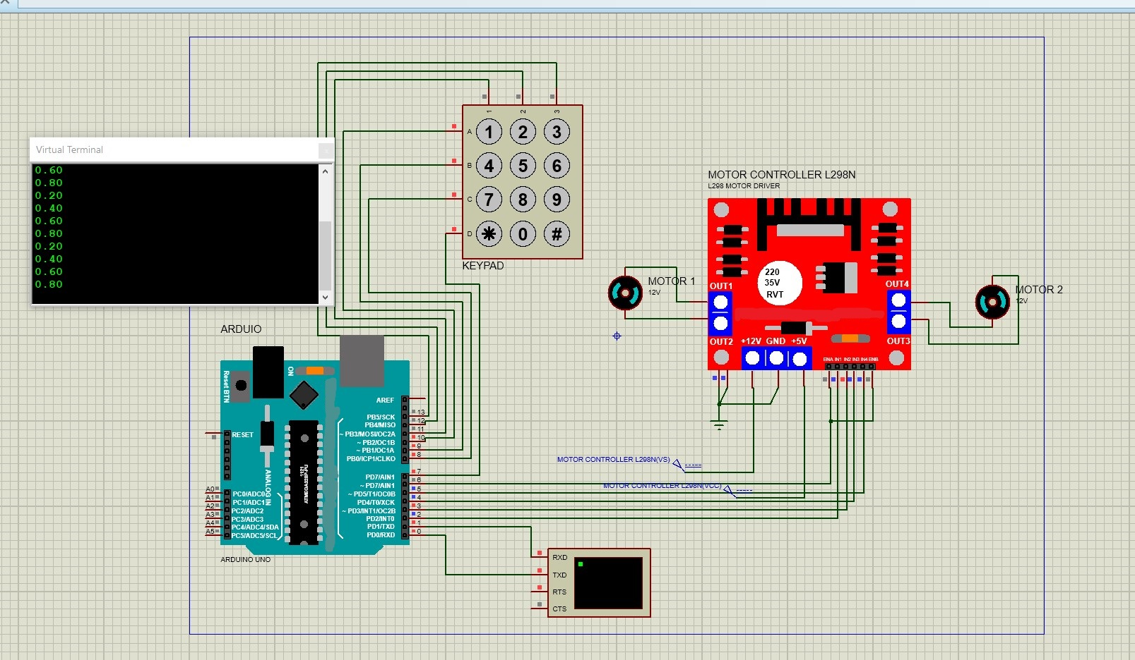
Output Screenshot

Slide 10
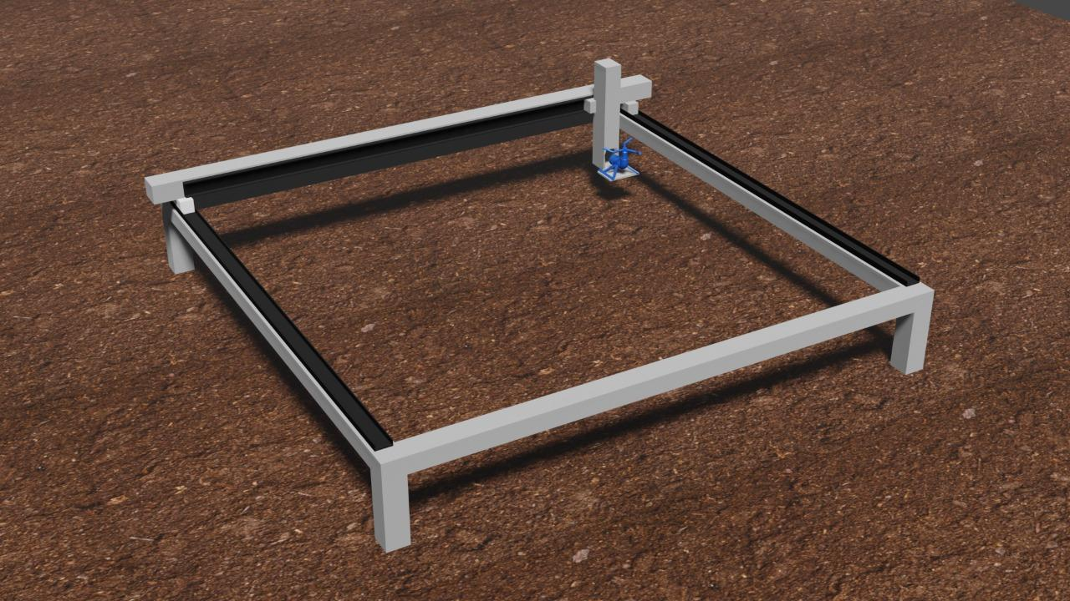
Model

Slide 11
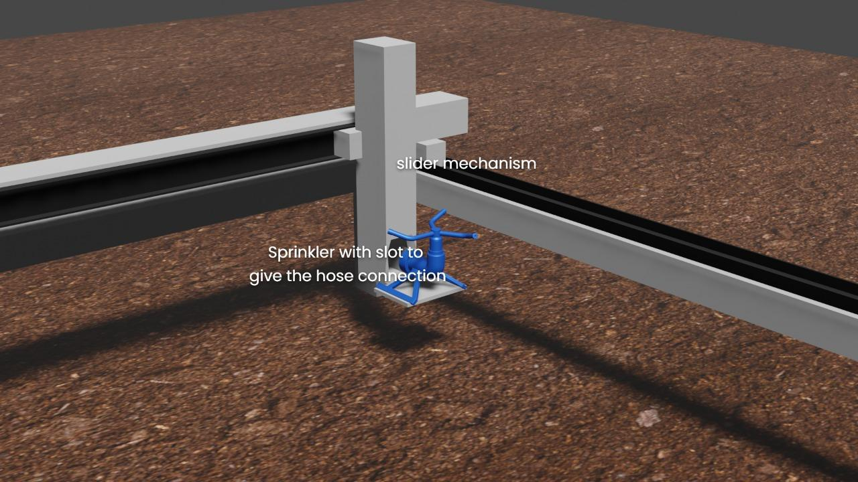
Model

Slide 12
Results & Discussion
We successfully developed the model at low cost and affordable Smart Autonomous Remote Monitored Agri - Horticulture systems.
We used Arduino Nano, Keypad and Direction Control Unit (L298N) to simulate the Bot in the Proteus Design Suite tool.
Also we modeled a sample structure of how the MentoBot will look like in Blender software.
Discussion:
We hosted our code to Github and anyone who interested in open source contribution can raise issue by pulling requests in the site. Link to GitHub repository - MentoBot.

Slide 13
Business Scope
Cost analysis of production : (Varies depending upon crop area)For 1m sq. area – (n=area in sq. Meters, n>1)
Mild steel Square Pipes (50×50 mm and 3mm thick) – Rs. 1500×n/2, L Brackets – Rs.200, Ball Bearing Sliding Tracks – Rs. 600×n/2, Gear rack arrangement – 2, Sprinkler – Rs. 350, Arduino Nano – Rs. 1500, Arduino keypad – Rs. 100, Motors(12v 1kg/cm 300rps-2nos. + 5v dc motor- 1 no.) – Rs. 800, Motor speed and direction control circuit (L298N) – Rs. 200.
Total cost will be approx. Rs. 5000 for 1m sq. area, for 5m sq. it will be approx Rs. 8000.
With a maximum level of automation, the number of manual activities, dependency on labour and overall labour cost is reduced.
It creates microclimate surrounding the crops that help in maximum growth regarding production and quality.
You can grow the plants in polyhouse conditions that are otherwise impossible to cultivate in that particular climatic zone. Eg. Growing strawberry in plains of India.
Polyhouse crops can give you maximum profit in a minimum area under cultivation.

Slide 14
Thank You!
Any Queries?

