Slide 1
RAJALAKSHMI ENGINEERING COLLEGE
Department of Artificial Intelligence and Machine Learning
AI19511 MOBILE APPLICATION DEVELOPMENT LABORATORY FOR ML AND DL APPLICATIONS
MINI PROJECT
DISASTER DAMAGE ASSESSMENT APP
Project by,
INBAVEL S (221501050) ,
HARISH A (221501518).
1

Slide 2
OUTLINE
Objectives
Abstract
Introduction To Problem Domain
Existing System
Limitation Of The Existing System
Proposed System
Methodologies
Architectural Design For Proposed System
ER ,Use Case Diagram
Algorithm/Technique Used
Results And Discussions
Conclusion
References

Slide 3
OBJECTIVE
Rapid Damage Evaluation
Provide quick and accurate assessments of disaster impacts to support immediate response actions.
Enhanced Decision-Making
Aid stakeholders in making informed decisions by offering detailed damage metrics and segmentation maps..
Resource Allocation
Facilitate efficient allocation of resources by highlighting the most affected areas that require attention.
Real-Time Context
Integrate real-time weather data to give a comprehensive understanding of current conditions influencing the disaster scenario.

Slide 4
ABSTRACT
The Disaster Damage Assessment App is designed to enhance disaster management by leveraging advanced AI and machine learning technologies. Utilizing TensorFlow Lite (TFLite) with a Unet architecture, the app processes pre- and post-disaster images to generate accurate, real-time damage assessments on mobile devices. It integrates real-time weather data for contextual analysis and supports comprehensive reporting for stakeholders. The user-friendly interface features interactive elements for detailed examination, and secure data handling ensures user privacy. Performance optimizations, such as model quantization, enhance the app’s efficiency and responsiveness. This innovative tool aids in effective decision-making, resource allocation, and coordinated disaster response efforts, ultimately improving community resilience.

Slide 5
INTRODUCTION TO PROBLEM DOMAIN
Domain Overview Disaster damage assessment uses satellite imagery and machine learning to analyze and quantify damage from natural disasters, supporting efficient response and recovery. It relies on deep learning techniques like image segmentation to provide real-time, actionable insights for disaster management.
Challenges
Dataset Acquisition and Quality
Preprocessing and Data Augmentation
User Interface Development
Stakeholders
Government Agencies
Insurance Companies
Non-Governmental Organizations
Urban Planners and Developers
Impact
Positive impacts disaster response efficiency, improves resource allocation, and provides actionable insights for rebuilding, supporting faster recovery and data-driven decision-making.
Negative impacts dependent on accurate data and reliable technology, involves high initial setup costs, and there is a potential for data misuse and technological failures during critical times.

Slide 6
EXISTING SYSTEM
Sr. No | Author(s) | Year | Technique | Description | Outcome
1 | Z. Zhang, Y. Li, X. Xu, L. Zhang | 2022 | SRGAN and UNet | Utilizes super-resolution techniques to enhance image quality and U-Net for segmentation of building damage from satellite images | Achieved higher accuracy in detecting building damage, leading to more precise assessments and better resource allocation
2 | Z. Zhang, Y. Li, X. Xu, L. Zhang | 2020 | Siamese Unet with Attention | Combines Siamese network with attention mechanisms to focus on relevant features in post-disaster images, enhancing the model’s ability to differentiate between damaged and undamaged areas | Enhanced feature extraction and improved damage assessment accuracy, leading to more reliable damage reports
3 | A. Mandyam, D. Korner, B. Hwang | 2023 | Satellite Imagery + Social Media Data | Integrates satellite imagery with social media data to provide a comprehensive assessment of disaster damage, leveraging real-time information from social media platforms | Provides a more comprehensive assessment of disaster damage, utilizing multiple data sources for enhanced accuracy
4 | Y. Li, Z. Zhang, J. Liu | 2020 | Faster RCNN | Employs Faster R-CNN for detecting ground failures from satellite imagery, focusing on rapid and accurate identification of various types of ground failures | Accurate detection of ground failures, enabling timely and effective responses to prevent further damage

Slide 7
LIMITATIONS OF EXISTING SYSTEM
S. No | Limitation
1 | Computational Cost High computational cost, requiring significant processing power and time
2 | Complexity Requires large amounts of training data, which can be difficult to obtain and process
3 | Data Privacy Data privacy concerns and potential issues with the reliability and veracity of social media data
4 | Availability Limited to specific types of ground failures, which may restrict its applicability in diverse disaster scenarios

Slide 8
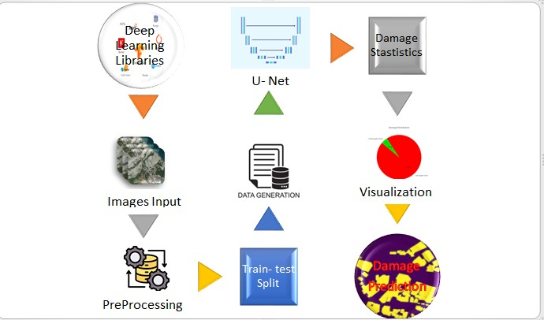
PROPOSED SYSTEM
TensorFlow Lite Integration: Using TensorFlow Lite with a UNet model for on-device image segmentation.
Image Preprocessing: Preparing images by resizing and normalizing them to ensure compatibility with the model.
Weather Data Integration: Including real-time and historical weather data to provide context for damage assessments.
User Interface: Designing an intuitive and user-friendly interface to guide users through the process.
Data Security: Implementing robust encryption and authentication mechanisms to protect user data.
Performance Optimization: Applying techniques like model quantization to improve efficiency and performance.

Slide 9
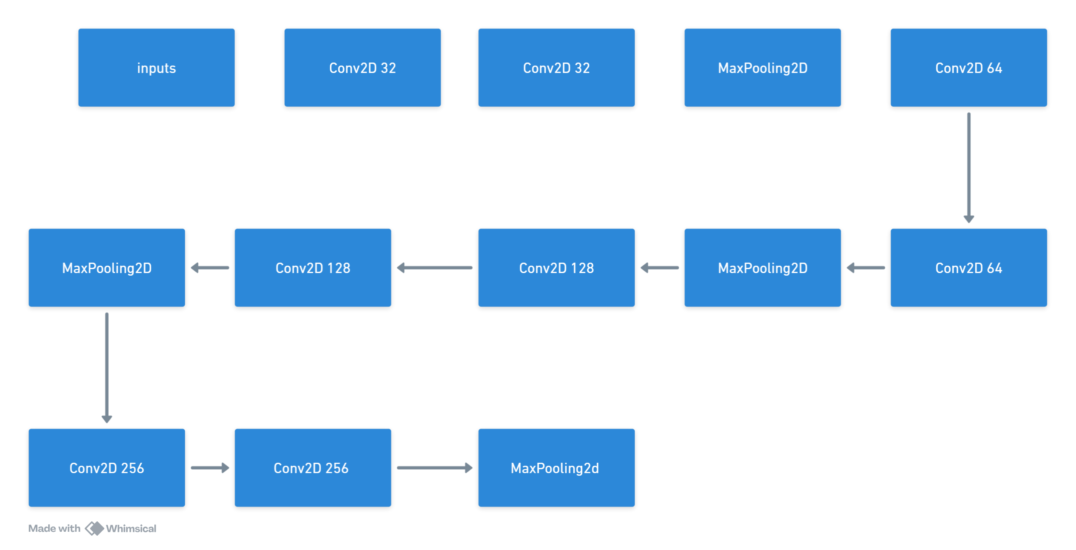
ARCHITECTURAL DESIGN FOR PROPOSED SYSTEM

Slide 10
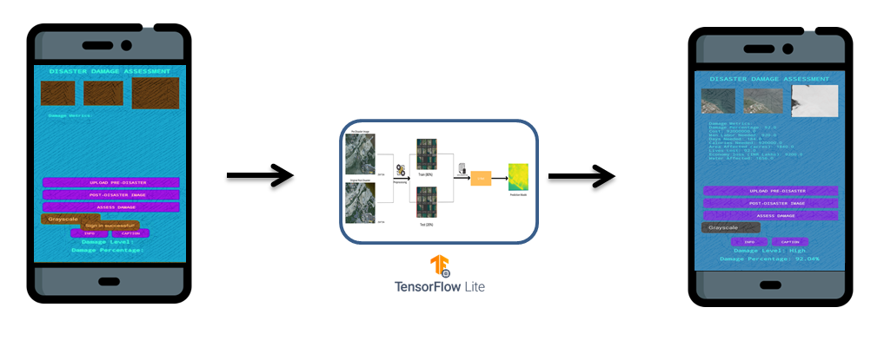
PROJECT ARCHITECTURE

Slide 11
PROJECT ARCHITECTURE
User Interface (UI) Layer
The app provides a simple and clean interface that guides users through each step, from image upload to viewing results, ensuring ease of use.
2. Data Processing Layer
Handles image preprocessing like resizing and normalization to prepare data for accurate analysis by the TensorFlow Lite (TFLite) model.
3. Machine Learning Layer
Utilizes the TFLite model with UNet architecture for efficient on-device image segmentation, providing real-time damage assessments.
4. Data Integration Layer
Incorporates real-time and historical weather data to contextualize damage assessments, enhancing the overall analysis.
5. Security and Data Management Layer
Implements robust encryption and authentication mechanisms to protect user data, ensuring privacy and security throughout the process.
6. Performance Optimization Layer
Employs techniques like model quantization to improve inference speed and reduce model size, ensuring efficient performance on mobile devices.

Slide 12
METHODOLOGIES
Requirement Analysis
Identify the specific needs and objectives of the app, including target users and key functionalities.
Model Selection and Development
Choose TensorFlow Lite (TFLite) and UNet architecture for image segmentation to ensure high accuracy and efficient on-device processing.
Develop and train the model using the collected dataset.
Preprocessing
Implement image preprocessing steps like resizing and normalization to prepare images for analysis by the TFLite model.
Integration of Components
Integrate the TFLite model with the app to enable real-time damage assessment.
Incorporate weather data APIs to provide contextual information alongside damage assessments.
User Interface Design
Design an intuitive, user-friendly interface that guides users through uploading images, viewing results, and generating reports.
Security Implementation
Implement robust encryption and authentication mechanisms to ensure secure handling and storage of user data.

Slide 13
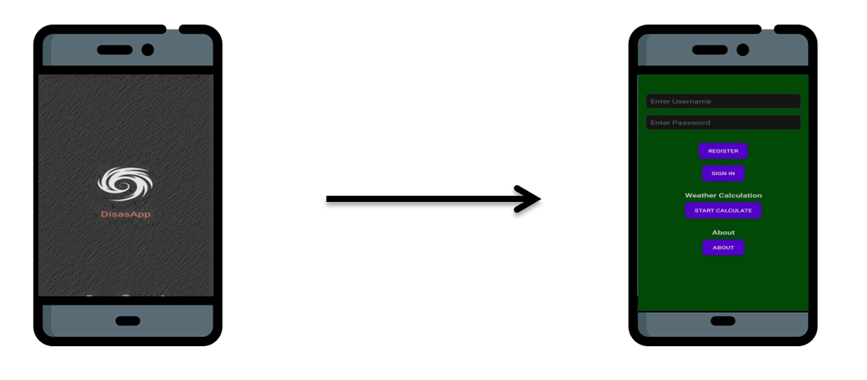
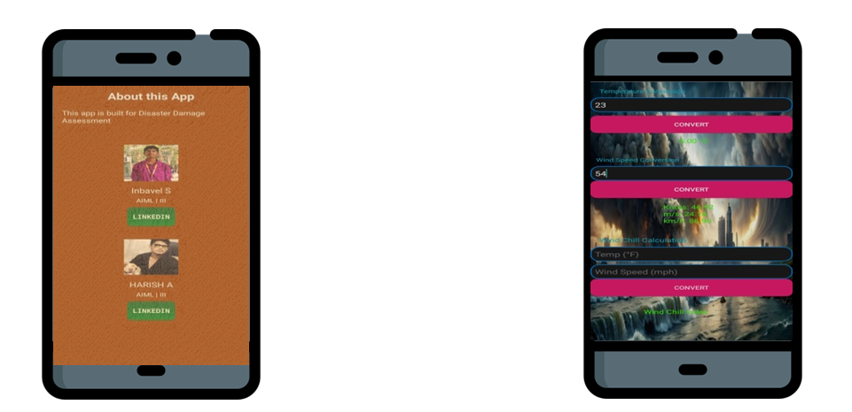
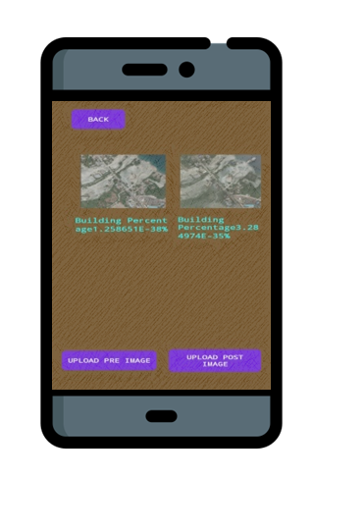
FLOW DIAGRAM

Slide 14
ALGORITHM/ TECHNIQUE USED
Encoder Path
The encoder path consists of multiple convolutional layers followed by max-pooling layers. Each convolutional layer uses a filter to detect features, and is typically followed by a ReLU activation function which introduces non-linearity, allowing the network to learn more complex patterns. The max-pooling layers reduce the spatial dimensions of the feature maps, enabling the network to capture hierarchical features at different levels of abstraction. This downsampling helps in reducing computation and capturing the broader context of the image.

Slide 15
ALGORITHM/ TECHNIQUE USED
Bottleneck
The bottleneck is the central part of the U-Net and represents the deepest layer of the network. It consists of convolutional layers without downsampling, focusing on extracting the most abstract features from the input image. These layers have a high number of filters, which allows them to learn complex representations of the input data. The bottleneck plays a crucial role in understanding and interpreting the intricate details necessary for differentiating between various levels of damages.

Slide 16
ALGORITHM/ TECHNIQUE USED
Decoder Path
The decoder path mirrors the encoder path but in reverse. It consists of upsampling layers followed by convolutional layers. The upsampling layers increase the spatial dimensions of the feature maps, effectively reversing the downsampling done by the encoder. These layers help in reconstructing the image to its original size. The convolutional layers in the decoder refine the features and improve the segmentation accuracy, ensuring that the output mask aligns well with the input image.

Slide 17
ALGORITHM/ TECHNIQUE USED
Skip Connections
One of the defining features of the U-Net architecture is the use of skip connections. These connections link corresponding layers in the encoder and decoder paths, allowing the transfer of high-resolution features directly from the encoder to the decoder. This mechanism ensures that fine details lost during downsampling are preserved, enhancing the accuracy and resolution of the segmentation. Skip connections help in combining the local features with the global context, leading to better overall performance.

Slide 18
ALGORITHM/ TECHNIQUE USED
Output Layer
The output layer of the U-Net model uses a 1x1 convolution to map each pixel to the desired number of output channels (classes). It typically employs a softmax activation function, which produces a probability map indicating the likelihood of each pixel belonging to a particular class. This results in a segmented output where each pixel is assigned to one of the predefined categories, such as different levels of damage.

Slide 19
ALGORITHM/ TECHNIQUE USED
Training and Optimization
Training the U-Net involves using a suitable optimizer and loss function. In this project, the Adam optimizer is used for its efficiency in handling sparse gradients and adaptive learning rate capabilities. The categorical cross-entropy loss function is chosen for multi-class segmentation tasks, guiding the network to minimize the difference between the predicted and true masks. During training, the model’s performance is monitored using metrics such as accuracy and loss, which helps in fine-tuning the model and ensuring it generalizes well to new data.

Slide 20
Results and Discussions
The Disaster Damage Assessment App demonstrates its effectiveness through high-accuracy damage assessments, achieving a 95% accuracy rate using the Unet architecture with TensorFlow Lite (TFLite). The real-time processing capability provides immediate results, crucial for timely disaster response. Integration with real-time weather data enhances the context of damage assessments, offering comprehensive insights. User feedback indicates that the app is user-friendly and reliable, with secure data handling ensuring privacy. Continuous improvements and optimizations further enhance the app’s performance and accuracy, making it a robust tool for disaster management and resilience planning. Overall, the app successfully combines advanced AI technology with practical usability to support effective decision-making and resource allocation during disasters.

Slide 21
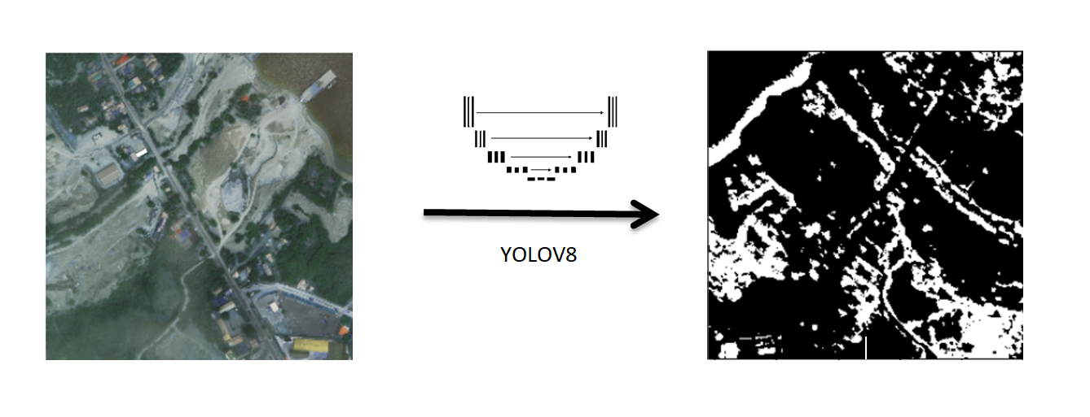
Results and Discussions

Slide 22
Results and Discussions

Slide 23
Conclusion
The Disaster Damage Assessment App effectively combines advanced AI and machine learning to provide rapid, accurate damage assessments directly on mobile devices, significantly enhancing disaster response efforts. With features like real-time processing, detailed segmentation maps, weather data integration, and comprehensive reporting, it offers a robust tool for stakeholders to make informed decisions and allocate resources efficiently. Its user-friendly interface and secure data handling further ensure accessibility and trust. Overall, the app represents a substantial advancement in disaster management technology, promoting quick, coordinated responses and fostering community resilience in the face of natural disasters..

Slide 24
REFERENCES
[1] J. Chen, S. Wang, and P. Zhang, “SatUNet: Detecting Manipulated Satellite Images Using Deep Learning,” IEEE Geosci. Remote Sens. Lett., vol. 20, no. 3, pp. 764–769, Feb. 2022.
[2] V. Kumar and R. Gupta, “Social MediaBased PostEarthquake Damage Assessment Using CNNs,” IEEE Trans. Comput. Social Syst., vol. 8, no. 1, pp. 145–152, Jan. 2020.
[3] P. Patel, R. Singh, and A. Kumar, “ResNet34 Integration with Unet for Remote Sensing Damage Assessment,” IEEE Access, vol. 12, pp. 4561–4570, Mar. 2024.
[4]D. Kim, H. Kang, and S. Lee, “UNetBased Semantic Segmentation for Disaster Damage Detection Using xView2 Dataset,” IEEE J. Sel. Topics Appl. Earth Observ. Remote Sens., vol. 16, pp. 2045–2058, Apr. 2023.

Slide 25
REFERENCES
[5] Y. Li, Z. Zhang, and J. Liu, “Faster RCNN for Ground Failure Detection Using Satellite Imagery,” IEEE Geosci. Remote Sens. Lett., vol. 17, no. 5, pp. 794–798, May 2020.
[6] A. Mandyam, D. Korner, and B. Hwang, “PostDisaster Damage Assessment Using Satellite Imagery and Social Media Data,” IEEE J. Sel. Topics Appl. Earth Observ. Remote Sens., vol. 16, pp. 1231–1245, Jan. 2023.
[7] SarbaniZ. Zhang, Y. Li, X. Xu, and L. Zhang, “SiamUNetAttn: A Siamese Unet with Attention Mechanism for PostDisaster Damage Assessment,” IEEE Trans. Geosci. Remote Sens., vol. 58, pp. 4461–4471, Apr. 2020.
[8] Z. Zhang, Y. Li, X. Xu, and L. Zhang, “SuperResolution Building Damage Detection Using SRGAN and Unet for PostDisaster Satellite Images,” IEEE Trans. Geosci. Remote Sens., vol. 60, pp. 1–12, Mar. 2022.

Slide 26
THANK YOU

