Slide 1
Data Browser Vision
2014

Slide 2
Goal of Data Browser
Ability for IT Admin to view data in their tenant
Overview of completed ingestion statuses
Notes:
The Data Browser provides the IT Administrator role a view of data in SDS that is relevant to their EdOrg. This information can be used to instill confidence that the data stored is an accurate reflection of what has been loaded as well as provide the detail that is needed to troubleshoot discrepancies in data.

Slide 3
Data Browser- Answer Data Questions
Respond to inquiries regarding counts and/or discrepancies.
There are 100 schools in my district, however my EdOrg is only showing 95 schools, I need to identify which schools are missing.
A teacher’s roster is wrong, I need to search for the specific teacher and view the detail of the class roster, so that I can identify the incorrect data.
Notes:
Provide IT Administrator with the data to answer questions regarding counts or data discrepancies
Not all schools in EdOrg – which ones missing
Teacher’s roster is wrong

Slide 4
Data Browser – Completed Ingestion Job Status
Determine the overall health of my ingestions and use this information in troubleshooting data discrepancies.
I just completed an ingestion job, and I want to understand whether it was successful and the number of records that were actually ingested, compared to what I sent in the file.
Notes:
Provide IT Administrator with information about completed ingestion jobs
Number of records ingested successfully compared to what I sent in

Slide 5
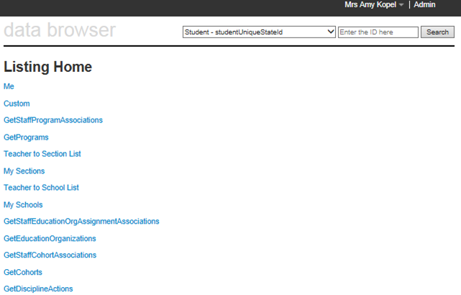
Current Data Browser
Notes:
This is the original homepage of the data browser, which was not user friendly.

Slide 6
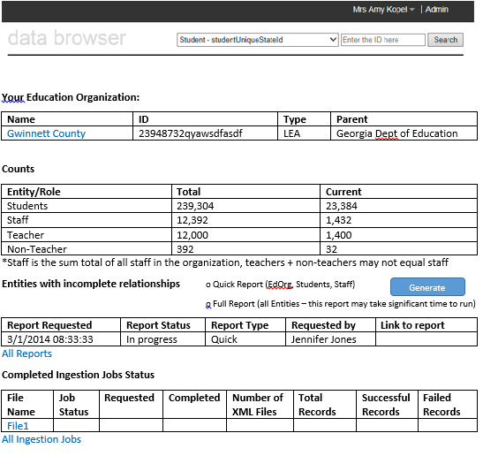
Data Browser Mockup - Homepage
Notes:
New homepage – changes were made to give an IT Admin a logical entry point into their data (the highest level EdOrg they’re associated with)
High level overview of data in your EdOrg
List of EdOrgs you’re directly related to. Drill into data through the EdOrg
High level overview of last 5 completed ingestion jobs for tenant
Drill down from here to get more information

Slide 7
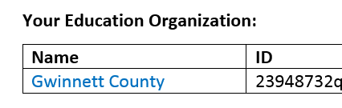
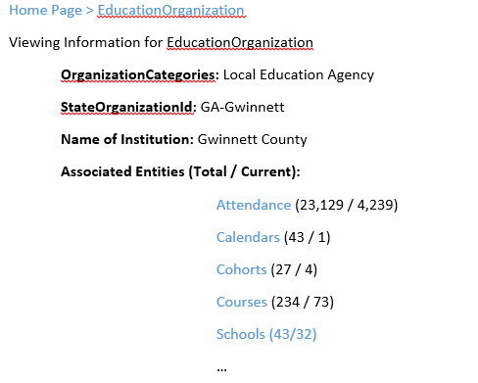
Data Browser – Mockup Education Organization Data
Notes:
You can traverse the data in the data store by starting at the top level EdOrg and drilling in.

Slide 8
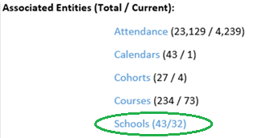

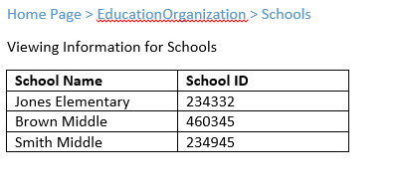
Data Browser Mockup – School Data

Slide 9
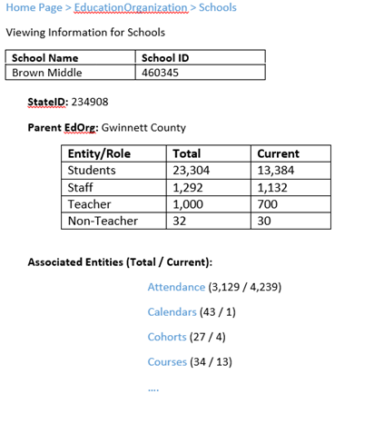

Data Browser Mockup – School Data
Notes:
Counts in the box reflect the counts for the EdOrg your are viewing, plus all the children EdOrgs. In this example, you are viewing a middle school, so the counts of Students, Staff, etc. will reflect the total number for the school only. These numbers will match those displayed on the Teacher/Staff/Student links on the bottom of the page.
If you were on a district’s page, the numbers in the table would reflect the counts of the District, plus all the schools associated the district. However, the links would be lower number, since they will only reflect the Staff/Teachers/Students directly associated to the district.

Slide 10
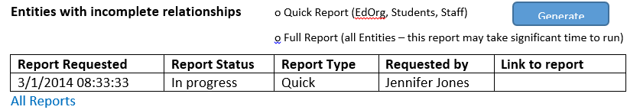
Entities with incomplete relationships
Incomplete relationships – Entities with required relationships that are invalid
No data provided to required entity
Required entity cannot be found
Examples:
Students without a reference to an EdOrg
Staff associated to an EdOrg that doesn’t exist
Notes:
This feature was not implemented.

Slide 11
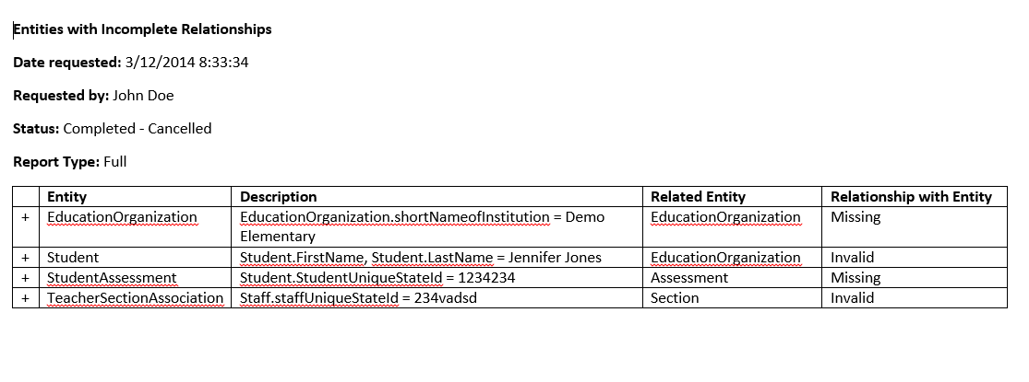
Entities with incomplete relationships

Slide 12
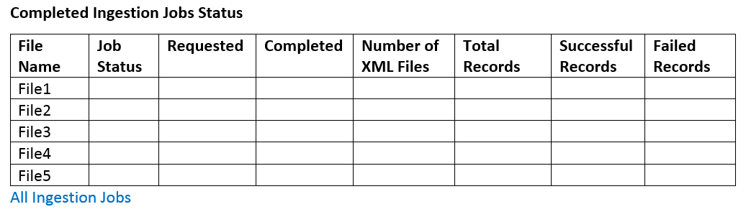
Data Browser Mockup – Completed Ingestion Jobs
Notes:
Only completed ingested are displayed in the data browser. To view details about the completed ingestion job (excluding log files), click the file name.
Log files are still only viewed from the Landing Zone.

Slide 13
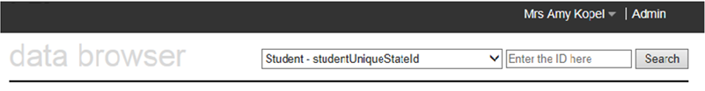
Data Browser - Search
StudentID
Student Last Name
StaffID
Staff Last Name
EdOrgID
EdOrg Name
ParentID
Notes:
Search for specific students, staff, education organizations by name and ID

