Slide 1


Vehicle Service Management System
PRESENTED BY
23AID214
DATABASE MANAGEMENT SYSTEMS
S SANJANA AM.SC.U4AID24036
SURYA SURESH AM.SC.U4AID24045
VAISHNAVI KS AM.SC.U4AID24048
SREEKANTH S AM.SC.U4AID24066
1

Slide 2
ABSTRACT
The Vehicle Service Management System is a centralized database solution designed to replace manual record-keeping in vehicle service centers by efficiently managing entities such as Customer, Vehicle, Mechanic, Service Record, Spare Parts, and Billing through Entity-Relationship (ER) modelling. The system incorporates key DBMS concepts including primary keys, foreign keys, constraints, and weak entities to ensure data integrity, while offering features such as automatic bill calculation, spare parts stock monitoring, and next service date prediction using SQL for all core database operations, thereby improving accuracy, reducing redundancy, and enhancing overall service center efficiency.
2

Slide 3

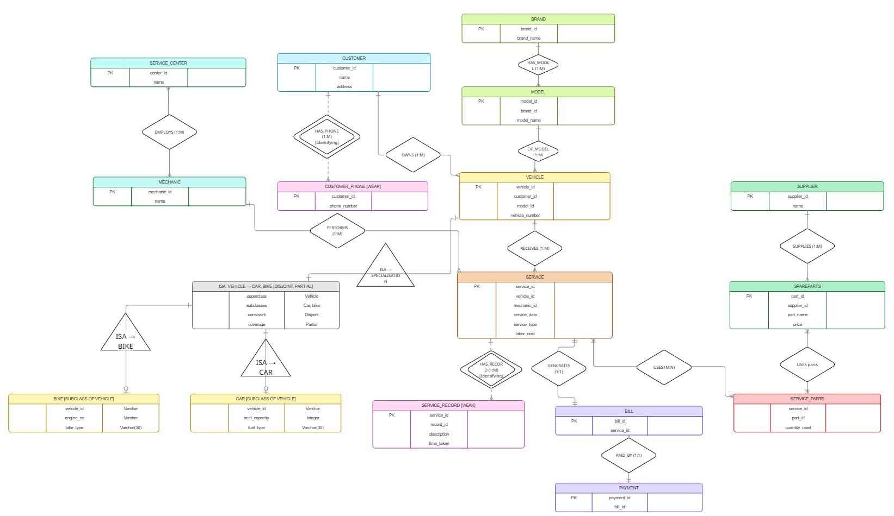
ER DIAGRAM
3

Slide 4
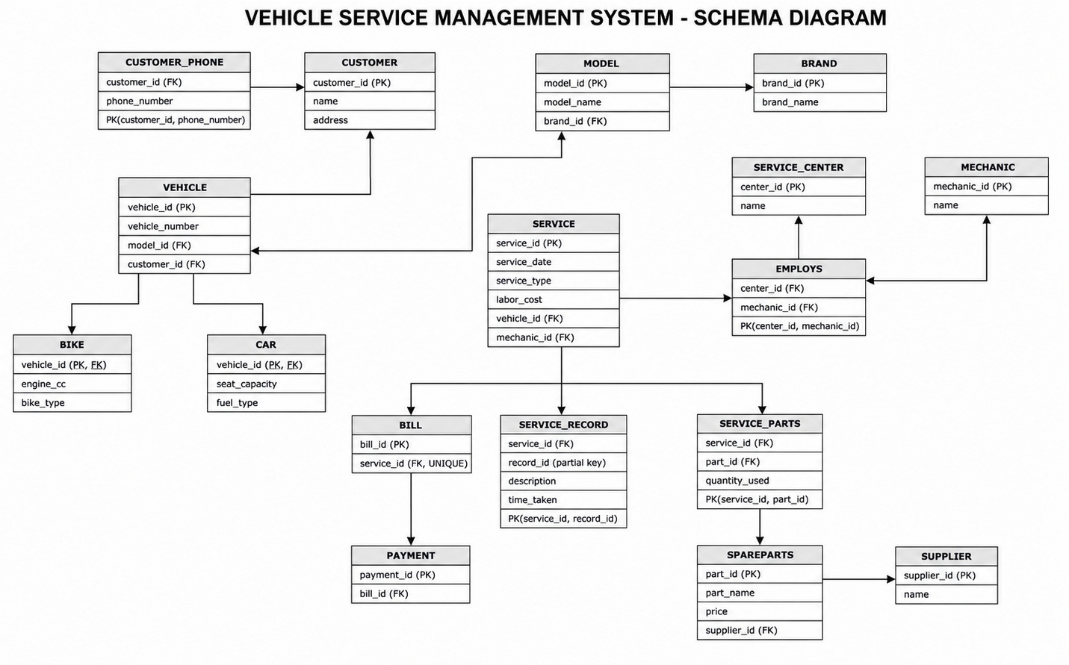
SCHEMA DIAGRAM
4

Slide 5


Normalisation
UNIVERSAL_RELATION
UNIVERSAL_RELATION (
customer_id, customer_name, address, phone_number
vehicle_id, vehicle_number, model, brand,
engine_cc, bike_type, seat_capacity, fuel_type,
mechanic_id, mechanic_name,
center_id, center_name,
service_id, service_date, service_type, labor_cost, total_cost,
record_id, description, time_taken,
part_id, part_name, price,
supplier_id, supplier_name,
quantity_used,
bill_id, payment_id
)
5

Slide 6
ANOMALIES
Insertion anomalies:
(a) Cannot insert CUSTOMER alone
(b) Cannot insert VEHICLE without SERVICE
(c) Cannot insert MECHANIC independently
(d) Cannot insert SERVICE CENTER alone
(e) Cannot insert SPARE PART alone
(f) Cannot insert SUPPLIER alone
(g) Cannot insert BILL / PAYMENT alone
Deletion anomalies:
(a) Deleting SERVICE deletes everything
(b) Deleting last SERVICE of a VEHICLE
(c) Deleting last VEHICLE of CUSTOMER
(d) Deleting SERVICE_PART entry
(e) Deleting BILL
Update anomalies
(a) Customer details repeated
(b) Vehicle details repeated
(c) Mechanic name repeated
(d) Service Center repeated
(c) Spare part details repeated
(d) Supplier details repeated
6

Slide 7
Fuctional Dependency
customer_id → name, address
customer_id, phone_number → phone_number (composite key)
vehicle_id → vehicle_number, model, brand, customer_id
model → brand (transitive — causes anomaly)
mechanic_id → name
center_id → name
center_id, mechanic_id → (composite key)
service_id → service_date, service_type, labor_cost, total_cost, vehicle_id, mechanic_id
total_cost = labor_cost + parts_cost (derived — not stored)
service_id, record_id → description, time_taken
part_id → part_name, price, supplier_id
supplier_id → name
service_id, part_id → quantity_used
bill_id → service_id
payment_id → bill_id
7

Slide 8
First Normal Form (1NF)
After converting to 1NF:
- Multi-valued attributes (phone_number, parts) are separated — basic insertion anomalies reduced.
- However, partial dependencies may still exist in tables with composite keys.
- Transitive dependencies still exist (model → brand in VEHICLE).
Conclusion: Anomalies not fully removed. Proceed to 2NF.
8

Slide 9
Second Normal Form (2NF)
After checking 2NF:
No partial dependencies found in any composite-key table.
CUSTOMER_PHONE, EMPLOYS, SERVICE_RECORD, SERVICE_PARTS are all in 2NF.
Single-PK tables are automatically in 2NF.
However, transitive dependency remains: model → brand (in VEHICLE) and total_cost is derived.
Conclusion: Partial dependency anomalies removed. Transitive dependency anomalies remain. Proceed to 3NF.
composite keys:
CUSTOMER_PHONE (customer_id, phone_number)
EMPLOYS (center_id, mechanic_id)
SERVICE_RECORD (service_id, record_id)
SERVICE_PARTS (service_id, part_id)
Customer_phone, employs, service_records,service_parts: already in 2nf
CUSTOMER, VEHICLE, CAR, BIKE, MECHANIC, SERVICE_CENTER, SERVICE, SPAREPARTS, SUPPLIER, BILL, PAYMENT: single PK ---2nf
9

Slide 10
Third Normal Form(3NF)
[transitive dependency]
After checking 2NF:
No partial dependencies found in any composite-key table.
CUSTOMER_PHONE, EMPLOYS, SERVICE_RECORD, SERVICE_PARTS are all in 2NF.
Single-PK tables are automatically in 2NF.
However, transitive dependency remains: model → brand (in VEHICLE) and total_cost is derived.
Conclusion: Partial dependency anomalies removed. Transitive dependency anomalies remain. Proceed to 3NF.
composite keys:
CUSTOMER_PHONE (customer_id, phone_number)
EMPLOYS (center_id, mechanic_id)
SERVICE_RECORD (service_id, record_id)
SERVICE_PARTS (service_id, part_id)
Customer_phone, employs, service_records,service_parts: already in 2nf
CUSTOMER, VEHICLE, CAR, BIKE, MECHANIC, SERVICE_CENTER, SERVICE, SPAREPARTS, SUPPLIER, BILL, PAYMENT: single PK ---2nf
10

Slide 11
FINAL NORMALISED TABLES (3NF)
1. CUSTOMER (customer_id PK, name, address)
2. CUSTOMER_PHONE (customer_id FK, phone_number,PK(customer_id, phone_number))
3. BRAND (brand_id PK, brand_name)
4. MODEL (model_id PK, model_name, brand_id FK)
5. VEHICLE (vehicle_id PK, vehicle_number, model_id FK, customer_id FK)
6. CAR (vehicle_id PK FK, seat_capacity, fuel_type)
7. BIKE (vehicle_id PK FK, engine_cc, bike_type)
8. MECHANIC (mechanic_id PK, name)
9. SERVICE_CENTER (center_id PK, name)
10. EMPLOYS (center_id FK, mechanic_id FK, PK(center_id, mechanic_id))
11. SUPPLIER (supplier_id PK, name)
12. SPAREPARTS (part_id PK, part_name, price, supplier_id FK)
13. SERVICE (service_id PK, service_date, service_type, labor_cost, vehicle_id FK, mechanic_id FK)
14. SERVICE_RECORD (service_id FK, record_id, PK(service_id, record_id), description, time_taken)
15. SERVICE_PARTS (service_id FK, part_id FK, PK(service_id, part_id), quantity_used)
16. BILL (bill_id PK, service_id FK UNIQUE)
17. PAYMENT (payment_id PK, bill_id FK)
11

Slide 12
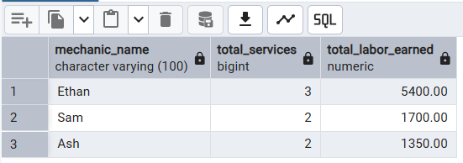
Queries
1.GROUP BY ... HAVING
Use case: Find mechanics who have handled more than 1 service, along with their total labor cost earned.
Query:
SELECT
m.name AS mechanic_name,
COUNT(s.service_id) AS total_services,
SUM(s.labor_cost) AS total_labor_earned
FROM SERVICE s
JOIN MECHANIC m ON s.mechanic_id = m.mechanic_id
GROUP BY m.name
HAVING COUNT(s.service_id) > 1
ORDER BY total_labor_earned DESC;
12

Slide 13
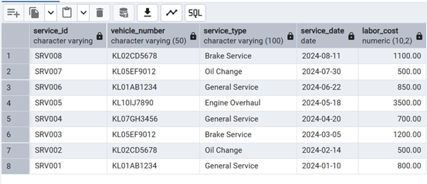
2.ORDER BY
Use case: List all services in chronological order along with the vehicle number and service type, most recent first.
SELECT
s.service_id,
v.vehicle_number,
s.service_type,
s.service_date,
s.labor_cost
FROM SERVICE s
JOIN VEHICLE v ON s.vehicle_id = v.vehicle_id
ORDER BY s.service_date DESC;
13

Slide 14
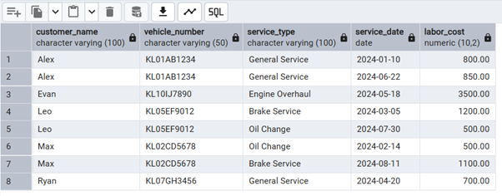
3. INNER JOIN
Use case: Display customer name, vehicle number, and all services availed, to get a complete service history.
SELECT
c.name AS customer_name,
v.vehicle_number,
s.service_type,
s.service_date,
s.labor_cost
FROM CUSTOMER c
INNER JOIN VEHICLE v ON c.customer_id = v.customer_id
INNER JOIN SERVICE s ON v.vehicle_id = s.vehicle_id
ORDER BY c.name, s.service_date;
14

Slide 15

SELF JOIN
Use case: Find pairs of mechanics who work at the same service center (to identify co-workers).
SELECT
e1.center_id,
sc.name AS center_name,
e1.mechanic_id AS mechanic_1,
m1.name AS mechanic_1_name,
e2.mechanic_id AS mechanic_2,
m2.name AS mechanic_2_name
FROM EMPLOYS e1
JOIN EMPLOYS e2 ON e1.center_id = e2.center_id AND e1.mechanic_id < e2.mechanic_id
JOIN MECHANIC m1 ON e1.mechanic_id = m1.mechanic_id
JOIN MECHANIC m2 ON e2.mechanic_id = m2.mechanic_id
JOIN SERVICE_CENTER sc ON e1.center_id = sc.center_id;
15

Slide 16
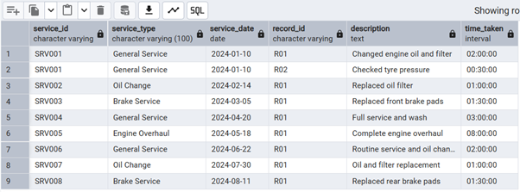
NATURAL JOIN
Use case: Retrieve service records naturally joined with service to show descriptions per service.
SELECT
service_id,
service_type,
service_date,
record_id,
description,
time_taken
FROM SERVICE
NATURAL JOIN SERVICE_RECORD;
16

Slide 17
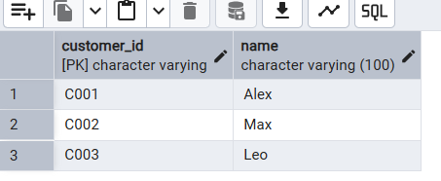
CORRELATED SUBQUERY
Use case: Find customers who have at least one vehicle that has been serviced more than once.
SELECT
c.customer_id,
c.name
FROM CUSTOMER c
WHERE EXISTS (
SELECT 1
FROM VEHICLE v
WHERE v.customer_id = c.customer_id
AND (
SELECT COUNT(*)
FROM SERVICE s
WHERE s.vehicle_id = v.vehicle_id
) > 1
);
17

Slide 18
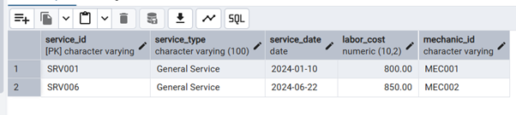
6. BOOLEAN OPERATORS (AND / OR / NOT)
Use case: Find services that are either 'General Service' or 'Oil Change', cost more than 600, and are NOT done by mechanic MEC004.
SELECT
service_id,
service_type,
service_date,
labor_cost,
mechanic_id
FROM SERVICE
WHERE (service_type = 'General Service' OR service_type = 'Oil Change')
AND labor_cost > 600
AND NOT mechanic_id = 'MEC004';
18

Slide 19
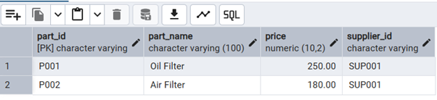
8. STRING OPERATORS (LIKE / ILIKE)
Use case: Search for spare parts whose name contains the word 'Filter' (case-insensitive search).
SELECT
part_id,
part_name,
price,
supplier_id
FROM SPAREPARTS
WHERE part_name ILIKE '%filter%';
19

Slide 20
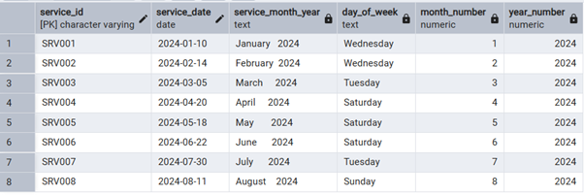
9. TO_CHAR AND EXTRACT
Use case: Display service month, year and day of week for all services to analyse peak service periods.
SELECT
service_id,
service_date,
TO_CHAR(service_date, 'Month YYYY') AS service_month_year,
TO_CHAR(service_date, 'Day') AS day_of_week,
EXTRACT(MONTH FROM service_date) AS month_number,
EXTRACT(YEAR FROM service_date) AS year_number
FROM SERVICE
ORDER BY service_date;
20

Slide 21
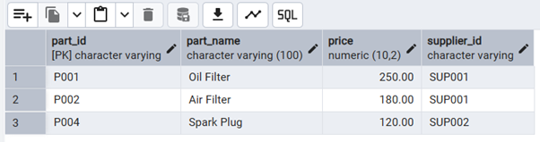
10. BETWEEN, IN, NOT BETWEEN, NOT IN
Use case: Find spare parts whose price is between 100 and 500,supplied by specific suppliers, and exclude parts
-- with price between 300 and 400.
SELECT
part_id,
part_name,
price,
supplier_id
FROM SPAREPARTS
WHERE price BETWEEN 100 AND 500
AND supplier_id IN ('SUP001', 'SUP002')
AND price NOT BETWEEN 300 AND 400
AND part_id NOT IN ('P999');
21

Slide 22
10. BETWEEN, IN, NOT BETWEEN, NOT IN
Use case: Find spare parts whose price is between 100 and 500,supplied by specific suppliers, and exclude parts
-- with price between 300 and 400.
SELECT
part_id,
part_name,
price,
supplier_id
FROM SPAREPARTS
WHERE price BETWEEN 100 AND 500
AND supplier_id IN ('SUP001', 'SUP002')
AND price NOT BETWEEN 300 AND 400
AND part_id NOT IN ('P999');
22

Slide 23
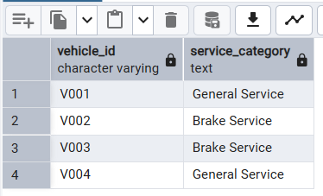
11. SET OPERATIONS (UNION)
Use case: Get a combined list of all vehicle IDs that have either had a 'General Service' OR a 'Brake Service', to identify vehicles needing regular attention.
SELECT vehicle_id, 'General Service' AS service_category
FROM SERVICE
WHERE service_type = 'General Service'
UNION
SELECT vehicle_id, 'Brake Service' AS service_category
FROM SERVICE
WHERE service_type = 'Brake Service'
ORDER BY vehicle_id;
23

Slide 24
THANK YOU
24

