Slide 1


Inbrain Workshop
ITK-Snap
André Avanzine
andreavanzine@usp.br

Slide 2
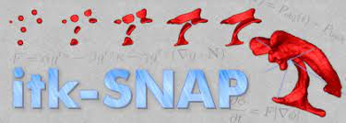
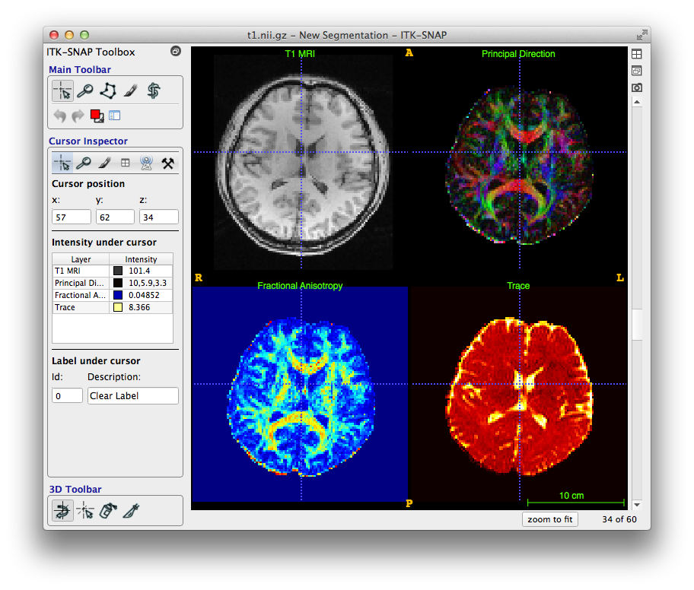
Interface and utilities
Free Software;
3D IRM Segmentation:
Manual (QSM);
Intuitive and easy to
learn.

Slide 3
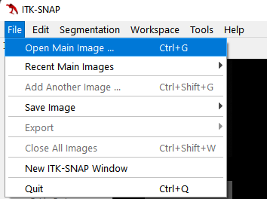
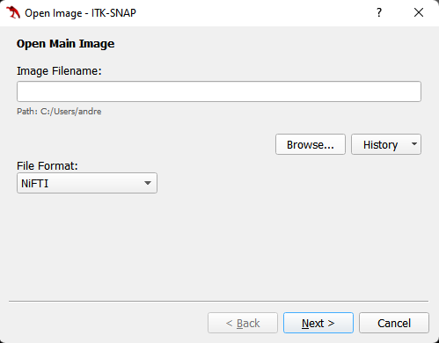
Guide
Select Open Main Image at “File”
to open our T2 image
Notes:
bet2 - the main brain extraction program
betsurf - using a registered T1 and T2 image pair, estimates inner and outer skull surfaces and outer scalp surface

Slide 4
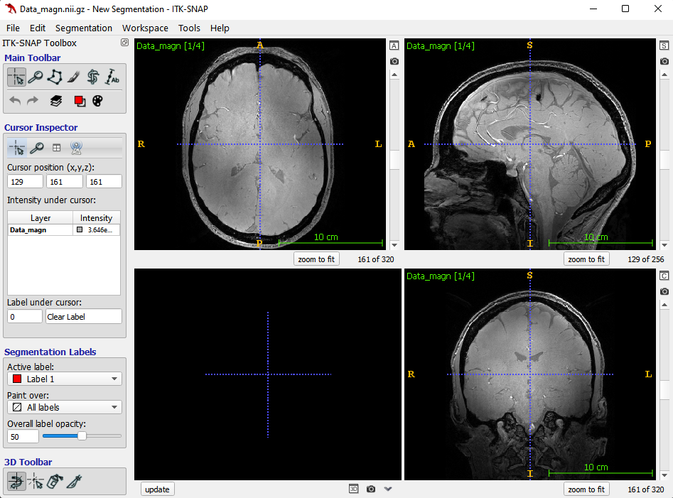
Guide
Ctrl+J to adjust contrast!
Notes:
bet2 - the main brain extraction program
betsurf - using a registered T1 and T2 image pair, estimates inner and outer skull surfaces and outer scalp surface

Slide 5
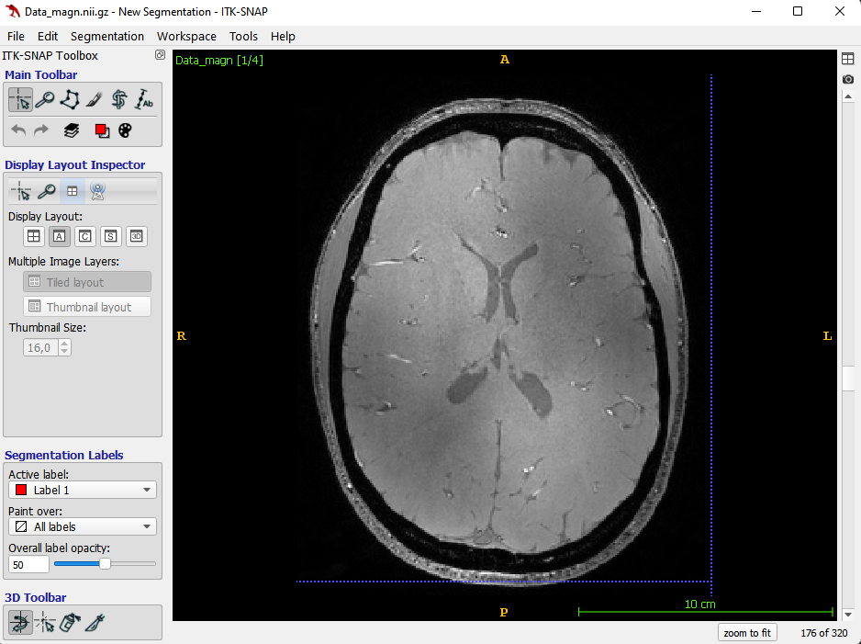
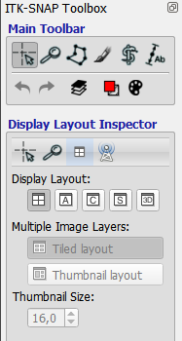
Guide
Select axial view at
“Display Layout Inspector”
Notes:
bet2 - the main brain extraction program
betsurf - using a registered T1 and T2 image pair, estimates inner and outer skull surfaces and outer scalp surface

Slide 6
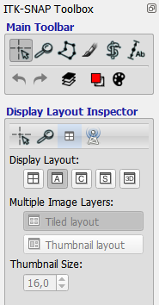
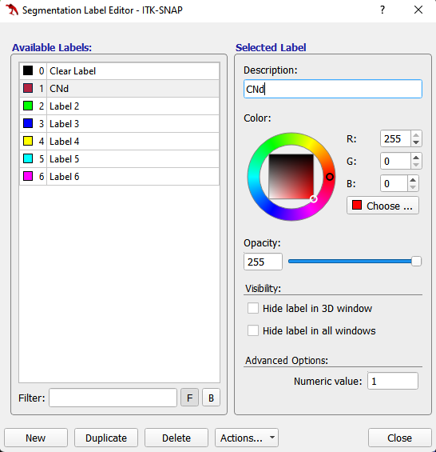
Guide
Let’s segment Caudate Nucleus head (CN)!
Select Label Editor (Ctrl+L)
at “Main Toolbar”
Notes:
bet2 - the main brain extraction program
betsurf - using a registered T1 and T2 image pair, estimates inner and outer skull surfaces and outer scalp surface

Slide 7
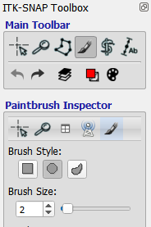
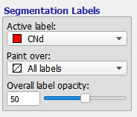
Guide
Let’s segment Caudate Nucleus head (CN)!
Round brush shape
Select your label “CNd”
at “Segmentation Labels”
Size 1 or 2
Select Paintbrush Mode
at “Main Toolbar”
Notes:
bet2 - the main brain extraction program
betsurf - using a registered T1 and T2 image pair, estimates inner and outer skull surfaces and outer scalp surface

Slide 8
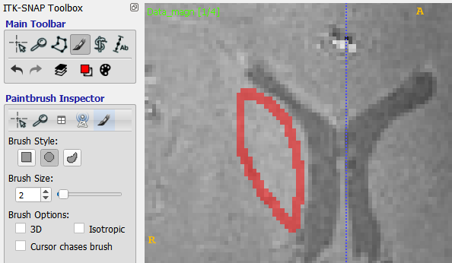
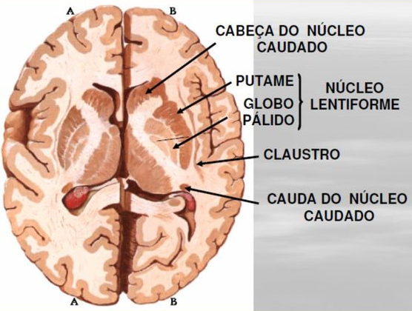
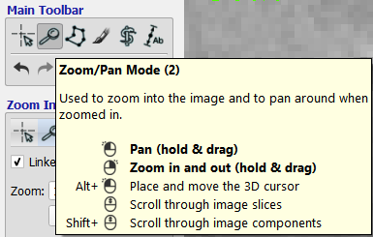
Guide
Let’s segment Caudate Nucleus head (CN)!
Axial slice (layer 177)
Adjust Zoom (hold & drag)
with right mouse button!
Notes:
bet2 - the main brain extraction program
betsurf - using a registered T1 and T2 image pair, estimates inner and outer skull surfaces and outer scalp surface

Slide 9

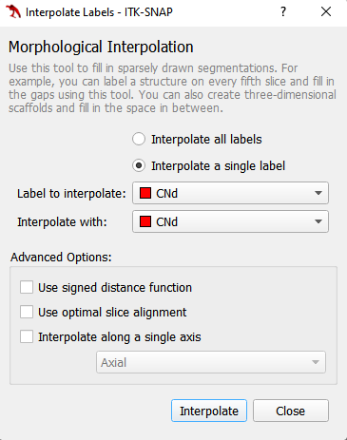
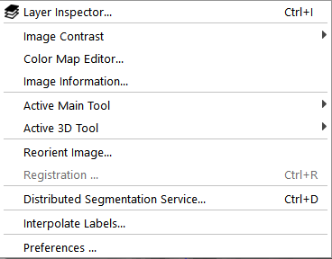
Guide
We can also interpolate the layers!
Select Interpolate Labels
at “Tools”
Notes:
bet2 - the main brain extraction program
betsurf - using a registered T1 and T2 image pair, estimates inner and outer skull surfaces and outer scalp surface

Slide 10
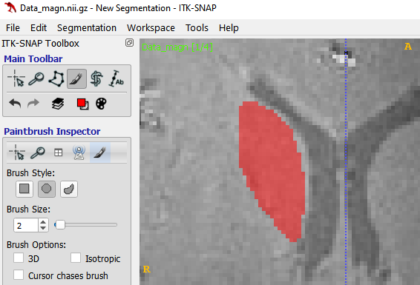
Guide
Now we can brush all inside the structure!
Notes:
bet2 - the main brain extraction program
betsurf - using a registered T1 and T2 image pair, estimates inner and outer skull surfaces and outer scalp surface

Slide 11
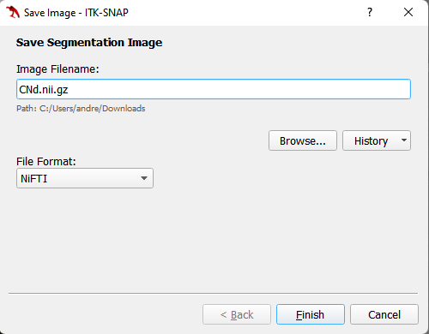
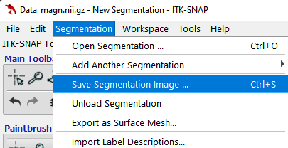
Guide
Save your segmentation image as .nii format...
... and apply to QSM!
Notes:
bet2 - the main brain extraction program
betsurf - using a registered T1 and T2 image pair, estimates inner and outer skull surfaces and outer scalp surface

Slide 12
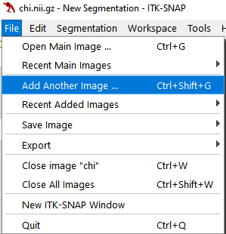
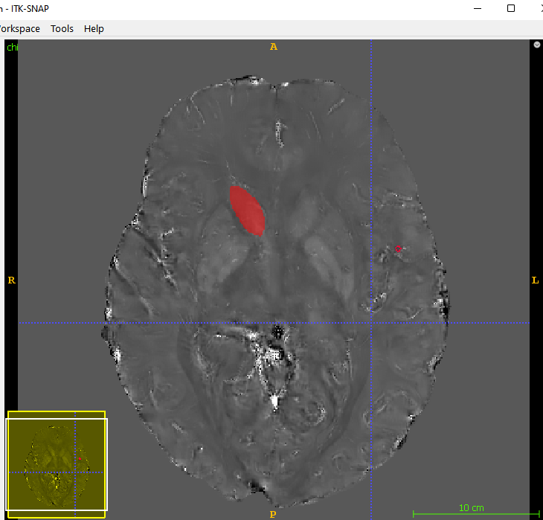
Guide
Select Add Another Image
at “File”
Notes:
bet2 - the main brain extraction program
betsurf - using a registered T1 and T2 image pair, estimates inner and outer skull surfaces and outer scalp surface

Slide 13
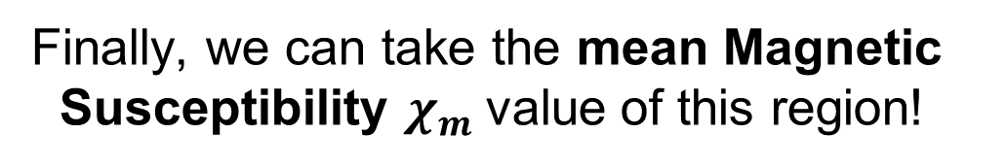
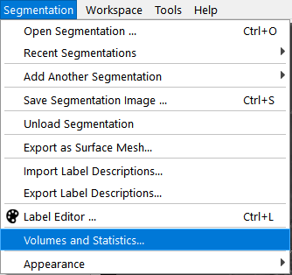
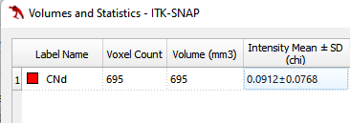
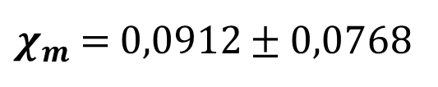
Guide
It must be positive, due to grey matter regions (Paramagnetic)
Notes:
bet2 - the main brain extraction program
betsurf - using a registered T1 and T2 image pair, estimates inner and outer skull surfaces and outer scalp surface

Slide 14
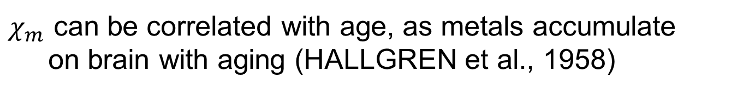
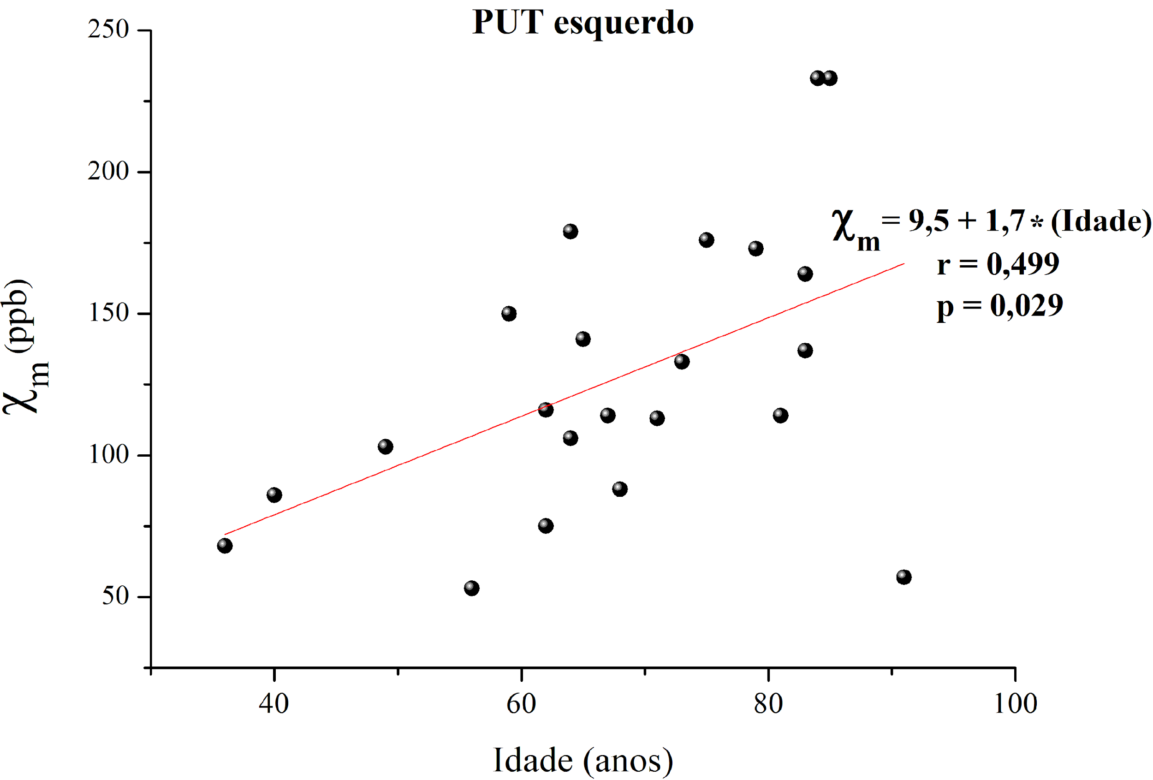
Applications
Graph 1 – Linear correlation between susceptibility and age,
for Left Putamen (PUT), of twenty two ex-vivo subjects
Notes:
bet2 - the main brain extraction program
betsurf - using a registered T1 and T2 image pair, estimates inner and outer skull surfaces and outer scalp surface

Slide 15
ITK-Snap WIKI: http://itksnap.org/pmwiki/pmwiki.php
THANK YOU!

