Slide 1

Web services : Why and How

Slide 2
Roadmap
Remote Objects
What is SOAP
What is REST
Snarky Questions
Snarky Questions
The killer argument
N-Tier Web Architecture
Snarky Questions

Slide 3
Rules of engagement
Talk is cheap!
Friction always yields something!
Training is not done until you try it for yourself!

Slide 4
What’s a Web Service?
A web service is just a web page meant for a computer to request and process
More precisely, a Web service is a Web page that’s meant to be consumed by an autonomous program as opposed to a Web browser or similar UI tool

Slide 5
Origins Of Web-Service
Electronic Data Interchange EDI
Remote Procedure Call RPC
Remote Data Invocation RMI
Common Request Broker Architecture CORBA

Slide 6
Talking to Remote Objects
Finding the object you want
Getting a reference to the object
Invoking methods on the object
Receiving results

Slide 7
Finding The Object You Want
DNS
RMI Registry
JNDI and CORBA Name Service
UDDI

Slide 8
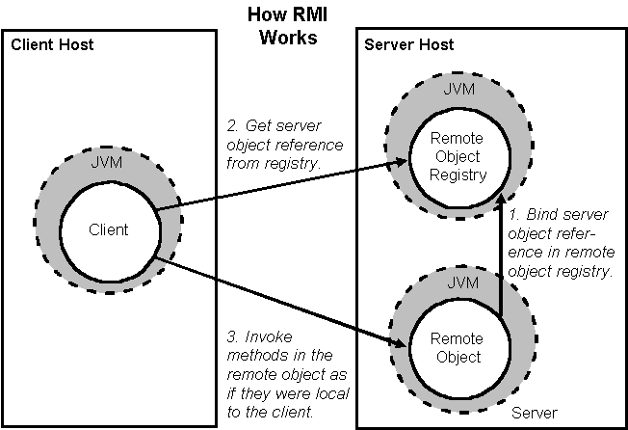
JAVA RMI

Slide 9
SOAP Web Services
Uses Simple Object Access Protocol (SOAP) as common representation
SOAP is expressed in an XML dialect
All information is transmitted as strings
Uses HTTP as the request-reply protocol

Slide 10
SOAP Web Services
Finding Services - UDDI
Describing Services - WSDL
Invoking Services – SOAP

Slide 11
UDDI
Universal Description, Discovery and Integration
A way for clients to find web services
Not being used very much, yet

Slide 12
WSDL
For defining the interfaces for a web service
Names of methods
Types and order of parameters
Types of return values
URL of service
Writing WSDL
Do it once, when service is defined
Annoying and error-prone to do by hand
Several free generating packages available e.g. Apache Ant Java2wsdl

Slide 13
SOAP
Simple Object Access Protocol, works over HTTP
RPC style : It indicates that the SOAP message body contains an XML representation of a method call and uses the names of the method and its parameters to generate XML structures that represent a method’s call stack
Good tools are available e.g. Apache Axis, CXF, Spring WS and Visual Studio .NET etc.
Document style : It indicates that the SOAP body contains a XML document which can be validated against pre-defined XML schema document.

Slide 14
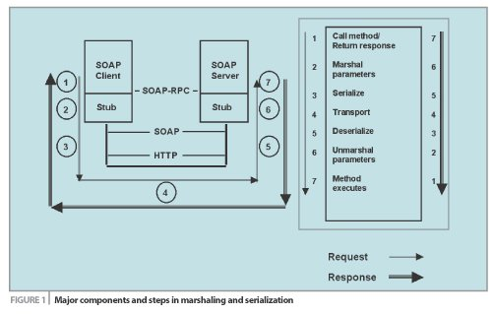
SOAP RPC Style

Slide 15
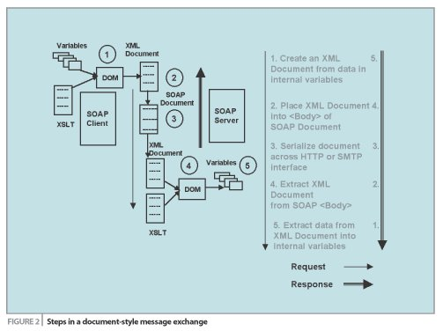
SOAP Document Style

Slide 16
Examples
WSDL
SOAP Request/Response
Different approach of writing SOAP web services
UDDI

Slide 17
Snarky Questions?
Informal, Irritable, Sarcastic, Irreverent or Impertinent

Slide 18
Anything easier?
Would you like something cleaner than SOAP? Something less impenetrable than WSDL? Something less confusingly intertwingled than the various WS-*standards? ...
It’s all No Problem. It’s all Easy as Pi. REST isn’t some obscure thing that nobody supports; it’s the way the Web already works, just formalized a bit and with some do’s and don’ts.

Slide 19
REST
REpresentational State Transfer
An architectural style, not a toolkit
“We don't need no stinking' toolkits!”
A distillation of the way the Web already works

Slide 20
Noun
URIs are the equivalent of a noun
Most words in English are nouns, from cat to antidisestablishmentarianism
The REST language has trillions of nouns for all the concepts in all the heads and files of all the people in the world

Slide 21
Verb
Verbs (loosely) describe actions that are applicable to nouns
Using different verbs for every noun would make widespread communication impossible
In programming we call this “polymorphism”
Some verbs only apply to a few nouns
In REST we use universal verbs only

Slide 22
Four verb for each noun
GET to retrieve information
POST to add new information, showing its relation to old information
PUT to update information
DELETE to discard information

Slide 23
Representation
Resources are first-class objects
Indeed, “object” is a subtype of “resource”
Resources are retrieved not as character strings or BLOBs but as complete representations

Slide 24
Web pages as resources
A web page is a representation of a resource
Resources are just concepts
URIs tell a client that there's a concept somewhere
Clients can then request a specific representation of the concept from the representations the server makes available

Slide 25
“My boss just wants it on time and under budget”
An analogy: Our genes want everyone to reproduce
But that doesn’t mean reproducing will always make you any happier
If your want to build a web-accessible toolkit that a lot of people make use of, REST may help
For a one-off project written by a small group of developers, REST may be

Slide 26
Power of XML
Using XML formats as your machine-processable representations for resources allows applying new tools to old data
It also simplifies interconnection with remote systems
XML has plenty of tools, as we all know

Slide 27
WADL
For defining the interfaces for a web service
Names of methods
Types and order of parameters
Types of return values
URL of service
Writing WADL
No need to write it. Its not required. Its just a better way of identifying the REST service

Slide 28
Snarky Questions?
Informal, Irritable, Sarcastic, Irreverent or Impertinent

Slide 29
The killer argument
Lower learning curve for the consumer
Lower support overhead for the producer
What is better SOAP or REST?

Slide 30
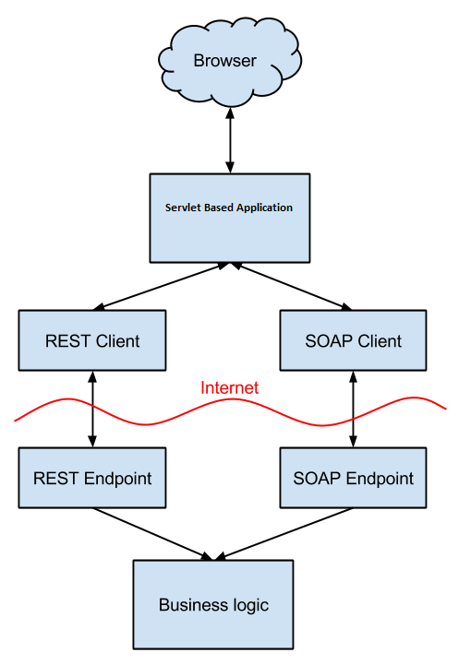
N-Tier Architecture

Slide 31
Scaling? Well...
What kind of scaling is most important is application-specific
Not all apps are Hotmail, Google, or Amazon
Integration between two corporate apps has different scaling and availability needs
The right approach to one isn't necessarily the right approach to the other

Slide 32
Snarky Questions?
Informal, Irritable, Sarcastic, Irreverent or Impertinent

