Slide 1
Java Virtual Machine
http://inbravo.github.io/html/jvm.html
Notes:
Complete subject details are available at: http://inbravo.github.io/html/jvm.html

Slide 2
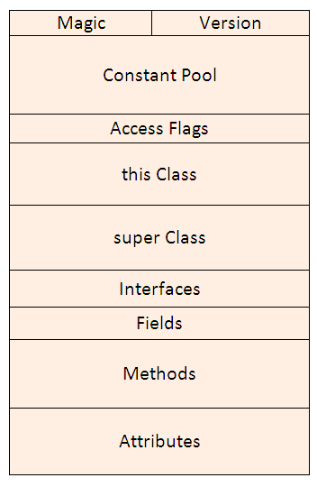
Class file structure

Slide 3
Lets run a java class with –verbose
Java –verbose Anagram

Slide 4
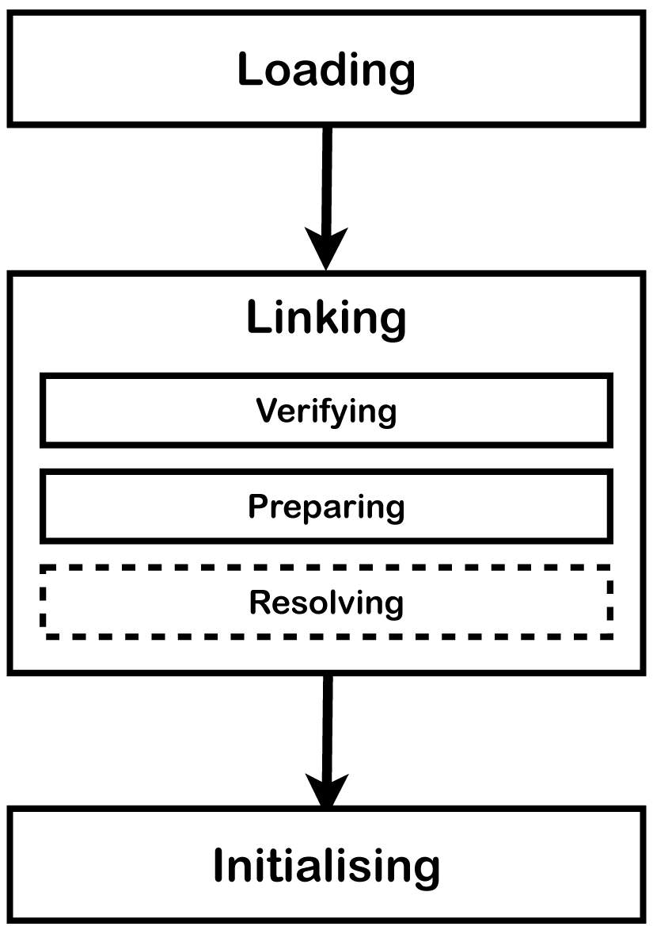
Class loader sub system
Notes:
Loading (BEA)
Boot strap class Loader – load classes from rt.jar
Extension class Loader – load classes from jre\lib\ext folder
Application class Loader –load path mentioned environment variable etc.
Linking (VPR)
Verify – verify generated byte code, if fails generate verification error
Prepare – static variables memory will be allocated and assigned with default values
Resolve – symbolic references replaced by original references from Method Area.
Initialization
here all static variables will be assigned and static block will be executed

Slide 5
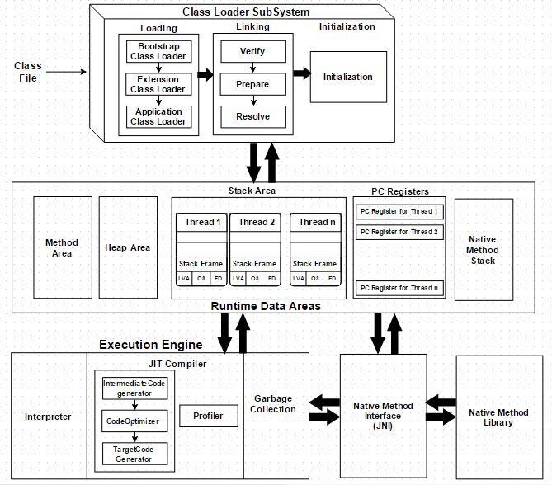
JVM architecture
Notes:
Interpreter – Interpreter interprets the byte code faster but executes slowly.
JIT compiler
neutralizes the disadvantage of the interpreter,
when it found repeated code it uses JIT compiler
JIT compiles the entire bytecode and change it to native code.
Garbage collector
Java Native Interface

Slide 6
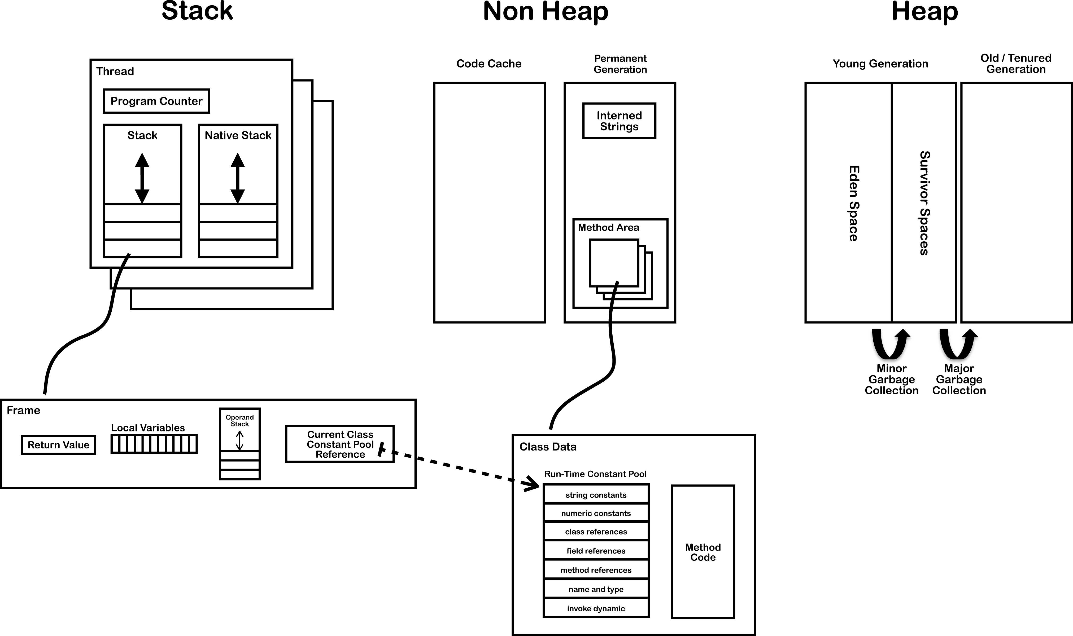
Runtime data areas
Notes:
Method Area
Class level data will be stored here.
Method Area is one per JVM
Heap
Objects and its corresponding instance variables and arrays will be stored here.
Heap Area is one per JVM
Stack
Runtime stack for each thread.
One stack frame for every method call
PC Registers – holds address of current executing instruction
Native stack – holds native method info

Slide 7
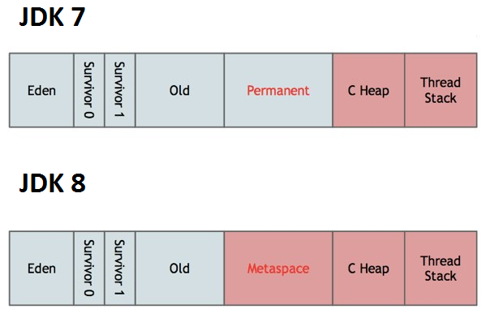
Heap

Slide 8
JDK byte code dissembler
JDK/bin/javap -c Anagram
Javap looks boring ☹
lets use another tool byte code viewer to do make it interesting ☺
Notes:
For more details on ‘javap’ refer https://docs.oracle.com/javase/8/docs/technotes/tools/windows/javap.html

Slide 9

Jvisualvm
Available since JDK 7
Java process id based analysis and thread dump analysis
Notes:
Provided with JDK but can be downloaded from https://visualvm.java.net/download.html
Can be integrated with Eclipse IDE

Slide 10
Primitive variable sizing
Int: 32-bit or 4 byte
long: 64-bit or 8 byte
float: 32-bit or 4 byte
double: 64-bit or 8 byte
boolean, char, byte, short: 32 bit or 4 byte
Notes:
Test class : https://github.com/inbravo/java-src/blob/master/src/com/inbravo/memory/PrimitiveVarsSizeTest.java

Slide 11
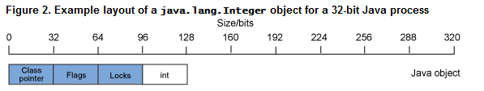
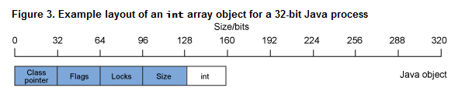
Object sizing
Size of java.lang.Integer
Size of int array
Notes:
Class pointer: A pointer to the class information, which describes the object type. In the case of a java.lang.Integer object, for example, this is a pointer to the java.lang.Integer class
Flags : A collection of flags that describe the state of the object, including the hash code for the object if it has one, and the shape of the object (that is, whether or not the object is an array).
Lock : The synchronization information for the object
Total Object Memory: [OBJECT META INFO] + [OBJECT DATA]
[OBJECT META DATA]: [CLASS INFO = 4 bytes] + [FLAGS = 4 bytes] + [LOCK INFO = 4 bytes]
Total Object Memory: [12 bytes] + [OBJECT DATA]

Slide 12
JVM Source code
http://hg.openjdk.java.net/jdk8/jdk8/hotspot

Slide 13
JVM options
Option types: Standard(-), Non-standard(-X), Developer (-XX)
Option: -XX:+PrintFlagsFinal lists all flags available
Option types:
Behavioural options
Garbage Collection options
Performance tuning options
Debugging options

Slide 14
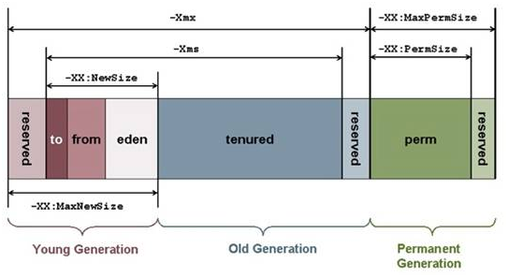
JVM options

Slide 15
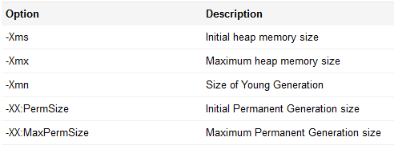
JVM options

Slide 16
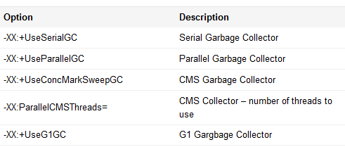
JVM options

Slide 17
References
Topic details : http://inbravo.github.io/html/jvm.html
Examples:
Anagram.java : https://github.com/inbravo/java-src/blob/master/src/com/inbravo/string/Anagram.java
PrimitiveVarsSizeTest.java: https://github.com/inbravo/java-src/blob/master/src/com/inbravo/memory/PrimitiveVarsSizeTest.java
Byte code instructions: https://en.wikipedia.org/wiki/Java_bytecode_instruction_listings
Byte code viewer tool: http://bytecodeviewer.com
Hex editor: https://mh-nexus.de/en/hxd
Jvisualvm: https://visualvm.java.net/download.html

Slide 18
Whacky questions ☺
Why should I learn about byte code?
Why should I know Jvisualvm?
What the hell I am going to do with Hex Editor?
What is the benefit of understanding object sizing?
Why should I read java source code?
Why understanding of JVM is so important?
Why should I bother about JVM options?
What is next?

