Slide 1
Trees

Slide 2
What is a Tree?
A tree is a collection of nodes with the following properties:
  The collection can be empty.
  Otherwise, a tree consists of a distinguished node r, called root, and zero or more nonempty sub-trees T₁, T₂, … , T_{k}, each of whose roots are connected by a directed edge from r.
The root of each sub-tree is said to be child of r, and r is the parent of each sub-tree root.
If a tree is a collection of N nodes, then it has N-1 edges.
root
T₁
T₂
...
T_{k}

Slide 3
Preliminaries
A
B
C
D
E
F
G
H
I
J
K
L
M
N
P
Q
  Node A has 6 children: B, C, D, E, F, G.
  B, C, H, I, P, Q, K, L, M, N are leaves in the tree above.
  K, L, M are siblings since F is parent of all of them.

Slide 4
Preliminaries (continued)
A path from node n₁ to n_{k} is defined as a sequence of nodes n₁, n₂, …, n_{k} such that n_{i} is parent of n_{i+1} (1 ≤i < k)
  The length of a path is the number of edges on that path.
  There is a path of length zero from every node to itself.
  There is exactly one path from the root to each node.
The depth of node n_{i} is the length of the path from root to node n_{i}
The height of node n_{i} is the length of longest path from node n_{i} to a leaf.
If there is a path from n₁ to n₂, then n₁ is ancestor of n₂, and n₂ is descendent of n₁.
  If n₁ ≠ n₂ then n₁ is proper ancestor of n₂, and n₂ is proper descendent of n₁.

Slide 5
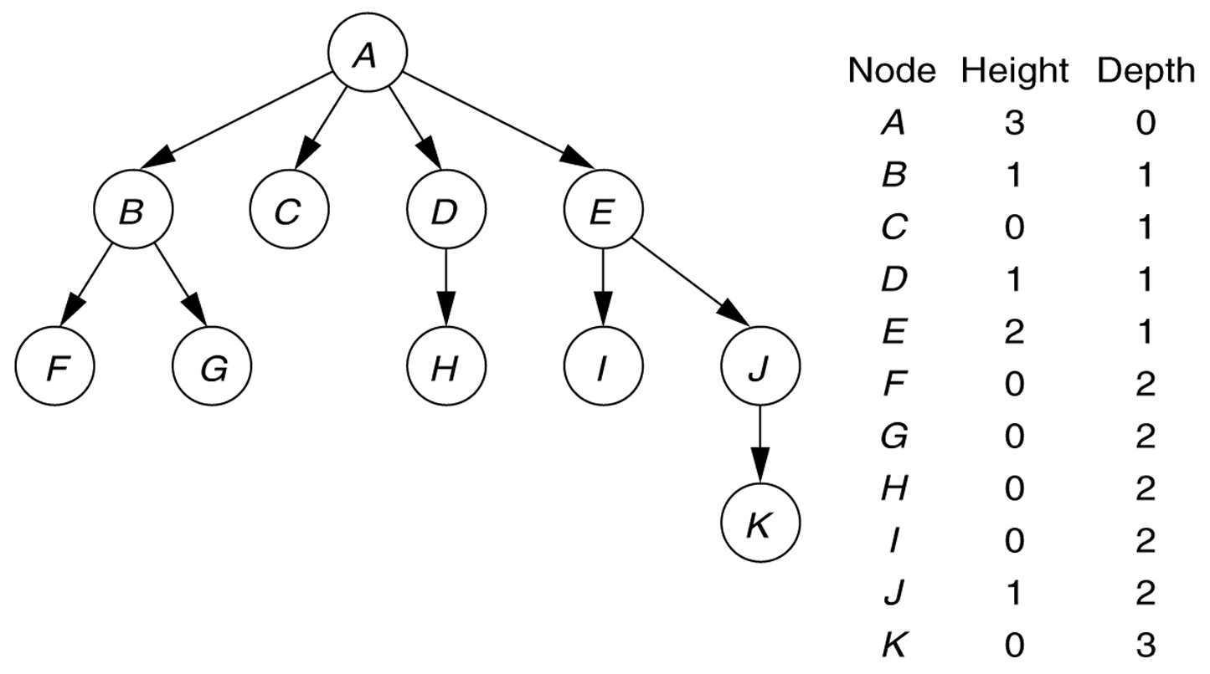
Figure 1
A tree, with height and depth information

Slide 6
Implementation of Trees
A
element
struct TreeNode {
Object element;
struct TreeNode *firstChild;
struct TreeNode *nextSibling;
};
firstChild
NULL
nextSibling
B
C
D
NULL
NULL
A
H
NULL
NULL
B
C
D
E
F
G
H
I
J
K
L
M
N
P
Q

Slide 7
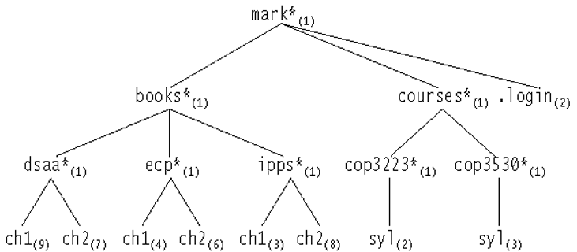
Figure 2: The Unix directory with file sizes

Slide 8
Listing a directory
// Algorithm (not a complete C++ code)
listAll (struct TreeNode *t, int depth) {
printName(t, depth);
if (isDirectory())
for each file c in this directory (for each child)
listAll(c, depth+1);
}
printName() function prints the name of the object after “depth” number of tabs -indentation. In this way, the output is nicely formatted on the screen.
The order of visiting the nodes in a tree is important while traversing a tree.
  Here, the nodes are visited according to preorder traversal strategy.

Slide 9
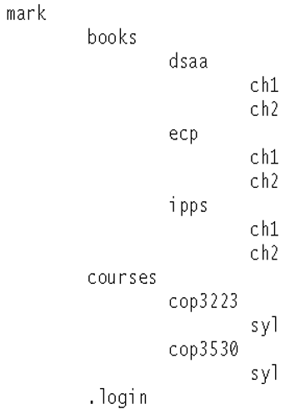
Figure 3: The directory listing for the tree shown in Figure 2

Slide 10
Size of a directory
int FileSystem::size () const {
int totalSize = sizeOfThisFile();
if (isDirectory())
for each file c in this directory (for each child)
totalSize = totalSize + c.size();
return totalSize;
}
The nodes are visited using postorder strategy.
The work at a node is done after processing each child of that node.

Slide 11
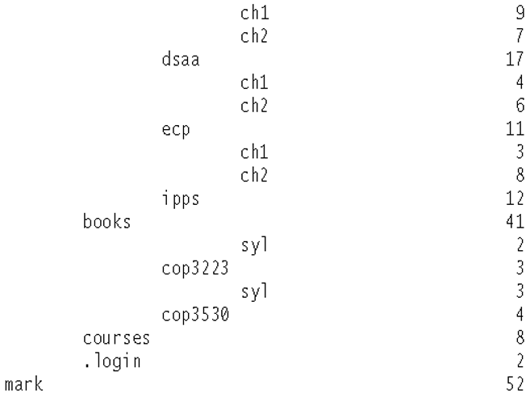
Figure 18.9
A trace of the size method

Slide 12
Preorder Traversal
A traversal visits the nodes of a tree in a systematic manner
In a preorder traversal, a node is visited before its descendants
Application: print a structured document
Algorithm preOrder(v)
  visit(v)
  for each child w of v
  preorder (w)
Make Money Fast!
1
2
5
9
1. Motivations
2. Methods
References
3
4
6
7
8
1.1 Greed
1.2 Avidity
2.1 Stock
Fraud
2.2 Ponzi
Scheme
2.3 Bank
Robbery

Slide 13
Postorder Traversal
In a postorder traversal, a node is visited after its descendants
Application: compute space used by files in a directory and its subdirectories
Algorithm postOrder(v)
  for each child w of v
  postOrder (w)
  visit(v)
9
cs16/
8
3
7
homeworks/
programs/
todo.txt
1K
1
2
4
5
6
h1c.doc
3K
h1nc.doc
2K
DDR.java
10K
Stocks.java
25K
Robot.java
20K

Slide 14
Binary Trees
A binary tree is a tree in which no node can have more than two children
root
A binary tree consisting of a root and two subtrees T_{L} and T_{R}, both of which could possibly be empty.
T_{L}
T_{R}

Slide 15
Binary Tree Terminology
Left Child – The left child of node n is a node directly below and to the left of node n in a binary tree.
Right Child – The right child of node n is a node directly below and to the right of node n in a binary tree.
Left Subtree – In a binary tree, the left subtree of node n is the left child (if any) of node n plus its descendants.
Right Subtree – In a binary tree, the right subtree of node n is the right child (if any) of node n plus its descendants.

Slide 16
Binary Tree – Example
A is the root.
B is the left child of A, and
C is the right child of A.
D doesn’t have a right child.
H doesn’t have a left child.
B, F, G and I are leaves.
• A
• B
• C
• D
• E
• F
• G
• H
• I

Slide 17
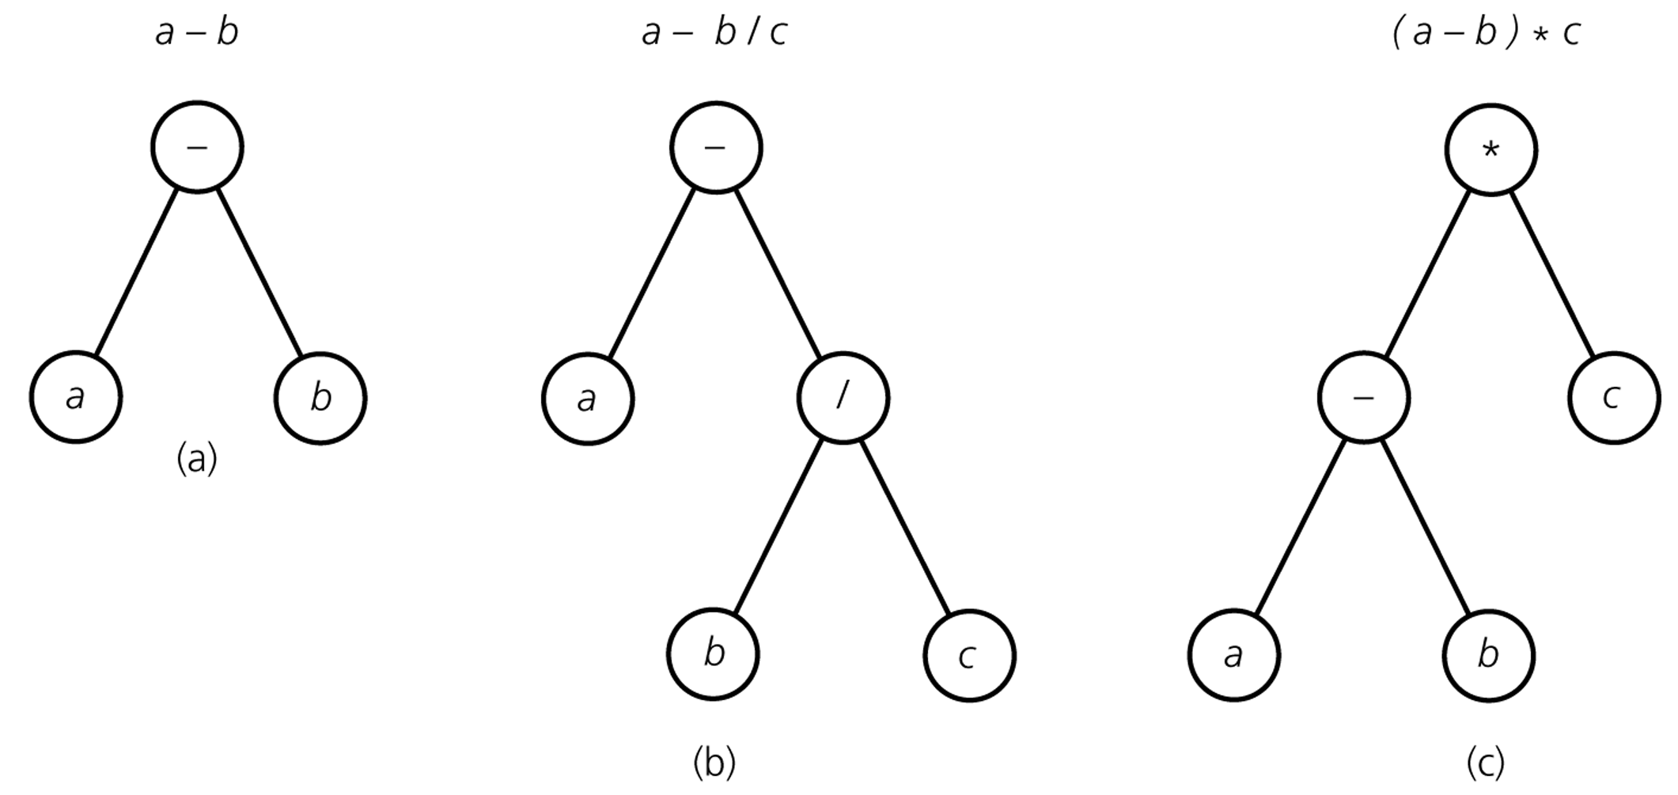
Binary Tree –
Representing Algebraic Expressions

Slide 18
Height of Binary Tree
The height of a binary tree T can be defined recursively as:
  If T is empty, its height is -1.
  If T is non-empty tree, then since T is of the form
  r
  T_{L} T_{R}
  the height of T is 1 greater than the height of its root’s taller subtree;
  i.e.
  height(T) = 1 + max{height(T_{L}), height(T_{R})}

Slide 19
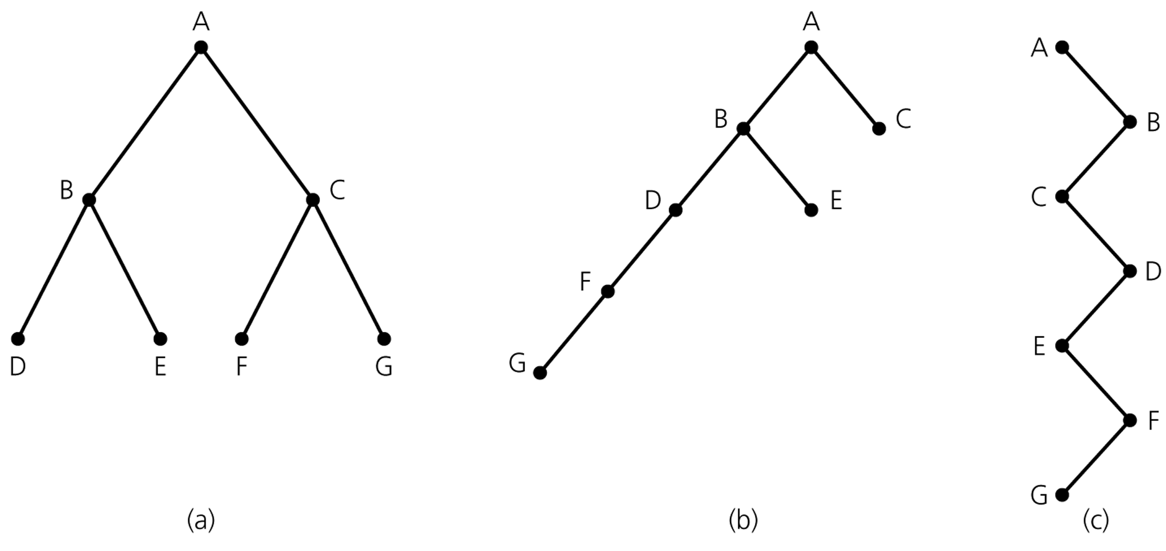
Height of Binary Tree (cont.)
Binary trees with the same nodes but different heights

Slide 20
Number of Binary trees with Same # of Nodes
n=0 ➔ empty tree
n=1 ➔
•
(1 tree)
•
•
n=2 ➔
(2 trees)
•
•
n=3 ➔
•
•
•
•
•
•
•
(5 trees)
•
•
•
•
•
•
•
•
The maximum height can be as large as N-1.

Slide 21
Full Binary Tree
In a full binary tree of height h, all nodes that are at a level less than or equal to h have two children each.
Each node in a full binary tree has left and right subtrees of the same height.
Among binary trees of height h, a full binary tree has as many leaves as possible, and they all are at level h+1.
A full binary has no missing nodes.
Recursive definition of full binary tree:
  If T is empty, T is a full binary tree of height -1.
  If T is not empty and has height h>0, T is a full binary tree if its root’s subtrees are both full binary trees of height h-1.

Slide 22
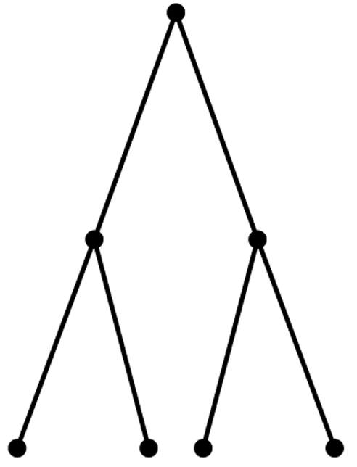
Full Binary Tree – Example
A full binary tree of height 2

Slide 23
Complete Binary Tree
A complete binary tree of height h is a binary tree that is full down to level h, with level h+1 filled in from left to right.
A binary tree T of height h is complete if
  All nodes at level h-1 and above have two children each, and
  When a node at level h has children, all nodes to its left at the same level have two children each, and
  When a node at level h has one child, it is a left child.
A full binary tree is a complete binary tree, too.

Slide 24
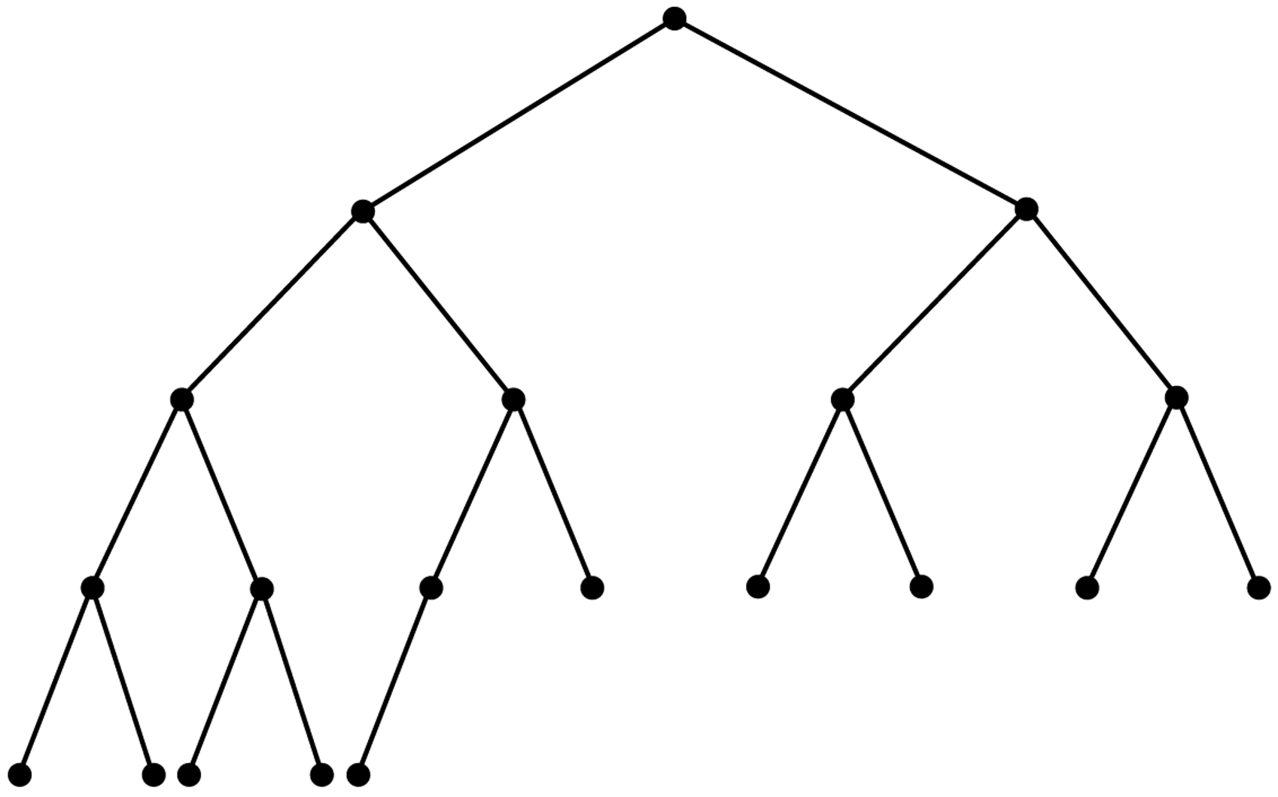
Complete Binary Tree – Example

Slide 25
Balanced Binary Tree
A binary tree is height balanced (or balanced), if the height of any node’s right subtree differs from the height of the node’s left subtree by no more than 1.
A complete binary tree is a balanced tree.
Other height balanced trees:
  AVL trees
  Red-Black trees
  B-trees
  ....

Slide 26
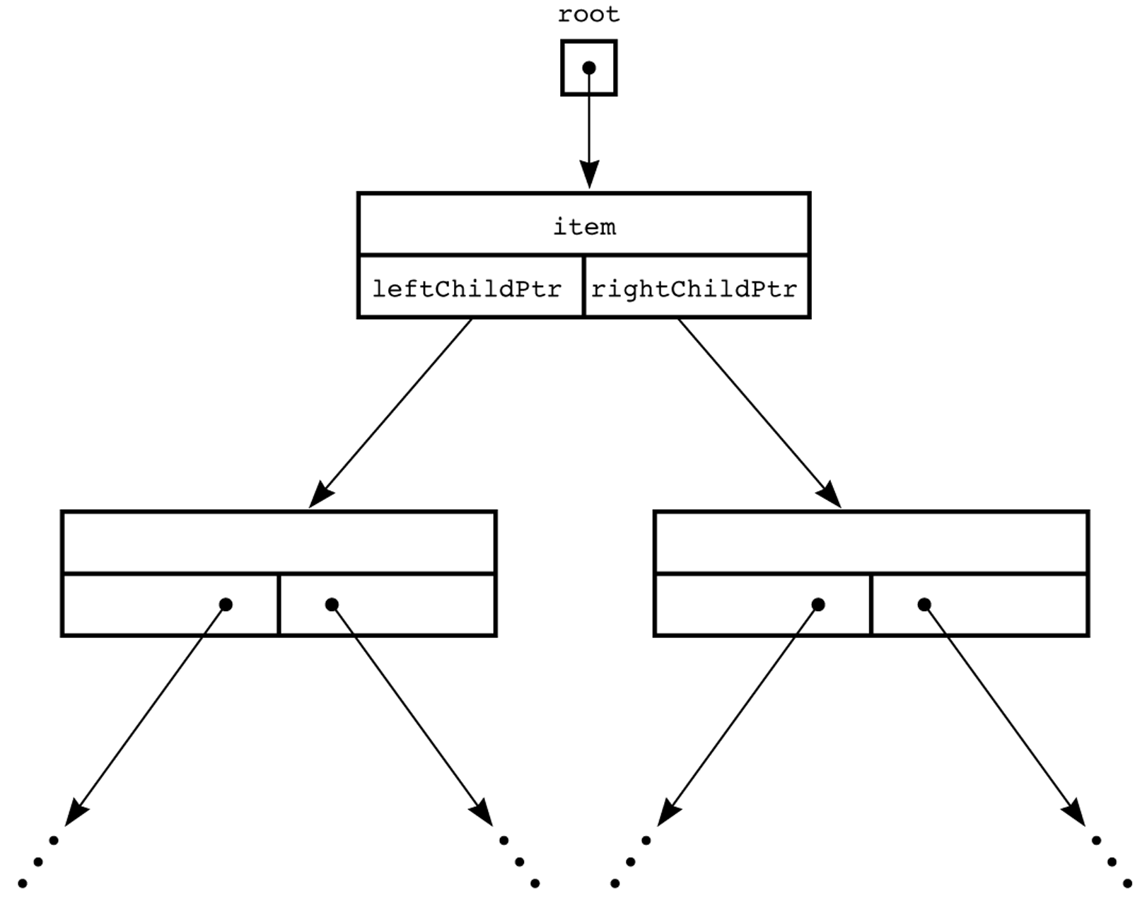
A Pointer-Based Implementation of Binary Trees
struct BinaryNode {
Object element;
struct BinaryNode *left;
struct BinaryNode *right;
};

Slide 27
Binary Tree Traversals
Preorder Traversal:
The node is visited before its left and right subtrees
Visit the node → its left subtree → its right subtree.
Postorder Traversal:
The node is visited after both subtrees
Visit its left subtree → its right subtree → the node.
Inorder Traversal:
The node is visited between the subtrees
Visit its left subtree → the node → its right subtree.

Slide 28
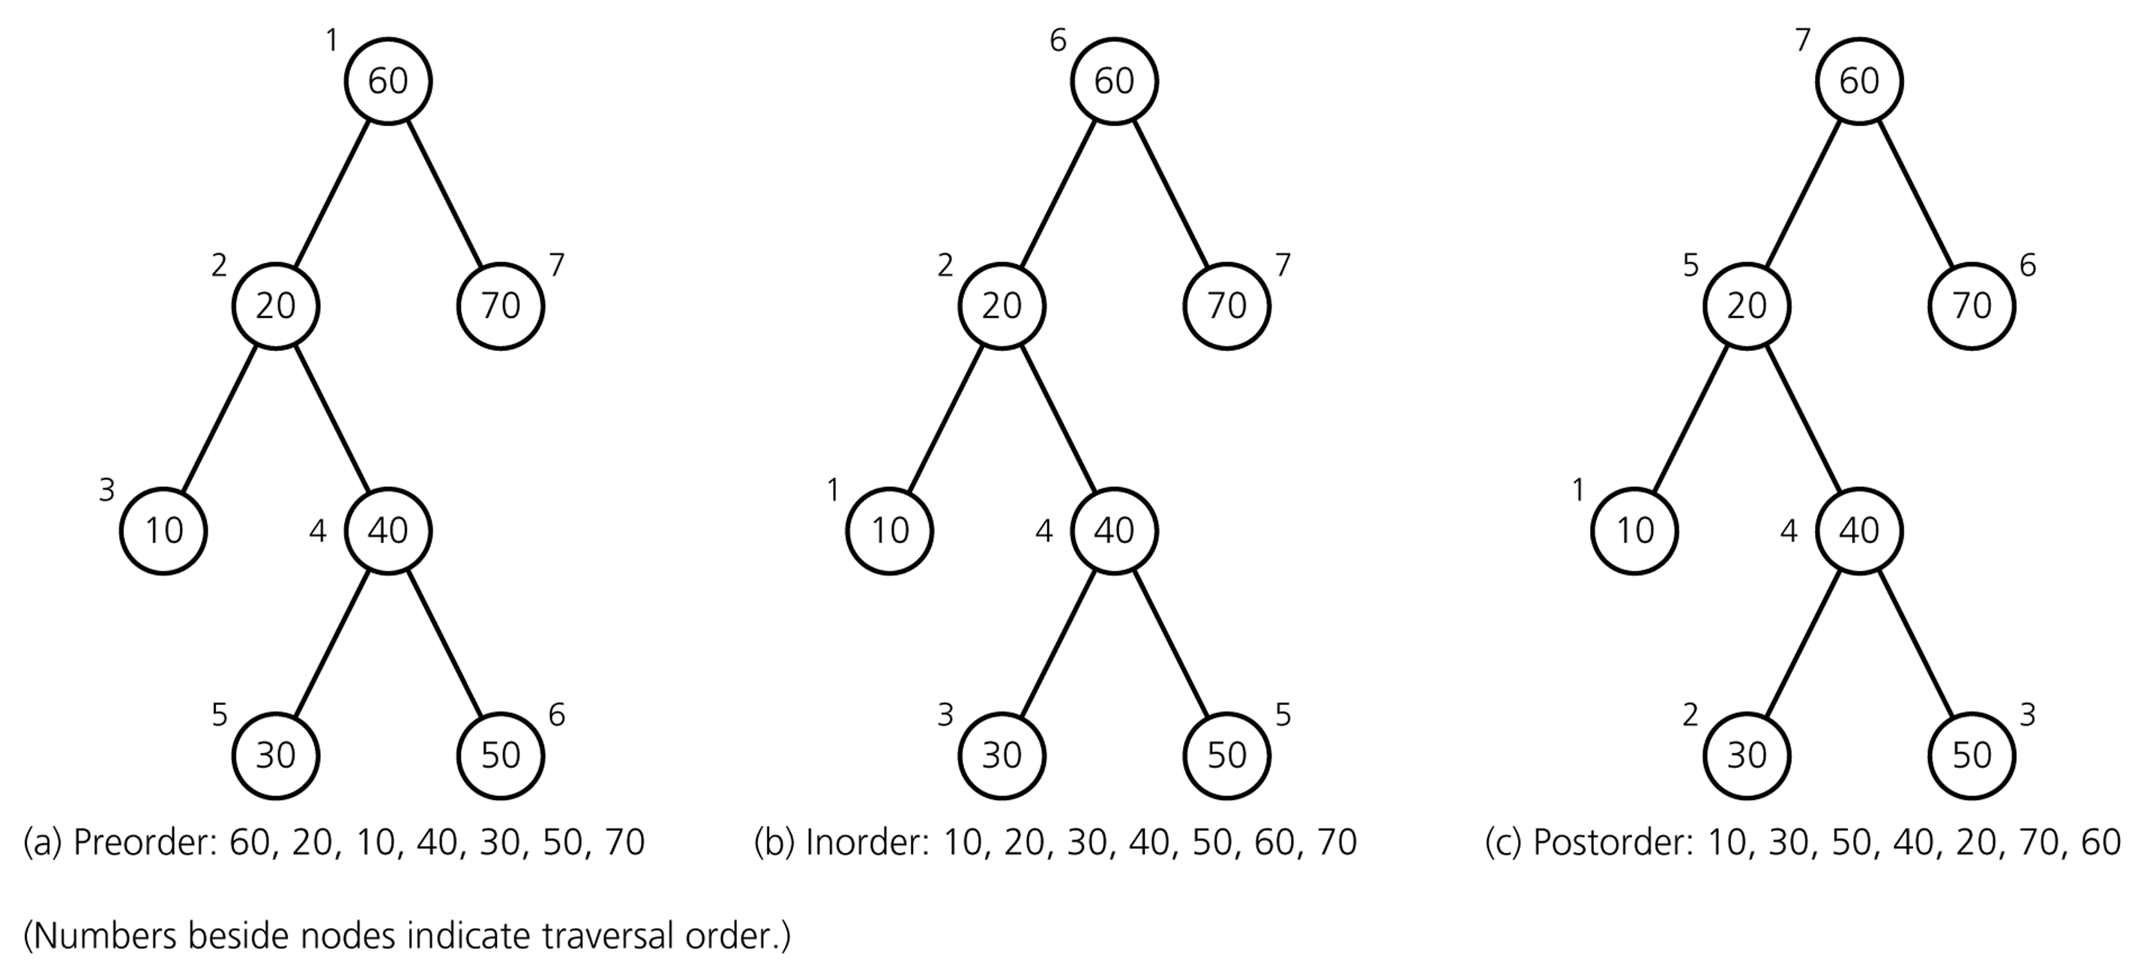
Binary Tree Traversals

Slide 29
Preorder
void preorder(struct tree_node * p) {
if (p != NULL) {
cout << p->data << endl;
preorder(p->left_child);
preorder(p->right_child);
}
}

Slide 30
Inorder
void inorder(struct tree_node *p) {
if (p != NULL) {
inorder(p->left_child);
cout << p->data << endl;
inorder(p->right_child);
}
}

Slide 31
Postorder
void postorder(struct tree_node *p) {
if (p != NULL) {
postorder(p->left_child);
postorder(p->right_child);
cout << p->data << endl;
}
}

Slide 32
Finding the maximum value in a binary tree
int FindMax(struct tree_node *p) {
int root_val, left, right, max;
max = -1; // Assuming all values are positive integers
if (p != NULL) {
root_val = p->data;
left = FindMax(p->left_child);
right = FindMax(p->right_child);
// Find the largest of the three values.
if (left > right)
max = left;
else
max = right;
if (root_val > max)
max = root_val;
}
return max;
}

Slide 33
Adding up all values in a Binary Tree
int add(struct tree_node *p) {
if (p == NULL)
return 0;
else
return (p->data + add(p->left_child)
+ add(p->right_child));
}

Slide 34
Exercises
Write a function that will count the leaves of a binary tree.
Write a function that will find the height of a binary tree.
Write a function that will interchange all left and right subtrees in a binary tree.

Slide 35
Binary Search Trees
An important application of binary trees is their use in searching.
Binary search tree is a binary tree in which every node X contains a data value that satisfies the following:
  all data values in its left subtree are smaller than the data value in X
  the data value in X is smaller than all the values in its right subtree.
  the left and right subtrees are also binary search tees.

Slide 36
Example
6
6
2
8
2
8
1
4
1
4
3
3
7
A binary search tree
Not a binary search tree, but a binary tree

Slide 37
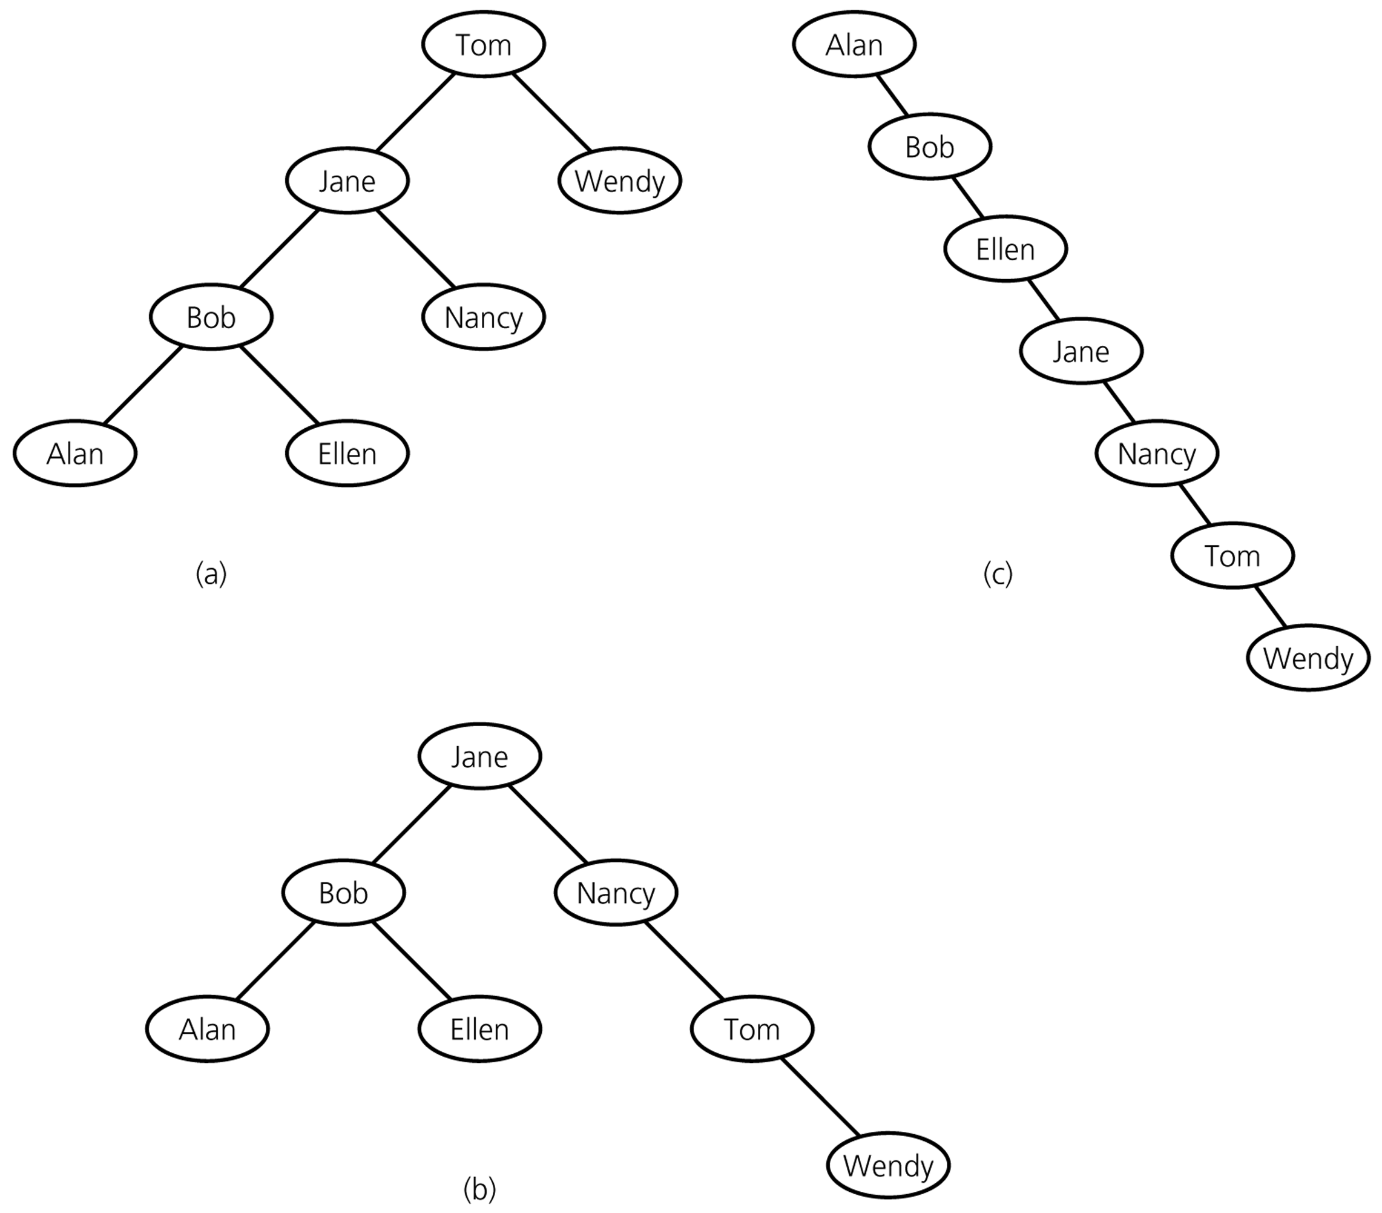
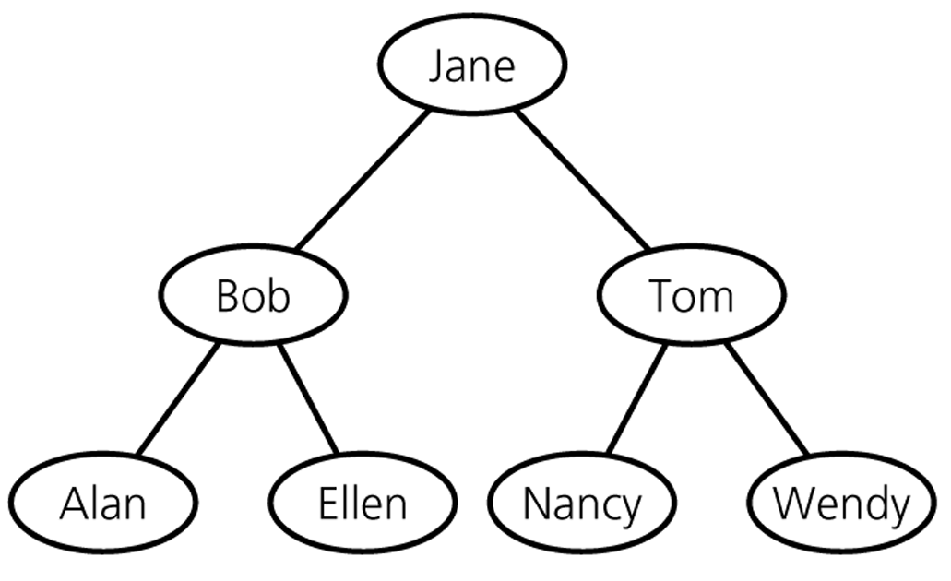
Binary Search Trees – containing same data

Slide 38
Operations on BSTs
Most of the operations on binary trees are O(logN) when balanced.
  This is the main motivation for using binary trees rather than using ordinary lists to store items.
Most of the operations can be implemented using recursion.
  we generally do not need to worry about running out of stack space, since the average height of binary search trees is O(logN).

Slide 39
The BinaryNode class
template <class T>
class BinaryNode {
T element; // this is the item stored in the node
BinaryNode *left; // left subtree
BinaryNode *right; // right subtree
BinaryNode(const T& e, BinaryNode *lt, BinaryNode *rt)
: element(e), left(lt), right(rt) { }
};

Slide 40
find
/**
* Method to find an item in a subtree.
* x is item to search for.
* t is the node that roots the tree.
* Return node containing the matched item.
*/
template <class T>
BinaryNode<T>* find(const T & x, BinaryNode<T> *t) const {
if(t == NULL)
return NULL;
else if(x < t->element)
return find(x, t->left);
else if(t->element < x)
return find(x, t->right);
else
return t; // Match
}

Slide 41
findMin (recursive implementation)
/**
* Method to find the smallest item in a subtree t.
* Return node containing the smallest item.
*/
template <class T>
BinaryNode<T>* findMin(BinaryNode<T> *t) const {
if(t == NULL)
return NULL;
if(t->left == NULL)
return t;
return findMin(t->left);
}

Slide 42
findMax (nonrecursive implementation)
/**
* Method to find the largest item in a subtree t.
* Return node containing the largest item.
*/
template <class T>
BinaryNode<T>* findMax(BinaryNode<T> *t) const {
if(t != NULL)
while(t->right != NULL)
t = t->right;
return t;
}

Slide 43
Insert operation
Algorithm for inserting X into tree T:
  Proceed down the tree as you would with a find operation.
  if X is found
  do nothing, (or “update” something)
  else
  insert X at the last spot on the path traversed.

Slide 44
Insert 5
Example
6
2
8
1
4
3
5

Slide 45
Insertion into a BST
/* Method to insert into a subtree.
* x is the item to insert.
* t is the node that roots the tree.
* Set the new root.
*/
template <class T>
void insert(const T& x, BinaryNode<T> * & t) const {
if(t == NULL)
t = new BinaryNode<T>(x, NULL, NULL);
else if(x < t->element)
insert(x, t->left);
else if(t->element < x)
insert(x, t->right);
else
; // Duplicate; do nothing
}

Slide 46
Deletion operation
There are three cases to consider:
  Deleting a leaf node
    Replace the link to the deleted node by NULL.
  Deleting a node with one child:
    The node can be deleted after its parent adjusts a link to bypass the node.
  Deleting a node with two children:
    The deleted value must be replaced by an existing value that is either one of the following:
      The largest value in the deleted node’s left subtree
      The smallest value in the deleted node’s right subtree.

Slide 47
Deletion – Case1: A Leaf Node
To remove the leaf containing the item, we have to set the pointer in its parent to NULL.
Delete 70 (A leaf node)
50
50
➔
40
60
40
60
30
45
70
30
45
42
42

Slide 48
Deletion – Case2: A Node with only a left child
Delete 45 (A node with only a left child)
50
50
40
60
➔
40
60
30
45
70
30
42
70
42

Slide 49
Deletion – Case2: A Node with only a right child
Delete 60 (A node with only a right child)
50
50
➔
40
70
40
60
70
30
45
30
45
42
42

Slide 50
Deletion – Case3: A Node with two children
Locate the inorder successor of the node.
Copy the item in this node into the node which contains the item which will be deleted.
Delete the node of the inorder successor.
Delete 40 (A node with two children)
50
50
40
60
➔
42
60
30
45
70
30
45
70
42

Slide 51
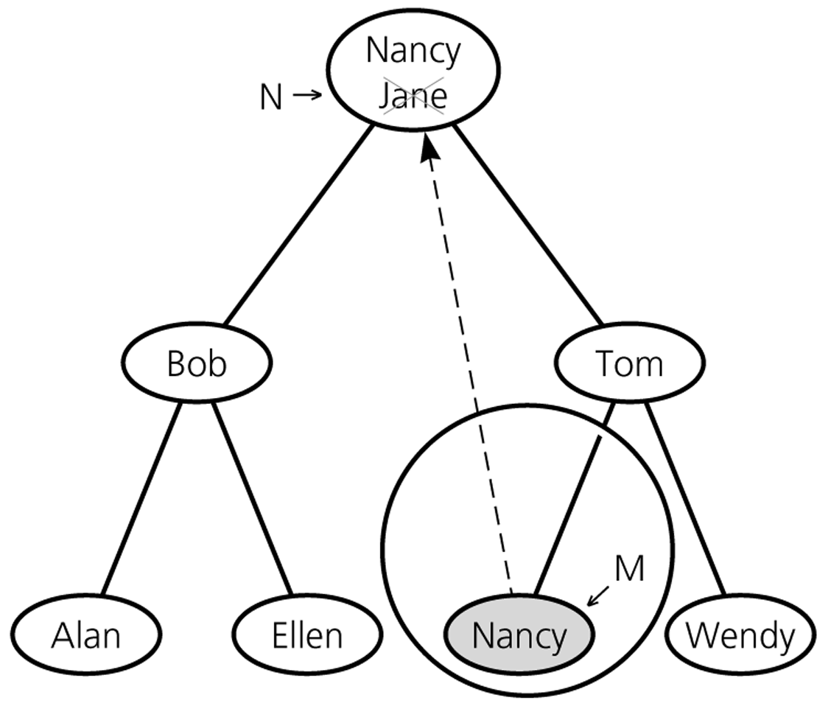
Deletion – Case3: A Node with two children

Slide 52
Deletion routine for BST
template <class T>
void remove(const T & x, BinaryNode<T> * & t) const {
if(t == NULL)
return; // item not found; do nothing
if(x < t->element)
remove(x, t->left); // trying to find
else if(t->element < x)
remove(x, t->right); // trying to find
else if(t->left != NULL && t->right != NULL {
// found – it has two children: copy min of right subtree here
t->element = findMin(t->right)->element;
remove(t->element, t->right); // and delete its original node
}
else { // it has zero or one child: move that or right child here
BinaryNode<T> *oldNode = t;
t = (t->left != NULL) ? t->left : t->right;
delete oldNode; // delete it
}
}

Slide 53
Analysis of BST Operations
The cost of an operation is proportional to the depth of the last accessed node.
The cost is logarithmic for a well-balanced tree, but it could be as bad as linear for a degenerate tree.
In the best case we have logarithmic access cost, and in the worst case we have linear access cost.

Slide 54
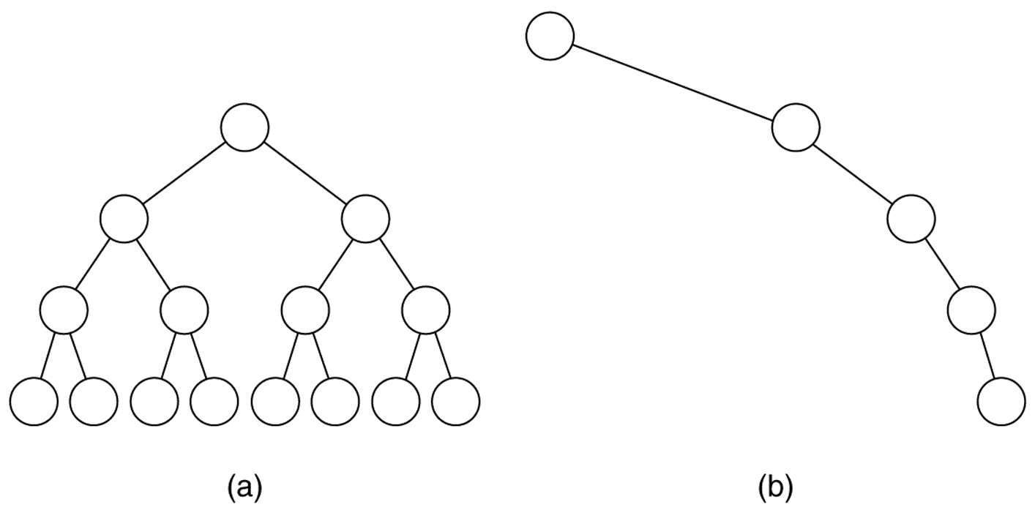
Figure 19.19
(a) The balanced tree has a depth of log N; (b) the unbalanced tree has a
depth of N – 1.

Slide 55
Maximum and Minimum Heights of a Binary Tree
The efficiency of most of the binary tree (and BST) operations depends on the height of the tree.
The maximum number of key comparisons for retrieval, deletion, and insertion operations for BSTs is the height of the tree.
The maximum height of a binary tree with n nodes is n-1.
Each level of a minimum height tree, except the last level, must contain as many nodes as possible.

Slide 56
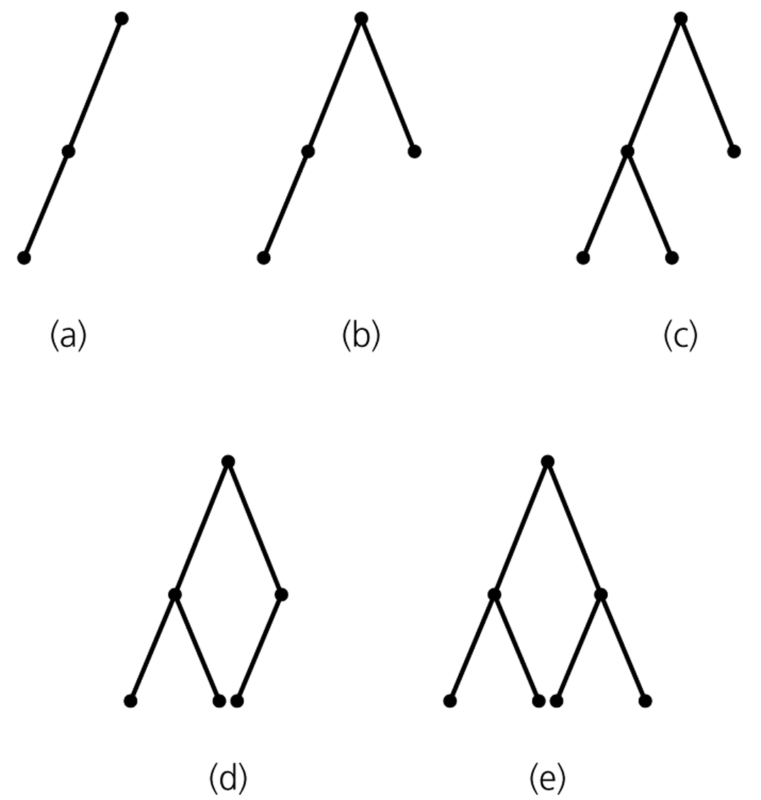
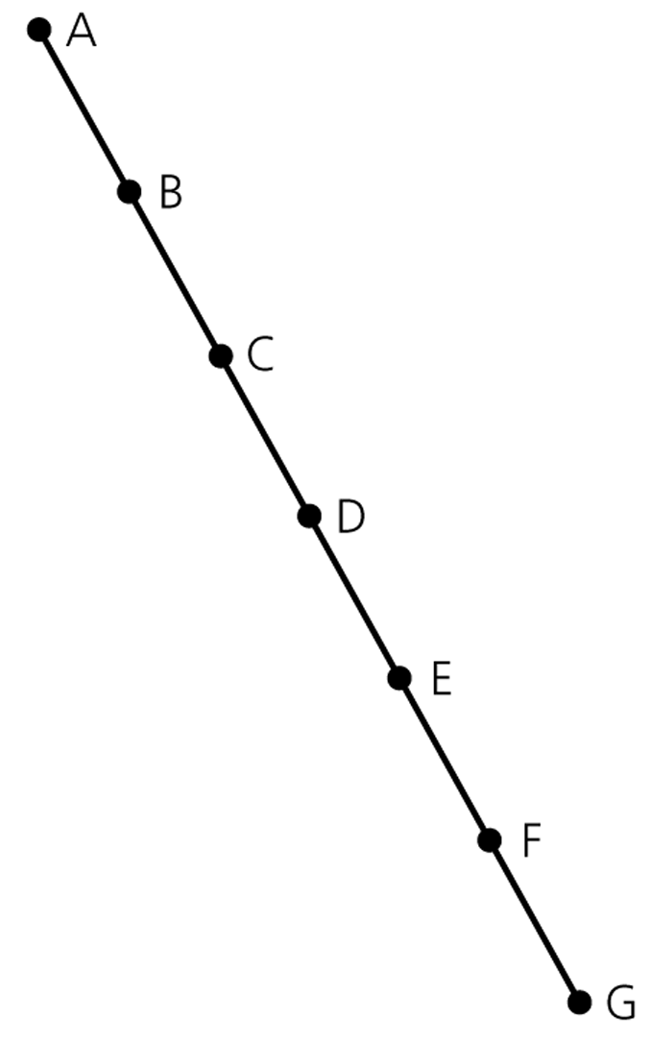
Maximum and Minimum Heights of a Binary Tree
A maximum-height binary tree
with seven nodes
Some binary trees of height 2

Slide 57
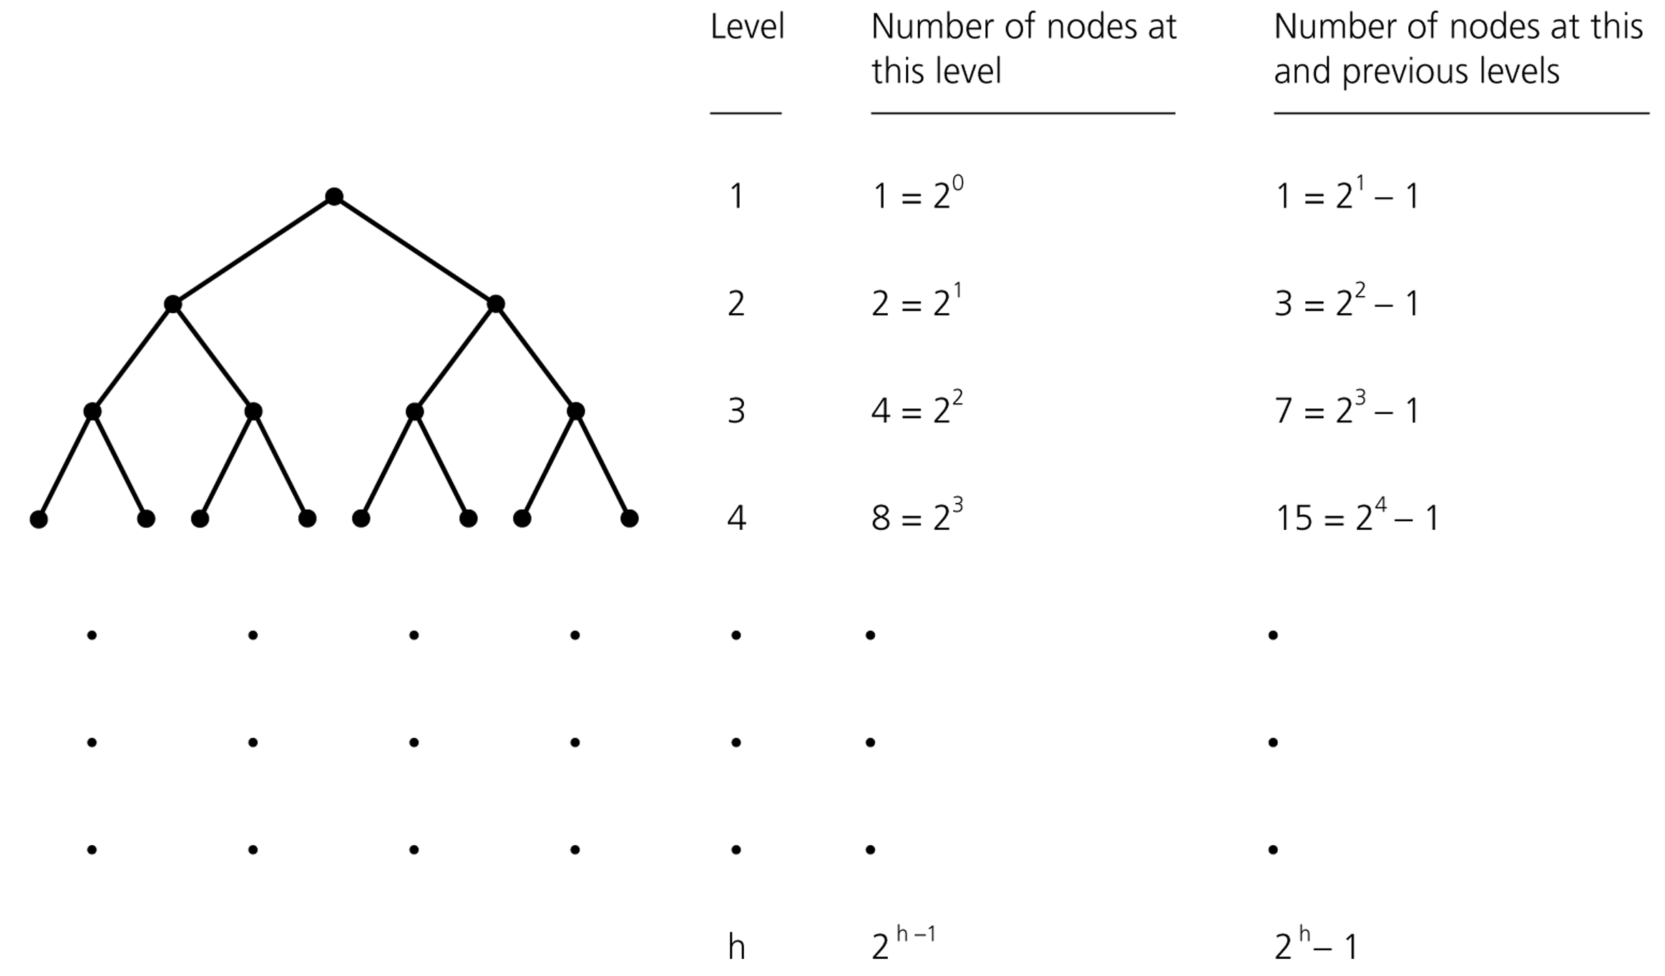
Counting the nodes in a full binary tree
Height
______
0
1
2
3
h-1

Slide 58
Some Height Theorems
Theorem 1: A full binary of height h ≥ 0 has 2^{h+1}-1 nodes.
Theorem 2: The maximum number of nodes that a binary tree of height h can have is 2^{h+1}-1.
We cannot insert a new node into a full binary tree without
increasing its height.
Theorem 3: The minimum height of a binary tree with n nodes is ⎡log₂(n+1)-1⎤ .

Slide 59
Minimum Height
Complete/Full trees have minimum height.
Insertion in search-key order produces a maximum-height binary search tree.
Insertion in random order produces a near-minimum-height binary search tree.
That is, the height of an n-node binary search tree
  Best Case – ⎡log₂(n+1)-1⎤ ➔ O(log₂n)
  Worst Case – n-1 ➔ O(n)
  Average Case – close to ⎡log₂(n+1)-1⎤ ➔ O(log₂n)
    In fact, 1.39log₂n

Slide 60
Average Height
Suppose we’re inserting n items into an empty binary search tree to create a binary search tree with n nodes,
➔ How many different binary search trees with n nodes, and
What are their probabilities,
There are n! different orderings of n keys, but how many different binary search trees with n nodes?
n=0 ➔ 1 BST (empty tree)
n=1 ➔ 1 BST (a binary tree with a single node)
n=2 ➔ 2 BSTs
n=3 ➔ 5 BSTs

Slide 61
Average Height (cont.)
•
•
•
•
•
n=3 ➔
•
•
•
•
•
•
•
•
•
•
Probabilities: 1/6 1/6 2/6 1/6 1/6
Insertion Order: 3,2,1 3,1,2 2,1,3 1,3,2 1,2,3
2,3,1
In general, given n elements, the number of binary search trees that can be made from those elements is given by the n^{th} Catalan Number (denoted C_{n}).
(2n)!
C_{n} = ----------
(n+1)!n!

Slide 62
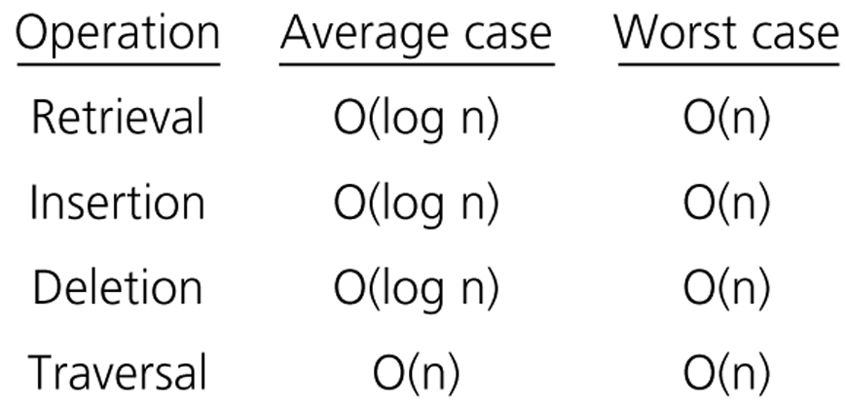
Order of Operations on BSTs

Slide 63
Treesort
We can use a binary search tree to sort an array.
treesort(inout anArray:ArrayType, in n:integer)
// Sorts n integers in an array anArray
// into ascending order
Insert anArray’s elements into a
binary search tree bTree
Traverse bTree in inorder.
As you visit bTree’s nodes, copy their data items
intosuccessive locations of anArray

Slide 64
Treesort Analysis
Inserting an item into a binary search tree:
  Worst Case: O(n)
  Average Case: O(log₂n)
Inserting n items into a binary search tree:
  Worst Case: O(n²) ➔ (1+2+...+n) = O(n²)
  Average Case: O(n*log₂n)
Inorder traversal and copy items back into array ➔ O(n)
Thus, treesort is
➔ O(n²) in worst case, and
➔ O(n*log₂n) in average case.
Treesort makes exactly the same comparisons of keys as quicksort when the pivot for each sublist is chosen to be the first key.

Slide 65
Saving a BST into a file, and restoring it to its original shape
Save:
  Use a preorder traversal to save the nodes of the BST into a file.
Restore:
  Start with an empty BST.
  Read the nodes from the file one by one, and insert them into the BST.

Slide 66
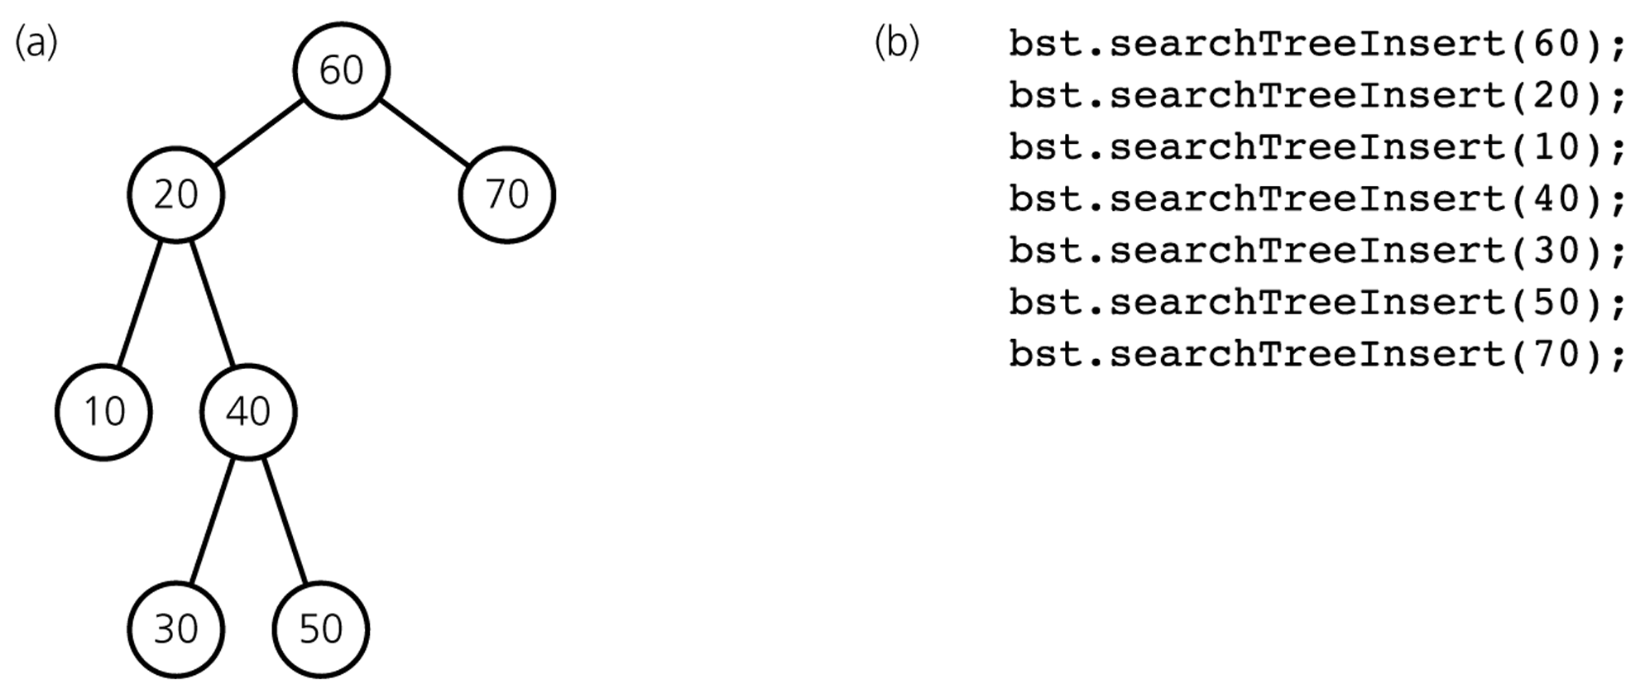
Saving a BST into a file, and restoring it to its original shape
Preorder: 60 20 10 40 30 50 70

Slide 67
Saving a BST into a file, and restoring it to a minimum-height BST
Save:
  Use an inorder traversal to save the nodes of the BST into a file. The saved nodes will be in ascending order.
  Save the number of nodes (n) in somewhere.
Restore:
  Read the number of nodes (n).
  Start with an empty BST.
  Recursively,
    read the first half of the nodes from the file in to the left subtree,
    then read the root and
    finally read the second half in to the right subtree
  to create a minimum-height binary search tree.

Slide 68
Building a minimum-height BST
readTree(out treePtr:TreeNodePtr, in n:integer)
// Builds a minimum-height binary search tree for n sorted
// values in a file. treePtr will point to the tree’s root.
if (n>0) {
// construct the left subtree
treePtr = pointer to new node with NULL child pointers
readTree(treePtr->leftChildPtr, n/2)
// get the root
Read item from file into treePtr->item
// construct the right subtree
readTree(treePtr->rightChildPtr, (n-1)/2)
}

Slide 69
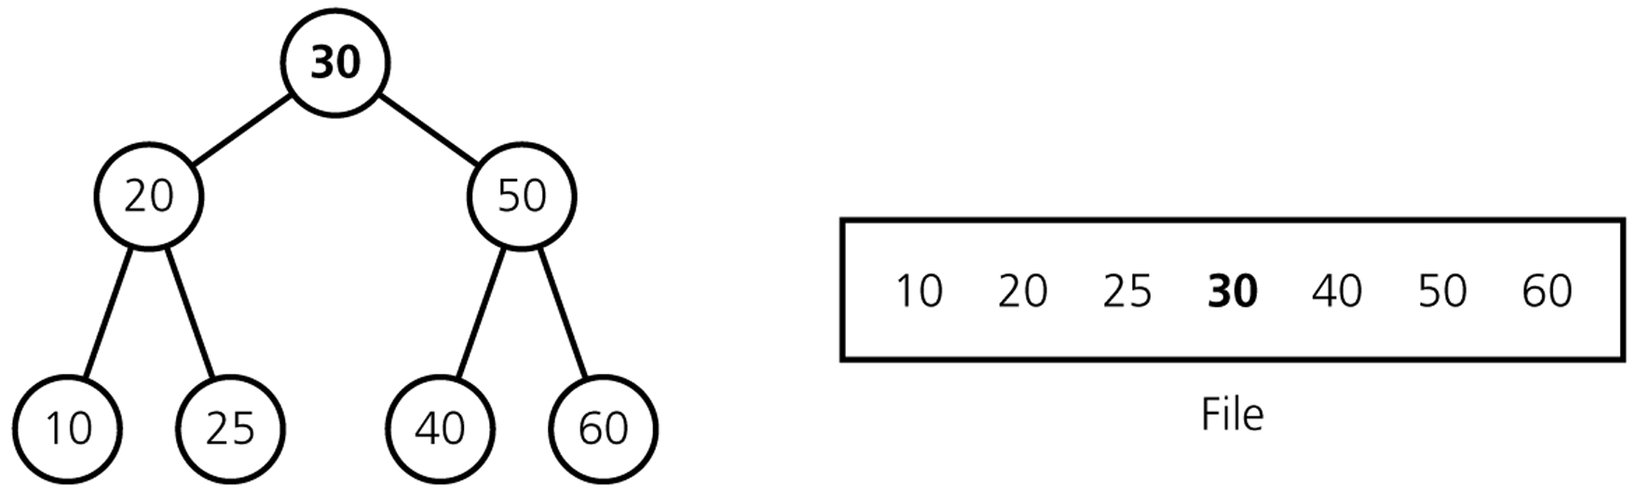
A full tree saved in a file by using inorder traversal

