Slide 1
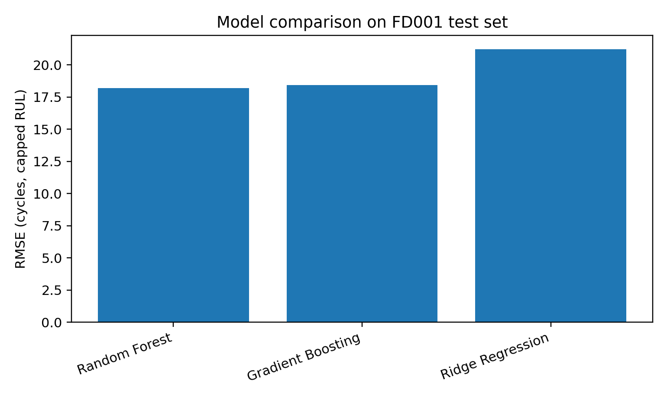
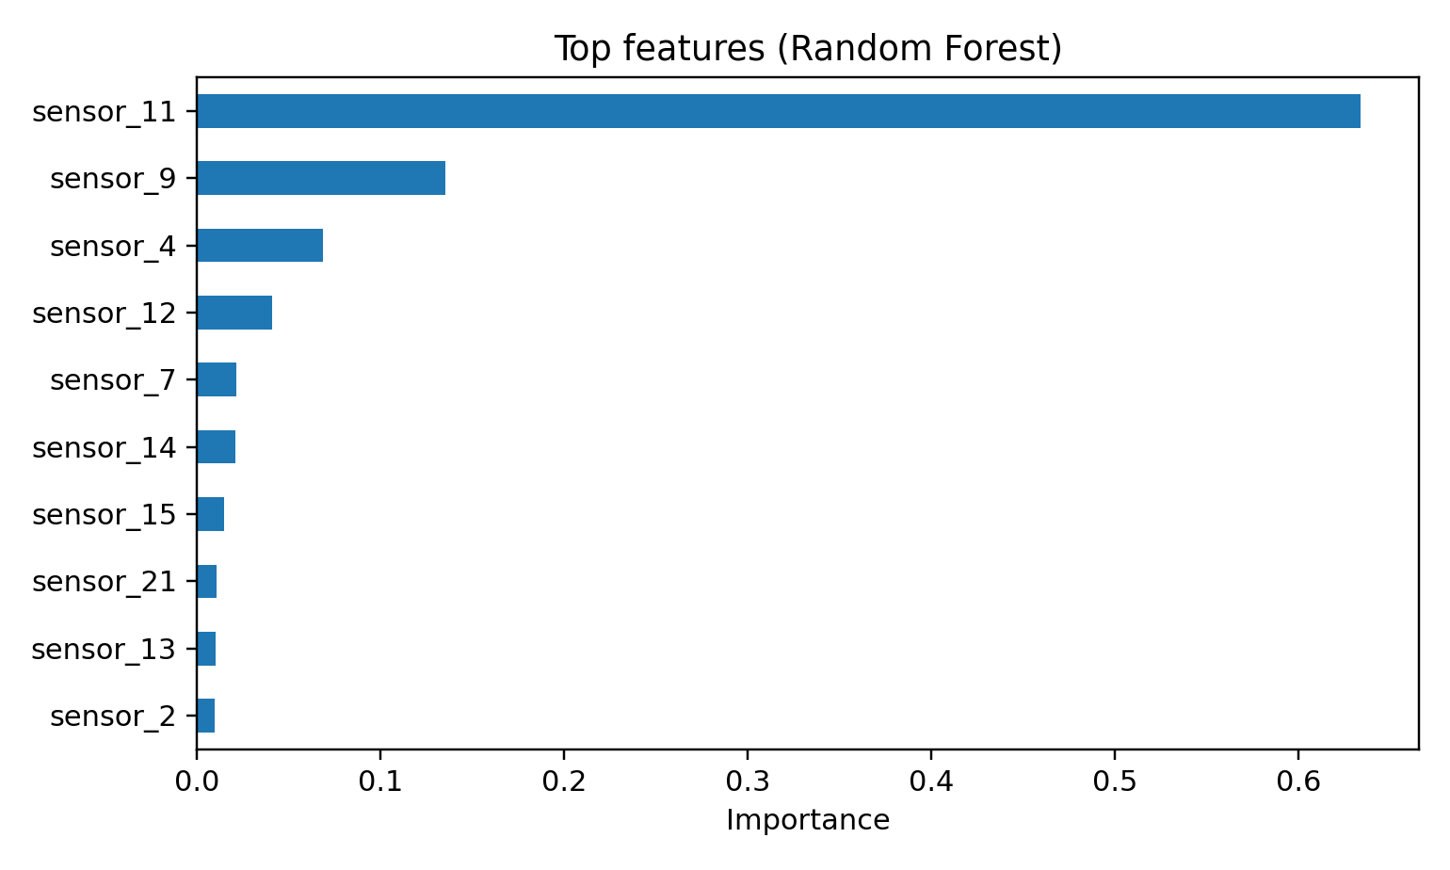
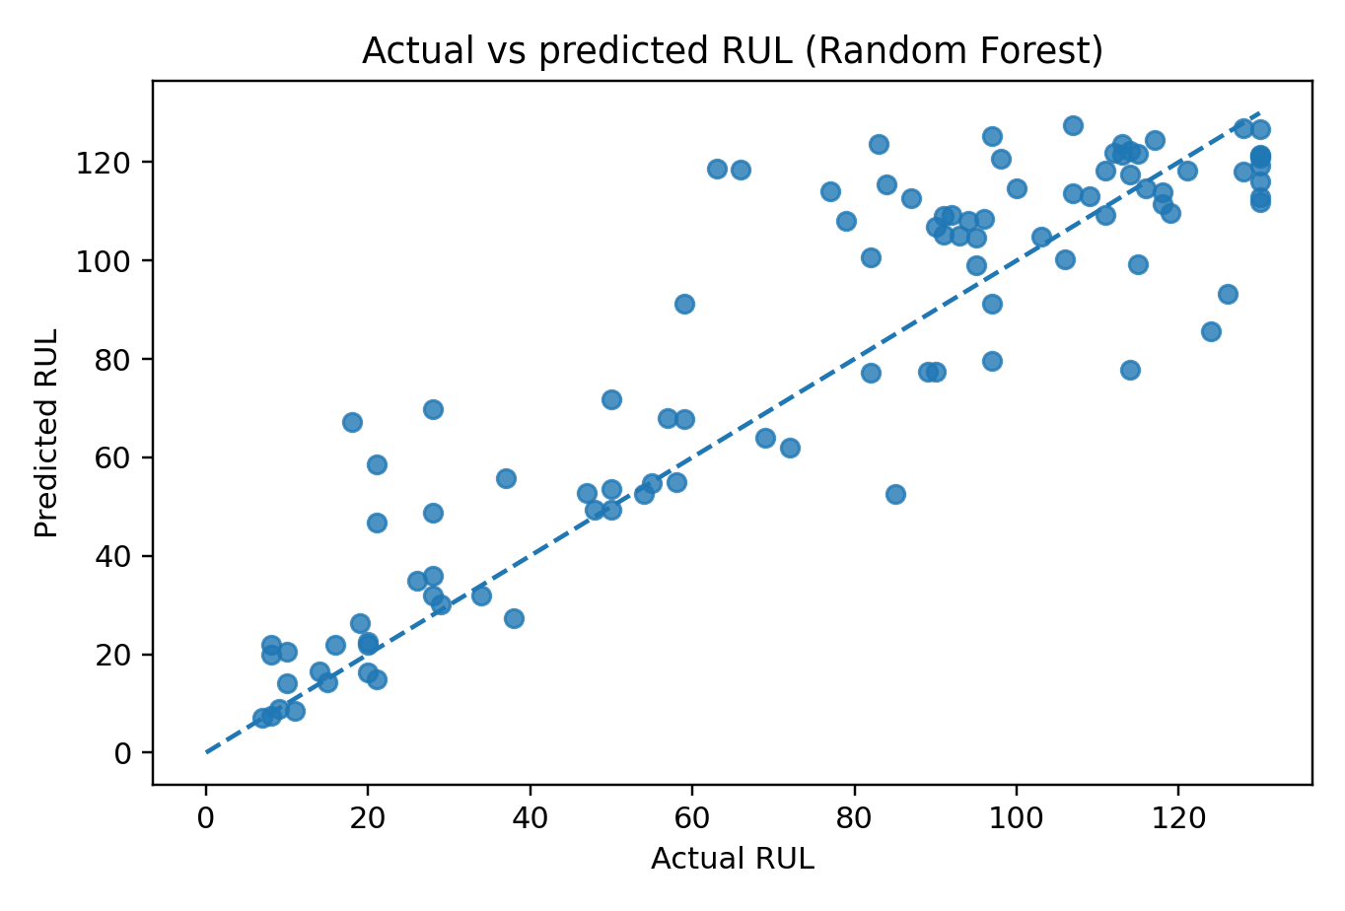
Predictive Maintenance for Aircraft Engines: Machine Learning RUL Prediction
DSCI-441 M2 Final Project
Problem & Motivation
Model Selection
Unexpected engine degradation can cause costly delays, safety risk, and unnecessary maintenance.
Goal: estimate Remaining Useful Life (RUL) from current engine sensor data.
Output: predicted cycles remaining before failure.
Compared three regression models:
Ridge Regression baseline.
Random Forest for nonlinear sensor interactions.
Gradient Boosting as additional ensemble model.
Selection criterion: lowest RMSE on FD001 test labels.
Dataset
Evaluation Results
NASA C-MAPSS FD001 turbofan data.
100 training engines run to failure.
100 test engines with partial histories.
Each row: engine ID, cycle, 3 settings, 21 sensor readings.
Test labels come from RUL_FD001.txt.
Model | RMSE | MAE
Random Forest | 18.20 | 13.18
Gradient Boosting | 18.45 | 12.96
Ridge | 21.23 | 16.93
Best model: Random Forest (RMSE = 18.20 cycles).
Preprocessing
Deployment
Training label: RUL = max_cycle - current_cycle.
Capped RUL at 130 cycles.
Removed constant / low-information features.
Retained informative settings and sensor channels.
Evaluated using final observed test cycle per engine.
A Streamlit app was built for interactive predictions.
Upload CSV engine measurements.
Or manually enter one current cycle.
App returns predicted RUL and maintenance priority.
File: app.py
Conclusion
Machine learning can convert multivariate engine sensor measurements into actionable RUL estimates. Random Forest performed best among tested models and is suitable for a clear, deployable predictive-maintenance prototype.
Data source: NASA C-MAPSS FD001 Turbofan Engine Degradation Simulation Data | Metrics: RMSE, MAE, R2 | Code includes model training, saved model, and Streamlit demo.

