Slide 1

Auto-Support
Team Name: KICK
Sharad, Saurabh, Ginni, Gaurav, Vikash

Slide 2
So what are we building to
Help Customers
Self-Service, Shorter
Support/Sustenance Lifecycle

Slide 3

Main Objective
Identification and resolution of known problems
Focus on real issues , avoid duplicity of effort
Cost Saving
Customer Delight and satisfaction
Pro-active Support

Slide 4

Automated

Slide 5

Support Service
Notes:
There are hundreds of Engineers working on issues.
This service is designed to leverage all the intellectual property;
All the known problems
Common environment mis-configurations
Best practices
Performance optimization recommendations.

Slide 6

Best Practices

Slide 7
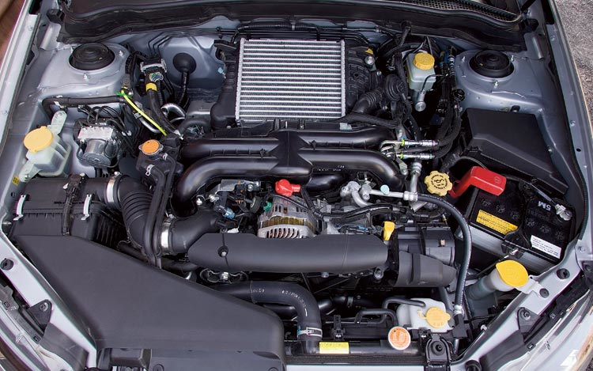
Notes:
Today’s engine looks a bit different and has amazing improvements –
More reliability
Greater longevity
Better fuel economy
Better emissions controls
A lot of benefits –

Slide 8


Slide 9
Features & Road map
Plug-in Architecture for various product analysis engines
Automated / Self-service Support
Push Button – Data collection
Pro-active service – Call Home
Usability survey & Metrics
Environment Health checking
Identification and resolution of known problems
Of known configuration recommendations
Of known best practices and common problem areas

Slide 10

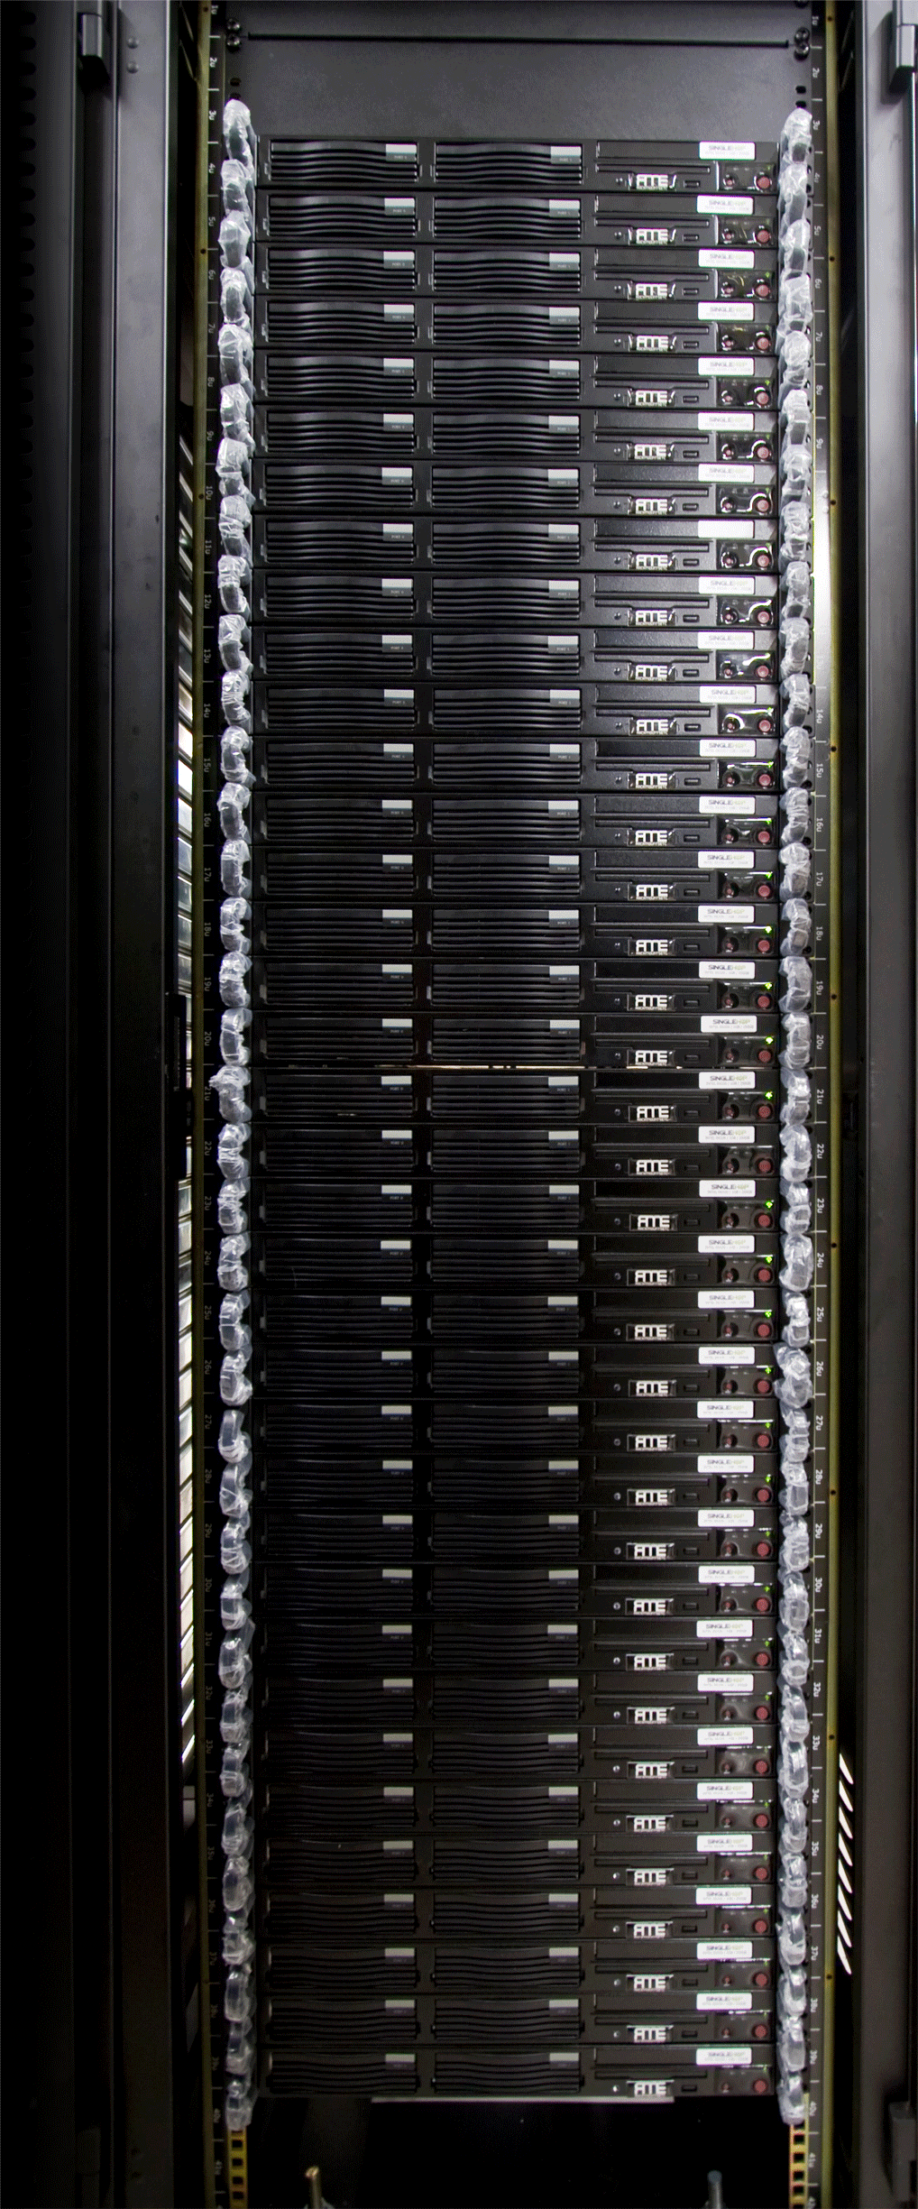


Auto Support
Web Page with Auto Analysis
Industry metrics and data analysis
Secure data
Known Issues &
Customer Telemetry
Push Button Easy
Data uploaded
& analyzed

Slide 11
Top Level Architecture
UI
Parser
Analysis Engine
Comparator
Reporting /
Admin

Slide 12
Thank You!!!

