Slide 1

I
h
r
P
Intelligent Hiring Resume Parser
BY: C.O.L. INC.
Proprietary & Confidential

Slide 2

Agenda
Problem Statement
Business Impact
Wireframe
UI
Design Architecture
I
h
Algorithm
r
P
Reporting

Slide 3
Problem Statement
Most of the Job are made by Resume & Resume are made by Job description
Hiring is Not a challenge, Joining is a Challenge
Effective Resume Screening is a time consuming task
Research
Issues
Job board (monster, Times, Naukri etc.)
People mostly reply on JD
Market reference
Employee Referral
LinkedIn (Matching Profiles, Ratio is not good)
Company reference
Fraudulent Screening
Identifying Multiple skills
Notice Period
Dropout after rolling out offer letter

Slide 4
Business Benefits
Increasing Incedo Credibility in Market
Reduce number of login license: One stop Job board access link
Easy Resume Screening: Screen resume large pool
Turn Around Time: Reducing manual effort by automating process by 50%
Accuracy Increase in HR Competency: Detailed analytics on resume which can be missed by naked eyes
Ranked Resume: Higher visibility to the relevant resume
Pre Joining buddy: Increasing probability of candidate to Join organization
Resume Repository Analytics : Evaluate & Re-use historical Resumes repository

Slide 5
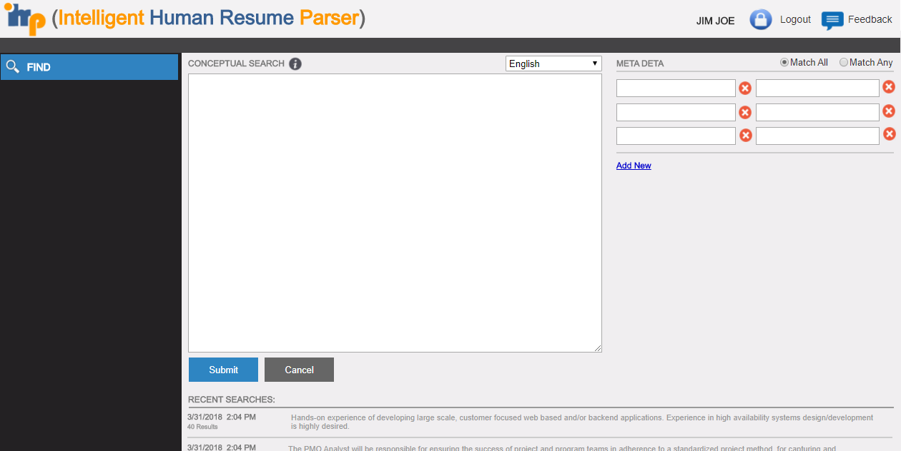
Wireframe (https://uabj4r.axshare.com/#p=home )

Slide 6
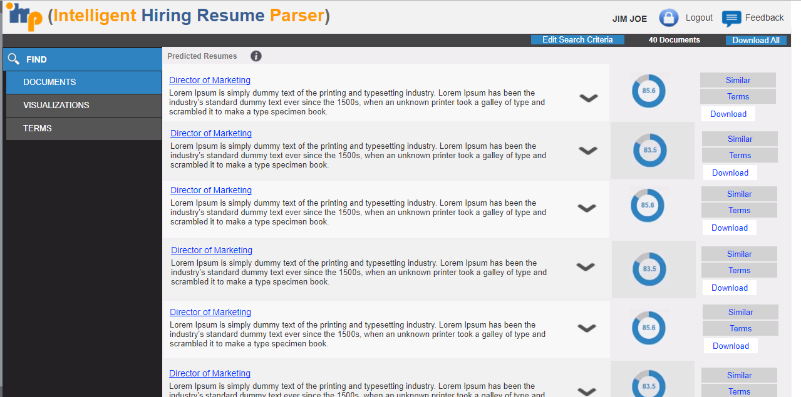
Wireframe (https://uabj4r.axshare.com/#p=resume_parser )

Slide 7
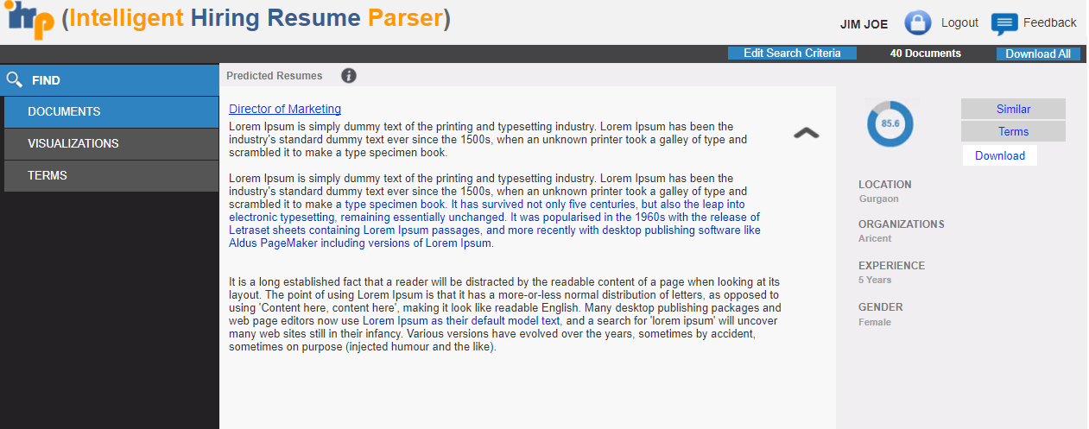
Wireframe (https://uabj4r.axshare.com/#p=resume_parser__1_ )

Slide 8
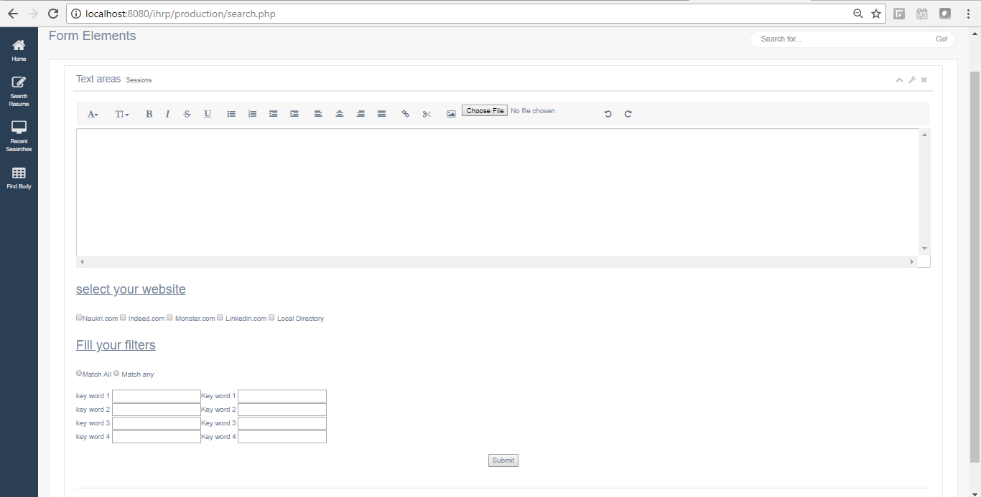
UI (http://localhost:8080/ihrp/production/search.php)

Slide 9
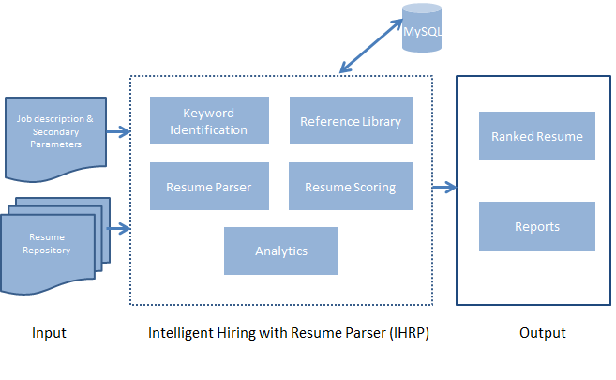
Design Architecture

Slide 10
Proposed Algorithm (1 of 2)
JD Input: Input/Upload Job description(JD) in IHRP application in doc file/HTML/copy-paste JD content in conceptual search text box and provide secondary parameters if any. (Example: Gender, Experience etc.)
Parsing & Categorization Module: Parse JD & create categorization of data keywords using python code
Auto Logging to Job board: Auto Logging into job board sites using employer credentials like Naukri, Indeed, Monster, Linkedin etc.
Fill Search Criteria: After successful log-in fill search criteria.
Decision to alter search criteria: If search results are greater than certain number (<1000) then add more search criteria to derive required results (i.e. > 100 resumes).
Download Resume: Download all resumes in directory named with searched JOB Title.

Slide 11
Proposed Algorithm (2 of 2)
Parse Resume & Score: Parse resume and score them.
Scoring: Parameters for scoring resume are Job title, primary/key skills, experience, location of picking up resumes (naukri, linkedin etc), location constraint, notice period and qualification from highest to lowest priority.
Ranking of the collected resumes based on the primary keywords.
Connect UI to Analytics: UI will connect with DB to display analytics.
Predict Job Buddy: Match education/previous company of “desired candidate” with existing INCEDO employee’s education/previous company

