Slide 1
Business Integration
Tool using AI
- PBD Smart works Team, Chennai

Slide 2
Introduction

Slide 3
Introduction
Enterprise seems to be entering a new era ruled by data. AI in business intelligence is evolving into everyday business as we know it. Companies can now use machines algorithms to identify trends and insights in vast reams of data and make faster decisions that potentially position them to be competitive in real-time.
The tool is designed to search the keywords across available data sources and collect the relevant data and provides the output in the different output format (charts, Tabular formats)

Slide 4
Team Members
- Mohamed Allabakash, Project Manager, Financial Services
Rajesh Samuel, Senior software Engineer, Financial Services
Muralidharan Subbiah, Software engineer, Financial Services

Slide 5
Tool Process
Data Source
Flat Files
Etc.
BI Tool
Keyword Search analysis using AI
Output
Pictographic
PDF
Data Services
Database
Tabular format
Etc

Slide 6
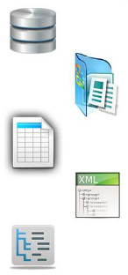






Architecture
BI Tool
Application Server
Consumers
Data Source
Database System
Flat files
Spread sheets
XML files
Unstructured content
Data Services
Firewall

