Slide 1
Suggesting a nice neighborhood in Kadikoy,Istanbul,Turkey
Gokhan INCE
09/17/2019

Slide 2
INTRODUCTION
I am a data scientist in a consultancy company.
My project targets the people who wants to move to Istanbul, Turkey.
I will try to give them many suggestions based on their preferences and expectations. I will try to find them the neighborhoods that they can enjoy to live.

Slide 3
BUSINESS PROBLEM
Istanbul is a big city and it is very multicultural. In this project, i will focus on a client's need and try to find a good neighborhood where he can enjoy. But also, I will cluster the neighborhoods based on the venues they have. We will be able to suggest about which neighborhoods can make them happier. The neighborhoods should satisfy the needs of my clients. The clients who has different backgrounds would like live in a neighborhoods which can feel them comfortable. I should be able to give them suggestions to satisfy their needs.
My client Hans is currently living in Berlin, Germany. His company promoted him to be the general manager for one of their branch office. The company office is in Kadikoy, Istanbul. Hans wants to live close to the office and he prefers to live in Kadikoy. He is asking for our suggestions about neighborhoods. He wants to live in an enjoyable neighborhood. He likes bars, pubs, restaurants etc. and we must give him the suggestions. Also, he wants to be close to public transportation like bus, metro and trains.

Slide 4
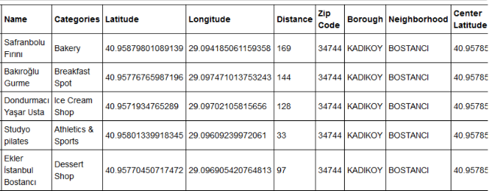
DATA AND PREPARATION
Data will be provided from internet and Foursquare. I will use latitude and longitude information to pull data from Foursquare

Slide 5
METHODOLOGY
In this project I will use Foursquare data, analyze it and try to get meaningful results. The venues will be within 500 meters to the neighborhood centers.
In first step, I pulled the data from Foursquare and matched them with neighborhood data. Also, I created some filtered data frames. There is a purpose for each data frame.
In second step, I will start to analyze the data. I will try to get the most popular venue categories, frequency, filtering with desired venue types and then visualizing them. I will also, show the findings on a map.
In third and final step, I will cluster the neighborhoods by using the most popular venue types and frequencies in the neighborhood, detect the clusters and show them on a map. Wish me luck.

Slide 6
ANALYSIS
In this stage, I will analyze my data in detail. I will perform some basic explanatory data analysis and derive some additional info from my raw data.
Our client has some expectations. His house should be entertainment venues like bars, clubs and it should be close to public transportation like metro. I filtered the data and visualized it.
I will visualize the desired venues on a horizontal bar plot and maps.

Slide 7
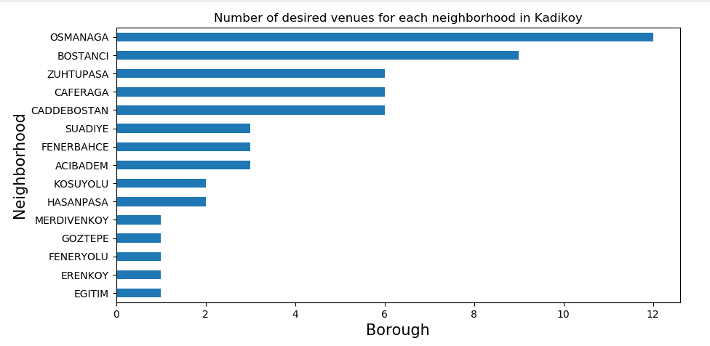
ANALYSIS
It is a horizontal bar plot to visualize the data

Slide 8
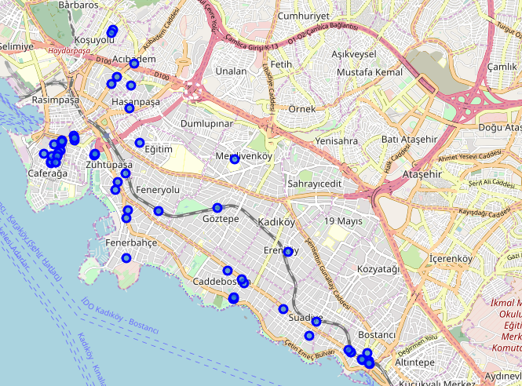
ANALYSIS
And it is the map of the desired venues on the map.

Slide 9
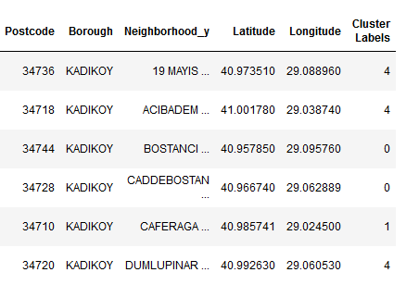
ANALYSIS
I used most common venue categories to cluster the neighborhoods and label them with cluster labels. I used K-means clustering. These are some examples..

Slide 10
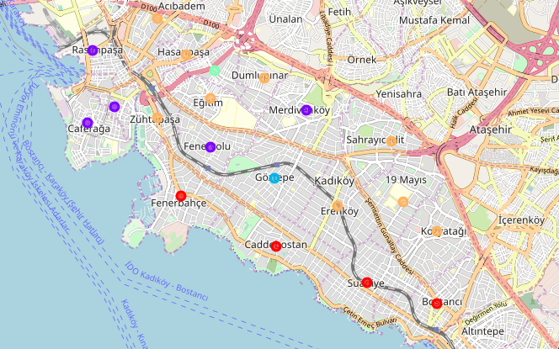
ANALYSIS
It was also possible to show the clustered neighborhoods on a map by using Folium Library. There are 5 clusters.

Slide 11
DISCUSSION AND RESULTS
Now, let's discuss about the issue and results. I had to analyze the neighborhoods in Kadikoy and detect what kind of venues these neighborhoods have. After that i should group them based on client needs. Different kind of people wants to be close to different type of places. I need to detect their needs and find the perfect neighborhoods for them to satisfy their needs.
First, I detected latitude and longitude information of the neighborhoods. After that I used Foursquare API to pull the venue to the neighborhoods closer than 500 meters. Then, I used some filters to detect the best neighborhood for my client. My client already told us that he likes to be close to bars, pubs, restaurant and the entertainment venues. So, we should suggest the neighborhoods that can satisfy his needs. Then I used one-hot encoding to detect the frequency of the venues. I detected 10 most popular venue categories in the neighborhoods. I used K-means clustering to cluster the neighborhoods and used Folium library to show them on a map. I detected 5 clusters.
My analysis shows that Osmanaga is the best neighborhood in Kadikoy for our client. There are many entertainment venues around. Hans can find many places like bars, pubs, restaurants etc. But also, Rasimpasa, Caferaga, Feneryolu and Merdivenkoy can be good for him. These neighborhoods are also in the same cluster.

Slide 12
CONCLUSION
Purpose of the project was to suggest the best neighborhood for our client. In order to do it, I clustered the neighborhoods by using Foursquare data. This data helped me to cluster the neighborhoods.
I detected that Osmanaga is the best neighborhood for the client. But also, we can suggest him Rasimpasa and Caferaga neighborhoods. They are in the same clusters.
As a final decision, we will offer him to move to Osmanaga and give Rasimaga and Caferaga neighborhoods as alternative suggestions.

