Slide 1

Steam API for game recommendation

Slide 2
Team Members
Zijian Chen
Xueming Feng
Lu Liu
Chengjun Wu
Zhongmin Yao
Honghao Zeng

Slide 3
Why this is a good idea?
Organize user information
Expand social network
Bring friend and game recommendation
Improve user gaming experience

Slide 4
Main language and tool
Language | Tool
HTML JavaScript CSS | Vis.js Graph.js

Slide 5
Main function
Analyze user’s gaming time
Analyze user’s gaming category
Analyze user’s social network
Friend recommendation
Game suggestion
Create chart

Slide 6
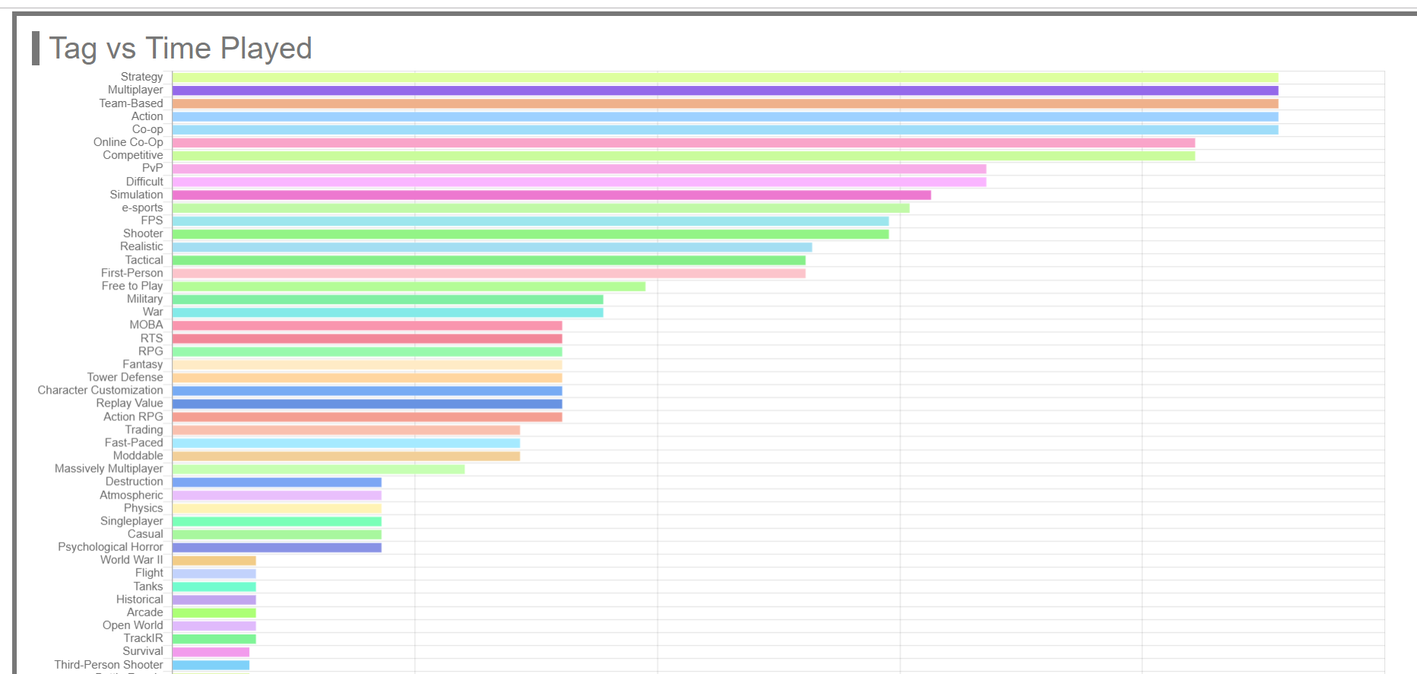
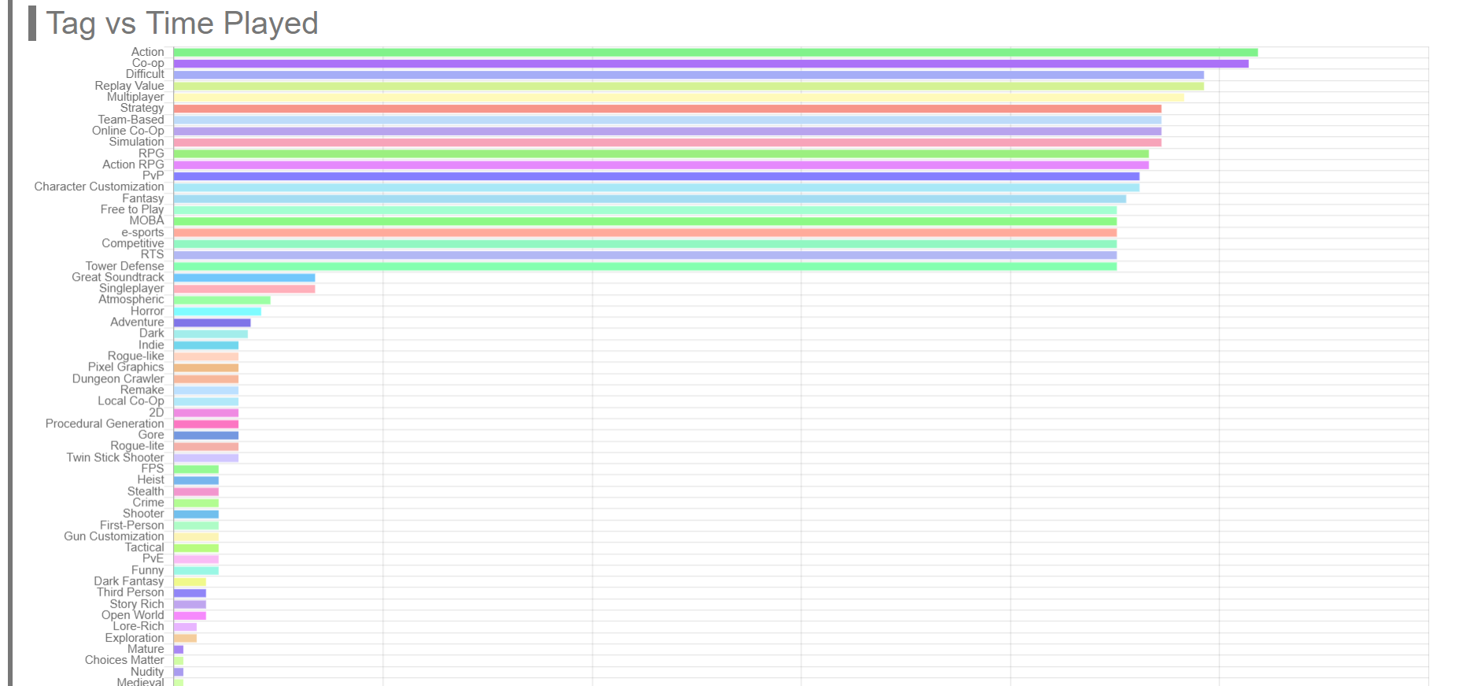
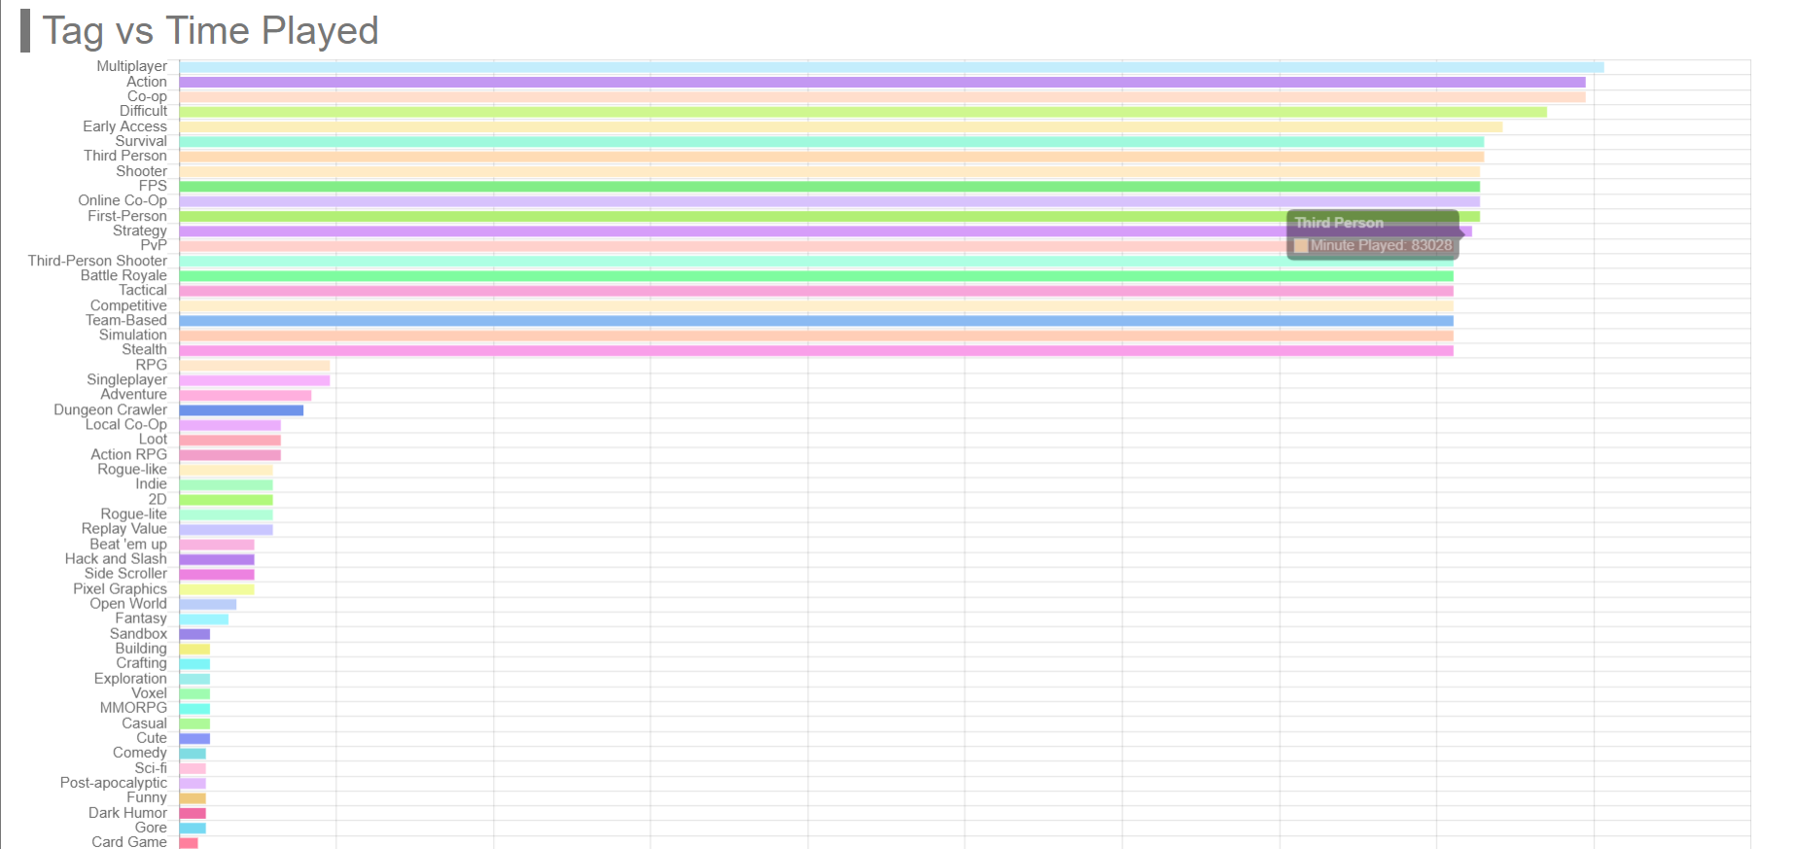
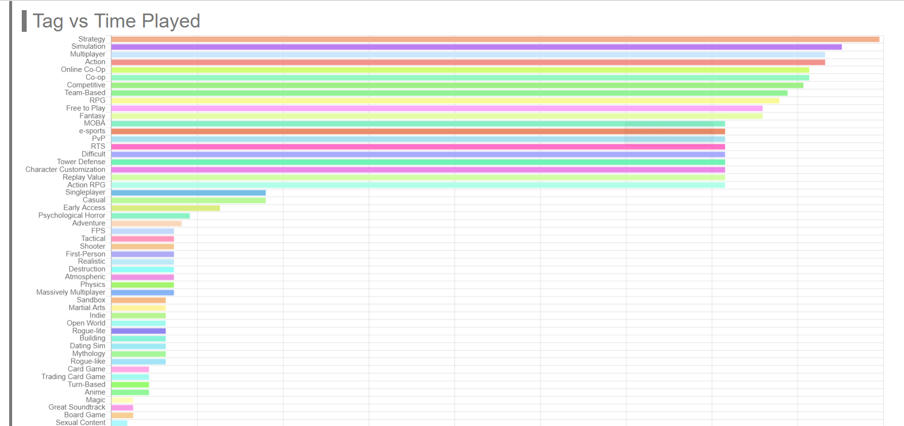
Example of gaming category analyze
User ID: Kiramio
User ID: Incfex
User ID: Understan
User ID: sbwwq

Slide 7
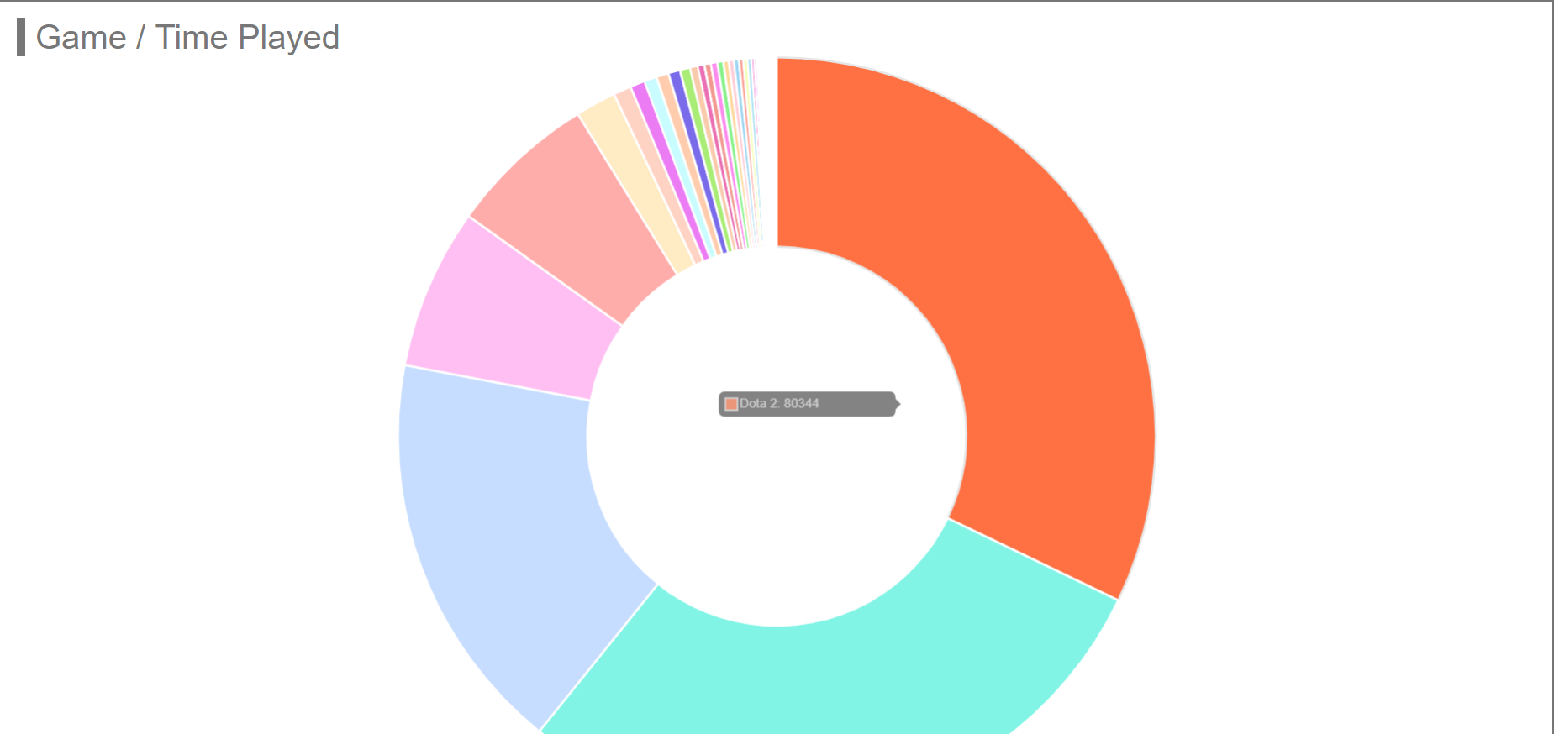
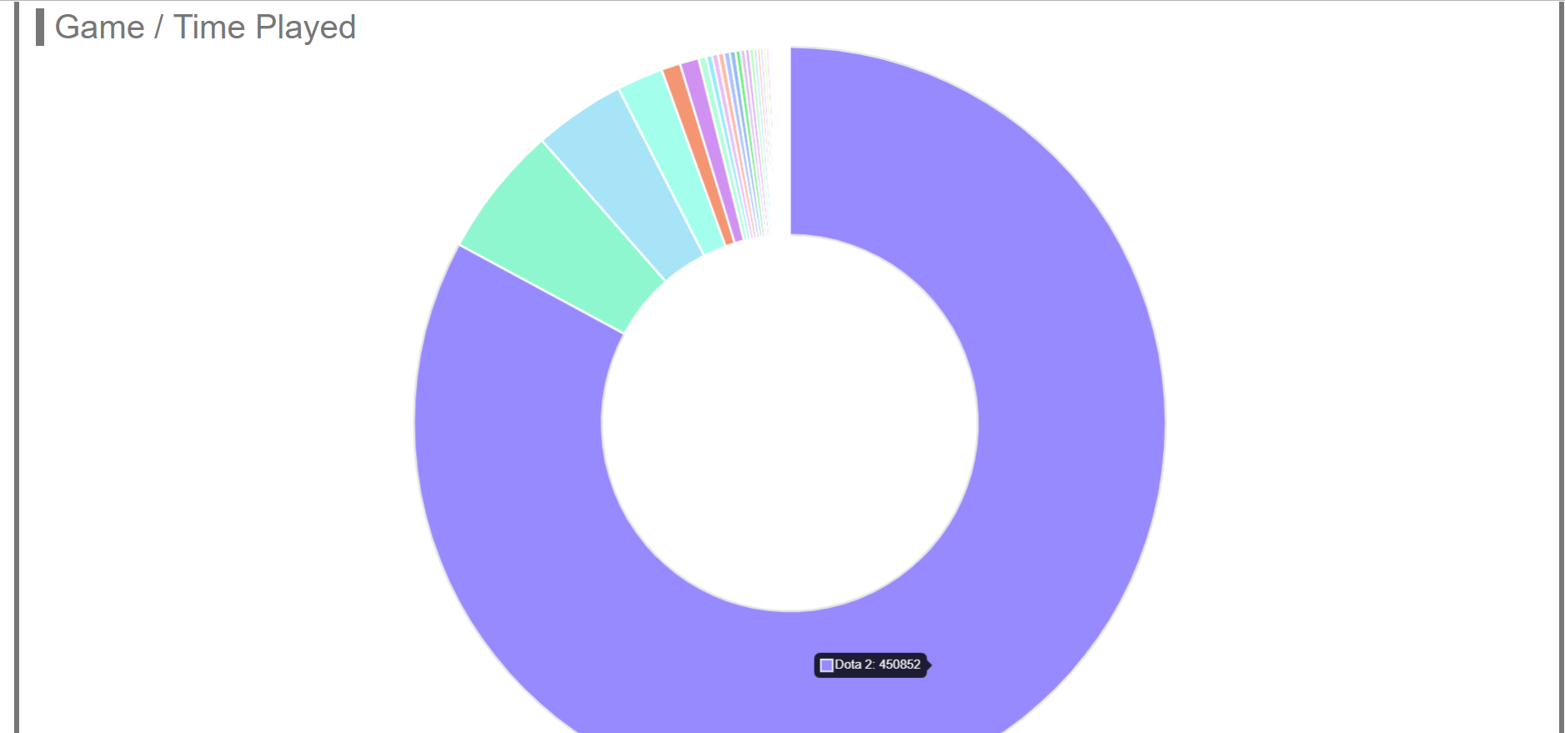
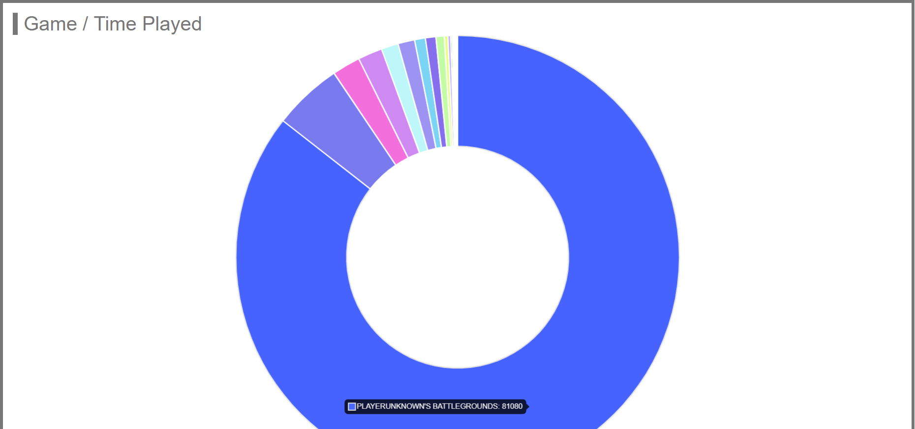
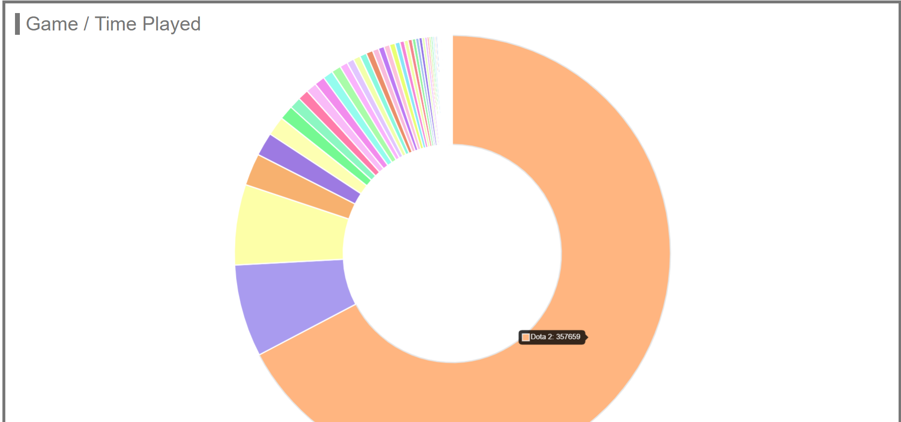
Example of gaming time analyze
User ID: Kiramio
User ID: Incfex
User ID: Understan
User ID: sbwwq

