Slide 1
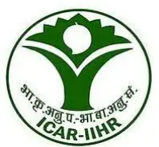

CHIP TO CROP 24 HOURS AGRITECH HACKATHON 14th & 15th October 2025
🌾 Intelligent Precision Spraying Drone
Tech Fighters
P.Tejaswini(20231CAI0120)
Inchara K R(20231CAI0117)
Sahana Haragapure (20231CAI0115)
Bharath R K(20231CSN0032)
K . Sai Krishna(20231I ST0041)
Varadharajula Nishant(20231IST0044)

Slide 2
PROBLEM STATEMENT DESCRIPTION
Farmers often spray fertilizers manually by carrying heavy bags or knapsack sprayers on their backs.This method requires intensive labor.
So this drones helps us to Consumes time and covers limited area per day.
Exposes farmers to harmful chemicals.
Leads to uneven spraying and fertilizer wastage .
Introducing fertilizer-spraying drones that can cover large farm areas quickly, efficiently, and safely.
The drone carries a tank of fertilizer..It sprays uniformly using automated nozzles and Controlled by a farmer via mobile app/remote.
Can be programmed with GPS for precise spraying.

Slide 3
PROPOSED SOLUTION
Fertilizer-Spraying Drone Solution
GPS-guided autonomous hexacopter with 10-16L fertilizer tank, precision spray nozzles, and mobile app control for automated field spraying operations.
Problem Resolution:
Eliminates Manual Labor: Covers 20-25 acres/day vs 2-3 acres manually
Zero Chemical Exposure: Remote operation keeps farmers safe
Precision Application: GPS-guided uniform spraying reduces 25% fertilizer waste
Time Efficiency: Completes in hours what takes days manually
Key Innovations:
Cost-Effective Design: ESP32/Arduino-based system (₹50k-₹2.5L) vs ₹10L+ imports
Farmer-Friendly App: Local language support, offline capability, one-touch operation
Real-Time Analytics: GPS tracking, spray pattern logging, weather integration
Modular Architecture: Upgradeable components, multi-crop compatibility
Environmental Impact: 90% water savings, reduced chemical runoff
Unique Value Proposition
"Transforming 8 hours of hazardous manual work into 30 minutes of safe, precise automation while reducing costs by 40% and increasing coverage by 800%"

Slide 4
TECHNICAL APPROACH
Technologies & Implementation
Hardware
Flight Controller: ESP32/Pixhawk + GPS module + IMU sensors,Propulsion: Hexacopter frame + 6 brushless motors + ESCs + LiPo battery,Spray System: 10L tank + brushless pump + precision nozzles,Communication: WiFi/4G module + RC transmitter (backup)
Software
Mobile App: React Native/Flutter + Google Maps API + Firebase,Flight Firmware: Arduino C++/Python + ArduPilot/PX4 + MAVLink protocol,Backend: Node.js/Python + MongoDB/PostgreSQL + AWS IoT/Firebase
Languages: C++, JavaScript/Dart, Python
Implementation Flow (3 Weeks)
Week 1: Hardware Assembly → Software Development (Parallel)
├── Frame + Motors + Flight Controller Setup
├── Mobile App UI + GPS Integration
└── Spray System Integration + Firmware Development
Week 2: System Integration → Testing
├── Hardware-Software Communication (MAVLink/MQTT)
├── GPS Mission Planning + Spray Automation
└── Ground Testing + Flight Testing + Safety Validation
Week 3: Demo Preparation → Final Testing
├── Live Demo Scenario Setup
├── Performance Optimization + Bug Fixes
└── Presentation Materials + Technical Documentation

Slide 5
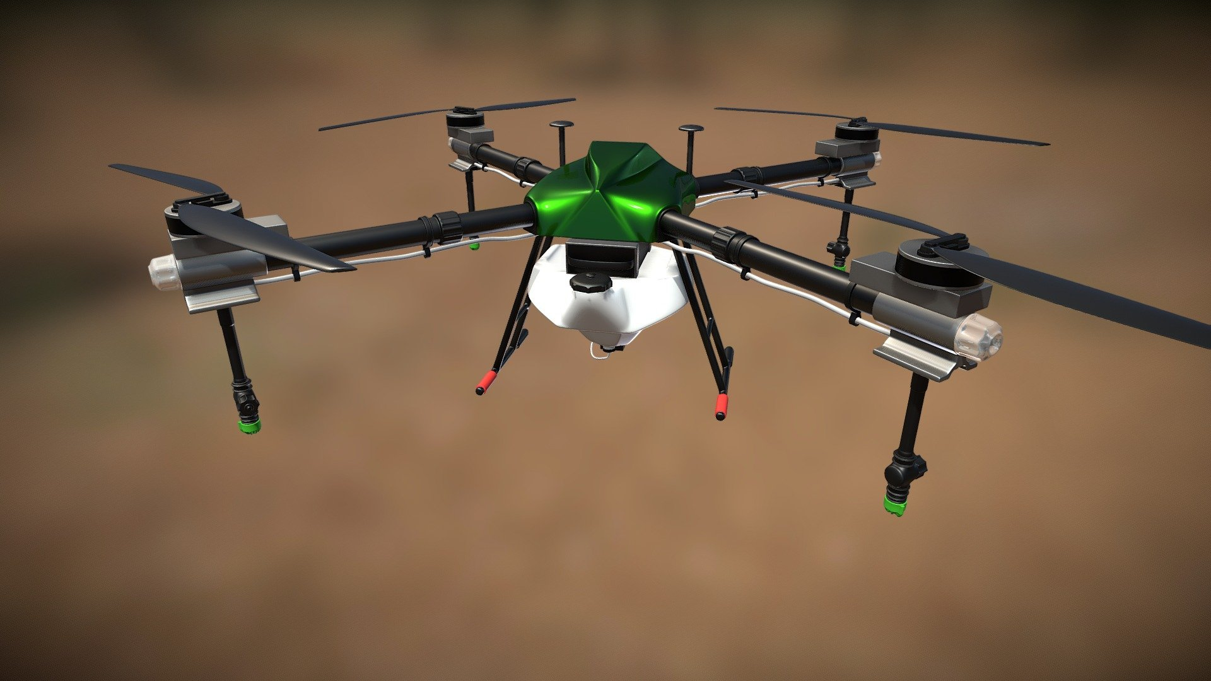
3D MODEL (if applicable)

Slide 6
FEASIBILITY AND VIABILITY
Feasibility Assessment
Technical: HIGH - Proven drone technology + available components (ESP32, GPS, motors)
Economic: HIGH - ROI in 2-3 seasons, ₹50k-2.5L cost vs ₹500/day manual labor
Market: MEDIUM - 600M+ farmers, growing digital adoption, government support
Regulatory: MEDIUM - Evolving DGCA rules, certification requirements
Potential challenges and risks
Technical: GPS accuracy limitations (±3-5m), limited flight time (15-20 min), weather dependencies affecting spray precision and operational days
Strategies for overcoming these challenges
Technical Solutions: Implement RTK-GPS upgrade + multi-battery rotation system + weather API integration for optimal operation timing

Slide 7
IMPACT AND BENEFITS
Target Audience Impact
600M+ Indian Farmers - Reduced labor dependency, improved safety, increased productivity
Social Impact
Zero chemical exposure - eliminates health risks from toxic fertilizers
Physical relief - no more carrying 15-20kg sprayers
Rural employment - drone operator job opportunities
Environmental Benefits
90% water savings through precision spraying
25% fertilizer reduction - less chemical runoff
Soil protection - prevents over-application damage
Economic Benefits
10x productivity - 20-25 acres/day vs 2-3 acres manually
50-60% cost savings - reduced labor and fertilizer costs
25% yield increase - through precision application

Slide 8
RESEARCH AND REFERENCES
ICL Growing Solutions - Drone Spray Technology in Agriculture Link: https://icl-growingsolutions.com/agriculture/categories/drone-spray-technology/
DJI Enterprise Insights - Precision Agriculture With Drone Technology Link: https://enterprise-insights.dji.com/blog/precision-agriculture-drones
Prototype of Model :
Link: TEAM TECH FIGHTERS

