Slide 1
SDM COLLEGE OF ENGINEERING AND TECHNOLOGY,Dharwad-580002
(An autonomous Institution affiliated to Visvesvaraya Technological University, Belagavi – 590018)
Department of Electronics and Communication Engineering
A review on Major project entitled
“A SUPPLY CHAIN FOR SAFE DISTRIBUTION OF MEDICINES”
Submitted by
B.Richa Rao 2SD20EC022
Inchara Nayaka 2SD20EC043
Kiran Pujar 2SD20EC048
M.Rohan 2SD20EC053
Students of 6th Semester ECE Department
Under the guidance of
Dr.Jayashree.C.N
Department of ECE, SDMCET, Dharwad-02
Academic Year 2023-2024

Slide 2

“A SUPPLY CHAIN FOR SAFE DISTRIBUTION OF MEDICINES”

Slide 3
pp
Presentation outline
1 | Introduction
2 | Literature survey
3 | Problems with Existing System and Proposed solution
4 | Problem Statement & Objectives
5 | Research Gaps
6 | Functions of Blockchain & ganache
7 | Advantages
8 | Implementation
9 | References

Slide 4
Introduction
The pharmaceutical supply chain network is a mechanism by which manufactured prescription medications are distributed to the patients.
Tampering within the supply chain and counterfeit products pose a serious threat as it is difficult to investigate the true value of the medicine.
Strong and elegant supply chains and a prompt customer service are the two key factors that define a successful logistic company.
Therefore we propose a system called Blockchain which helps in solving the threat and also helps in improving Customer Service.

Slide 5
Literature survey
PAPERS | TITLE | AUTHOR | YEAR
PAPER 1 | Strengthening and transforming the pharmaceutical supply chain | J. Augustin Jacob | 2018
PAPER 2 | Supply Chain Challenges in Pharmaceutical Manufacturing Companies | Arkadiy Morgenshtein | 2004
PAPER 3 | Four ways pharma companies can make their supply chains more resilient | Abin Satheesan, Geethiga | 2002
PAPER 4 | Pharma supply chain 360 | Arvind Kumar Mishral , Debiprasad Priyabrata Acharya, Pradip Kumar Patra | 2009

Slide 6
Problems with existing system and proposed solutions
UNTRUSTED SUPPLY CHAIN: It's incredibly difficult for customers or buyers to truly know the value of products because there is a significant lack of transparency in the current system.
TAMPERING WITHIN THE CHAIN: In a similar way, it's extremely difficult to investigate supply chains when there is suspicion of illegal or unethical practices.
INEFFICIENCY IN DELIVERY: They can also be highly inefficient as vendors and suppliers try to connect the dots on who needs what, when and how.
POOR CUSTOMER SERVICE: Customer experience should always be a top focus for any business. Keeping existing customers happy gives businesses a much better return than having to constantly find new

Slide 7
Problem statement
To create a secured environment (in medicine field) using blockchain
To create a full-fledged web application which manages the supply chain using blockchain instead of traditional centralized networks.
A feedback mechanism to evaluate the performance of different entities in the chain

Slide 8
Objectives
To improve the quality of service provided to customers.
To improve the pipeline visibility by notifying the customer regarding the process status.
Increasing trust between all entities of the chain.

Slide 9
Research Gaps
Lack of Implementation: Most of the papers only presented concepts in theory. In practical very few companies are trying to apply this methodology.
No Cost Estimation: Cost is an important factor when it comes to decision of choosing a business model. Total system cost estimation in the papers.
No Feedback Mechanism: Most proposed methodology fail to provide a feedback to credit a users performance in the blockchain

Slide 10
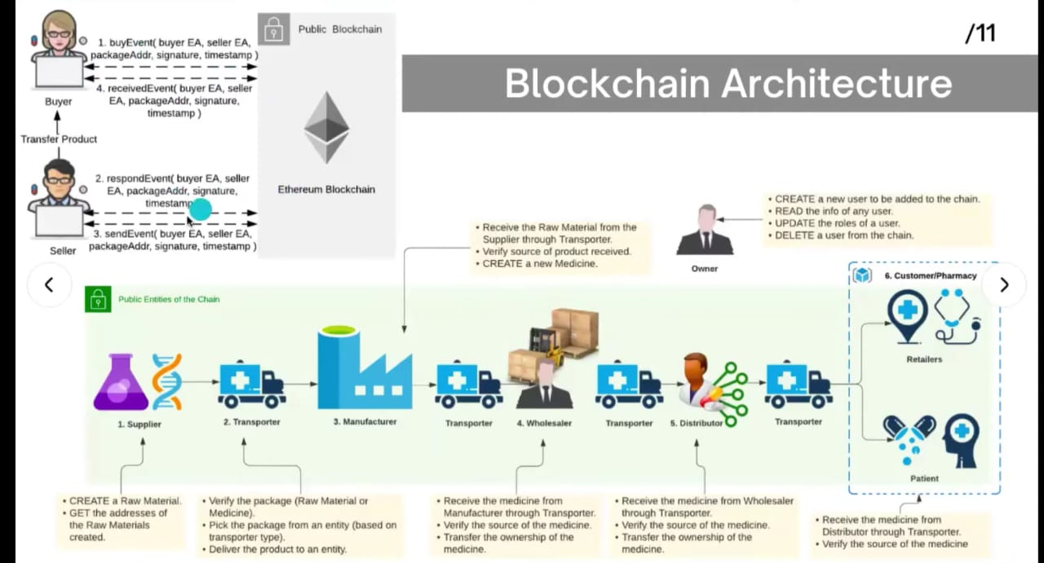
Blockchain Architecture

Slide 11
Functions of blockchain
Decentralization: Data is distributed across a network of nodes rather than stored in a central location.
Immutable Ledger: Once data is recorded on the blockchain, it cannot be altered or deleted.
Transparency: All transactions on the blockchain are visible to participants, enhancing trust and accountability.
Security: Cryptographic techniques ensure the integrity and security of transactions and data.
Consensus Mechanisms: Protocols ensure agreement on the validity of transactions across the network.
Smart Contracts: Self-executing contracts with predefined conditions, automating transactions without intermediaries.

Slide 12
Functions of ganache
Local Blockchain Development: Ganache allows developers to run a personal Ethereum blockchain locally on their machine.
Smart Contract Deployment: Developers can deploy smart contracts to the Ganache blockchain for testing purposes.
Transaction Simulation: Ganache allows developers to simulate transactions on the local blockchain. Developers can test various scenarios, such as contract interactions, token transfers, and transaction fees, to ensure the robustness and correctness of their smart contracts and applications.
Account Management: Ganache provides a set of pre-funded accounts for testing purposes. Developers can use these accounts to simulate different user roles and behaviors within their applications.
Blockchain State Inspection: Ganache offers a user-friendly interface for inspecting the state of the local blockchain.

Slide 13
Advantages
Improved transparency and traceability: Proposed system would enable real-time tracking and visibility of pharmaceutical products in the supply chain, allowing stakeholders to monitor the movement and status of products at any point in the process.
Enhanced security: System will provide a secure and transparent record of transactions, which can help to reduce the risk of counterfeiting and fraud in the pharmaceutical supply chain. This would improve the overall security of the supply chain, and help to ensure that only genuine, high-quality medications are distributed.
Greater Efficiency: By streamlining the supply chain process and enabling real-time tracking and visibility, a blockchain based system may help to improve the efficiency of the supply chain, reducing delays and errors

Slide 14
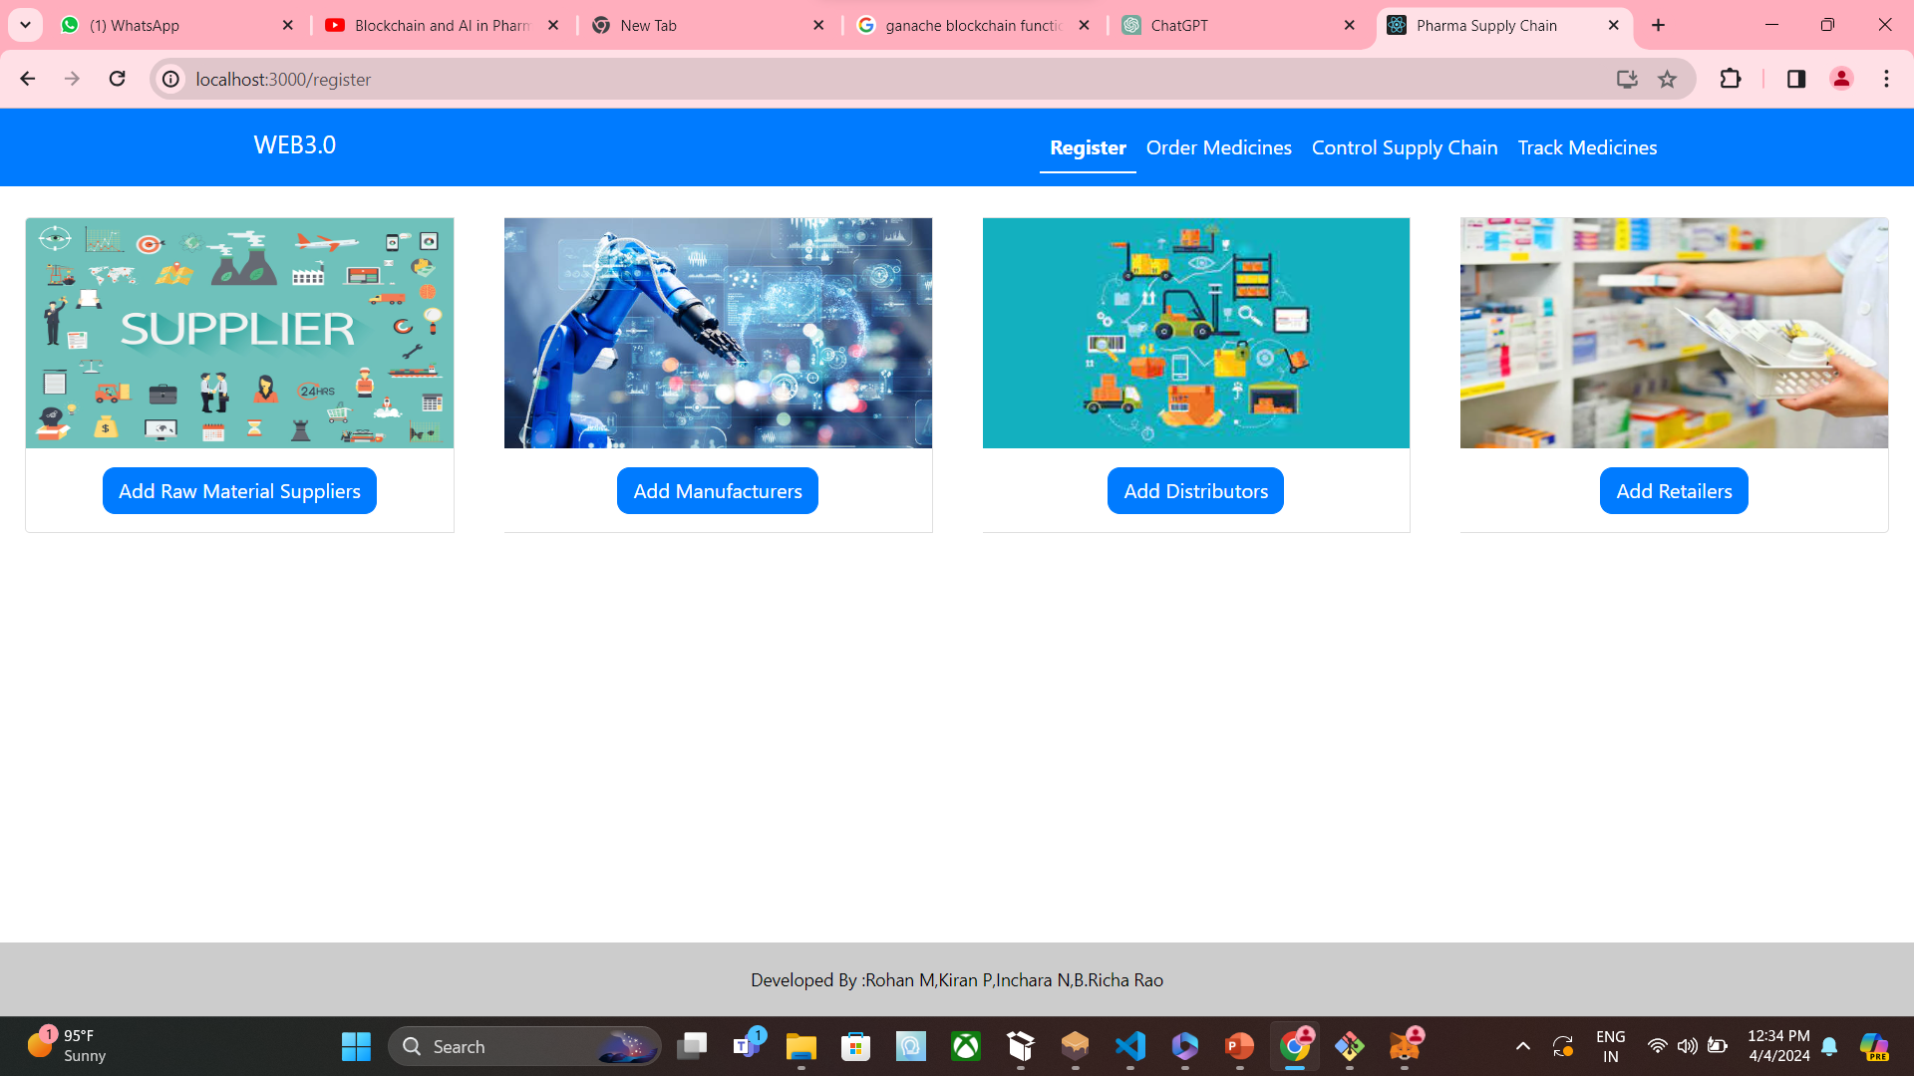
Implementation

Slide 15
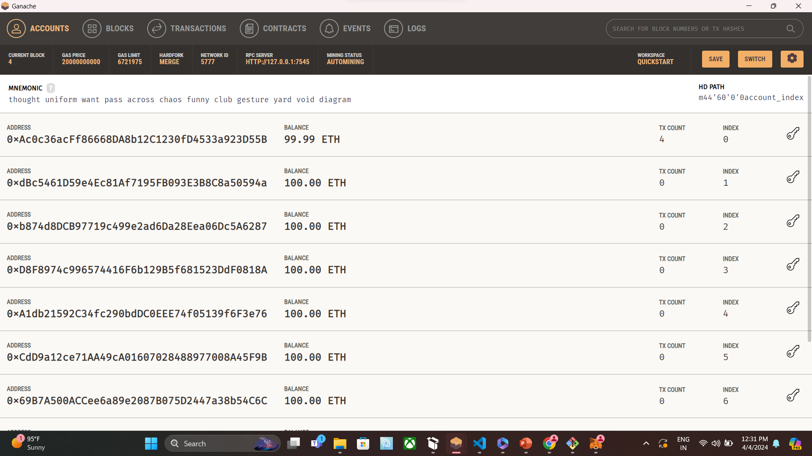

Slide 16
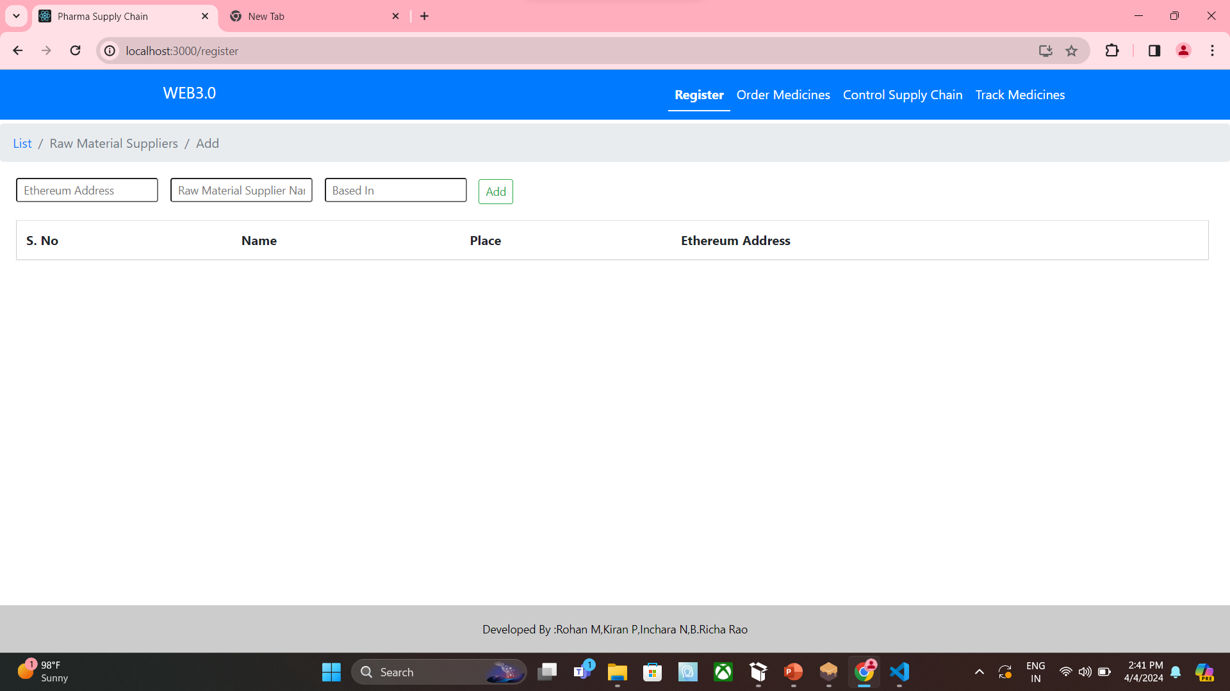

Slide 17
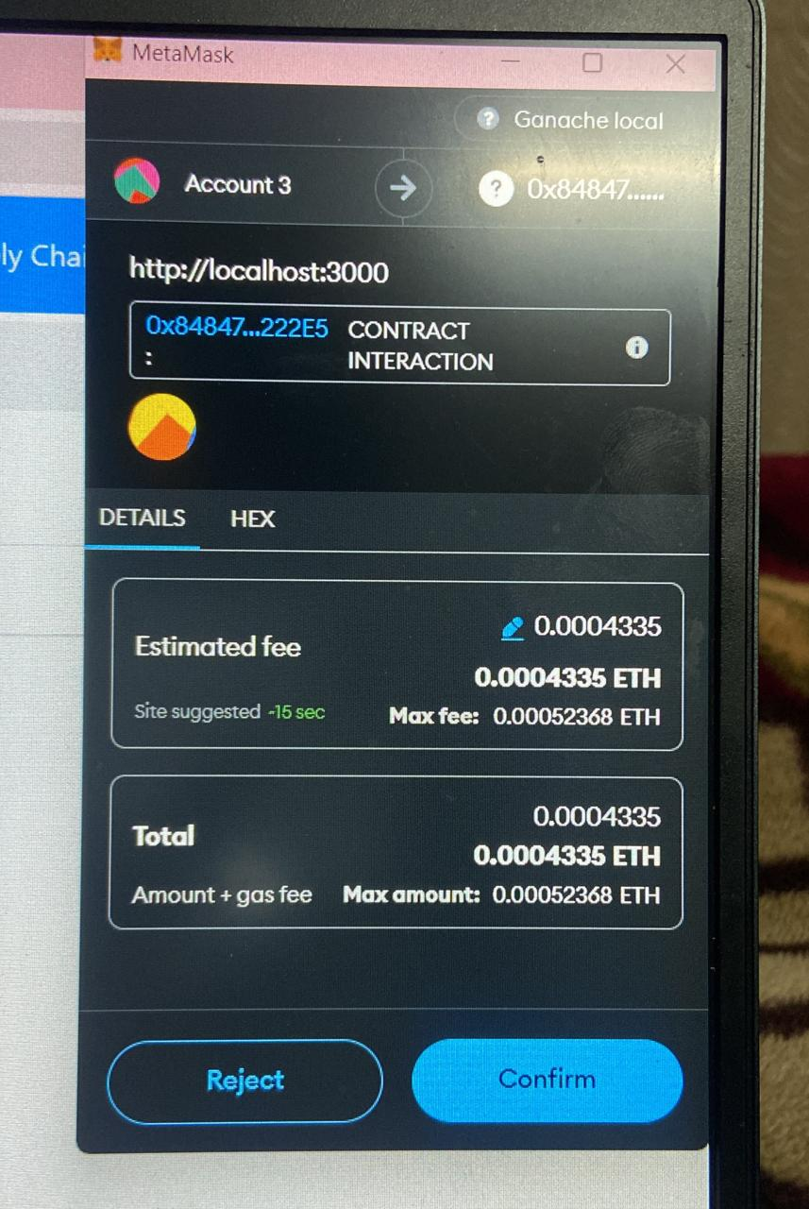

Slide 18
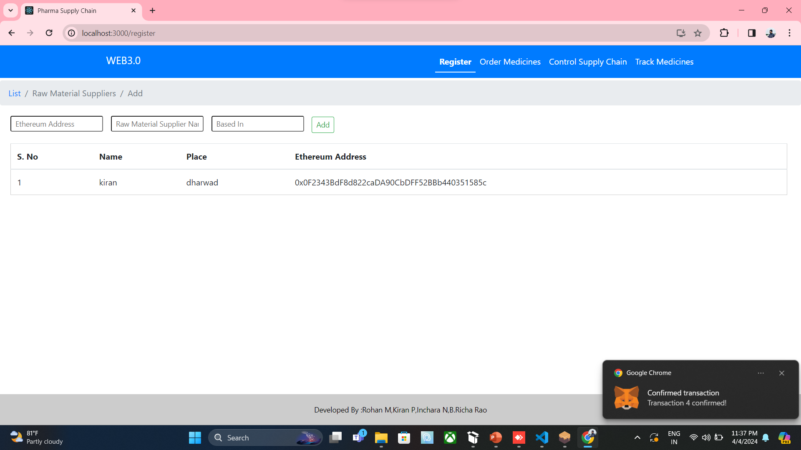

Slide 19
References
[1] G. Perboli, S. Musso and M. Rosano. "Blockchain in Logistics and Supply Chain: A Lean Approach for Designing Real-World Use Cases". in IEEE
Access. vol. 6.pp. 62018-62028, 2018. DOI: 10.1109/ACCESS.2018.2875782.
[2] R. Kumar and R. Tripathi. "Traceability of counterfeit medicine supply chain through Blockchain." 2019 11th International Conference on Communication
Systems & Networks (COMSNETS). Bengaluru, India. 2019. pp. 568-570. DOI: 10.1109/COMSNETS.2019.8711418.
[3] Jamil, F.; Hang, L.; Kim, K.; Kim, D. "A Novel Medical Blockchain Model for Drug Supply Chain Integrity Management in a Smart Hospital".
[4] pharma chain by shewyn dsouza using blockchain

