Slide 1
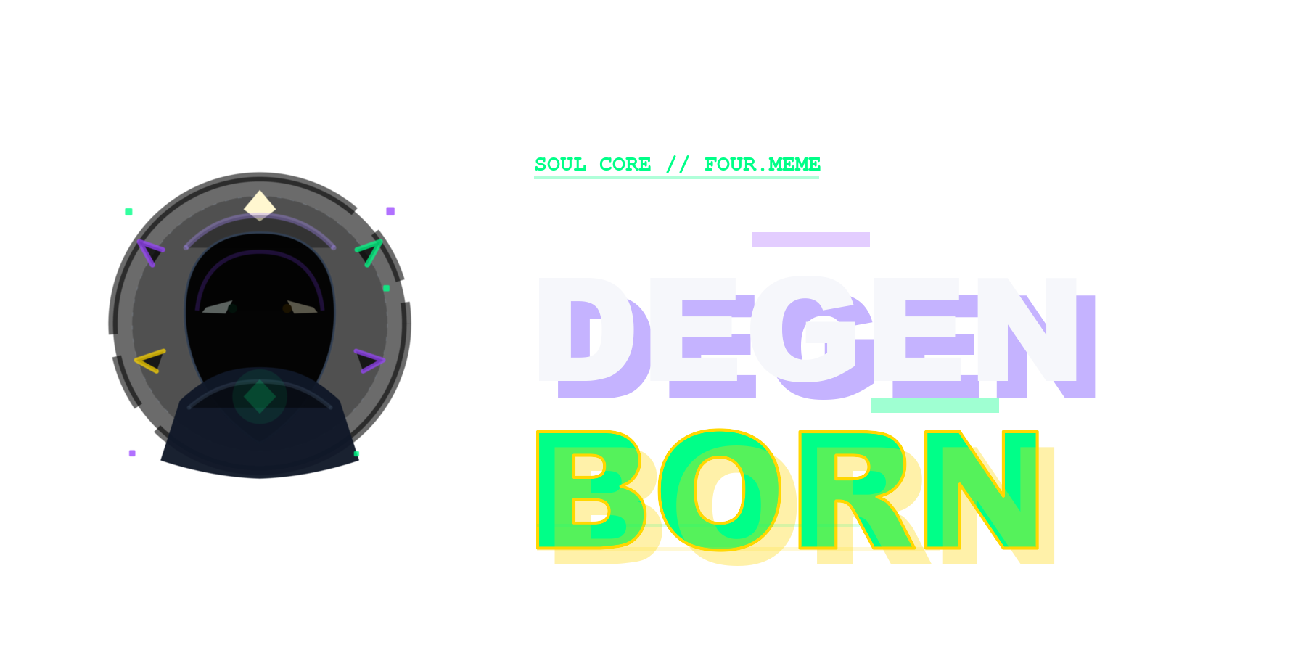
Your wallet has a personality. You just haven't seen it yet.
AI Identity Engine for Four.meme Traders // BNB Chain
Four.meme AI Sprint | April 2026 | Solo Build

Slide 2
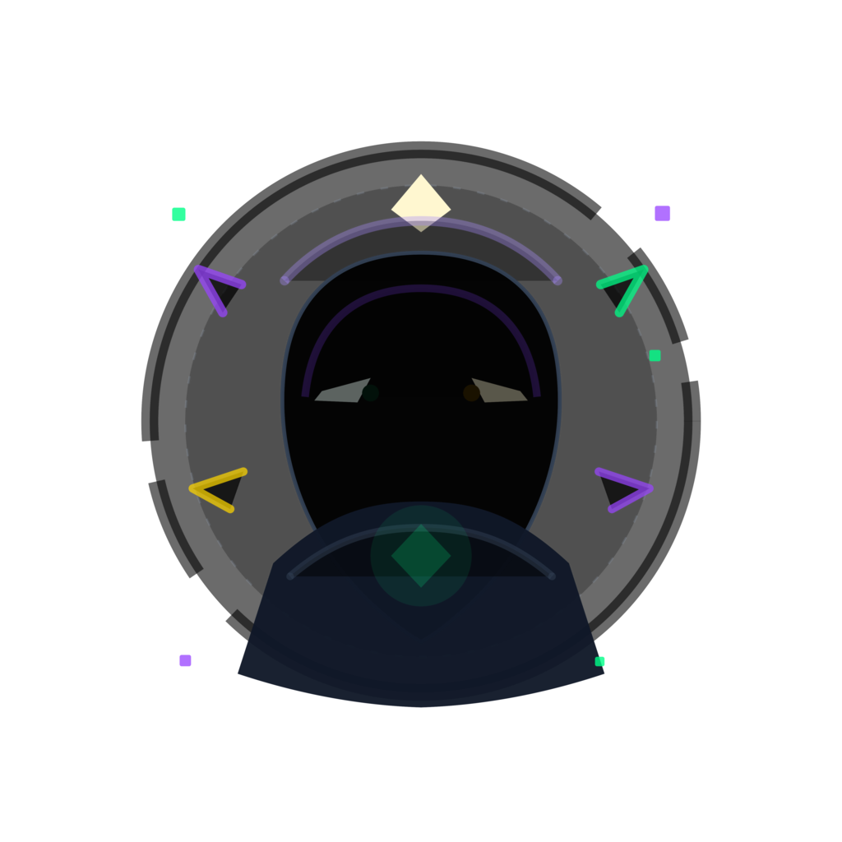
THE PROBLEM
On-chain data is rich with story.
But it collapses into a log nobody shares.
01
02
03
Wallets have no identity
On-chain data is boring
NFTs are static
Your wallet shows what happened,
not who you are. No style, no scars,
no personality.
Transaction hashes and P&L tables.
Nobody screenshots a block explorer.
Zero shareability.
Minted once, forgotten forever.
No growth. No connection to
your actual behavior.
02 / 12

Slide 3
We don't need another dashboard.
We need a mirror.
Panic sells at 3am. Diamond hands through -90%. Aping back in
after getting rugged. That's not just data. That's personality.
DegenBorn makes it visible.
03 / 12

Slide 4
HOW IT WORKS
From wallet activity to living character
1
2
3
4
5
CONNECT
>
ANALYZE
>
CLASSIFY
>
GENERATE
>
EVOLVE
Read Four.meme
wallet activity
Compute 5-axis
Persona DNA
Rule-tree assigns
archetype
AI creates genesis
character
Every trade mutates
your monster
Same wallet + same events = same result. Always. No LLM hallucination in the scoring layer.
04 / 12

Slide 5
PERSONA DNA
Five axes. Pure math. Zero LLM calls.
AGGRESSION
82
How fast and often you trade
CONVICTION
34
How long and focused you hold
CHAOS
76
How volatile your history is
LUCK
41
How well-timed your exits are
SURVIVAL
91
How many times you came back
Example: "Rug Necromancer" profile
05 / 12

Slide 6
ARCHETYPES
A rule tree decides. Not a prompt.
Mad Gambler
Ice Whale
Rug Necromancer
AGG >= 65, CHAOS >= 65
CONV >= 65, LUCK >= 65
CHAOS >= 65, SURV >= 65
All-in, always. The casino
never closes if you never leave.
Patient, loaded, lucky.
You're not gambling. You're investing
in chaos.
Your portfolio died.
You didn't. Death is just a dip.
Diamond Cultist
Sniper Jester
Ghost Bagholder
CONV >= 65, LUCK < 35
AGG >= 65, LUCK >= 65
CONV >= 65, SURV < 35
Bought the top. Still holding.
Not because it'll moon. Because
leaving means admitting defeat.
In and out. Perfectly timed.
Nobody knows if you're a genius
or just lucky.
You believed. Hard.
The token didn't. Still haunting
the chart.
06 / 12

Slide 7
EVOLUTION
Your monster isn't static. Every trade leaves a mark.
EVENT
MUTATION
STATE DELTA
Win streak x3
>
Crown appears
+1 crownCount, mood: euphoria
Major loss
>
Scar added
+1 scarCount, mood: despair
Rug pull detected
>
Zombie eyes activate
+20 corruption, zombieTrait: true
Comeback after -90%
>
Revenge aura ignites
+1 survivalStreak, mood: revenge
Long diamond hold
>
Royal cloak forms
+15 prestige, royalTrait: true
Multiple rug survival
>
Necromancer ascension
Full re-render triggered
Genesis image generated once. Daily changes use overlay compositing. Full re-render only at major milestones.
07 / 12

Slide 8
SOUL CORE
Your on-chain identity. Not a collectible.
SOUL CORE
SNAPSHOT RELIC
Soulbound ERC-721 on BNB Chain
First Crowned Win
One per wallet. Non-transferable.
Win streak milestone
Always reflects your current state.
Rug Survivor
On-chain data:
Survived 3+ rug events
dnaHash // persona fingerprint
Seven-Day Resurrection
archetype // rule-tree result
Major comeback
level // growth stage
Chaos Ascension
stateHash // latest mutation
Corruption threshold reached
Tradeable. Each one commemorates a major evolution moment.
08 / 12

Slide 9
Rules decide.
AI expresses.
Deterministic Identity
Trading Becomes Retention
Sharing Without Spam
Most AI x Web3 projects let the LLM make judgments.
We don't. Scoring engine and archetype classifier are
fully deterministic. AI only handles narrative, visuals,
and captions. Reproducible. Auditable. Stable.
Every trade changes your character. That's not a gimmick
--- it's a feedback loop. Four.meme gets stickier
when your portfolio has a face, scars, and a mood.
We generate meme-ready share cards and one-line
captions. Users decide when to post. No auto-tweeting.
No bot behavior. The content markets itself.
09 / 12

Slide 10
ARCHITECTURE
Built to ship, not to impress a whitepaper.
Frontend
Next.js 14, TypeScript, Tailwind, wagmi v2
Scoring
Deterministic engine — pure functions, 0 LLM
Classification
Rule-tree archetype mapper
Narrative
Claude / GPT-4o-mini + structured output
Image
DALL-E 3 genesis + Canvas overlay compositor
Contract
Solidity 0.8.24, Soulbound ERC-721, BNB Chain
Data
Moralis / Covalent + offline fixture mode
Persistence
Postgres + Vercel Blob
pnpm monorepo // apps/web + apps/worker + packages/shared + packages/contracts
10 / 12

Slide 11
WHAT'S LIVE
This isn't a concept. It's deployed.
+
Wallet connect > DNA analysis in <30s
+
Soulbound Soul Core on BNB Chain
+
AI genesis character generation
+
Replay Mode — full offline demo
+
12 overlay traits (crown, scar, zombie eyes...)
+
30+ pages: Gallery, Zodiac, Graveyard...
+
9-event state machine
+
Report Card with detailed stats
+
Mutation Diary tracking every change
+
Hall of Fame + Battle comparisons
+
Meme-ready share cards with captions
+
Token launch via Four.meme integration
Solo build. 12 days. Fully working product.
11 / 12

Slide 12
DegenBorn is not another NFT project.
It's the first time your wallet behavior
becomes a character with scars, crowns, and a mood.
Four.meme gets retention. The user gets a self.
degenborn.xyz
Your wallet, reborn as a monster.

