Slide 1

© 2026 Incipe Academy Limited. All rights reserved.
Incipe 101
M1: AI Literacy
Lesson 1
Introduction to
AI Development Workflows
Notes:
Frame the lesson: this is about working with AI agents day to day. No hardware background assumed. 30 minutes, four parts, one demo at the end.

Slide 2
2
Lesson Overview
Four parts, thirty minutes.
01
Where AI fits in the workflow
6 min
02
The three agents and their roles
6 min
03
Prompting, and how to check the answer
13 min
04
Live demo & questions
5 min
© 2026 Incipe Academy Limited. All rights reserved.
Notes:
Four parts. Say up front that the prompting section is the longest and the most immediately useful, and that questions are held to the demo.

Slide 3
3
Where AI Fits in the Workflow
AI shortens every stage. It removes none of them.
Stage 1
Stage 2
Stage 3
Stage 4
Stage 5
Ideate
Plug
Build
Debug
Hand Off
Describe the device in plain language. AI turns the description into a spec you can argue with.
Snap on the sensors. The board reports what is connected, so the AI starts with facts.
Prompt for the firmware. Workspace AI compiles it in our own toolchain, so it either builds or it does not.
Read the logs, describe the symptom, ask for causes to test. Do not ask for a rewrite.
Pin maps, README, known issues. The cheapest and most reliable use of AI in the whole list.
© 2026 Incipe Academy Limited. All rights reserved.
Notes:
Walk left to right. The point: AI is not a stage of its own, it sits inside every stage. It shortens the drafting; the decisions stay with the person.

Slide 4
4
The Three Agents
Each agent sees a different amount of your project.
AGENT 1
AGENT 2
AGENT 3
Copilot
ChatGPT
INCIPE Workspace AI
Writes alongside you
Explains and reasons
Finishes the line or function you are already typing. Best for repetitive setup code and test scaffolds.
Answers questions about datasheets, error messages and trade-offs. Best for understanding something before you commit to it.
Builds the project
Writes firmware and compiles it in our own toolchain, so what comes back is buildable rather than merely plausible.
Sees: your open files
Sees: only what you paste
Sees: the whole project
© 2026 Incipe Academy Limited. All rights reserved.
Notes:
Three tools, three amounts of context. Copilot sees your open file. ChatGPT sees only what you paste. Workspace AI sees the whole project and compiles the firmware.

Slide 5
5
Picking the Right Agent
Task
Reach for
Why
Writing code
Finish a function you already started
Copilot
It already has the surrounding code
Generate firmware for a connected board
Workspace AI
Only it runs our compilation toolchain
Understanding & debugging
Make sense of a compiler error
ChatGPT
The explanation matters more than the code
Compare two temperature sensors
ChatGPT
Open question, no project context needed
Documentation
Draft the README for a project
Workspace AI
It can read the real pin map and part list
© 2026 Incipe Academy Limited. All rights reserved.
Notes:
The practical takeaway of the first half. Rule of thumb: the more the answer depends on the actual board, the further down the table you go.

Slide 6
6
Anatomy of a Prompt
Role, Goal, Context. Then the details.
Role
Who the AI should act as, and who it is writing for.
ALL SIX, IN ONE PROMPT
Goal
One outcome, stated as a verb. Not two.
You are an embedded firmware engineer writing for a beginner. Write one C function that reads temperature and humidity from the DHT module on the INCIPE ― 1 board.
Context
The board, the chip, the language, what you already tried.
Use only the standard board library and no dynamic allocation. Return the code and a one-line comment per step, nothing else. Then tell me what a valid reading looks like so I can check it on the serial monitor.
Constraints
Limits it must respect: memory, no libraries, no rewrite.
Format
Code only, a table, three bullet points.
Three sentences. Every one of the six parts is in there.
Check
How you will know the answer is right.
© 2026 Incipe Academy Limited. All rights reserved.
Notes:
The core framework. Role, Goal, Context are the three you must always give. Constraints, Format and Check are what turn a good answer into a usable one. The next slides apply this.

Slide 7
7
Prompting for Coding
Name the board, the pin and the limit.
TOO VAGUE
SPECIFIC ENOUGH TO USE
Write code to read a temperature sensor.
In C for the INCIPE ― 1 board, write a function that reads temperature and humidity from the DHT module. No dynamic allocation. Return a struct and handle a read timeout. Code only.
You get code for some sensor on some chip. It may not compile, and you cannot tell whether it is wrong or just different.
You get code you can compile, flash and test in one pass.
© 2026 Incipe Academy Limited. All rights reserved.
Notes:
Example one of three. The vague prompt gets code for an unknown board. The specific one names the board, the module, the language and the limits, so the output can be compiled and checked.

Slide 8
8
Prompting for Debugging
Ask for causes to test, not for a rewrite.
TOO VAGUE
SPECIFIC ENOUGH TO USE
My sensor code does not work. Fix it.
This read returns −999 on every third call. Here is the function and the serial log. I have already checked the wiring and the module seating. List the three most likely causes, most likely first, and how to test each. Do not rewrite the function.
You get a guess, usually a full rewrite that quietly replaces your working code and hides the real fault.
You get causes you can test one at a time, and you keep your own code.
© 2026 Incipe Academy Limited. All rights reserved.
Notes:
Example two. Debugging prompts live or die on evidence. Paste the symptom, the code and what you already ruled out. Ask for ranked causes, not a rewrite.

Slide 9
9
Prompting for Documentation
Name the reader, the sections and the length.
TOO VAGUE
SPECIFIC ENOUGH TO USE
Document this project.
Write a README for this project aimed at a classmate who has never seen it. Sections: what it does, how to flash it, the pin map as a table, known issues. Under 400 words. Use only facts from the project files, and list anything you could not find.
You get filler at the wrong length for the wrong reader, and some of it will be invented.
You get a draft that needs editing rather than rewriting.
© 2026 Incipe Academy Limited. All rights reserved.
Notes:
Example three. Documentation is the highest-yield use of AI for a mixed team. Name the reader, the sections, the length, and where the facts must come from.

Slide 10
10
Watching for Hallucination
Give it a marker, then watch for the marker.
SET THE MARKER
READ THE SIGNAL
The word ON costs nothing and proves the model is still reading your instructions. When ON disappears, or the dividers drift, your context is gone — anything after that point is worth less than it looks.
Starting from this prompt, answer me in this format, with a divider between each section.
1. Say the word ON.
2. Answer the question.
3. List what you assumed.
TWO MORE CHECKS
Ask it to cite. Which line of the file did you take that from?
Ask it to separate. Which part of this did you read, and which part did you infer?
When the marker stops appearing, start a new chat and paste the prompt again. Do not argue with a model that has lost the thread.
© 2026 Incipe Academy Limited. All rights reserved.
Notes:
Demonstrate this one live if you can. Set a format with a marker word at the top of the conversation. When the marker or the dividers stop appearing, the model has dropped your instructions and it is time to start a fresh chat.

Slide 11
11
Grill Me
Make it ask you the questions first.
BEFORE IT WRITES ANYTHING
WHY IT WORKS
A model that cannot ask will assume. Its questions tell you exactly which parts of your own brief are missing — usually the pin, the units, or the update rate.
Before you write any code, grill me. Ask up to five questions about anything you need to know about the board, the sensors or what I am trying to build. Do not guess, and do not start until I have answered.
THE OTHER DIRECTION
Cap the number, or it will keep asking.
Grill me on this design. What have I not thought about that will break during the demo?
Useful once the thing works and you are about to show it to somebody.
© 2026 Incipe Academy Limited. All rights reserved.
Notes:
Turn the questioning around. A wrong assumption is cheap to fix now and expensive to fix after two hundred lines. Cap the number of questions or it will keep going.

Slide 12
12
Recycling a Prompt
A prompt that worked is worth keeping.
BLANK OUT THE SPECIFICS
WHERE TO KEEP THEM
One prompts file per project, next to the code. Three or four that you trust beat a folder of fifty you have never re-read.
In C for the [BOARD], write a function that reads [VALUE] from the [MODULE] . No dynamic allocation. Return a struct and handle a read timeout. Code only.
WORTH RECYCLING
The same skeleton covers the next sensor, and the one after that.
The driver prompt. The debug prompt. The README prompt. The grill-me prompt.
Note what you changed and why, in one line, at the top of the file.
© 2026 Incipe Academy Limited. All rights reserved.
Notes:
A prompt that worked is an asset, not a throwaway. Blank the specifics into brackets and keep it in the project. This is how a class or a team gets consistent output.

Slide 13
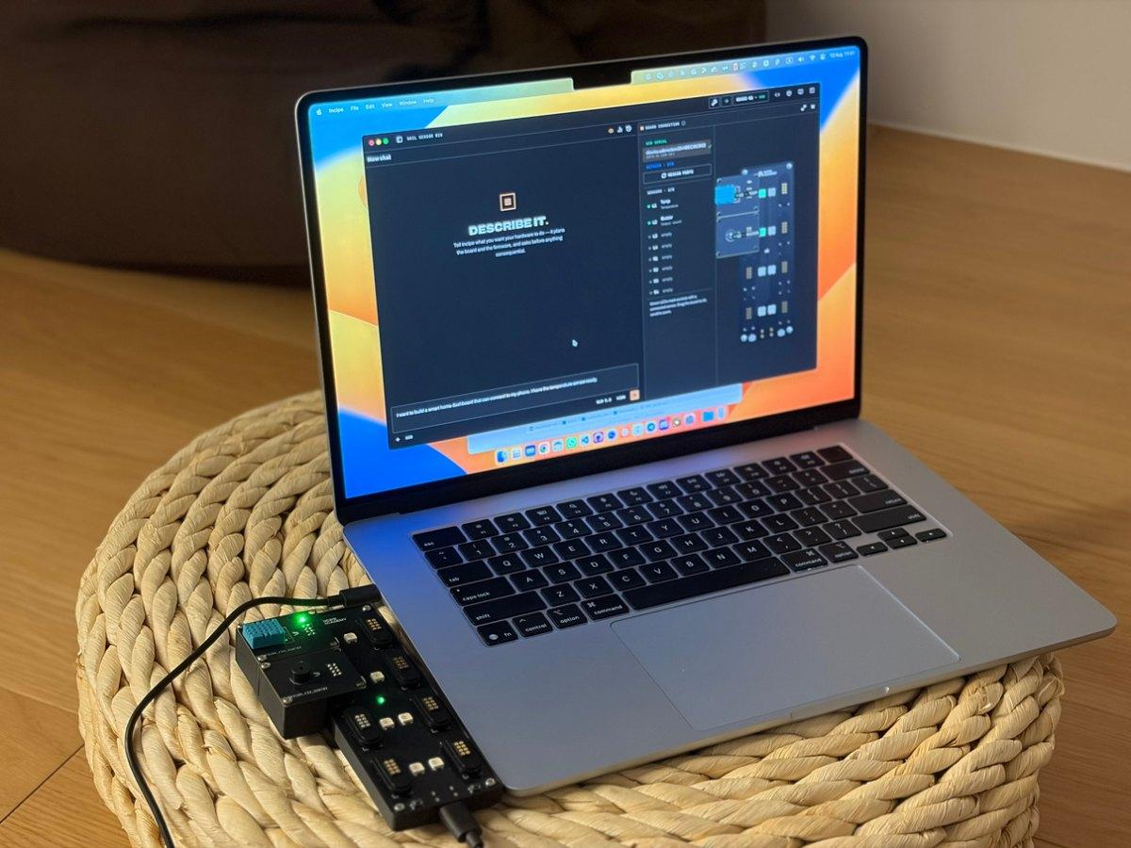
13
Live Demo
One prompt, start to compiled firmware.
Plug in any sensor and build an interactive experience with a prompt
5 minutes, then questions.
© 2026 Incipe Academy Limited. All rights reserved.
Notes:
Demo slot. Placeholder — drop in the flow you want to show live, and decide the fallback if the network or the board misbehaves.

Slide 14
14
Recap & Next Lesson
Three things to take away.
LESSON 2
1
AI shortens the drafting inside every stage. It does not remove a stage, and it does not remove you.
AI-Powered Firmware Development
Using the INCIPE Workspace AI agent for firmware compilation. AI-assisted code review and optimization. Understanding the limits of AI: when to trust it, and when to write your own code.
2
Pick the agent by how much of your project the answer depends on.
3
Role, Goal, Context — then set a marker so you can tell when the model has lost them.
Practice. Use AI to generate a function that reads from the Temperature & Humidity sensor, then manually optimize the memory usage.
© 2026 Incipe Academy Limited. All rights reserved.
Notes:
Recap in three lines, then set up Lesson 2: firmware compilation in the Workspace, AI-assisted review and optimization, where the limits are, and the sensor exercise.

