Slide 1

Lesson 1
Course Overview &
Programming Basics
© 2026 Incipe Academy Limited. All rights reserved.
CSWCSS Regular Course
M1: Programming with C++
Notes:
Frame the lesson: first lesson of Module 1, Fundamentals of Programming with C++. We cover the course, the Arduino IDE, setup and loop, data types, errors and the INCIPE library, then play with the INCIPE Board.

Slide 2
From the IDE to your first library.
Lesson Overview
2
01
Course overview & class setup
02
Getting started in the INCIPE Workspace
03
Writing codes: setup(), loop() & Serial
04
Data types
05
Errors & the error-free classwork
06
Libraries & the INCIPE Board
© 2026 Incipe Academy Limited. All rights reserved.

Slide 3


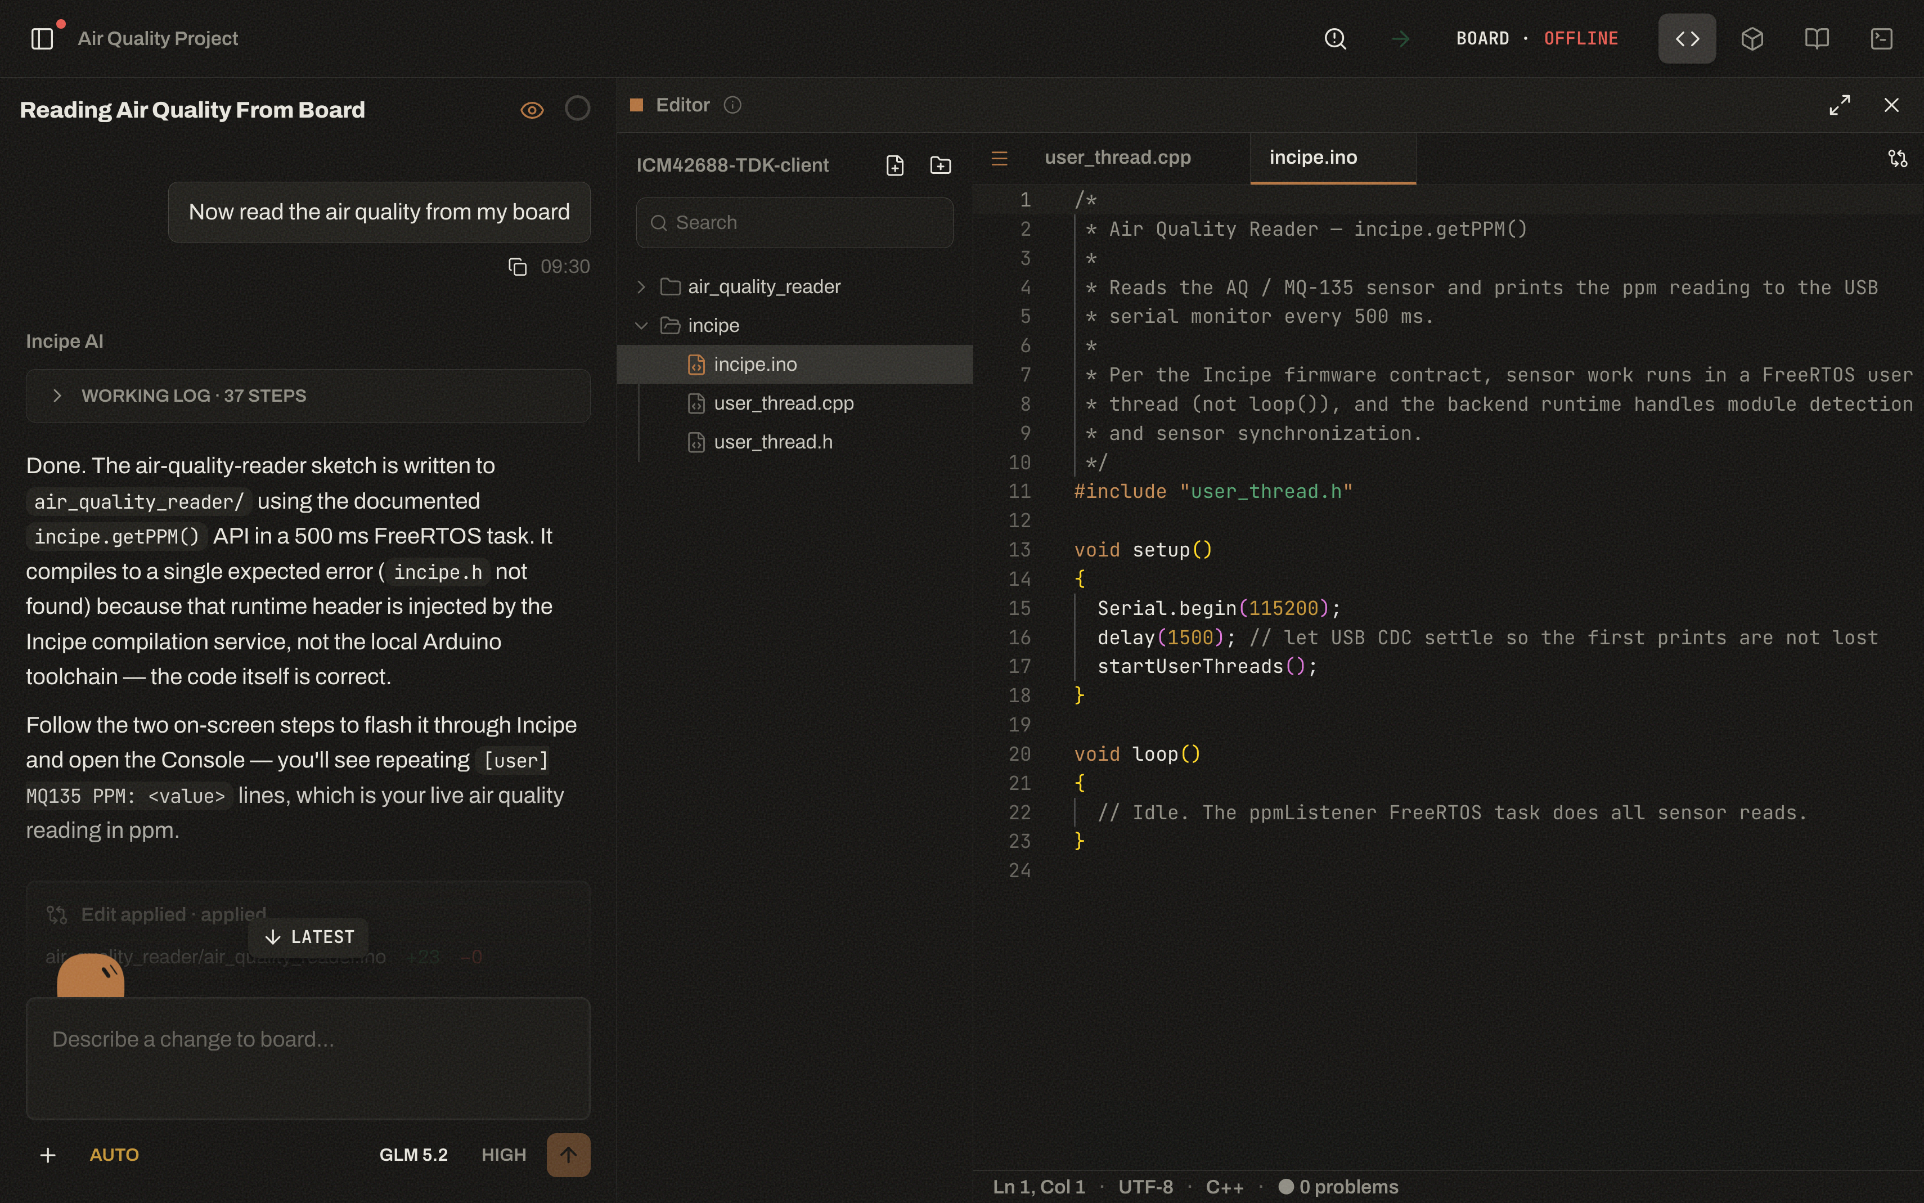
Find your way around INCIPE Workspace.
Getting Started
7
3
4
5
6
1
AI chat. Ask Incipe AI to write or change your code
2
Sketchbook & code. Your project files and the code editor
3
Verify. To verify the code
4
Upload. To upload the code to the INCIPE Board
1
2
5
Board menu. The INCIPE Board connected by USB, and its status
6
Serial monitor & plotter. The terminal icon: see results or plot graphs
© 2026 Incipe Academy Limited. All rights reserved.
Notes:
Left: the AI chat, where students describe what they want and Incipe AI writes the code. Right: the sketchbook (project files) and the code editor. Top bar, left to right: Verify (magnifier icon), Upload (arrow), the Board menu showing the USB-connected board and whether it is online, and the terminal icon for the serial monitor and plotter.

Slide 4
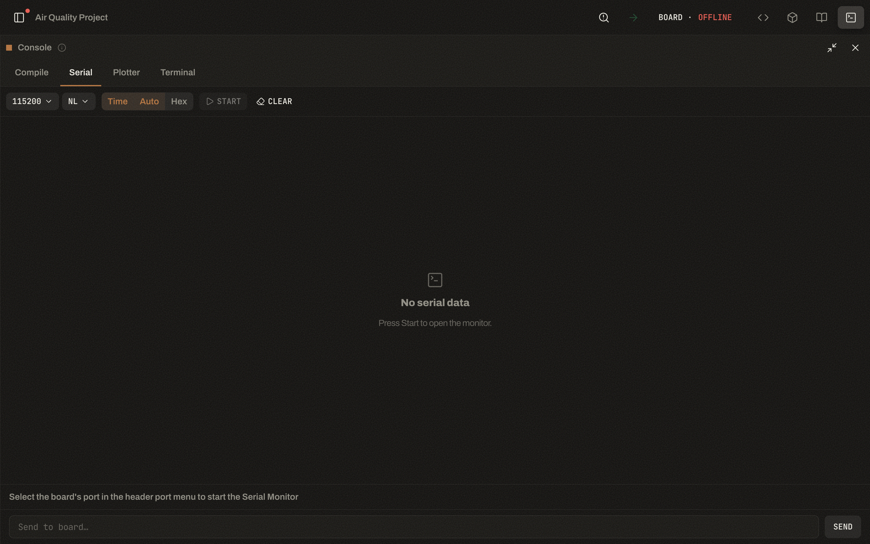
A virtual screen for the result of your code.
Serial Monitor
8
2
1
Similar to the screen in front of you, a serial monitor is a virtual screen inside the INCIPE Workspace for you to see the result of your code.
1
Terminal icon. Click it to open the Console
2
Serial tab. Shows what your code prints; Plotter draws graphs
3
4
3
Baud rate. Match Serial.begin(): 9600 in this lesson
4
Start. Opens the monitor
Connect first: select the board’s port in the Board menu.
© 2026 Incipe Academy Limited. All rights reserved.
Notes:
The screenshot shows 115200, but every sketch in this lesson uses Serial.begin(9600). If the baud rate does not match, the output looks garbled.

Slide 5
Every sketch has two functions.
Writing Codes
9
RUNS ONCE
RUNS CONTINUOUSLY
void setup() { }
void loop() { }
Used for setting up the motherboard.
Codes written here will run continuously.
The steps inside setup() function will only run once, after each powerup or reset of the INCIPE Board.
Majority of your codes would be placed here. Codes here will mainly be what you want the INCIPE Board to do, and what data to give you.
© 2026 Incipe Academy Limited. All rights reserved.

Slide 6
Five functions for your first sketches.
Writing Codes
10
Serial.begin(9600)
To activate your serial monitor.
Serial.print()
Prints numbers or words to the serial port. Words need “”, otherwise the computer would not understand. The words or numbers print on the same line.
Serial.println()
Similar to Serial.print(), but prints the data and then skips a line, so the next data is printed on a new line.
delay()
Tells the computer to wait before the next order. The unit is millisecond (1s = 1000ms).
Serial.parseInt()
Reads the integer input from users.
© 2026 Incipe Academy Limited. All rights reserved.

Slide 7
Printing “Hello world”.
Examples
11
void setup() {
Serial.begin(9600);
}
void loop() {
Serial.println("Hello world");
delay(1000);
}
WHAT IT DOES
setup() activates the serial monitor once. loop() prints Hello world on a new line, waits 1000ms, then repeats.
PRACTICE
Let’s have a try yourselves.
© 2026 Incipe Academy Limited. All rights reserved.

Slide 8
How to activate serial monitor?
Slido Check
12
HOW TO ANSWER
OPEN ANSWER
Answer in the Slido app.
Type the line of code on Slido.
Results show once the slide is presenting.
© 2026 Incipe Academy Limited. All rights reserved.
Notes:
Expected answer: Serial.begin(9600); inside setup().

Slide 9
Three ways to store a number.
Data Types
13
Type 1
Type 2
Type 3
int
float
double
Integer. Integer in Maths, can be positive, 0 or negative.
Float. Numbers that can have up to 7 decimal places.
Double. Numbers that can have up to 15 decimal places.
eg 1, 102
eg 1.234, 2.345
eg 1.234567890123
© 2026 Incipe Academy Limited. All rights reserved.
Notes:
Teacher note: on AVR boards such as the Arduino Mega, double is stored the same way as float, so both give about 6–7 significant digits.

Slide 10
How precise does the number need to be?
Data Types
14
SAME SUM
1+1 vs 001.000000000 + 001.000000000
SAME ROOM
22°C vs 22.3°C vs 22.3278453624°C
© 2026 Incipe Academy Limited. All rights reserved.
Notes:
Ask the class which type each number needs, and why extra decimal places do not always help.

Slide 11
Declaring & printing numbers.
Data Types
15
DECLARE
PRINT
int a = 10;
const int a_const = 10;
float b = 10.123456;
const float b_const = 10.123456;
double c = 10.123456789123456;
const double c_const = 10.123456789123456;
void setup() {
// put your setup code here, to run once:
Serial.begin(9600);
Serial.print("a = ");
Serial.println(a);
Serial.print("a_const = ");
Serial.println(a_const);
Serial.print("b = ");
Serial.println(b,6);
Serial.print("b_const = ");
Serial.println(b_const,6);
}
© 2026 Incipe Academy Limited. All rights reserved.
Notes:
The 6 in Serial.println(b,6) prints six decimal places.

Slide 12
Storing characters & words.
Data Types
16
String text = "I am William";
char character = 'A';
void setup() {
// put your setup code here, to run once:
Serial.begin(9600);
Serial.println(text);
Serial.println(character);
}
Char – Single character
e.g A
String – Multiple characters
e.g ABC, Hello
NEXT LESSON
Boolean – A data type whose value is either true or false.
© 2026 Incipe Academy Limited. All rights reserved.
Notes:
Point out the quotes: double quotes for a String, single quotes for a char. Boolean is covered further in the next lesson.

Slide 13
How to show a message Hi on serial monitor?
Slido Check
17
HOW TO ANSWER
OPEN ANSWER
Answer in the Slido app.
Type the line of code on Slido.
Results show once the slide is presenting.
© 2026 Incipe Academy Limited. All rights reserved.
Notes:
Expected answer: Serial.print("Hi"); or Serial.println("Hi"); after Serial.begin(9600).

Slide 14
Which of the following can print 1 on serial monitor?
Slido Check
18
HOW TO ANSWER
CHOOSE ALL THAT APPLY
Answer in the Slido app.
i Serial.print(1);
ii Serial.print("1");
iii Serial.print(0+1);
iv Serial.print("0+1");
Results show once the slide is presenting.
© 2026 Incipe Academy Limited. All rights reserved.
Notes:
Answer: i, ii and iii print 1. iv prints the text 0+1, because anything inside quotes is printed as written.

Slide 15
Three kinds of error.
Errors
19
Error 1
Error 2
Error 3
Syntax error
Run-time error
Logical error
Written mistakes.
The computer could not perform what you tell it to do.
The computer gives you an outcome, but not the one you expected.
eg missing a bracket in a conditional statement, missing a “;” or mixing up single equal and double equal
eg 1/0
© 2026 Incipe Academy Limited. All rights reserved.

Slide 16
Spot the written mistakes.
Syntax Error
20
int SensorValue = 10
void setup() {
// put your setup code here, to run once:
Serial.begin(9600);
Serial.print (SenserValue);
}
TRY IT
Press Verify. The IDE stops at the first written mistake.
How many can you find before you run it?
© 2026 Incipe Academy Limited. All rights reserved.
Notes:
Two mistakes: the missing ; after int SensorValue = 10, and SenserValue spelled differently from the variable SensorValue.

Slide 17
Nothing happens when the values are equal.
Logical Error
21
AS WRITTEN
FIXED
if (sensorValue > threshold) {
Print("true"); }
else if (sensorValue < threshold) {
Print("false"); }
if (sensorValue >= threshold) {
Print("true"); }
else if (sensorValue < threshold) {
Print("false"); }
Nothing would be performed when sensorValue = threshold.
When sensorValue = threshold, it now prints true.
© 2026 Incipe Academy Limited. All rights reserved.
Notes:
The code compiles and runs, so the IDE reports nothing. Only testing the equal case shows the gap.

Slide 18
Error-free exercise.
Classwork
22
THEN
YOUR NOTES
Fix every error so each sketch runs.
Refer to your note page 7-8.
Suggested answers follow.
© 2026 Incipe Academy Limited. All rights reserved.

Slide 19
Answer 1: print Hi every second.
Suggested Answer
23
void setup() {
// put your setup code here, to run once:
Serial.begin(9600);
}
void loop() {
// put your main code here, to run repeatedly:
Serial.print("Hi");
delay(1000);
}
CORRECTIONS
Bronze marks each fix.
Compare with your own answer on note page 7-8.
© 2026 Incipe Academy Limited. All rights reserved.

Slide 20
Answer 2: calculate BMI.
Suggested Answer
24
void setup() {
Serial.begin(9600);
}
void loop() {
Serial.println("Please enter your height in m");
while(Serial.available()==0){}
float height = Serial.parseFloat();
Serial.println("Please enter your weight in kg");
while(Serial.available()==0){}
float weight = Serial.parseFloat();
float BMI = weight/height /height;
Serial.print("Your BMI is:");
Serial.println(BMI);
}
CORRECTIONS
Bronze marks each fix.
Compare with your own answer on note page 7-8.
© 2026 Incipe Academy Limited. All rights reserved.
Notes:
Comment lines from the original sketch are left out here to fit the slide; the code itself is unchanged.

Slide 21
Answer 3: print a variable.
Suggested Answer
25
int a = 1;
void setup() {
// put your setup code here, to run once:
Serial.begin(9600);
}
void loop() {
// put your main code here, to run repeatedly:
Serial.print(a);
}
CORRECTIONS
Bronze marks each fix.
Compare with your own answer on note page 7-8.
© 2026 Incipe Academy Limited. All rights reserved.

Slide 22
Pre-written code you can reuse.
Libraries
26
WHAT
A collection of pre-written code that we can use to perform specific tasks.
NOW
Install INCIPE library now.
WHY
Libraries reduce the amount of code you need by providing reusable functions or classes that can be called upon as needed.
WHERE
You can find different libraries and install them in Arduino IDE.
© 2026 Incipe Academy Limited. All rights reserved.

Slide 23
Three lines to put data on the screen.
INCIPE Library
27
1
#include "incipe.h"
Gain access to INCIPE library.
2
Incipe incipe (true);
Activate the library.
3
incipe.onscreen("place", "data/word")
Print “data/word” on that specific “place”.
© 2026 Incipe Academy Limited. All rights reserved.

Slide 24
What does the following code do?
Slido Check
29
HOW TO ANSWER
READ THE CODE
Please download and install the Slido app on all computers you use.
int a = 10;
incipe.onscreen("light1", a);
Results show once the slide is presenting.
© 2026 Incipe Academy Limited. All rights reserved.
Notes:
Answer: it shows 10 in the light1 place on the INCIPE Board screen.

Slide 25
Let’s play with the INCIPE Board.
Hands-On & Next Lesson
30
1
Install the INCIPE library and add #include "incipe.h".
LESSON 2
C++ Basics: Operators, Comments, Input & Output
2
Pick a place on the screen and show a value with incipe.onscreen().
Introduction to Incipe Academy Advanced Sensor Kit.
3
Verify, then upload to the INCIPE Board.
Coming up. Boolean, the true-or-false data type.
Thank you!
© 2026 Incipe Academy Limited. All rights reserved.

