Slide 1

Lesson 9
Advanced Programming II
© 2026 Incipe Academy Limited. All rights reserved.
Taster Workshop
Programming with C++
Notes:
Four parts: a quick timer revisit, finite-state machines, enum with switch case, then connecting the board to Wi-Fi.

Slide 2
From states in code to the board on Wi-Fi.
Lesson Overview
2
01
Revisit: Timer
02
Finite-state machine
03
enum & switch case
04
Wi-Fi & signal strength
© 2026 Incipe Academy Limited. All rights reserved.

Slide 3

Mark a moment on the timeline.
Revisit: Timer
3
long last_tick = millis();
last_tick
Time (millis)
The moment the line runs
© 2026 Incipe Academy Limited. All rights reserved.
Notes:
millis() is the number of milliseconds since the board started, and it keeps growing. last_tick saves one moment on that line, so later you can check how much time has passed with millis() - last_tick. Tip: millis() returns an unsigned long, which is the safer type to store it in.

Slide 4


Traffic light: one state at a time.
Finite-State Machine
4
State 1
State 2
State 3
RED
GREEN
YELLOW
then back to RED
The light is always in exactly one state, and it moves to the next state when its time is up.
© 2026 Incipe Academy Limited. All rights reserved.
Notes:
A finite-state machine has a fixed list of states, is in exactly one at a time, and moves between them when something happens. The order shown is simplified to the three states used in the code later.

Slide 5
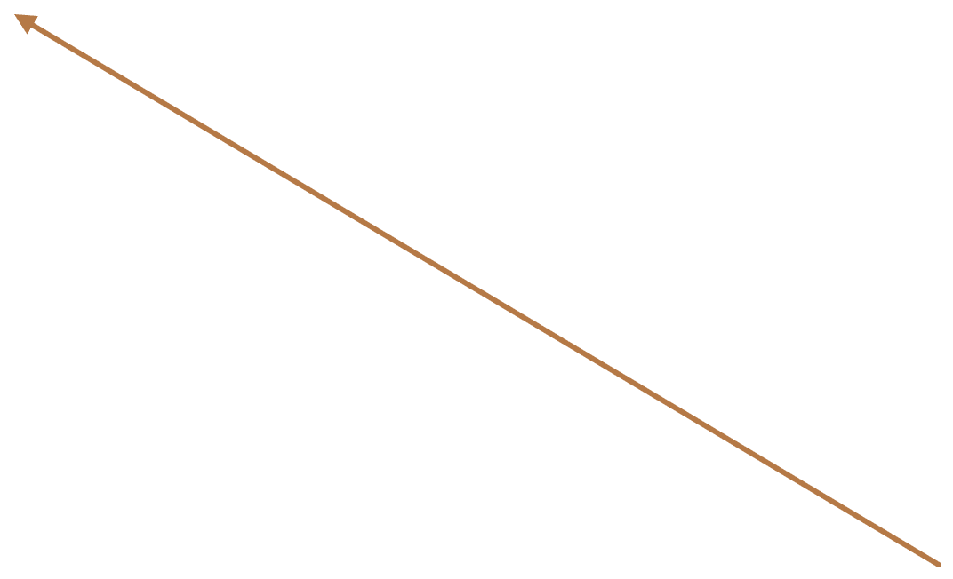
Vending machine: four states.
Finite-State Machine
5
Idle
Press the insert coin button
Accepting Coin
Insert coins (stays in this state)
Cancel request
Collect product
Cancel request
Press the select product button
Dispensing
Select product
Product Selection
get Change (internal)
© 2026 Incipe Academy Limited. All rights reserved.
Notes:
Each box is a state; each arrow is an event that moves the machine to another state. Trace one purchase: Idle, Accepting Coin, Product Selection, Dispensing, back to Idle.

Slide 6
Numbers can stand for names.
enum
6
DAYS OF THE WEEK
TRAFFIC LIGHT STATES
Monday → 1
Tuesday → 2
…
Sunday → 7
RED → 1
YELLOW → 2
GREEN → 3
MOTIVATION
An enum is a way to give friendly names to a set of related integer constants, making code more readable. Less debugging time.
© 2026 Incipe Academy Limited. All rights reserved.
Notes:
The original slide listed GREEN → 7; it is corrected to 3 here. Remembering that 2 means YELLOW is hard; writing YELLOW is easy. That is the job of an enum.

Slide 7
How to define your own enum.
enum
7
TEMPLATE
IN PRACTICE
enum EnumName
{ VALUE1,
VALUE2,
VALUE3
};
enum TrafficLight
{ RED,
YELLOW,
GREEN
};
© 2026 Incipe Academy Limited. All rights reserved.
Notes:
Point out the commas between values, no comma after the last one, and the semicolon after the closing brace.

Slide 8
How to use your own enum.
enum
8
DEFINE · NUMBERS START AT 0
DECLARE A VARIABLE
TrafficLight light = RED;
enum TrafficLight
{ RED,
YELLOW,
GREEN,
NUM_OF_STATES
};
(0)
(1)
(2)
(3)
The enum name becomes a type, like int. light can only hold one of its values.
© 2026 Incipe Academy Limited. All rights reserved.
Notes:
NUM_OF_STATES is a common trick: because counting starts at 0, the last entry equals the number of real states (3).

Slide 9
How to write switch case.
Switch Case
9
switch (light) {
case RED:
// turn on RED light
break;
case GREEN:
// turn on GREEN light
break;
case YELLOW:
// turn on YELLOW light
break;
}
switch (light)
Checks the value of light.
case RED:
Runs when light is RED.
break;
Leaves the switch. Without it, the next case runs too.
© 2026 Incipe Academy Limited. All rights reserved.
Notes:
Here light starts as RED (TrafficLight light = RED;), so only the RED case runs.

Slide 10

All together.
enum + Switch Case
10
1 · DEFINE
3 · SWITCH
enum TrafficLight
{ RED,
YELLOW,
GREEN
};
switch (light) {
case RED:
// turn on RED light
break;
case GREEN:
// turn on GREEN light
break;
case YELLOW:
// turn on YELLOW light
break;
}
2 · DECLARE
TrafficLight light = RED;
© 2026 Incipe Academy Limited. All rights reserved.
Notes:
This is the traffic light state machine in code: the enum lists the states, light holds the current state, and the switch decides what each state does.

Slide 11
Basic technical terms.
Wi-Fi
11
SSID
Network name
Request
Password
Security key
Server
Clients
Internet
IP address
Device identifier
Laptop, phone, computer
Client vs server
Who asks, who answers
Response
© 2026 Incipe Academy Limited. All rights reserved.
Notes:
Clients send a request through the internet; the server sends back a response. The board joins the network as a client using the SSID and password.

Slide 12
Connect the board to Wi-Fi.
Wi-Fi
12
BEFORE SETUP()
SETUP()
#include <WiFi.h>
const char* ssid =
"YourWiFiName";
const char* password =
"YourWiFiPassword";
void setup() {
Serial.begin(115200);
WiFi.begin(ssid, password);
Serial.print("Connecting to WiFi...");
while (WiFi.status() != WL_CONNECTED) {
delay(500);
Serial.print(".");
}
Serial.println("\nConnected! IP Address: ");
Serial.println(WiFi.localIP());
}
LOOP()
void loop() {
// Do nothing (or add more
// functionality later)
}
© 2026 Incipe Academy Limited. All rights reserved.
Notes:
Replace YourWiFiName and YourWiFiPassword with the classroom network. Note Serial.begin(115200): set the serial monitor to 115200 baud, not 9600, or the output looks garbled.

Slide 13
Step-by-step Wi-Fi connection.
Wi-Fi
13
Step 1
Step 2
Step 3
WiFi.begin()
WiFi.status()
WiFi.localIP()
Connects to Wi-Fi.
Checks connection status.
If success, gets the assigned IP address.
© 2026 Incipe Academy Limited. All rights reserved.

Slide 14
Closer to 0 dBm means a stronger signal.
Signal Strength
14
Signal strength | RSSI (dBm) | Meaning
Excellent | -30 to -70 dBm | Your connection is strong and you shouldn’t have any issues.
Good | -71 to -80 dBm | Your connection is good enough for most activities.
Fair | -81 to -90 dBm | Your connection is fine for most tasks, but you may experience some issues.
Weak | Below -90 dBm | Your connection isn’t strong enough for most activities.
© 2026 Incipe Academy Limited. All rights reserved.
Notes:
RSSI is negative: -50 is stronger than -85. Ask students to walk away from the router and watch the number drop.

Slide 15
Read the RSSI every two seconds.
Signal Strength
15
void loop() {
// Check WiFi connection status
if (WiFi.status() == WL_CONNECTED) {
// Get the RSSI (Received Signal Strength Indicator)
long rssi = WiFi.RSSI();
Serial.print("Signal strength (RSSI): ");
Serial.print(rssi);
Serial.println(" dBm");
}
else {
Serial.println("WiFi disconnected");
}
delay(2000); // Wait 2 seconds before next reading
}
TRY IT
Add this loop() to the Wi-Fi sketch.
Compare your reading with the table on the last slide.
© 2026 Incipe Academy Limited. All rights reserved.

Slide 16
Four things to take away.
Recap
16
1
A finite-state machine is always in one state and moves between states on events.
2
An enum gives friendly names to related integer constants, counting from 0.
3
switch case runs the code for the current value; break ends each case.
4
WiFi.begin(), WiFi.status() and WiFi.localIP() connect the board; WiFi.RSSI() reads signal strength.
© 2026 Incipe Academy Limited. All rights reserved.

