Slide 1
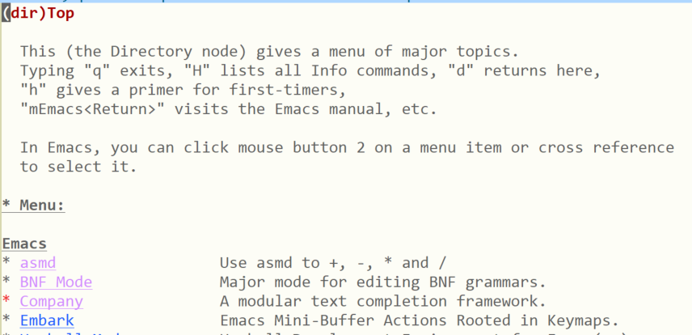
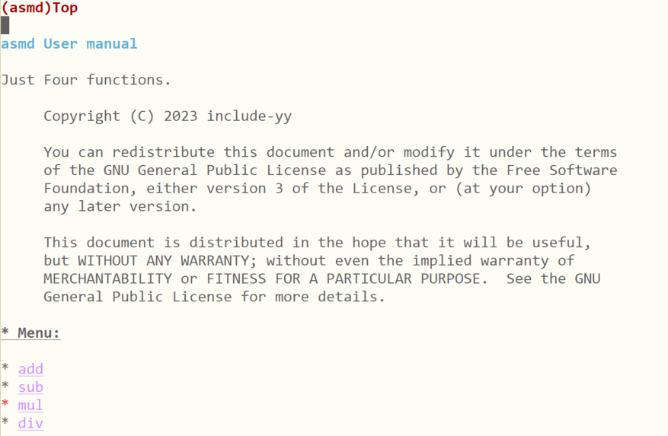
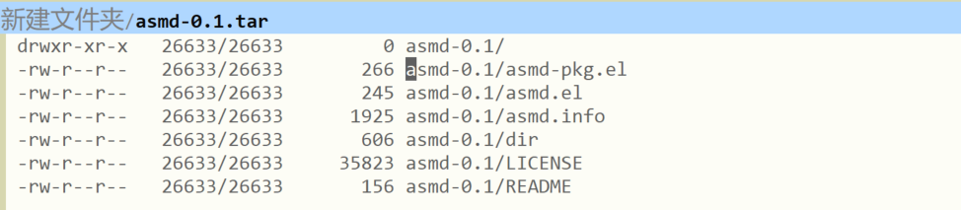

Slide 2
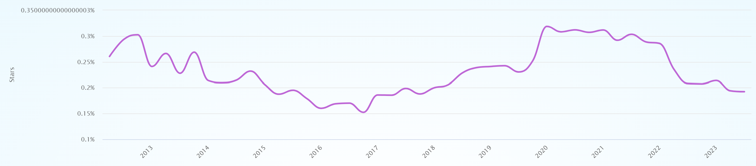
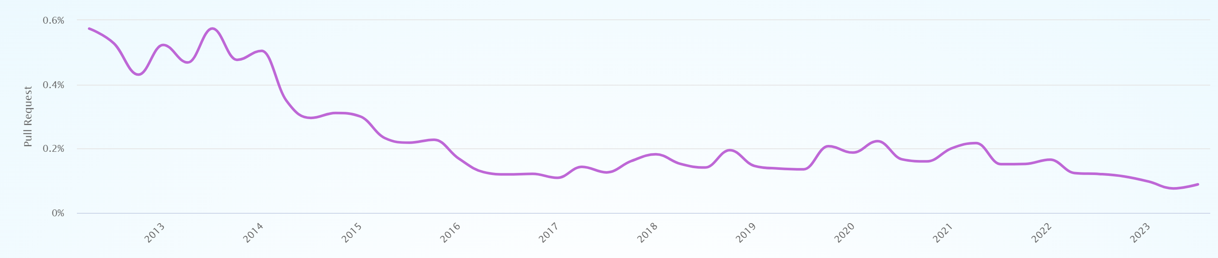
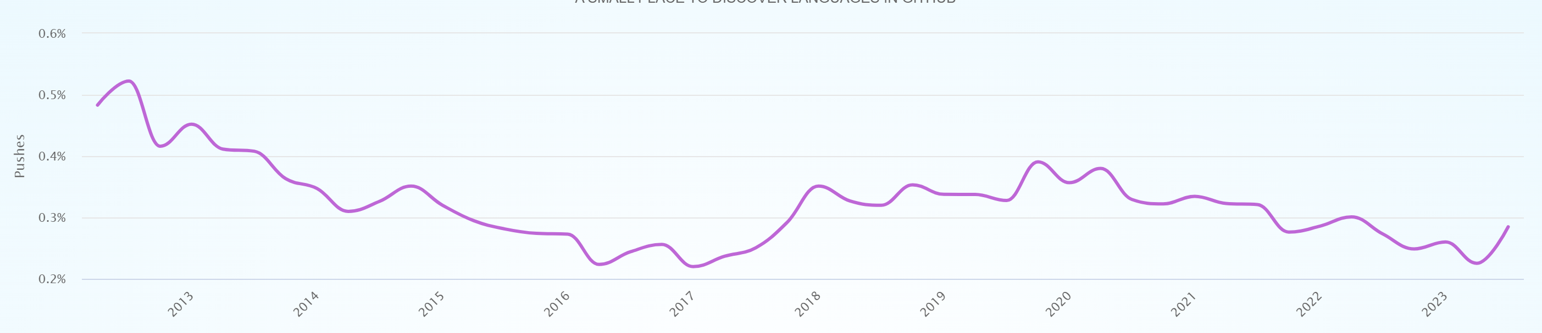
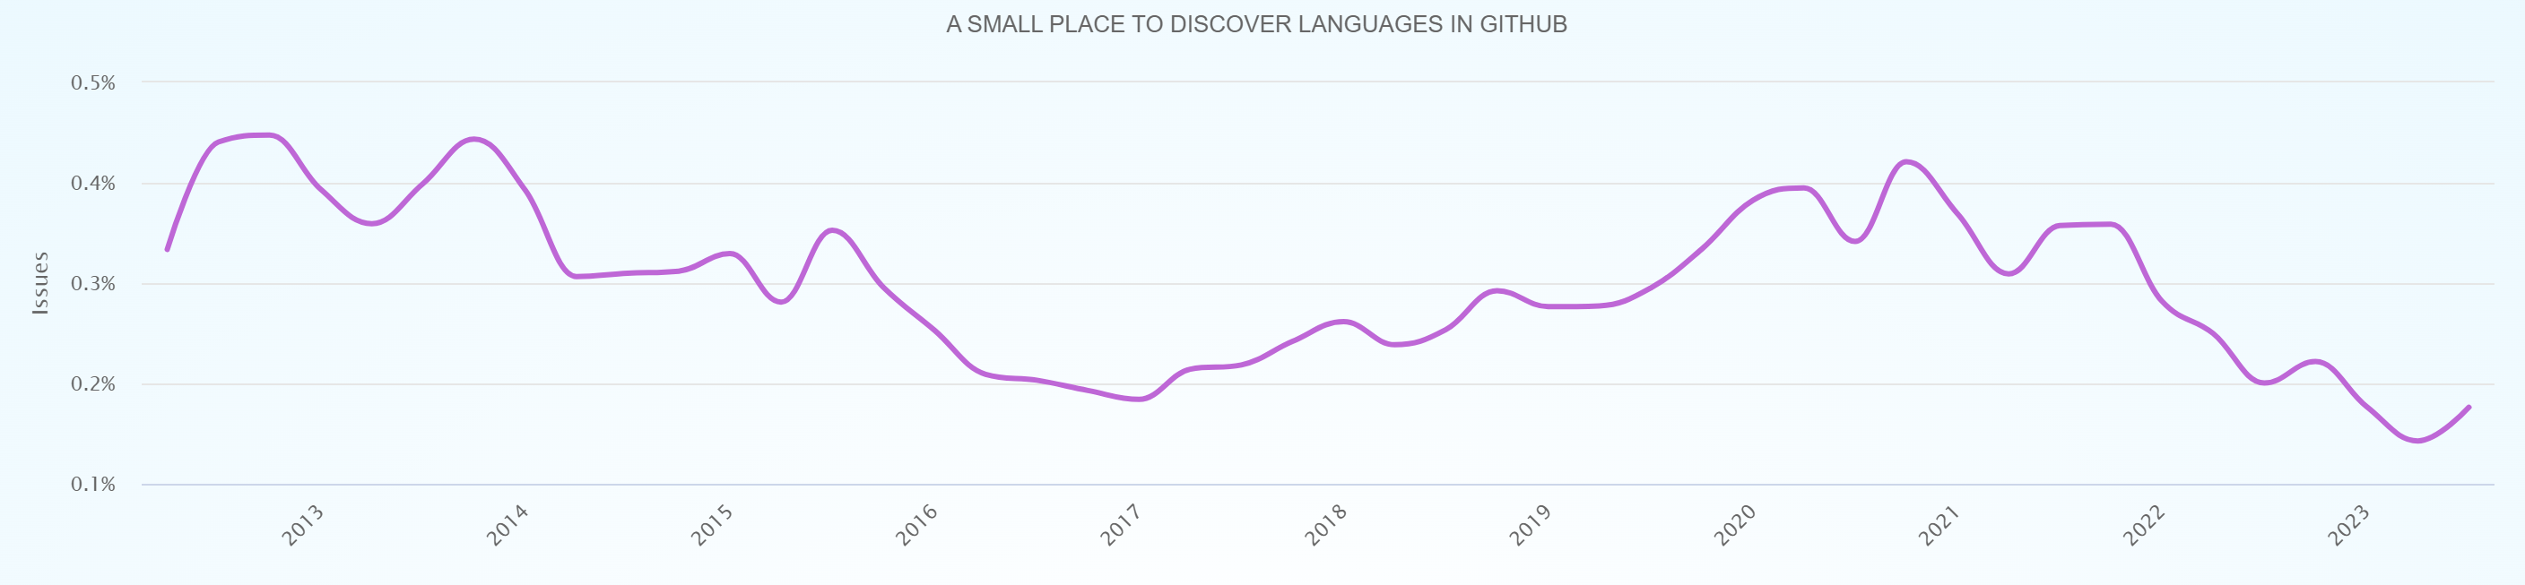
Stars(0.15% ~ 0.3%)
PRs(0.1% ~ 0.6%)
Pushs(0.2% ~ 0.5%)
Issues(0.1% ~ 0.5%)
https://madnight.github.io/githut/#/pull_requests/2023/3
include-yy 2023/12/20

