Slide 1

Mixin Robot Store
Code by Wuyun

Slide 2
Introduction
Collect all awesome Mixin Robots in our Store
Mixin ID:7000101718
base on Mixin Python3 SDK
Storage power by leancloud, use leancloud-better-storage-python

Slide 3
Commands of Robot
Collect all awesome Mixin Robots in our Store (Mixin ID:7000101718)
you can reply [..] these below:
hot: most popular mixin robots
new: the latest submission mixin robots
top: top rating mixin robots
search: find a mixin robot by name/tag/description
code: return a mixin robot by code (star with '7000')
rate: rating mixin robot
submit: submit a new mixin robot (http://m3blockchain.mikecrm.com/A95F8m4)
help: if you have other problems...

Slide 4
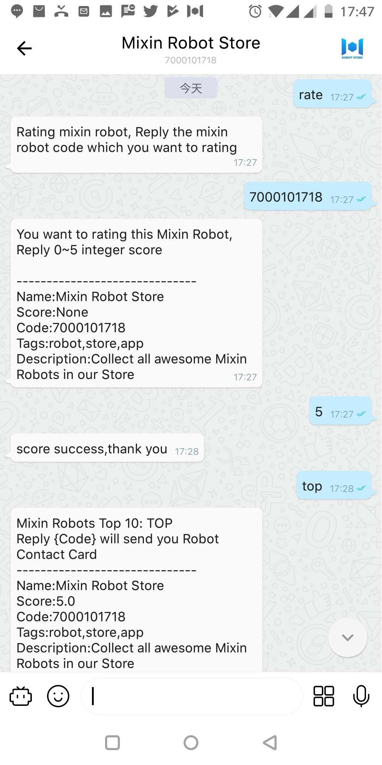
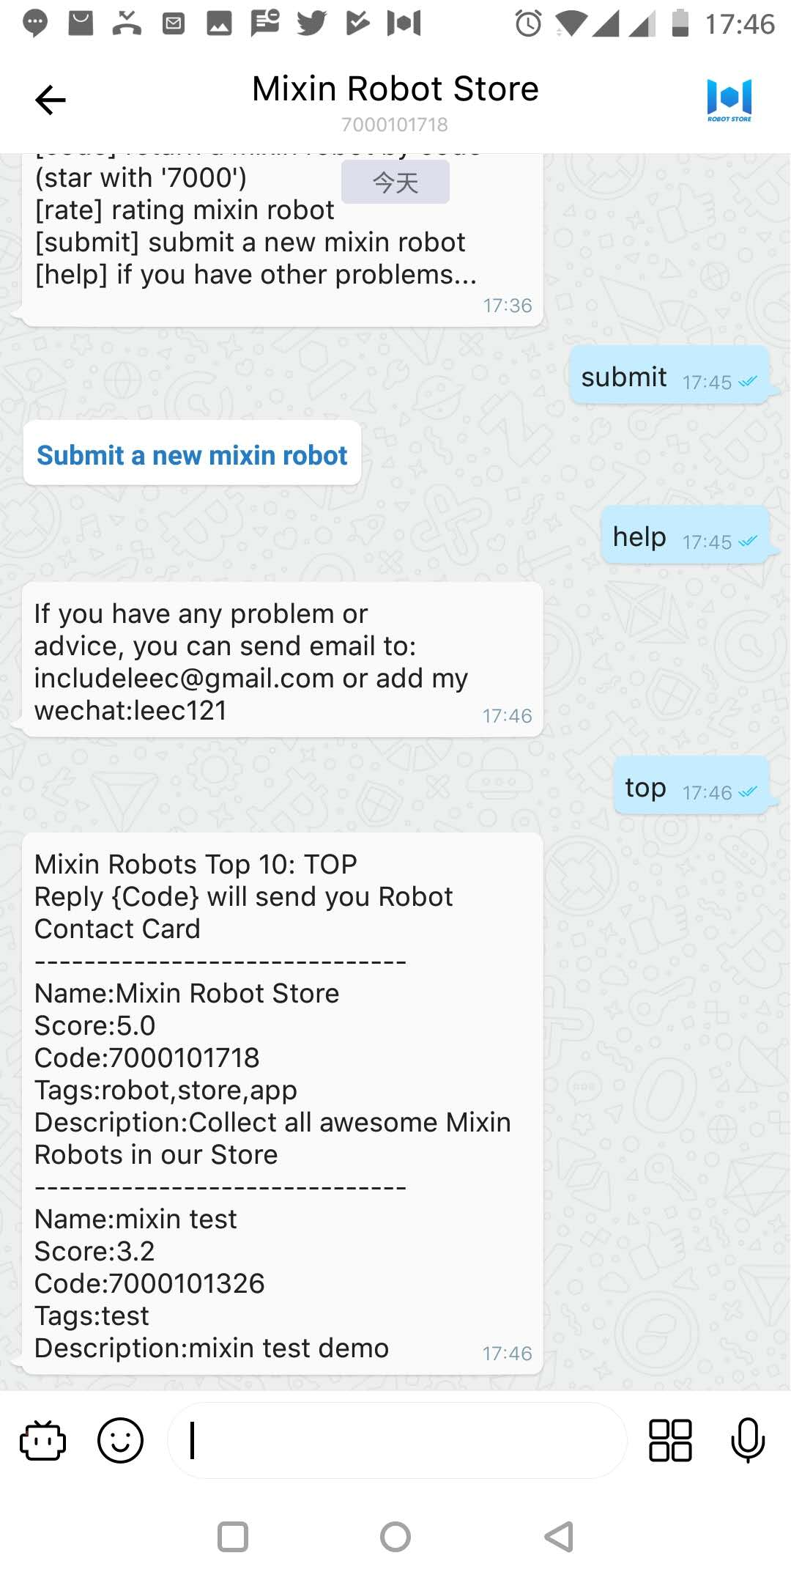
Screenshots

