Slide 1

Wheely-Joystick-Mouse

Slide 2
Table of Content
Project Introduction
Our Solution
Demonstration
What was the problem that needed to be solved
The requirements to the solution
Introduction to the Brackets to mount the Microcontrollers
The Code for the Microcontrollers
Demonstration of the final Solution

Slide 3
Project introduction
Familiarity with the Joystick
A wheelchair user is very used to the joystick of the wheelchair and in many cases, it is adapted specifically for the person’s residual functions
Lack of Mouse Emulation
Unfortunately, the wheelchair joystick normally does not support mouse emulation for computers or smartphones
Project Goal
The goal of the project is to develop a solution that transforms a wheelchair joystick into a PC mouse. This will allow users to utilize their familiar and customized joystick to operate computers, enhancing accessibility and ease of use for individuals with limited mobility.

Slide 4
Requirements of the Final Solution
Joystick and Mouse-click Compatibility
Adapted to the users’s needs, reliable and easy to set up
Sensitivity Adjustment
Customizable sensitivity dependent on the user’s needs
Usability
The Wheely-Joystick-Mouse should be intuitive and easy to use based on the users needs
Performance
The Battery should be long-lasting to reduce replacements

Slide 5
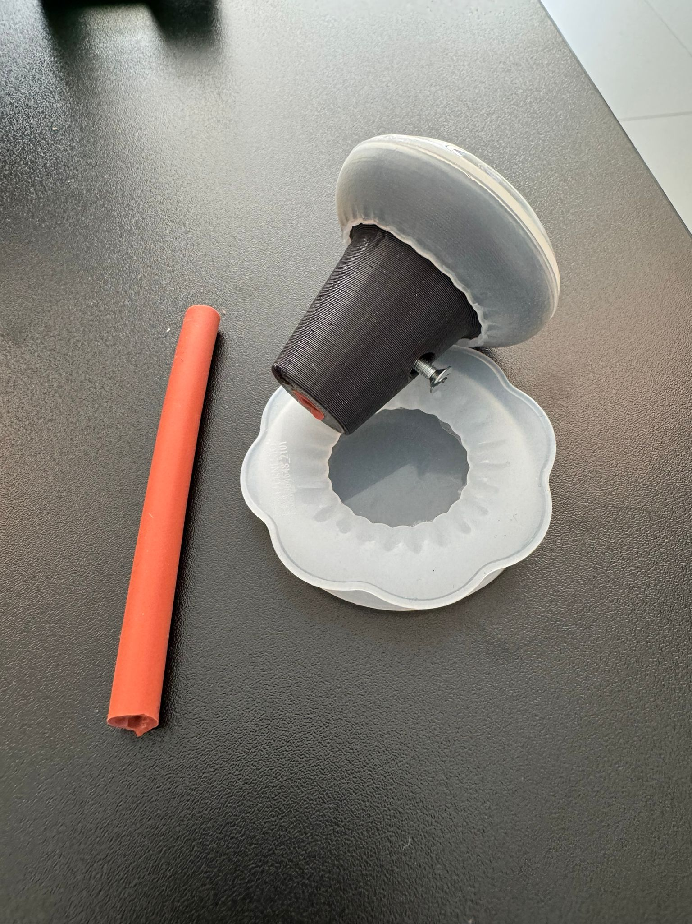
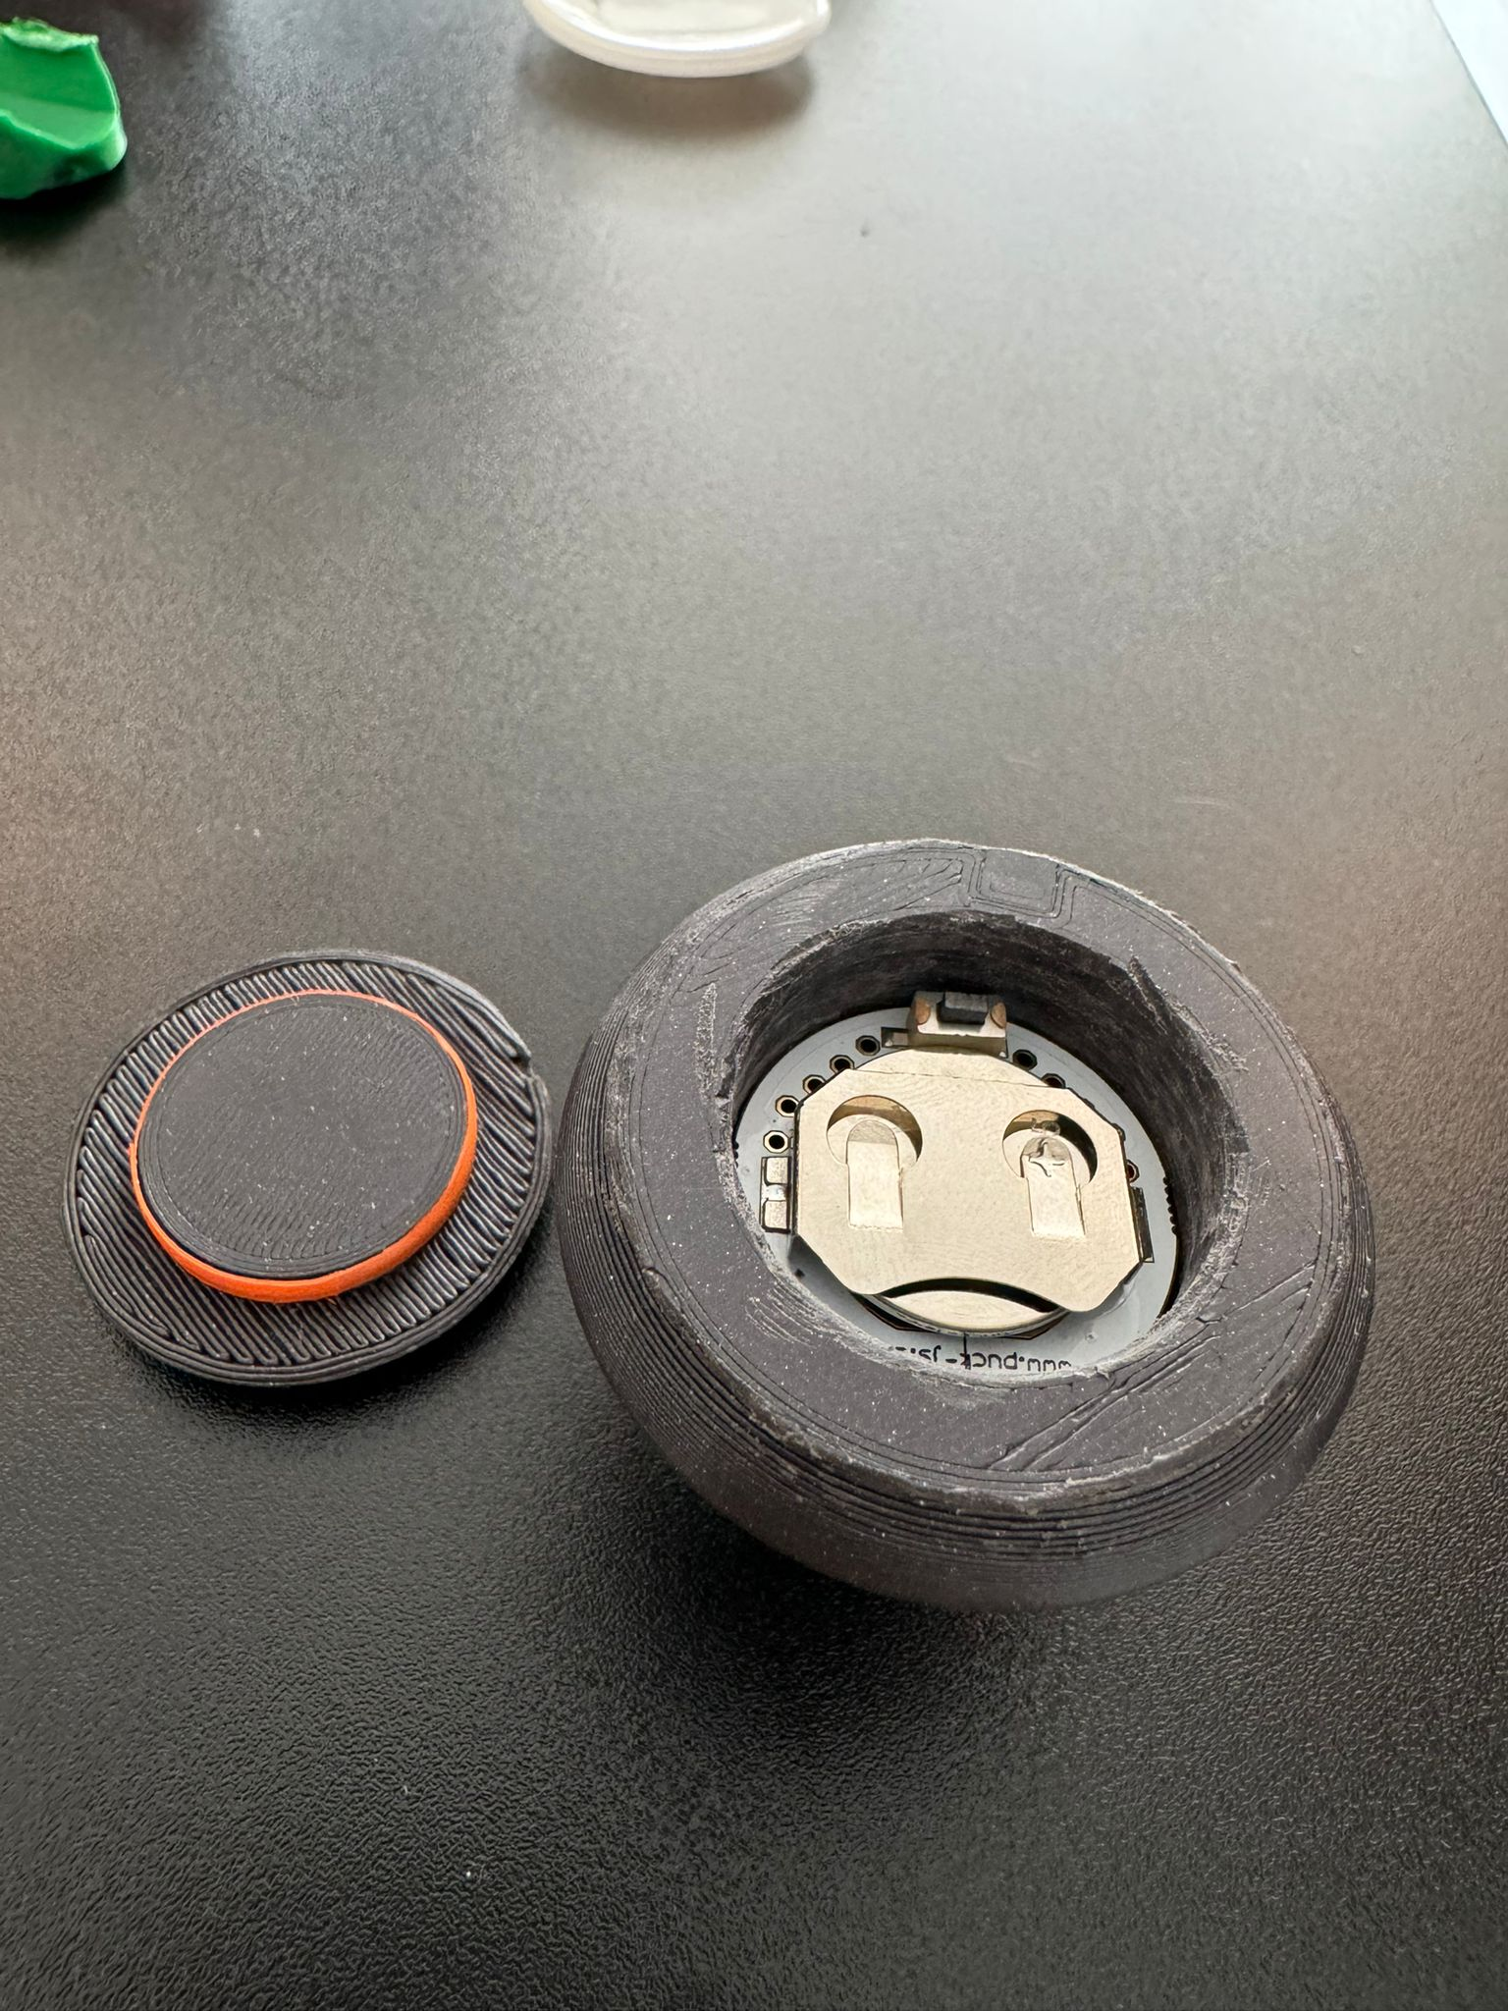
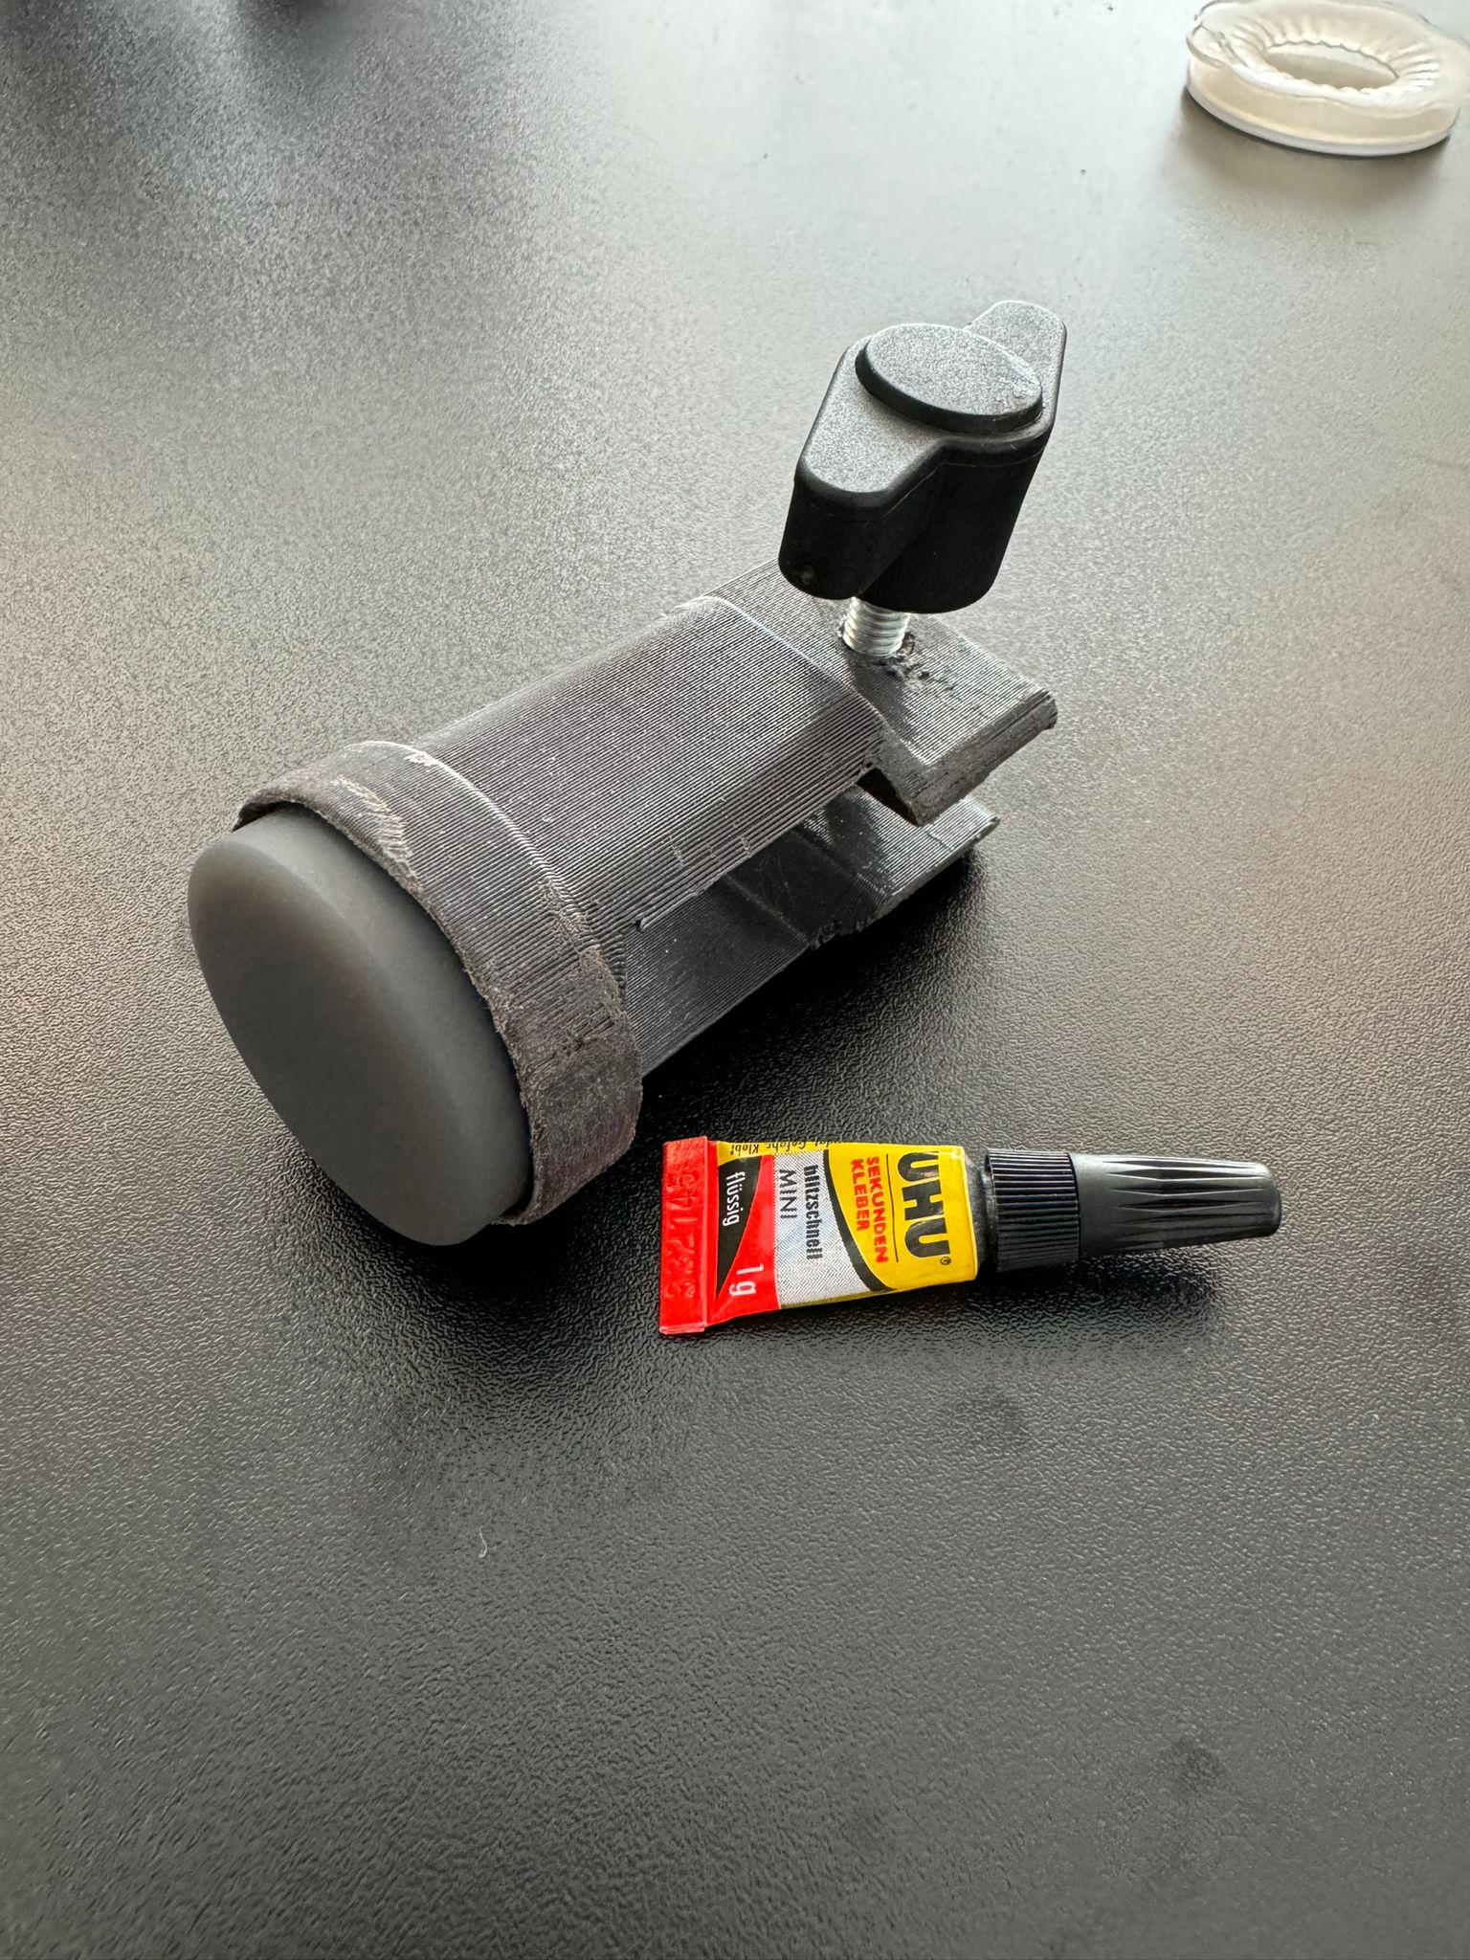
Mounts for the Microcontrollers
2
4
1
3
5

Slide 6
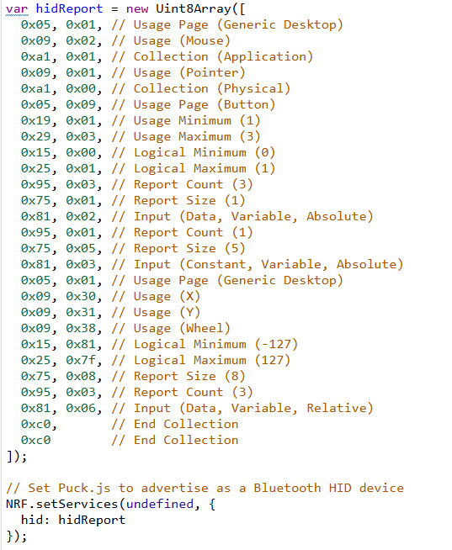
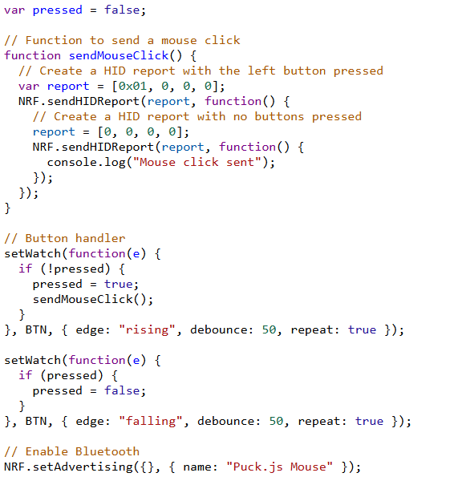
Mouse Click
2
4
1
3

Slide 7
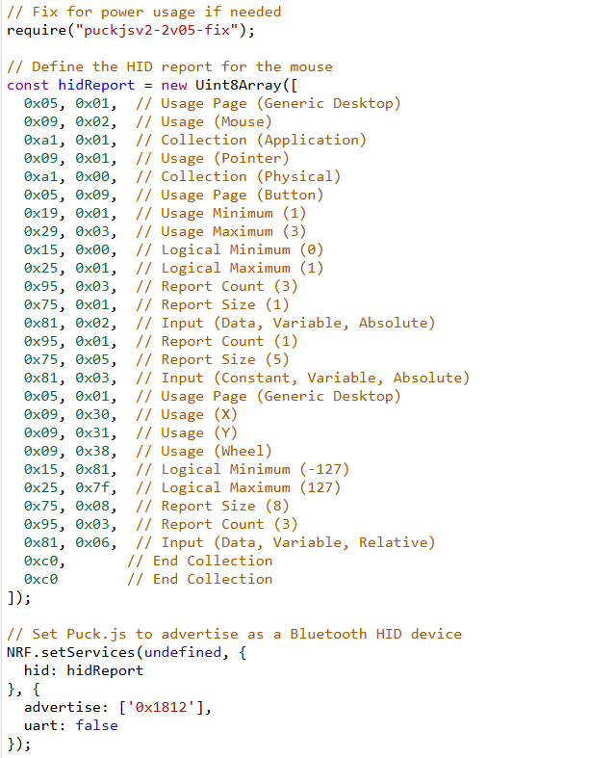
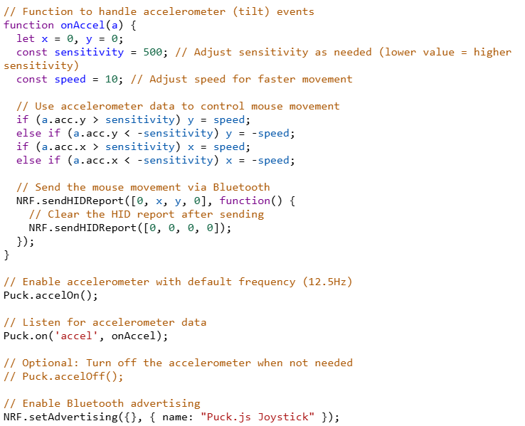
Mouse movements
2
4
1
3
5

Slide 8
Demonstration
— Thank you for your Attention!

