Slide 1
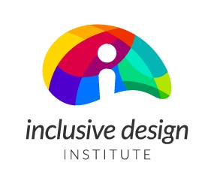


Improving Standards Development Processes
A commitment to including people with disabilities from the public from the beginning and in authentic ways:
“nothing about us without us”

Slide 2
16 recommendations for Standards Development Processes (1-8)
Build capacity in the community to engage in standards development.
Create audience-appropriate learning content.
Make standards understandable.
Make the message of standards discoverable and accessible.
Embark on an ongoing journey toward diversity and representation.
Be transparent and accountable to support diversity and representation.
Broadly announce the accessible enquiry stage.
Seek opportunities beyond enquiry.

Slide 3
16 recommendations for Standards Development Processes (9-16)
Provide flexible and understandable onboarding and training.
Engage with individuals regarding any necessary accommodations.
Leverage technical knowledge of people with disabilities.
Take regular pauses for critical reflection.
Increase public engagement.
Be transparent and accountable.
Reduce risk with curb-cut decision-making.
Leverage informal decision-making in a formalized process.

Slide 4
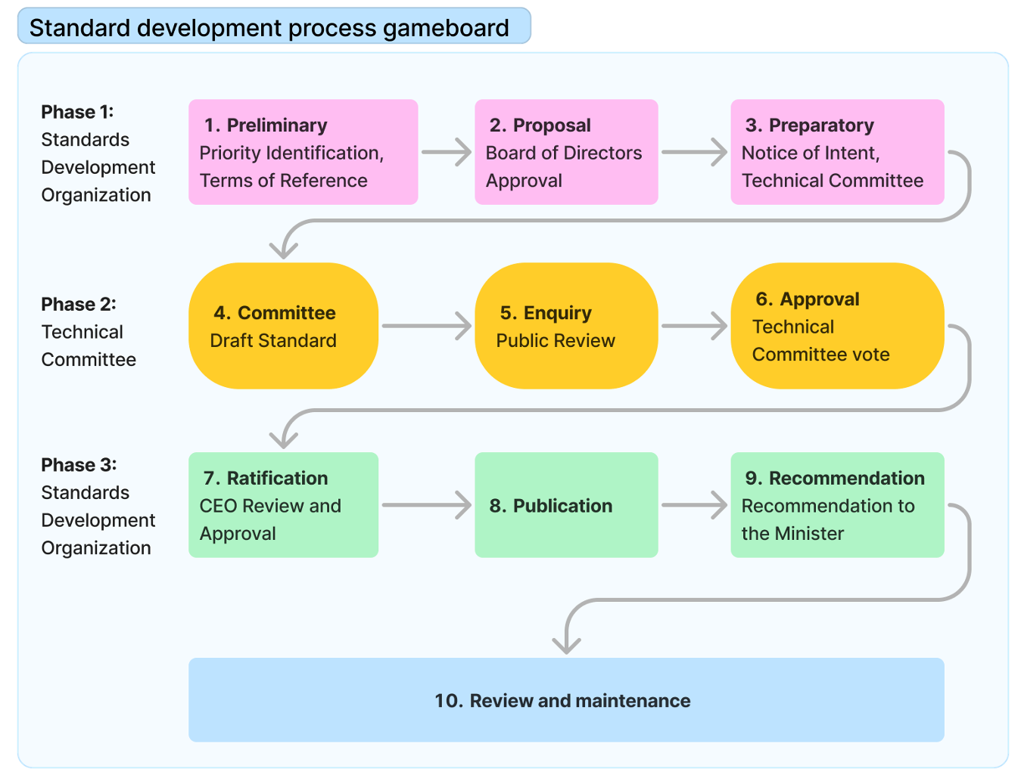
Standards Development Process Gameboard

Slide 5
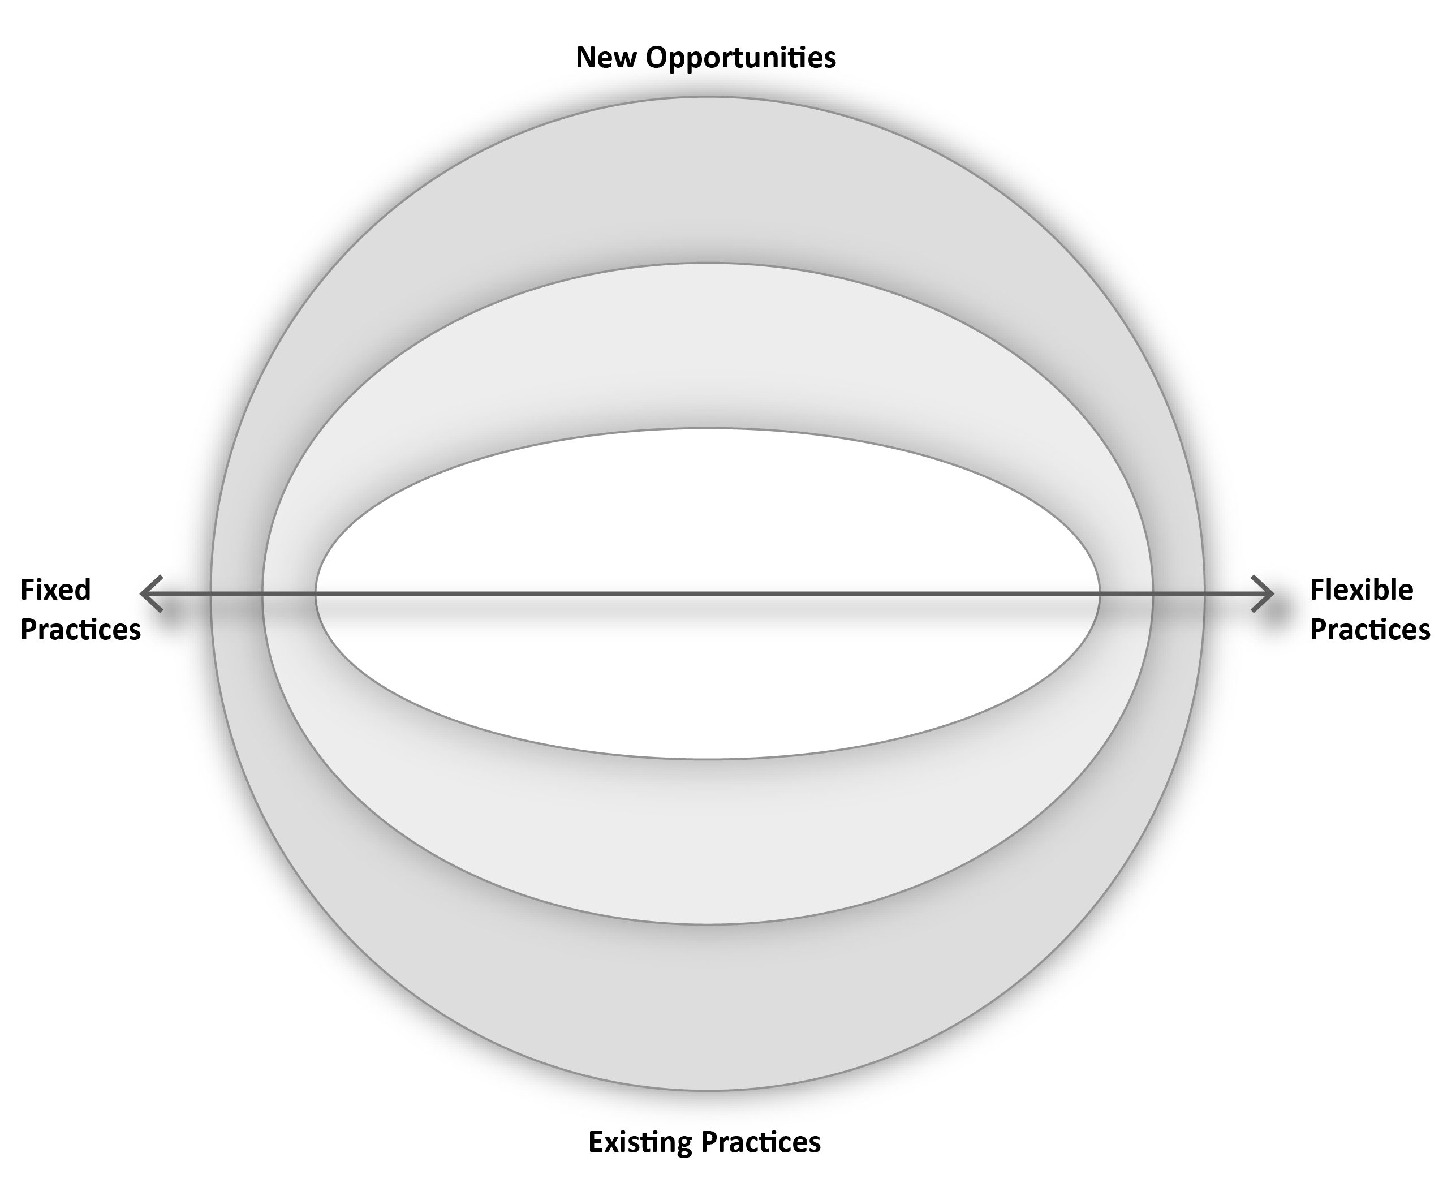
The Instrument
Dimension of the area under assessment | Position on Fixed/Flexible Practices Continuum | New Opportunity or Existing Practice | Level of Effort Required | Reflections

Slide 6
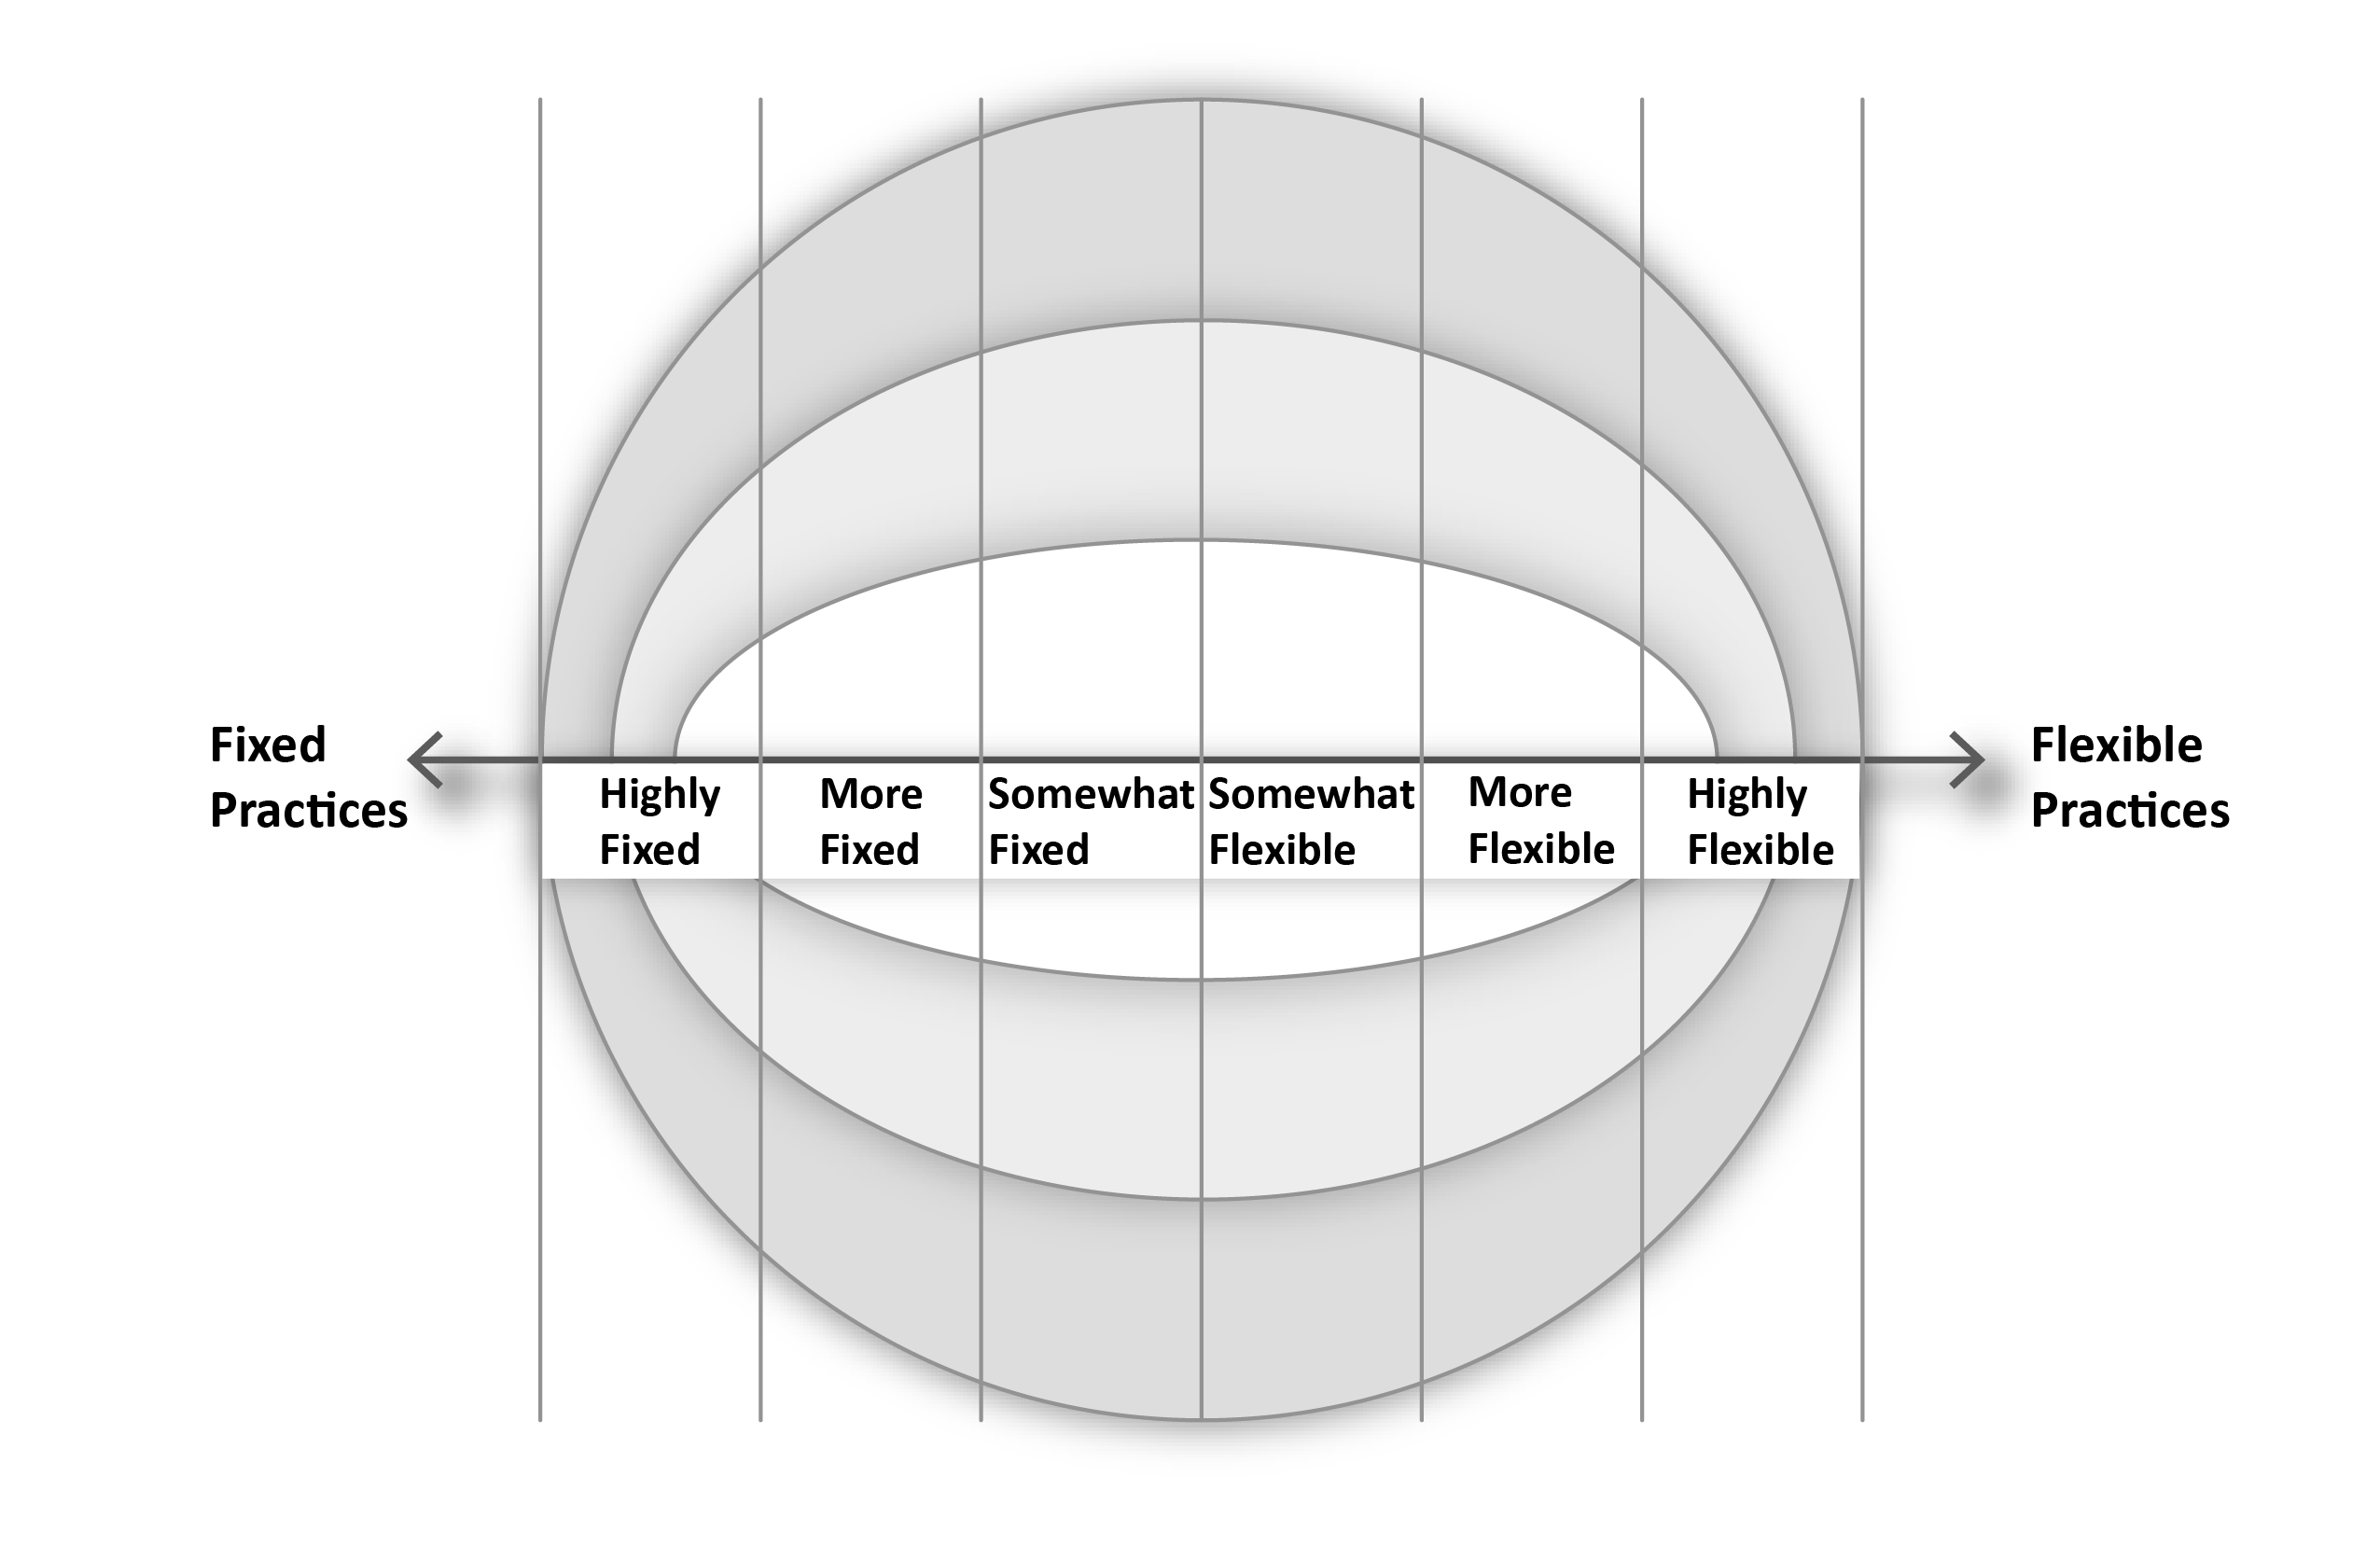
Areas Denoting Degrees of Flexibility

Slide 7
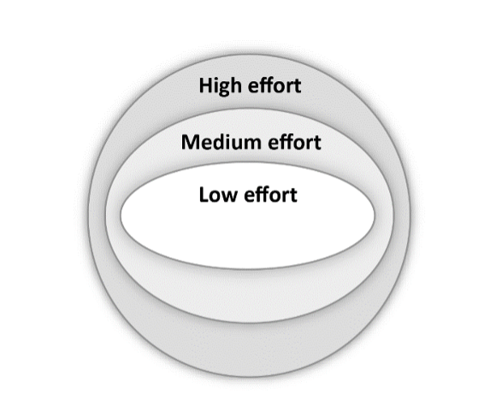
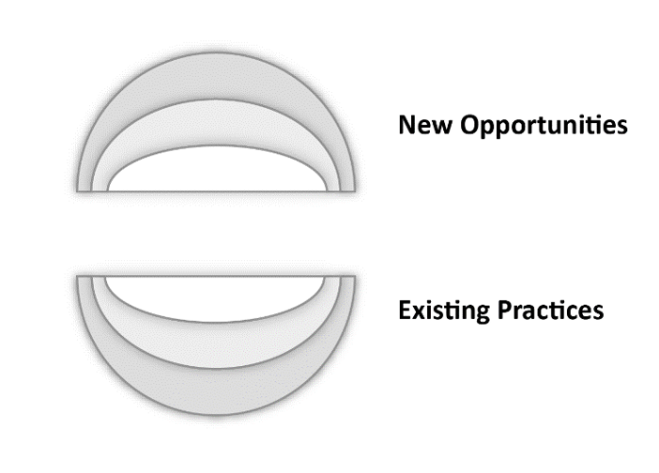
Effort and Opportunities

Slide 8
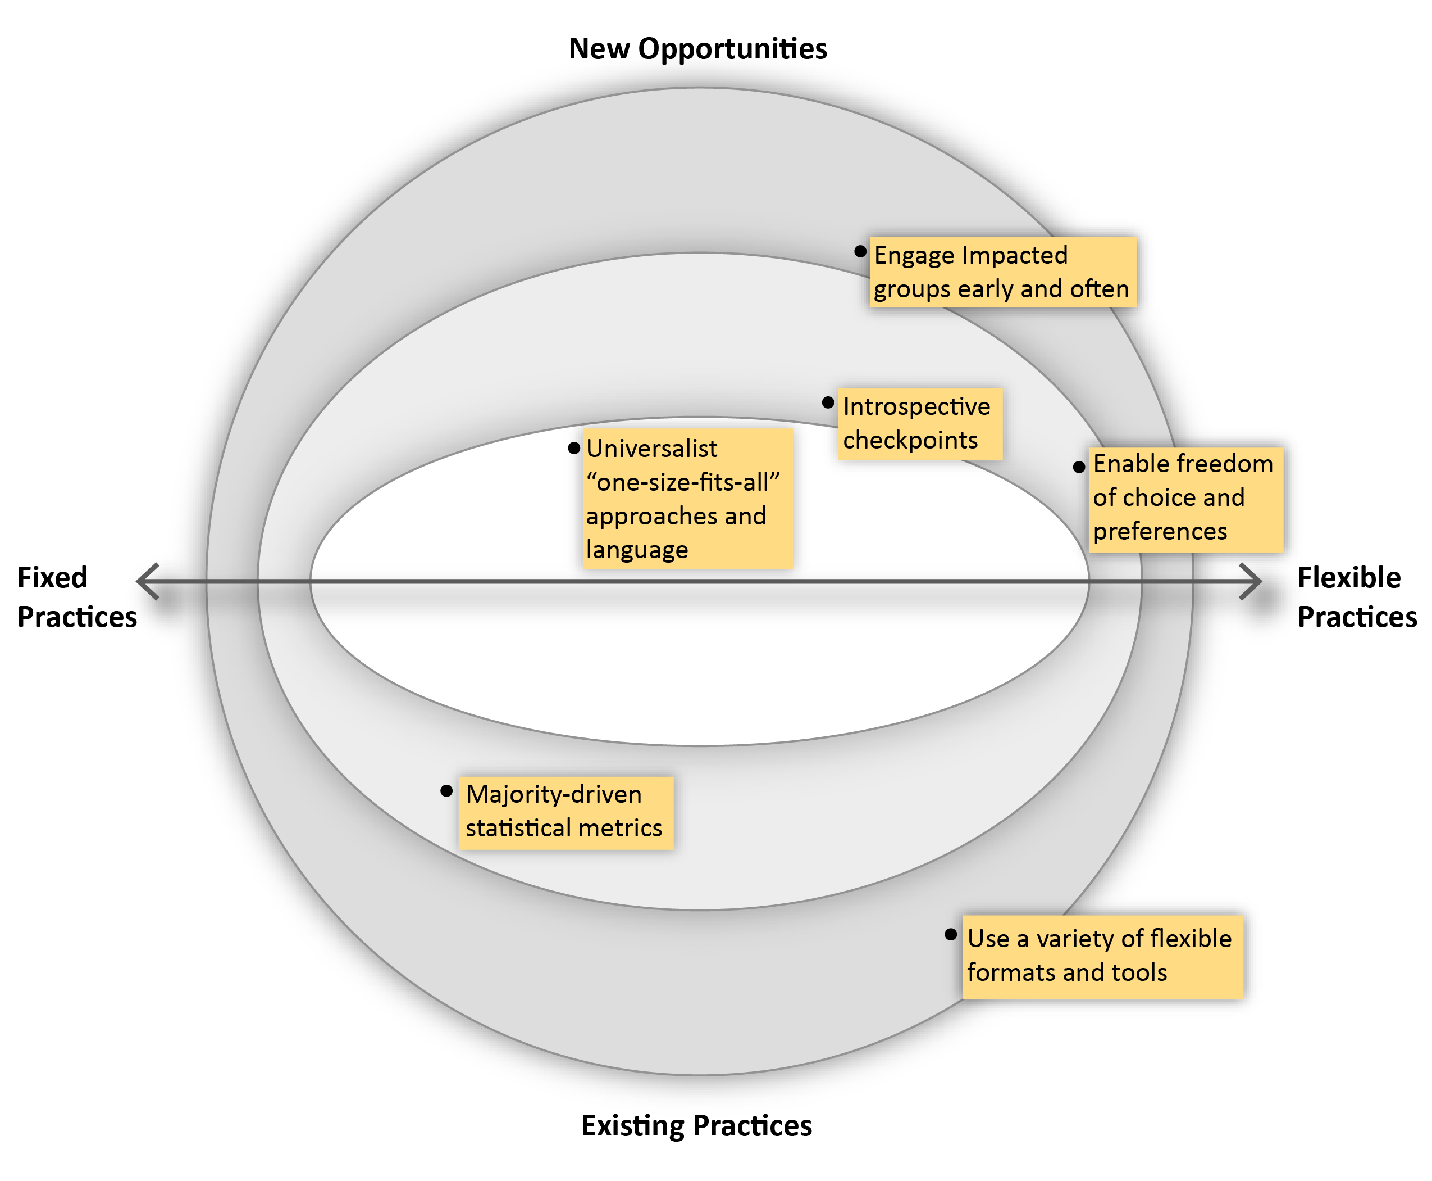
Example: General Considerations for an SDO

Slide 9
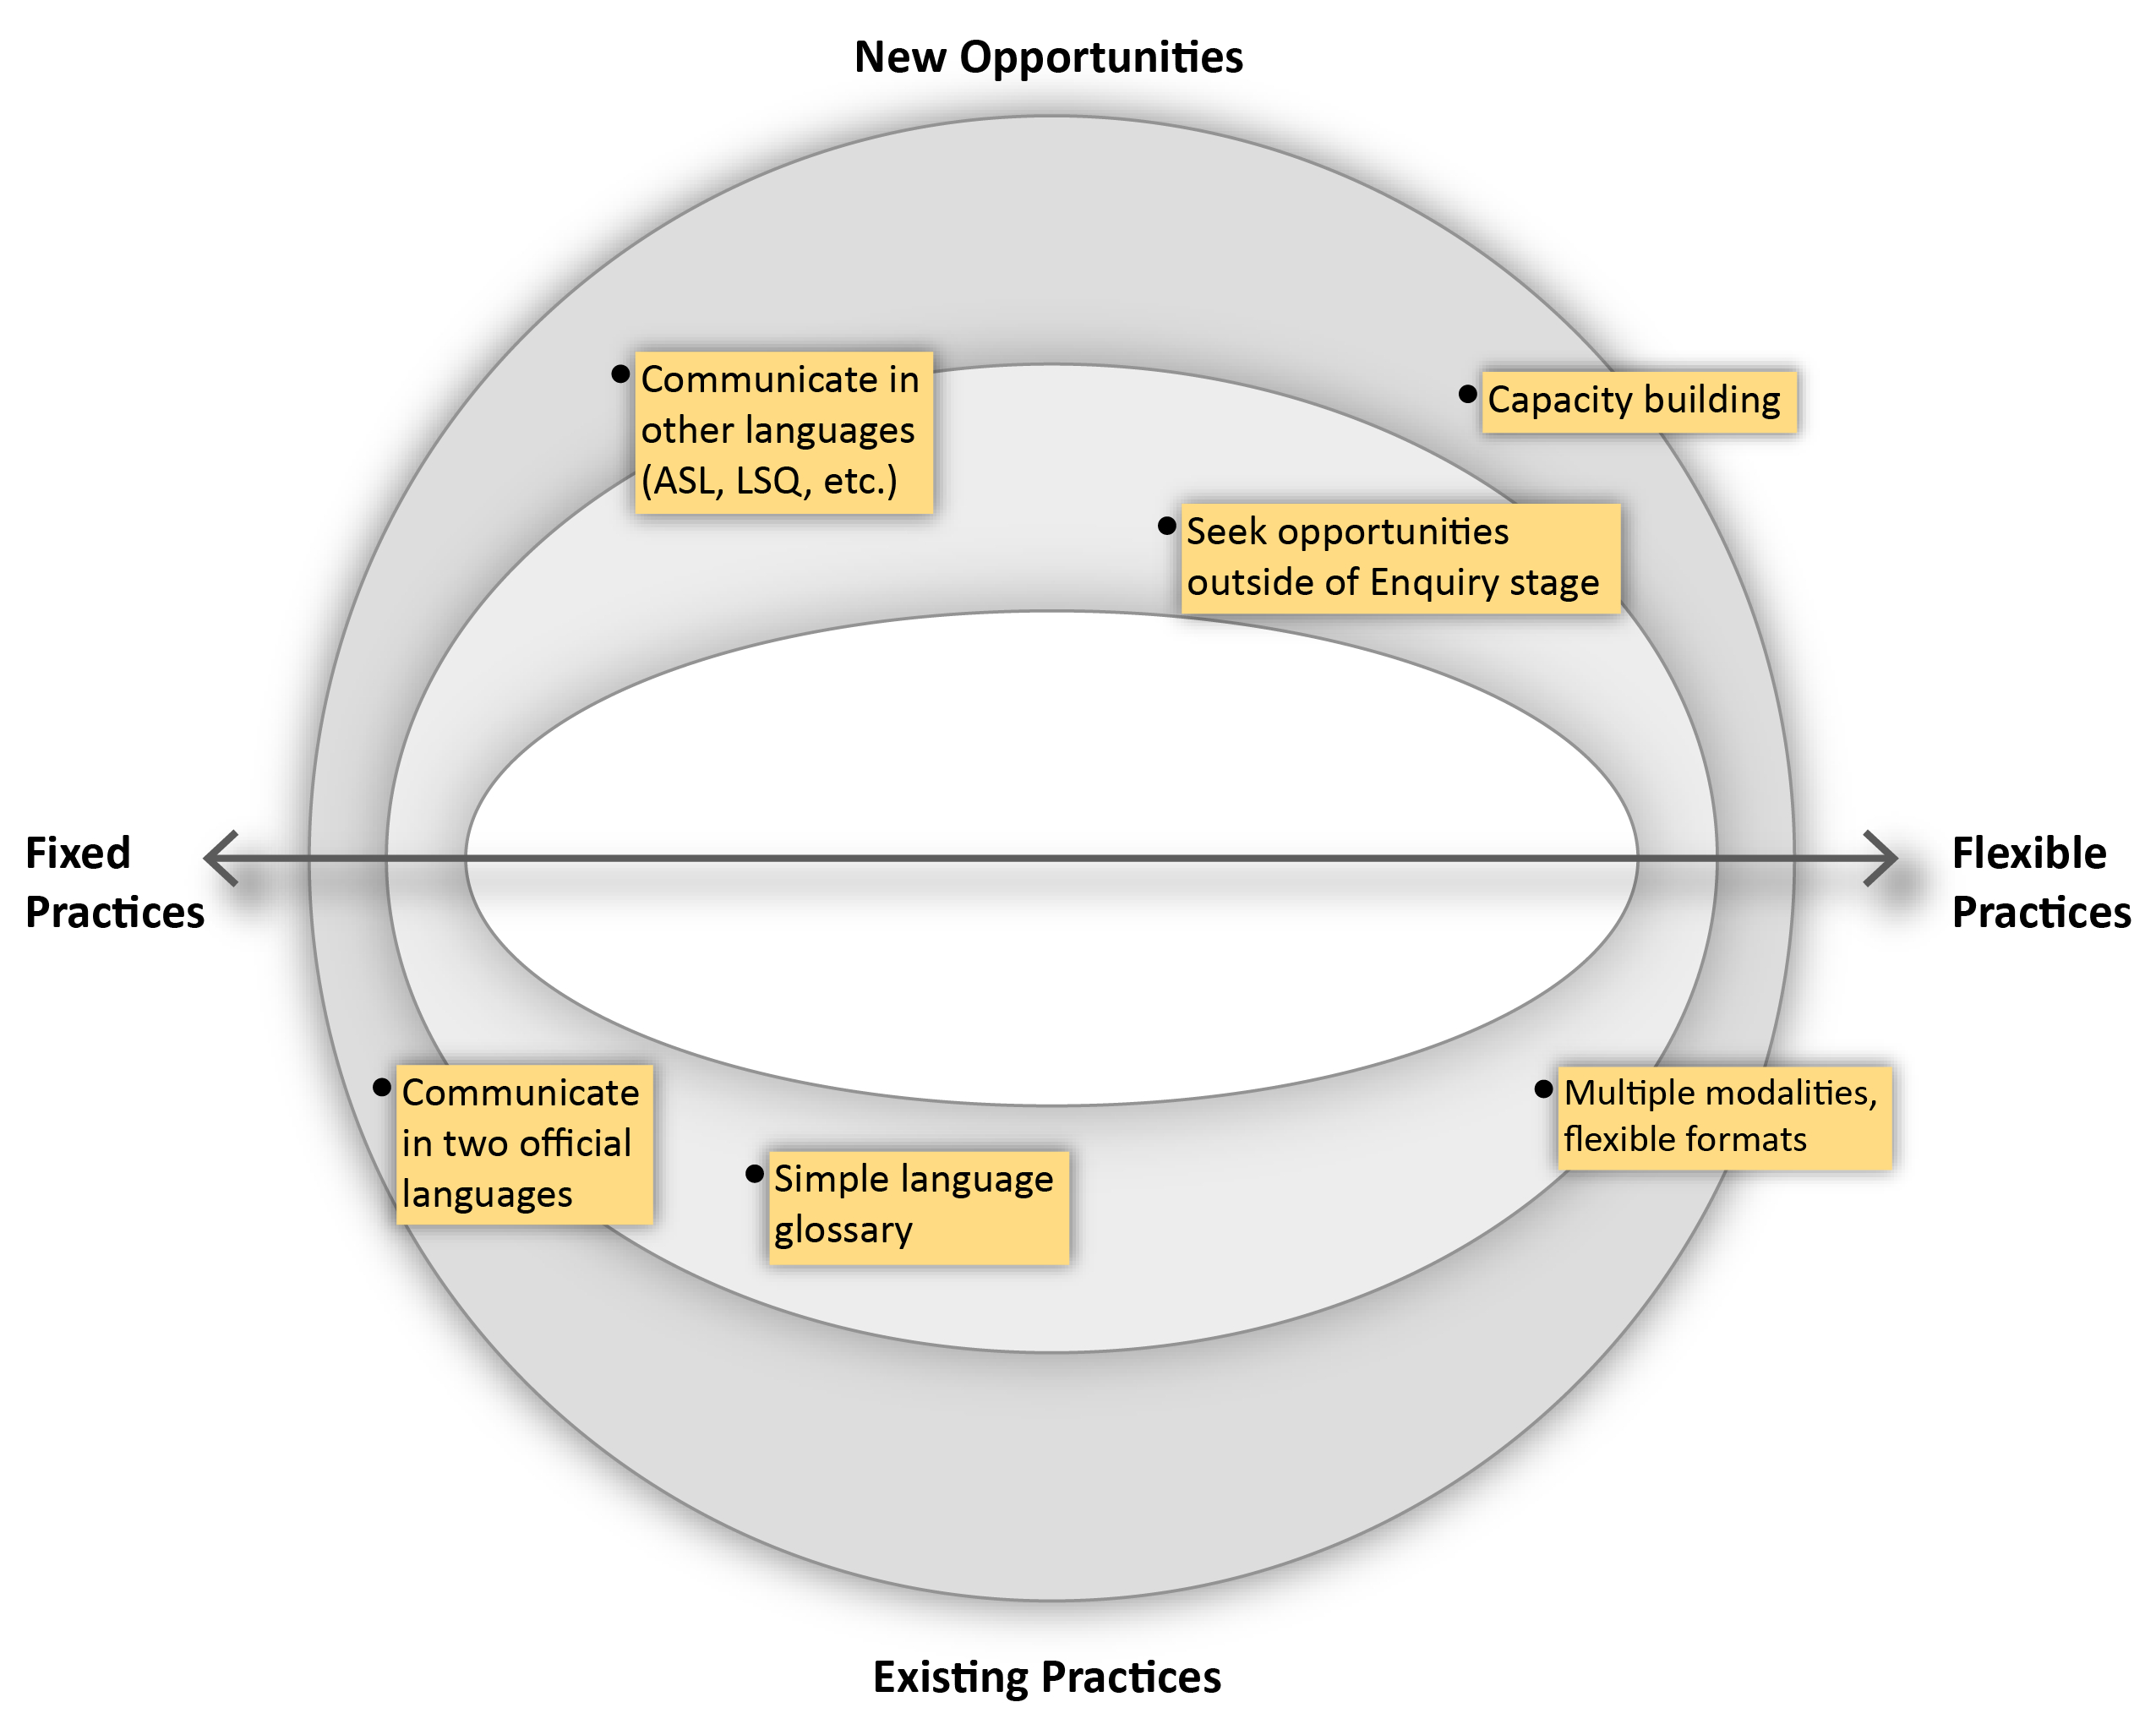
Example: Public Engagement Considerations

Slide 10
A Call to Action
“There need to be opportunities for engagement early and often.” – co-designer.

