Slide 1
Flexible E-Learning
TILE curriculum and content design
Robert Luke
Adaptive Technology Resource Centre
University of Toronto

Slide 2
Digital Pedagogies
Process-centric, continual
Informational, not industrial
Informal and formal learning
Part of digital, network(ed) culture
Promote digital literacy

Slide 3
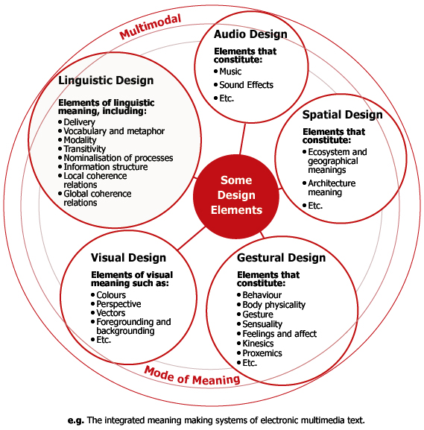
Digital Literacy
and
Multimodal
Design
The New London Group. (2000). A Pedagogy of Multiliteracies Designing Social Futures. In B. Cope & M. Kalantzis (Eds.), Multiliteracies: Literacy learning and the Design of Social Futures (pp. 9-38). Literacies. London and New York: Routledge, p. 26.
Notes:
Multimodal design means accounting for various learning styles, and using any and all available media in instruction.

Slide 4
Learner Scaffolds
Extra information for those that need it, when needed – “remedial detours”
Link learning resources together, to work with other linked resources, and to link further resources
Address learning gaps, styles
Learning to Learn

Slide 5
Educator Scaffolds
Can assist educators to learn about new teaching styles
Address instructional [instructor] gaps
Context experts + expert learners
Response ability
  To various learning styles and accessibility needs

Slide 6
Today’s Example
Asking students to locate and evaluate online information assumes a high level of digital literacy
What kinds of supports can assist students who need help?
What kinds of supports can assist educators in constructing these supports?

Slide 7
Teaching and Learning with TILE
How can we (re)use TILE content?
How can we enable ease of content transformation?
How to enable access to learner and educator scaffolds?
How to ensure effective interaction and evaluation?

