Slide 1

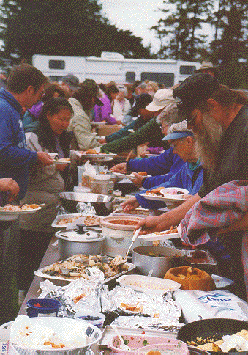

WELCOME to the
TILE Potluck and Community Kitchen

Slide 2

Educators have too little time to prepare curriculum

Slide 3

We should optimize the time and resources invested

Slide 4
We should pool and share learning resources

Slide 5

Digital content: We can copy
Without degradation
Virtually without cost

Slide 6
We can build things together at a distance.
We can share revisions.
We can take just a piece

Slide 7
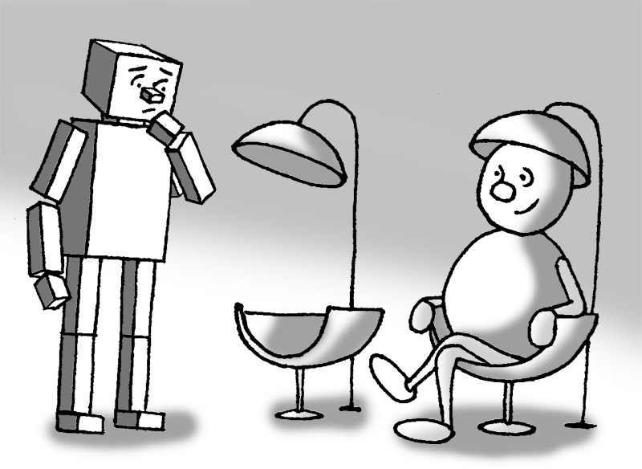

This translates into a larger range of choices for the learner

Slide 8
You are the design consultants..

Slide 9
What is the TILE Project?

Slide 10
Learning Object Repositories
3 Levels of Functionality
Sharing
Re-purposing
Personalization

Slide 11
Each level has Implications for:
Definition of learning object
Repository design
Metadata and tagging of objects
Authoring tool support required

Slide 12
Shared Learning Objects
Re-use of pre-packaged lesson or course - “as is”
All in one supper

Slide 13
Implications of Sharing
Learning Object: very coarse grained and self contained
Metadata as label to identify and describe learning object as a whole
Repository to store, catalogue and retrieve learning objects
Authoring support: Tool to author metadata label

Slide 14

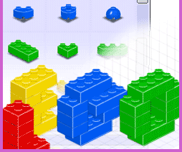
Re-purposing Learning Objects
Most educators adapt prepackaged curriculum
Localize for relevancy
Adapt for curriculum standards
Adapt for language and general reading level
Adapt to class-specific learning outcome goals

Slide 15
Implications of
Re-purposing
Greater granularity or modularity of learning objects: atomic and aggregate components
Metadata at aggregate level and atomic level
Tagging of structure
Ability to check-in new assembly objects with references to existing atomic objects
Authoring support: Editing and creation of assembly objects

Slide 16
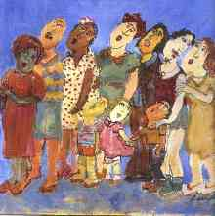
Learners are diverse
Expectations
Abilities
Background
Learning needs
Motivation
Reason for e-learning abandonment

Slide 17
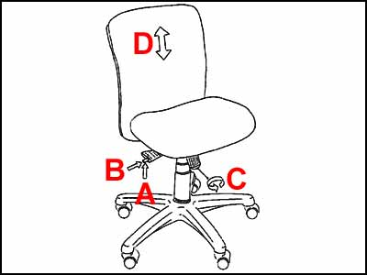
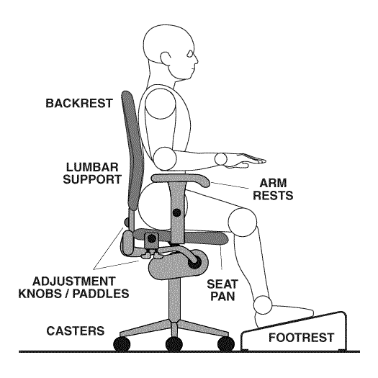

Personalization

Slide 18

Personalization of Learning Object
Background knowledge
Learning style
Learning orientation (transforming, performing, compliant)
Accessibility for people with disabilities
Pace and path

Slide 19
Implications of Personalization
Greater granularity, modularity and transformability
Independence of content and structure from presentation
Metadata on equivalents and style sheets
Method of expressing preferences
Support for specified transformation
Dynamic retrieval of specified equivalents and style sheets

Slide 20
The TILE Project
Supports personalization through:
  Authoring tools
  Repository
  Player and browser
  Metadata
  Portable user preferences
  Nature of “learning objects”

Slide 21
TILE PotLucks
1. Focus on cumulative and collaborative authoring (Toronto).
2. Focus on instructional design, customization and educator support (Calgary).
3. Focus on personalization.
4. Putting it all together.

Slide 22
Today’s focus:
How can we support good instructional design ?

Slide 23
What is good instructional design?

Slide 24
The Paradigm Shift in Instructional Design
INDUSTRIAN AGE
Standardization
Centralized control
Adversarial relationships
Autocratic decision making
Compliance
Conformity
One-way communications
Compartmentalization
Parts-oriented
Teacher as "King"
INFORMATION AGE
Customization
Autonomy with accountability
Cooperative relationships
Shared decision making
Initiative
Diversity
Networking
Holism
Process-oriented
Learner (customer) as "King"
Charles M. Reigeluth

Slide 25
Outcomes of E-learning or
“What have we E-learned”
Does not save money
Does not save instructor time
Does not shift the Bell curve higher
* Campus Computing Project, Educause, UCLA, Flashlight Implementations, Project 25, What's the Difference?: A Review of Contemporary Research on the Effectiveness of Distance Learning in Higher Education, NEA Affiliate Capacity Building--Higher Education

Slide 26
Outcomes of E-learning
Compresses the Bell curve
Assists students who had difficulty with traditional delivery
Makes academic life easier for students

Slide 27
Other side of Bell Curve
Fewer high achievers
Why?
Students unprepared for self-directed learning
We have cultivated “Educational Bulimics”- binge and purge on facts Thomas Marino
Require stress or tension to perform

Slide 28
Determinates of Success
Action and Interaction
  passive vs active learning
  Retention: “half the fun is in the chase”
  Engagement: “it’s good to feel needed”
  Ownership
Personal relevance
Personalization
Convenience- the customer attitude
  Expectations of technology

Slide 29
The Right Motivators
External vs Internal
Competition vs collaboration and the competition of collaboration
Private and public rewards

Slide 30
The Instructor is Key
As facilitator
Greater personal contact (more instructor-learner interaction, less instructor-group interaction)
You don’t need to see the whites of their eyes

Slide 31
Beyond No Significant Difference
Opportunity to
Emulate one-on-one teaching
Address educational breakdown
If done well, allows scaling of the small class experience to large classes
  Problem based learning or discovery learning
  Interaction and feedback (student-student, student-instructor)

Slide 32
Educational Breakdown
Mismatch of pace
Mismatch of knowledge assumptions
Mismatch of learning approach with teaching approach
Mismatch of motivators and feedback
Mismatch of sequence or path
Access barriers

Slide 33
Can Address
Education Breakdown
Mismatch of pace
  Flexible pace
  Adjust time for reflection
Mismatch of knowledge assumptions
  Opportunity to address gaps
Mismatch of learning style with teaching style
  Flexible sequencing, choice of modalities
  Redundant presentation of information

Slide 34
Marginalized Student
The student who is shy
  Flexible balance between social and private learning
The student who is learning English
  Pace and modality
The student who is disorganized
  Single structured repository
The student with a disability
  Flexible presentation and control

Slide 35
Challenge to Educational Traditions
“Information is cheap”
“Information is not Instruction”
The disconnected knowledge store versus the connected processor
The teacher as expert

Slide 36
Today’s Questions
How do we apply what we know about good instructional design to a repository environment?

Slide 37
Interactivity is...
a "necessary and fundamental mechanism for knowledge acquisition" Barker 1994
the "key to successful online learning.” Mesher (1999)

Slide 38
Premise
Shared learning activity frameworks will support interactivity
Learning activities are the most difficult and time consuming to construct
Learning activities can be re-purposed

Slide 39
Learning Design
Learning
Resource
Learning
Resource
Learning
Resource
Learning
Activity
Learning
Activity
Learning
Activity
dialogue
Assessment
Feedback

Slide 40
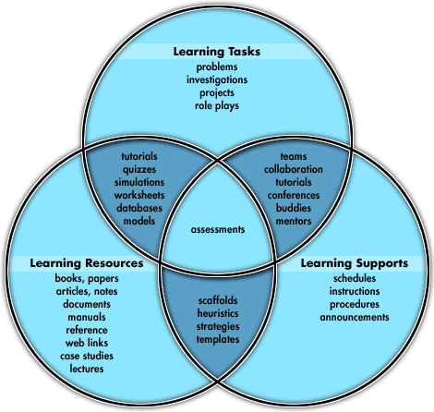
Oliver, 2000

Slide 41
What kinds of Learning Activity Structures Can be Re-used
Simulation
Visualizations or Demonstrations
Problem based learning
Concept Mapping
Investigation
Debates
Case Studies……...

Slide 42
How generic can the learning activities be?
“The starting block”

Slide 43
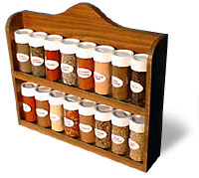


How granular should the learning resources be?

Slide 44
How much can we modularize?
Can we separate the content and structure from the presentation and control?
Can we separate the learning activity from the content?
Can we separate the lesson plan from the learning activities?

Slide 45



What kind of support do we need as Educators?
For reuse
For re-purposing
For personalization

Slide 46
Support ?
To create content
To label or add meta-data
To structure or meta-tag
To check in
To search and retrieve
To assemble or reassemble

Slide 47
Supporting the Roles of the Educator
Discipline expert: the content
Educational practitioner: activity templates
Curriculum designer: style sheets
Quality control: assessment tools

Slide 48
What is a realistic scenario ?
What can assist the average educator?
When will the change from familiar practices be worth it?

Slide 49
What supports do we need for customization?
Localization
Curriculum standards
Size of class

Slide 50
The Exercise
Web site

