Slide 1
Project TransformAble
A different approach to accommodating diversity

Slide 2
Diversity
Individual users have different
  Needs
  Background
  Motivations
Goal: Customized delivery of content

Slide 3
Accommodating Diversity
Individual Customization
Transform the UI
  Transform the Content

Slide 4


Standardization
IMS AccessForAll specifications
  Accessibility for Learning Information Package (LIP)
  AccessForAll Meta-data
Becoming ISO standard

Slide 5
TransformAble
Services that can be used by websites with digital cultural collections
Transform presentation and cultural resources
Personalized to each individual user’s needs.

Slide 6
Three Services
      PreferAble
      StyleAble
      SenseAble

Slide 7
PreferAble
Wizard that allows users to specify preferences or needs by answering
easy to
understand
questions

Slide 8
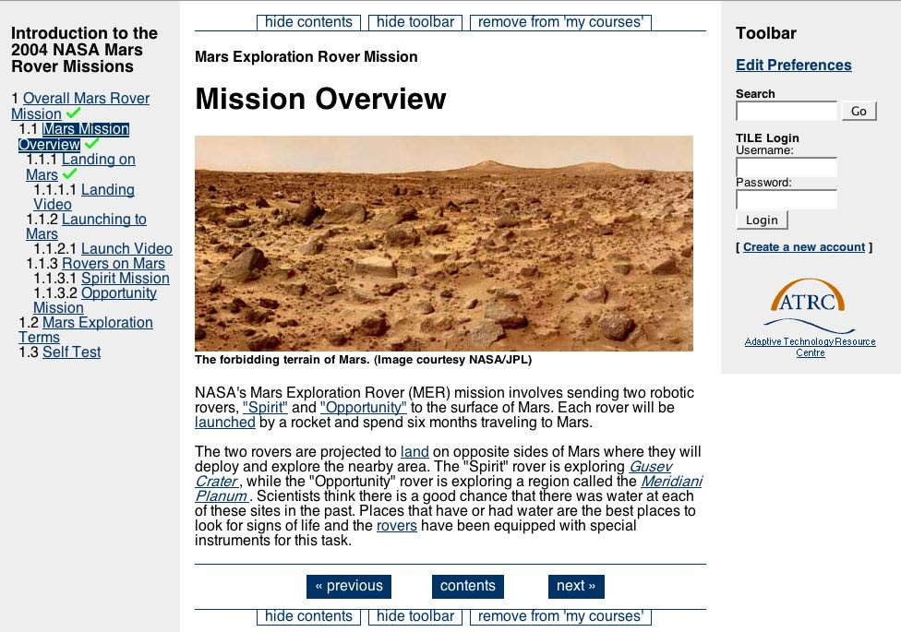
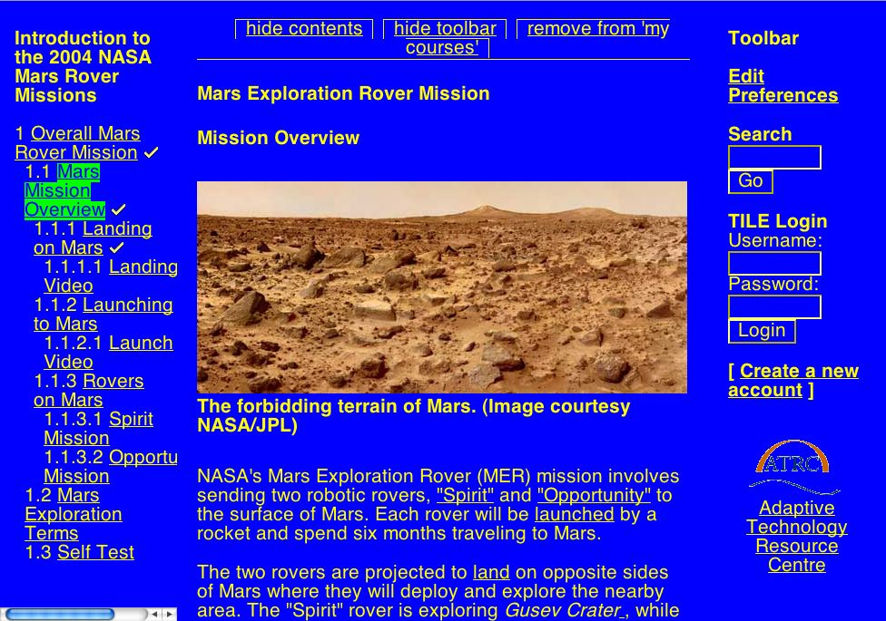
StyleAble
Creates and
delivers style
sheets and
document
transformations

Slide 9
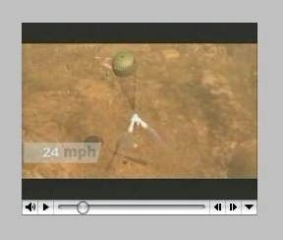
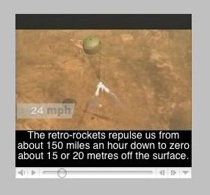
SenseAble
Combines resources to meet individual needs

Slide 10
Open Source
Incorporate into existing repository software
Use by any content delivery system

Slide 11

Integration
Sakai Online Collaboration and
Learning Environment
  free and open source product
  supports teaching and learning, ad hoc group collaboration, support for portfolios and research collaboration

Slide 12
Integration
Almost complete:
  PreferAble
  StyleAble
Next:
  SenseAble

Slide 13
Demo

