Slide 1

Accessible Media
Carmen Branje
Jonas Diamond
Deb Fels
Raisa Rashid
Ryerson University & Smiley Guy Studios

Slide 2

Agenda
Introduction
Universal Design
Audio Description
Example – Odd Job Jack
LiveDescribe
Enhanced Captioning
Take Away Message

Slide 3
From Disability Access to Universal Access – curbcut metaphor

Slide 4
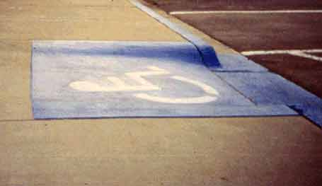
Disabilities approach
Access for people with mobility problems
People in wheelchairs
People using mobility devices
  Walkers
  Canes
  Crutches
People having difficulty walking

Slide 5
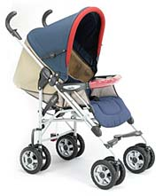
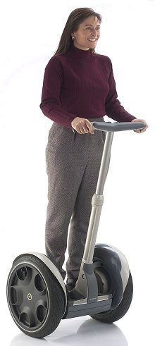

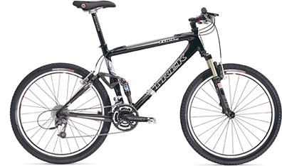
UD approach
So who really uses curbcuts?
People using Hand Trucks
People pushing Baby strollers
Bike riders
Rollerbladers
Scooter users
Wheelchair users, etc.

Slide 6
UD approach
Mainstream technologies designed to work with most, including people with disabilities.
Many technologies that seem specific for people with disabilities are useful for much wider populations.
Getting it in at the beginning is good design. Retrofitting is costly or prohibitive.
Customisation as another approach
Notes:
Text to speech automatic doors voice recogniton

Slide 7
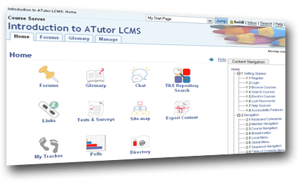
Electronic Curbcut
Electronic examples of the “curbcut” metaphor.
Examples
  Audio description
  Closed captioning
  A-tutor
Customization
  ASLPah.ca
http://www.atutor.ca/atutor/index.php

Slide 8
What is audio description
Purpose:
Allows people who are blind to watch TV
Procedure:
Description of the visual elements inserted between dialogue
  set, costumes, action, scenery
Only few seconds long
  Can’t describe everything
Convention is no emotion, 3rd person narrative form
Usually done for post-production TV (not live)
CRTC ruling from January 2004
2 hrs per week until 2008, then increase to 4

Slide 9
Odd Job Jack DVI
Different process from CC
  Interpreted
  New script + separate audio track = new creative intent
  More time-consuming, and arduous process
  Question of quality?
What we do at OJJ described
  Script writer, audio engineer, talent, director
  Want relaxed, funny, informal style
  Short timeline
  Differences between 1st person and 3rd person

Slide 10
Example - Odd Job Jack
1st person & 3rd person forms
  Blind people like emotion of 1st person form
3^{rd person example}
1st person example

Slide 11
Live Description
Description for live event
  Describer with content knowledge
Normally used in theatre
Colour commentary for sports
  Not really description
Working on research now
  Fashion Show at Ryerson
    Webcast on http://www.ryecast.ryerson.ca/dmpstreams/massexodus2006/index.asp
  Live described theatre performance of Hamlet, Nov. 25, 2006

Slide 12
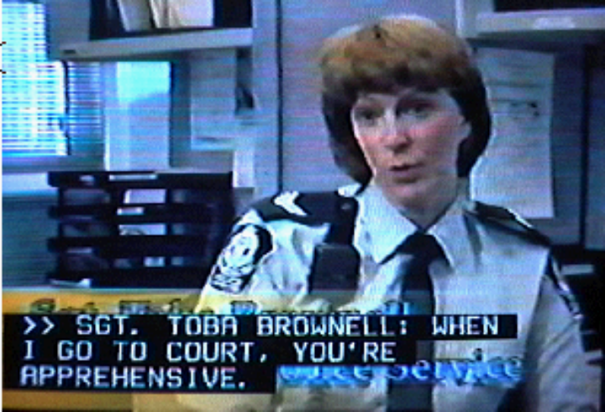
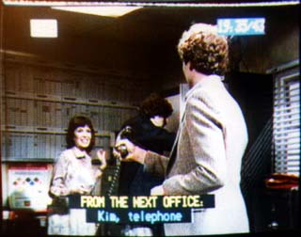
Closed captioning for TV
North America uses EIA-608; Europe uses Teletext
Verbatim translation of speech
Limited expression of non-speech sound
  Punctuation
  Some extra description in brackets (given space and time)
  Symbols (e.g., )
  Use of colour to separate
EIA608
Teletext

Slide 13
Viewers don’t like about captions
scrollup in post-production/offline captions
Missing information & experience
  Paralanguage, music, background, sound FX
Improper breaks in text
Confusion with speaker id
Inaccuracies
Sponsorship confusion

Slide 14
What viewers want
Depth
Complete information
Engagement
Quality
Equivalent experience to hearing audience

Slide 15
Some Examples
Graphical Captions
Burnt Toast
  Speaker ID
Animated captions
  To Air is Human
Created with production team

Slide 16
Concluding remarks

Slide 17
Acknowledgements
CANARIE
CHS, CNIB, NBRS
Heritage Canada
marblemedia
NSERC
Ontario Media Development Corporation
Smiley Guy Studios
Many subjects

Slide 18
Questions
Contact info
dfels@ryerson.ca
rrashid@ryerson.ca

