Slide 1
Intersections: On-line Barriers to Oral Cultures and Parallels with Accessibility Barriers
Ron Berti (De-ba-jeh-mu-jig)
Christopher Wemigwans (De-ba-jeh-mu-jig)
Jan Richards (ATRC)

Slide 2
This project involves:
1. Discussions on the barriers that members of oral cultures have on-line and how these are similar or different from on-line accessibility barriers…
2. Leading to an on-line report
3. A oral-culture-friendly demonstration site (a De-ba-jeh-mu-jig information site for parents and other family members)

Slide 3
A. Cultural Barriers
Traditional values may discourage technological communication of oral knowledge.
  In oral cultures, great importance is placed on the passing of information orally and in-person (e.g. traditional teachings or ceremonial customs)
  In most situations, oral knowledge may not be written down, since memorization helps to ensure that the knowledge is truly absorbed, rather than simply being written down and potentially forgotten about.
Notes:
POTENTIAL SOLUTIONS:

Slide 4
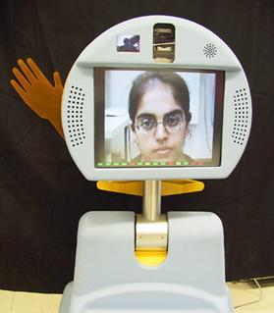
A. Cultural Barriers
Traditional values may discourage technological communication of oral knowledge.
  Partial Solution: Audio or video
  conferencing may sometimes be
  appropriate.
  Intersection: “Pebbles” robot is an
  example of an attempt to overcome
  some of the social constraints around
  how a hospitalized child can interact
  in a regular classroom.

Slide 5
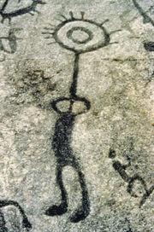
A. Cultural Barriers
Access to certain types of oral knowledge that is governed by various protocols.
  Many cultures include concepts of
  permission on certain knowledge.
    E.g. level of initiation into a group,
    gender-specific knowledge, time of
    year etc.
  Partial Solution: Mnemonics are a
  way to communicate to the initiated.
  Intersection: N/A
Notes:
POTENTIAL SOLUTIONS:

Slide 6
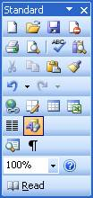
A. Cultural Barriers
Graphics have cultural significance and may cause confusion.
  Icons can be helpful when they use
  appropriate metaphors.
  But can be confusing out of cultural
  context (e.g. “recycle bins”).
  For oral cultures text or other
  literacy-related symbols (e.g.
  books) should be avoided.
  Intersection: Similar situation in
  Deaf culture.
Notes:
POTENTIAL SOLUTIONS:

Slide 7
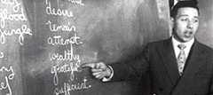

B. Writing System Barriers
A community may not have access to a writing system.
  This may be a total
  lack of a writing system
  or a local lack due to
  residential schooling etc.
  Intersection: American Sign Language
  does not have a commonly used
  writing system (SignWriting, right, is not
  well known).
Notes:
POTENTIAL SOLUTIONS:

Slide 8

B. Writing System Barriers
A writing system may not have an electronic text representation.
  Some have no e-text representation
  (e.g. Pahawh Hmong)
  Some lack tools:
(Arabic original)
يا صباح الخير ... يا ألف نهارأبيض
(Arabic transliteration in Latin alphabet)
9aba7 el kheir...Ya alf nhar abya'9
Notes:
POTENTIAL SOLUTIONS:

Slide 9
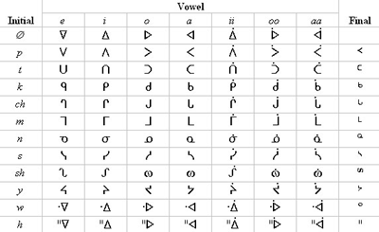
B. Writing System Barriers
A writing system may not have an electronic text representation.
  Ojibway has more than one system (including syllabics and a Latin alphabet system)
(The Fiero double vowel system)
a aa b ch d e g ' h i ii j k m n (nh) ny o oo p s sh t w y z zh
  Intersection: SignWriting does not yet have a Unicode set.

Slide 10
B. Writing System Barriers
A language may not include vocabulary for online contexts.
  Online environments often make use of terminology that a language may not have appropriate equivalents for.
    E.g. “website”, “browser”, “HTML”, “plug-in”, “search engine”
  Intersection: Sign languages have the same challenge.
Notes:
POTENTIAL SOLUTIONS:

Slide 11
B. Writing System Barriers
Members of community may not have the reading skills sufficient for online contexts.
  Some people may have insufficient literacy to make use of websites that contain advanced terms.
  The design of the website may exacerbate the situation if advanced words are presented using very small fonts or if the text is animated or flashing.
Notes:
POTENTIAL SOLUTIONS:

Slide 12
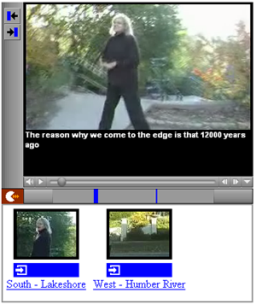
B. Writing System Solutions
Include:
  multi-media (audio/video)
  text-to-speech
  pictures and diagrams
  Supporting efforts to
  create new vocabulary
Notes:
POTENTIAL SOLUTIONS:

Slide 13
C. Other Practical Barriers
Multimedia content is more difficult to keep up-to-date.
  So any audio/video produced is harder to keep current than text.
  Intersection: Same problem for sign language video.
Notes:
POTENTIAL SOLUTIONS:

Slide 14
C. Other Practical Barriers
Player software may be unavailable for some multimedia formats
  e.g. “Windows Media” could not be played on Linux until recently
  Intersection: Analogous to “catch-up” relationship between software and assistive technology (AT).
  A Solution: Important to have a plan for keeping archives readable.
Notes:
POTENTIAL SOLUTIONS:

Slide 15
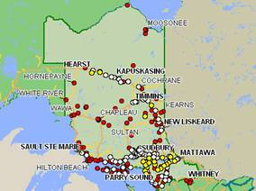
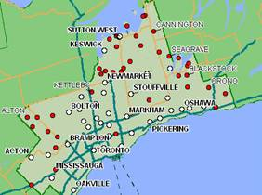
C. Other Practical Barriers
Oral cultural communities are often located where Internet access is limited.
  Intersection: Cost and mobility are barriers to broadband access for many people with disabilities.
Notes:
POTENTIAL SOLUTIONS:

Slide 16
Acknowledgements
Francis (Cotnee) Kaboni
Everyone at De-ba-jeh-mu-jig!!!
Wendy Porch (ATRC)
Heidi Hazelton (ATRC)

Slide 17
Thank You - Miigwech
For more information stay tuned to:
http://culturall.atrc.utoronto.ca/
Questions or Comments?

