Slide 1

TransformAble and Sakai
Anastasia Cheetham,
Jutta Treviranus
ATRC, University of Toronto

Slide 2

Background
Individual learners have different
  Needs
  Background
  Motivations

Slide 3
  A mismatch between learner needs
  and education offered:
  Disability

Slide 4
Disability in Learning Context
  Not a personal trait, but artifact of relationship between the learner and the learning environment or education delivery

Slide 5
Accessibility
Accessibility is
  The ability of the learning environment to adjust to the needs of all learners

Slide 6
Accessibility
Flexibility of education environment, curriculum and delivery
Availability of adequate alternative-but-equivalent content and activities

Slide 7
Accommodating Diversity
Individual customization
Transform the user interface
Transform the content

Slide 8
TransformAble
A transformable, flexible resource system
Dynamically matching resources and resource delivery to needs of each individual

Slide 9
Three Services
  PreferAble
  StyleAble
  SenseAble
Packaged as Web services and Java libraries
Can be used independently or as a suite to provide accessibility services to a Web app

Slide 10


Standardization
IMS AccessForAll specifications
Accessibility for Learning Information Package (LIP)
AccessForAll Meta-data
Becoming ISO standard

Slide 11
PreferAble
A guided preferences editing tool
Users specify preferences and needs by answering easy to understand questions
Implements ISO AccessForAll spec
Provides a user interface that can be embedded in a Web application
Implementers can customize UI to match site branding & user experience

Slide 12
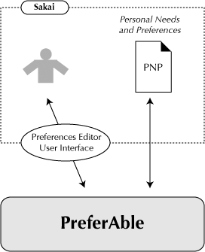
PreferAble

Slide 13
StyleAble
Styles and transforms site presentation to meet individual needs and preferences
Two types of transformations:
  Style sheet generation
  Document transformations
Transformations rely on HTML document markup: use good semantic markup

Slide 14
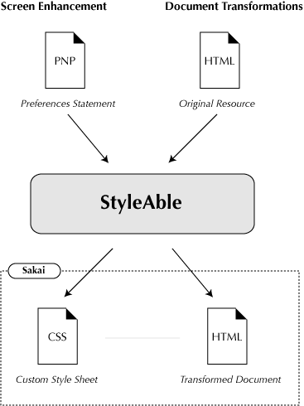

Slide 15
SenseAble
SenseAble is an alternative content matcher and aggregator
Performs two main functions:
  Matching and ranking adaptations based on learner preferences
  Aggregation, assembling, and substitution of resources

Slide 16
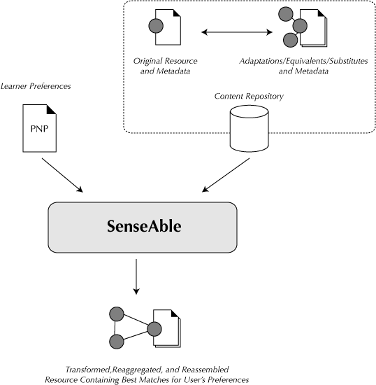

Slide 17
Sakai Integration
Step 1: Enhance Sakai presentation layer to support transformation
Step 2: Integrate PreferAble & StyleAble into Sakai
Step 3: Integrate SenseAble with Sakai’s ongoing repository work
Timeline: March 31, 2007

Slide 18
Current Status
Step 1: Enhance Sakai presentation layer to support transformation
Step 2: Integrate PreferAble & StyleAble into Sakai
  Stylesheet generation
  Document transformation
Step 3: Integrate SenseAble with Sakai’s ongoing repository work

Slide 19
Demonstration:
http://transformable-sakai.atrc.utoronto.ca/portal

Slide 20
Code
TransformAble libraries (public maven repository)
Sakai integration code (public subversion repository)

Slide 21
Next Steps
Put code into Contrib
Convert PreferAble to a Helper Tool, add to Sakai Preferences

Slide 22
Where to go
Information and download instructions:
http://transformable.atrc.utoronto.ca
Sandbox:
http://transformable-sakai.atrc.utoronto.ca/portal/

