Slide 1


Inclusive Authoring Tool
Build editor that authors accessible HTML
Ensure it is broadly used
Keep it free (open source)

Slide 2
Inclusive Authoring Tool
TinyMCE (Swedish)
Embedded WYSIWYG JS Editor
Used in many Web applications
Free Open Source Software (FOSS)
Modify existing source code to ATAG 2.0

Slide 3
Inclusive Authoring Tool
Make the editor accessible
Add text for all graphic elements
Ensure all element are keyboard accessible
Easy navigation between elements

Slide 4
Inclusive Authoring Tool
Make generated content accessible
Include ability to add accessible HTML elements
Prompt users where potential errors are identified
Generate an accessibility report

Slide 5
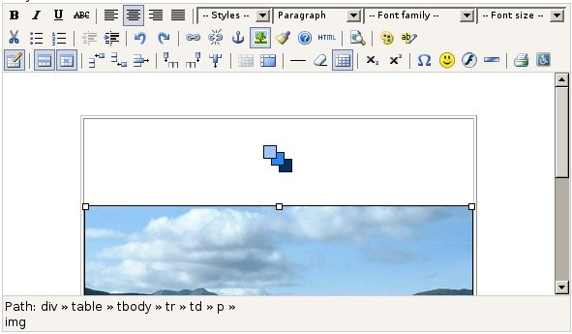
Inclusive Authoring Tool
ATutor TinyMCE Demo

