Slide 1


Inclusive Media
Deborah Fels
Ryerson University

Slide 2

Agenda
Introduction
Inclusion in media
Audio Description – Post production
Example – Odd Job Jack
LiveDescribe
Enhanced Captioning
Take Away Message

Slide 3
Inclusion in media
Media (television, film, print) & live events constitute main system of cultural expression and distribution
Purpose of cultural expression = ?
Universal design means providing technologies designed to work with most people but…
  Equivalent experience means access to everything, not just information
  Access to information ≠ access to entertainment
Notes:
Purpose = inform, entertain, engage, express ideas
People don’t get the sound channel, and the scripts and have to integrate and figure out how things fit together themselves.

Slide 4
Electronic Curbcut
Electronic examples of the “curbcut”.
Examples in the literature for media
  Closed captioning (?)
  Audio description (?)

Slide 5
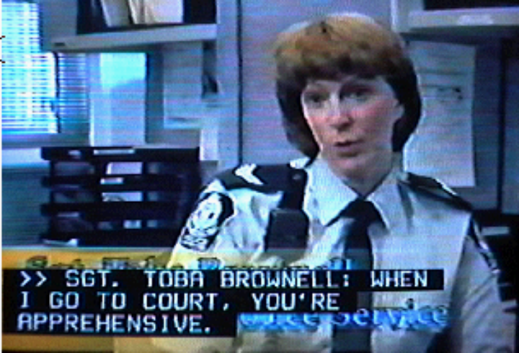
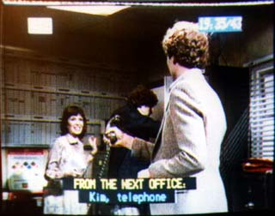
Closed captioning for TV
North America uses EIA-608 & 708; Europe uses Teletext & DTVCC
Verbatim translation of speech
Limited expression of non-speech sound
  Punctuation
  Some extra description in brackets (given space and time)
  Symbols (e.g., )
  Use of colour to separate
EIA608
Teletext

Slide 6
Viewers don’t like about captions
Scrollup in post-production captions
Missing information & experience
  Paralanguage, music, sound FX
Improper breaks in text
Confusion with speaker id
Inaccuracies
Sponsorship confusion

Slide 7
What viewers want
Depth
Complete information
Engagement
Quality
Equivalent experience to hearing audience

Slide 8
Some Examples
Graphical Captions
Burnt Toast
  Speaker ID
Animated captions
  Bad Vibes
Created with production team

Slide 9
What we found
Hearing and HOH viewers liked moving text & were not distracted
  Wanted symbols instead of words for FX
Graphical captions
  Difference between HOH and sign language viewers
  Difficulties with captions placed too close to mouth, size of captions and symbols.

Slide 10
What is audio description
Purpose:
Allows people who are blind to watch TV; SAP channel
Procedure:
Description of the visual elements inserted between dialogue
  set, costumes, action, scenery
Only few seconds long
  Can’t describe everything
Convention is no emotion, 3rd person narrative form
Usually done for post-production TV (not live)
CRTC ruling from January 2004
2 hrs per week until 2008, then increase to 4

Slide 11
Odd Job Jack DVI
Different process from CC
  Interpreted
  New script + separate audio track = new creative intent
  More time-consuming, and arduous process
  Question of quality?
What we did with OJJ described
  Script writer, audio engineer, talent, director
  Want relaxed, funny, informal style
  Short timeline
  Differences between 1st person and 3rd person
  Extended description on-line for previewing or extra undescribed info

Slide 12
Example - Odd Job Jack
1st person & 3rd person forms
  Blind people like emotion of 1st person form
3^{rd person example}
1^{st person example}
www.oddjobjack.com/describe for all description + extended

Slide 13
Live Description
Description for live event
  Describer with content knowledge
Normally used in theatre
Colour commentary for sports
  Not really description
Working on research now
  Fashion Show at Ryerson
    Webcast on http://www.ryecast.ryerson.ca/dmpstreams/massexodus2006/index.asp
  Live described theatre performance of Hamlet, Nov. 25, 2006
  Examples
    Fashion show
    Hamlet

Slide 14
What we found
Liked that description and context of show matched.
  Style and delivery
  Like “radio drama”
  Sighted people like it as well
Prefer to be entertained rather than just informed.
Speed and accuracy challenges
Video description can be its own creative form.
Production teams are willing & interested.
Notes:
Hamlet wanted it faster and to know when people entered and exited stage.

Slide 15
Concluding remarks
Entertainment value is important for inclusive media
  Impact on approach to captioning and description
  Creative process
Production teams want to participate and take ownership

Slide 16
Acknowledgements
CANARIE
CHS, CNIB, NBRS
Heritage Canada
marblemedia
NSERC
Ontario Media Development Corporation
Smiley Guy Studios
Many subjects

Slide 17
Questions
Contact info
dfels@ryerson.ca
www.ryerson.ca/clt

