Slide 1
Implementing PIPEDA in the Airline Industry
Barbara Bressolles

Slide 2
Principle 8: Openness
“An organization shall make readily available to individuals specific information about its policies and practices relating to the management of personal information.”

Slide 3
Airlines’ Openness About Privacy Practices
How open are airlines about their privacy practices in view of:
- PIPEDA’s application to airlines since 2001; and
- national security exceptions that allow disclosure of personal information without knowledge or consent?

Slide 4
National Security Exceptions
s. 7(3)(c.1)(i) PIPEDA allows disclosure of personal information without knowledge or consent if made to “a govt. institution…that has requested the information…and indicated that it suspects that the information relates to national security, the defence of Canada or the conduct of international affairs.”

Slide 5
National Security Exceptions
s. 98 Public Safety Act: allows organizations to collect personal information, without consent, for national security purposes.
s. 215 US Patriot Act: allows access to personal information about Canadians that is held in the US.

Slide 6
Review of Airline Privacy Policies
Four Canadian airlines reviewed for compliance with Openness:
- WestJet
- CanJet
- Jetsgo
- Air Canada

Slide 7
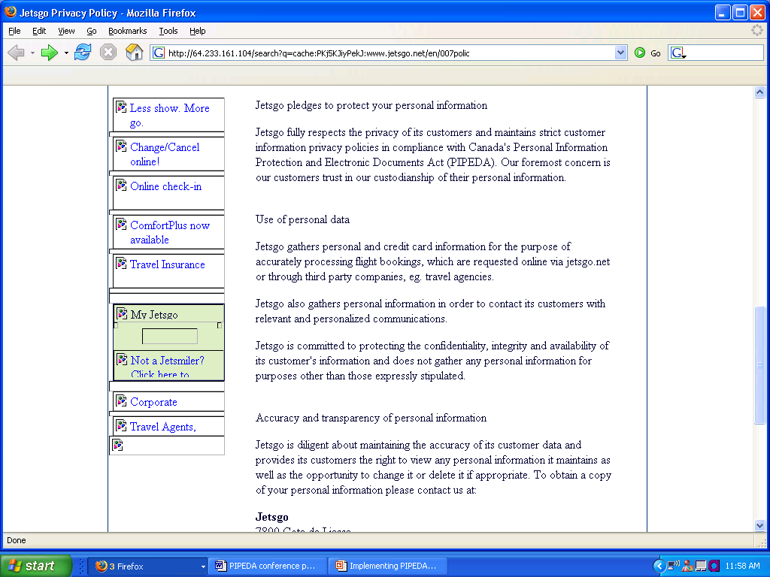

Slide 8
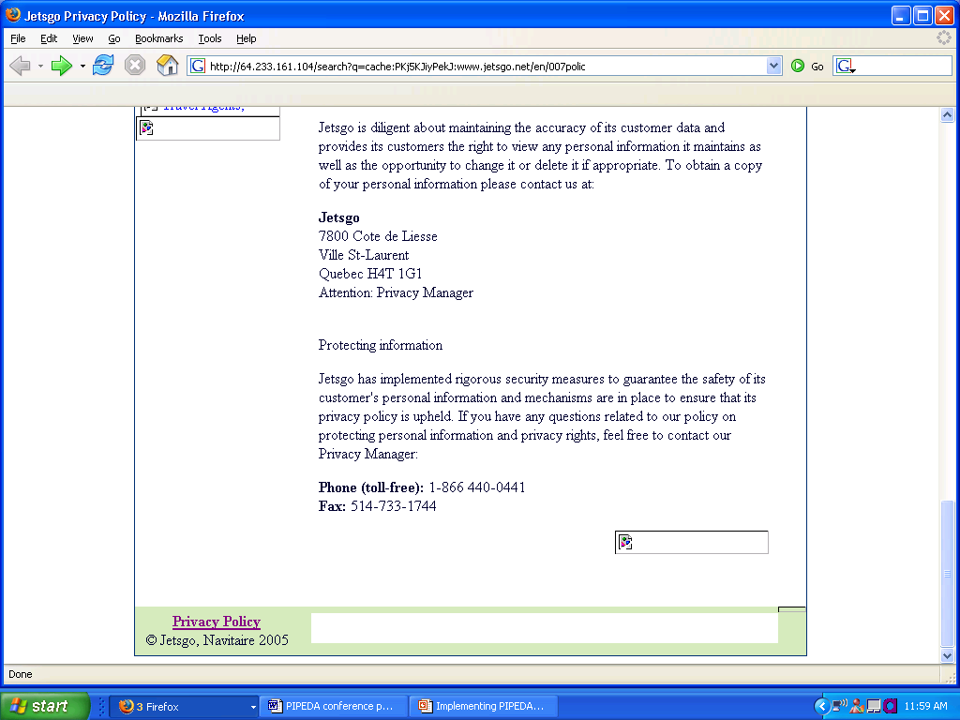

Slide 9
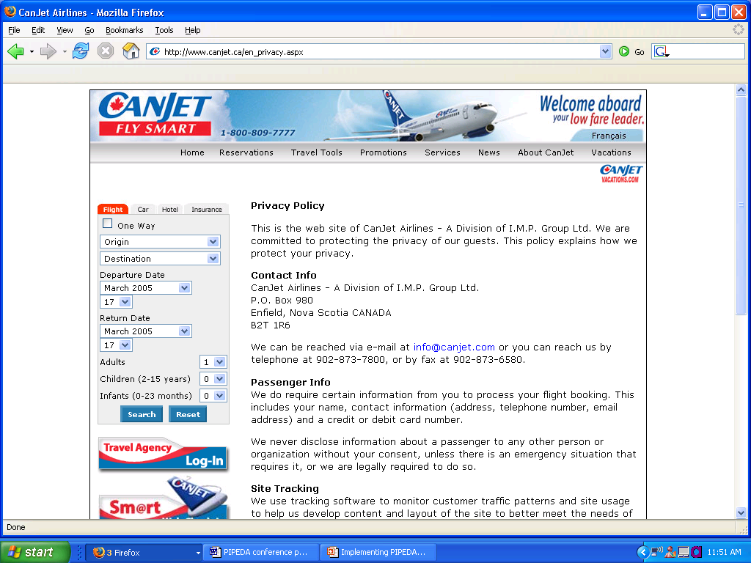

Slide 10
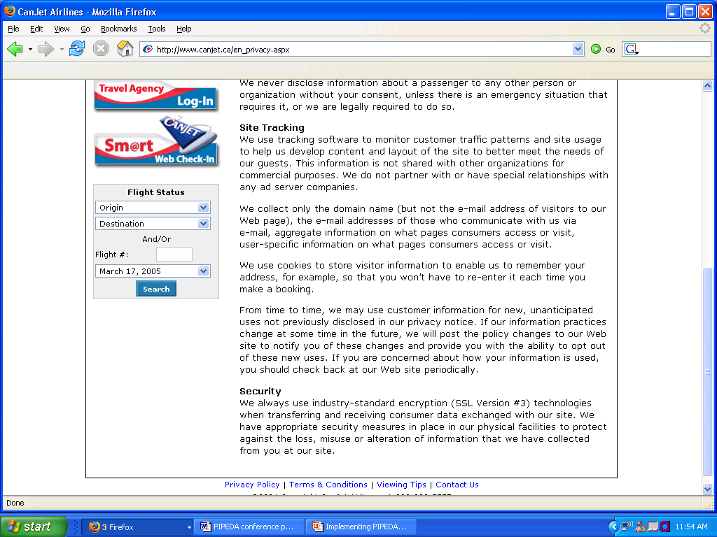

Slide 11
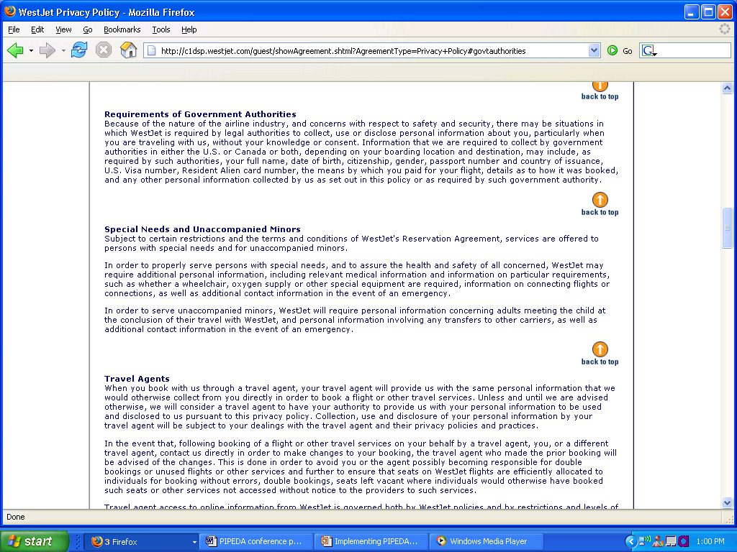

Slide 12
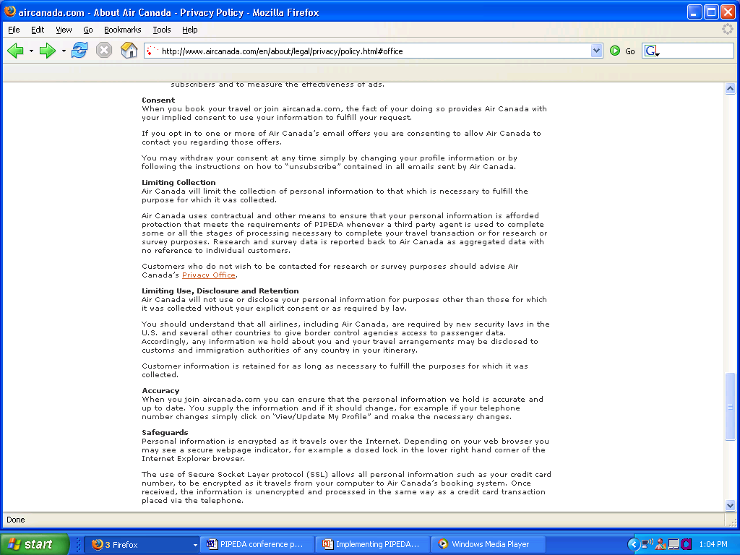

Slide 13
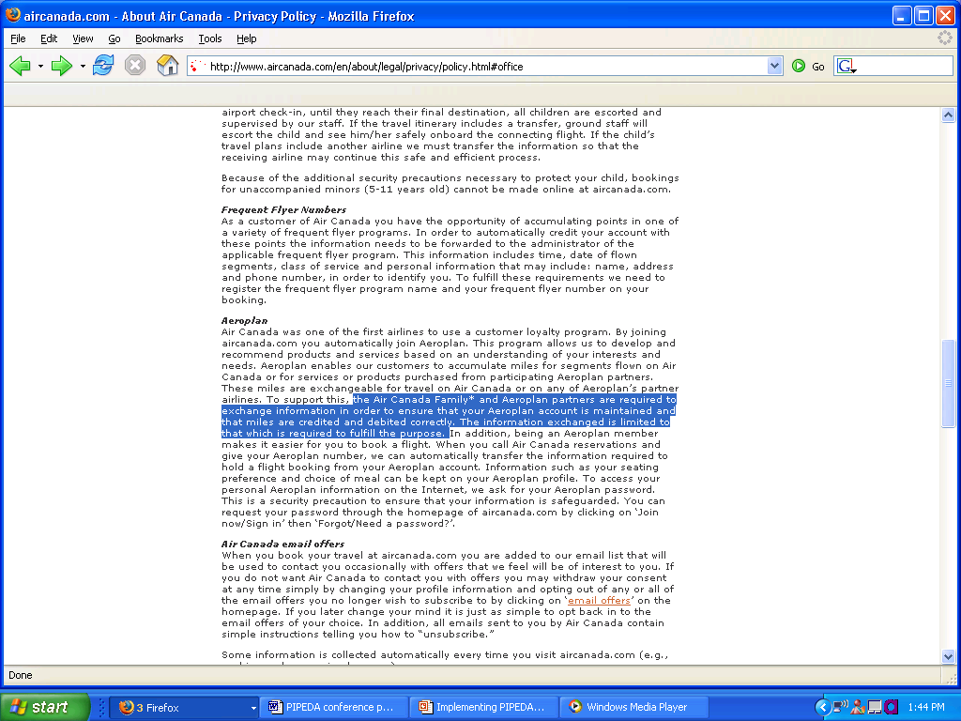

Slide 14
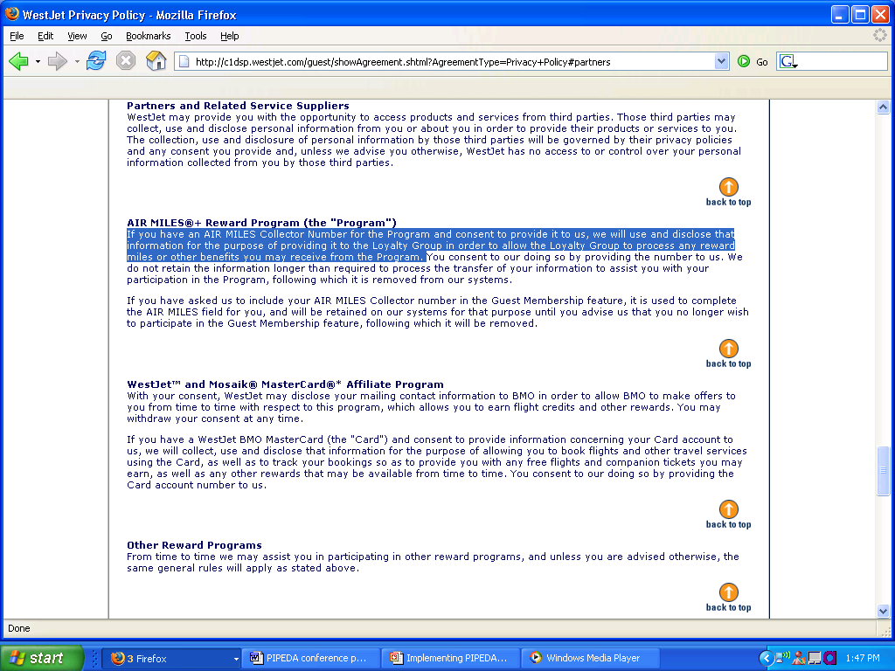

Slide 15
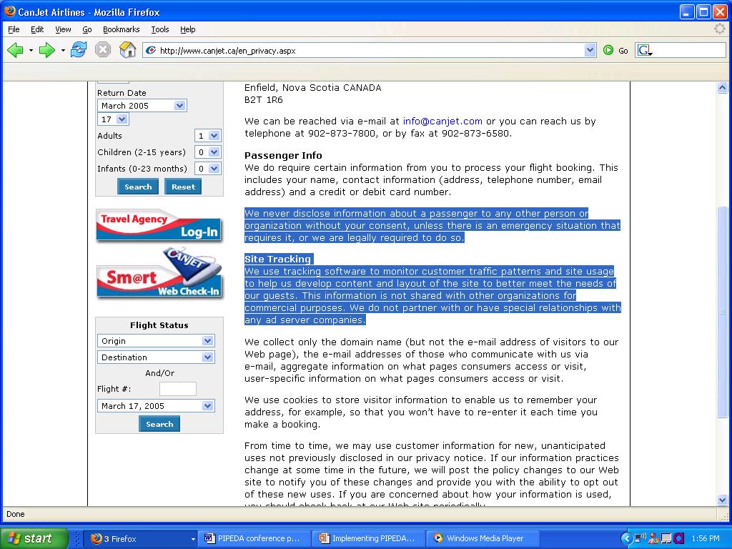

Slide 16
Findings
No uniformity of openness among statement.
Large airlines = comprehensive and robust policies
Small airlines = brief, less detailed policies.

Slide 17
Accessibility of Privacy Officers
Difficulty identifying and contacting airline privacy officers suggests reluctance for privacy officers to be accessible and visible.
Privacy in the airline industry outweighed by culture of information free flow?

Slide 18
Concluding Remarks
Possible means of increasing openness: consumer education, OPC audits.

